Slide 1
Introduction to AI/ML Basic concepts
In Pursuit of Protein Structure and Design: A Nobel-Winning Journey in Two Parts
Cecilia Arighi, PhD
Instructor CIS and CBCB

Slide 2
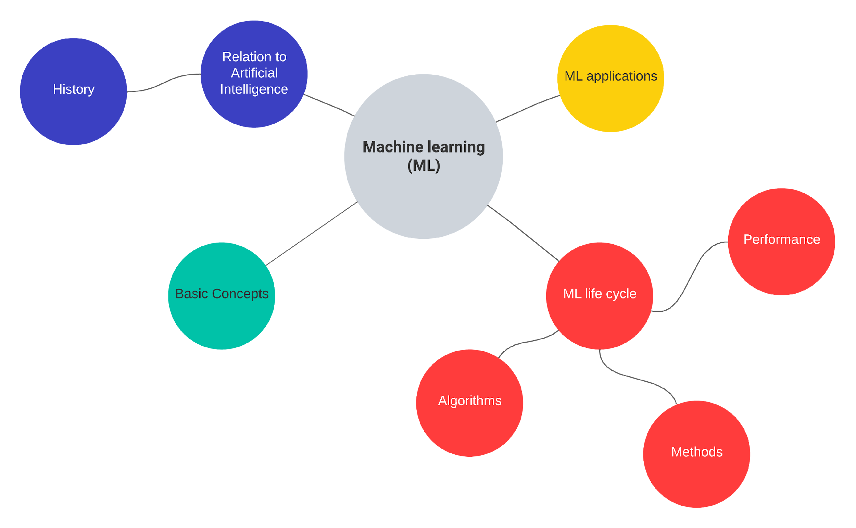

Slide 3
Dataset
A structured collection of data that is used in machine learning to train, validate, and test models. It serves as the foundational input for algorithms to learn patterns, relationships, and make predictions.
Key characteristics
Relevance: Matches the task or problem being solved.
Diversity: Covers a wide range of cases to ensure generalization.
Quality: Free of noise, errors, and inconsistencies.
Size: Large enough to represent the problem domain effectively.

Slide 4
Components of a Dataset
Features
Class/label*
Patient ID | Texture_mean | Radius_mean | Diagnosis
8510426 | 14.36 | 13.54 | Bening
842302 | 10.38 | 17.99 | Malignant
Observations/instances
+ Metadata: info about the dataset
Example: Wisconsin breast cancer dataset
* In supervised or semi-supervised ML

Slide 5
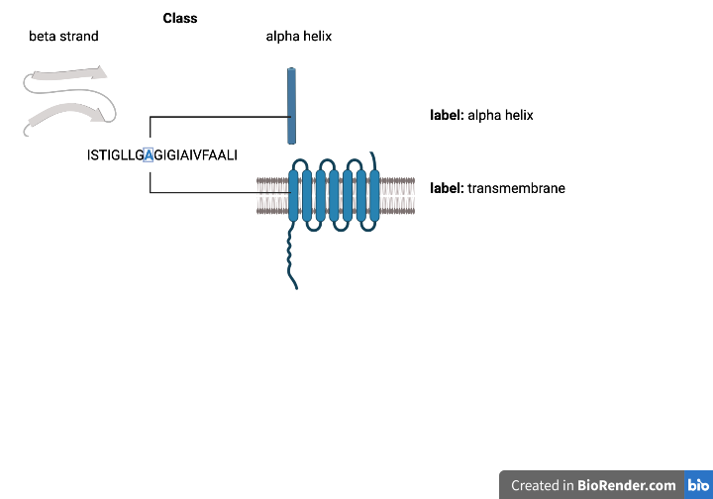
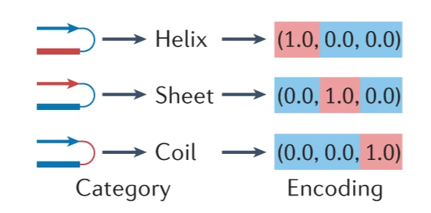
Classes and Labels (supervised ML)
Labels: When the set of values are not mutually exclusive
Classes: A discrete set of mutually exclusive values returned by a classifier
Created in Biorender
Classes and labels are usually represented by an encoding (e.g. one-hot encoding).
source: Greener et al. 2022

Slide 6
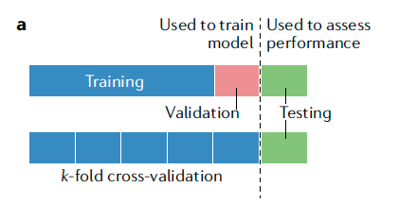
Training, Validation and Testing
Source: Greener et al. 2022

Slide 7
Loss or Cost Functions
The mathematical functions that measure the amount of ‘disagreement’ between the obtained and ideal outputs in ML.
In supervised ML, the loss function would be a measure of deviation from the predicted output relative to the ground truth output.
It plays a crucial role during the training phase, guiding the optimization process to improve the model.
e.g., mean squared error loss for regression problem and binary cross entropy loss for classification problems.

Slide 8
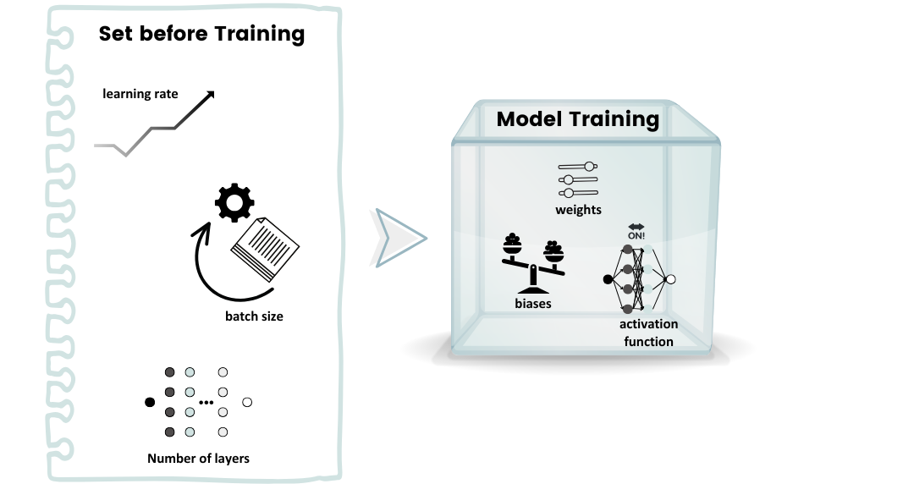
Parameters and Hyperparameters
Hyperparameters shape training
Parameters embody learning

Slide 9
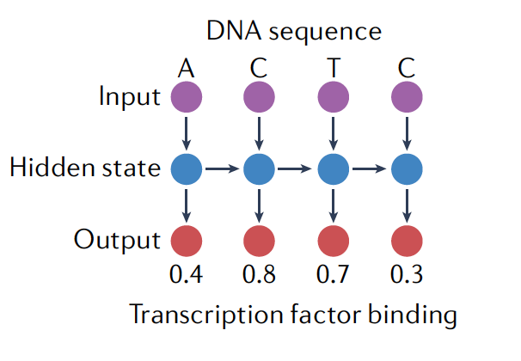
Inductive Bias
Assumptions that a model makes about the underlying structure of the data to generalize better from limited observations
Often programmed into the model using its specific mathematical form and/or by using a particular loss function.
Example: RNNs are specifically designed for sequential data, meaning data where the order of elements matters (e.g., time series, DNA sequences, or natural language)
source: Greener et al. 2022

Slide 10
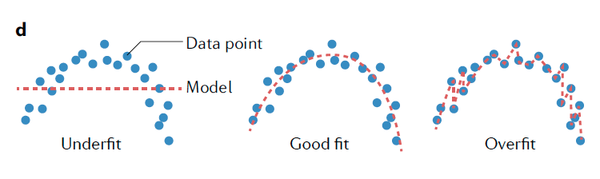
Generalization in ML
How well the concepts learned by a ML model apply to specific examples not previously seen
source: Greener et al. 2022
Overfitting and underfitting are major cause of poor model performance

Slide 11
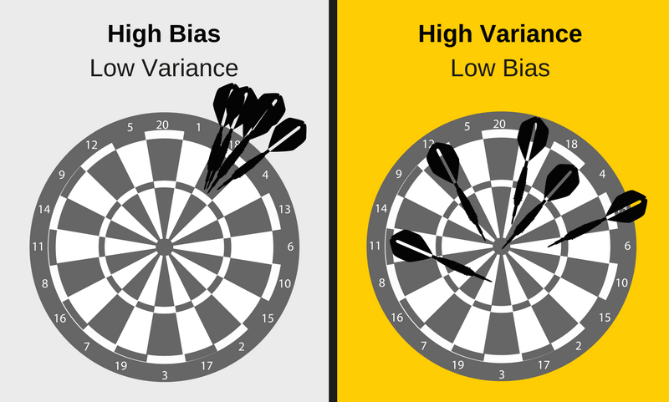
Bias and Variance
Bias
Phenomenon that skews the result of an algorithm in favor or against an idea
Difference between your model’s expected predictions and the true values
Variance
Changes in the model when using different portions of the training data set
High variance algorithms will produce drastically different models depending on the training set
Source: https://elitedatascience.com/bias-variance-tradeoff
Bias vs. variance refers to the accuracy vs. consistency of the models trained by your algorithm

Slide 12
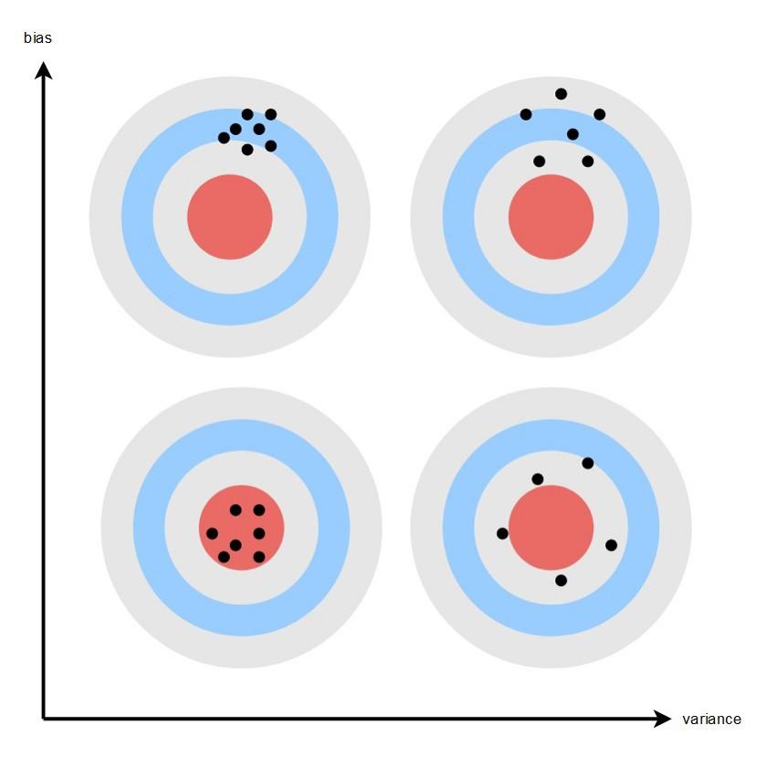
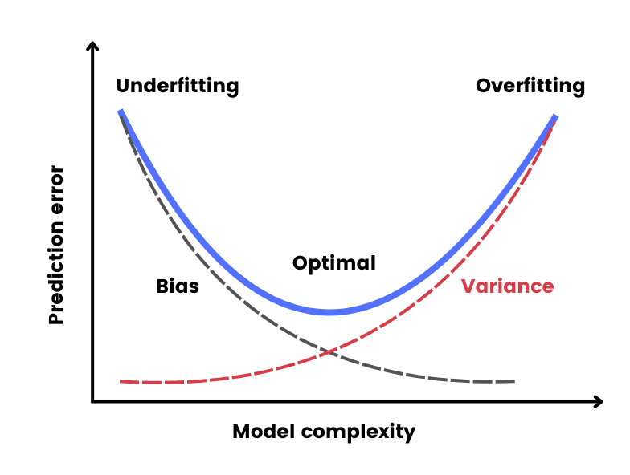
Bias-Variance Tradeoff
BIAS
Variance
Source: Seth Mottaghinejad,
https://towardsdatascience.com/bias-and-variance-but-what-are-they-really-ac539817e171

Slide 13

References
Artem Oppermann. Artificial Intelligence vs. Machine Learning vs. Deep Learning. Oct 29, 2019. (https://towardsdatascience.com/artificial-intelligence-vs-machine-learning-vs-deep-learning-2210ba8cc4ac)
Dipanjan Sarkar, Raghav Bali and Tushar Sharma. 2018. Practical Machine Learning with Python. A Problem-Solver's Guide to Building Real-World Intelligent Systems. Apress. (https://doi.org/10.1007/978-1-4842-3207-1), Chapter 1, 2.
Machine Learning Tutorial. (https://www.javatpoint.com/machine-learning)
Greener, J.G., Kandathil, S.M., Moffat, L. et al. A guide to machine learning for biologists. Nat Rev Mol Cell Biol 23, 40–55 (2022). https://doi.org/10.1038/s41580-021-00407-0

