Slide 1
AI/ML Applications

Slide 2
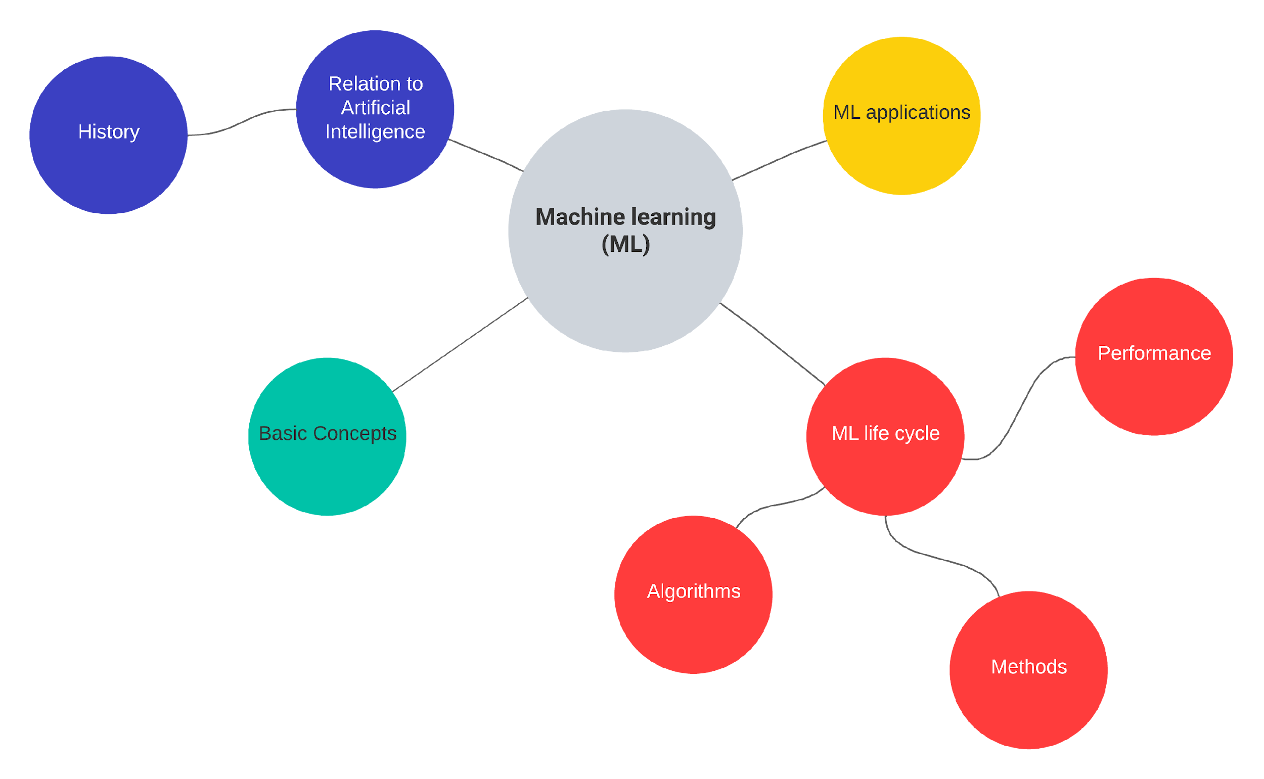

Slide 3
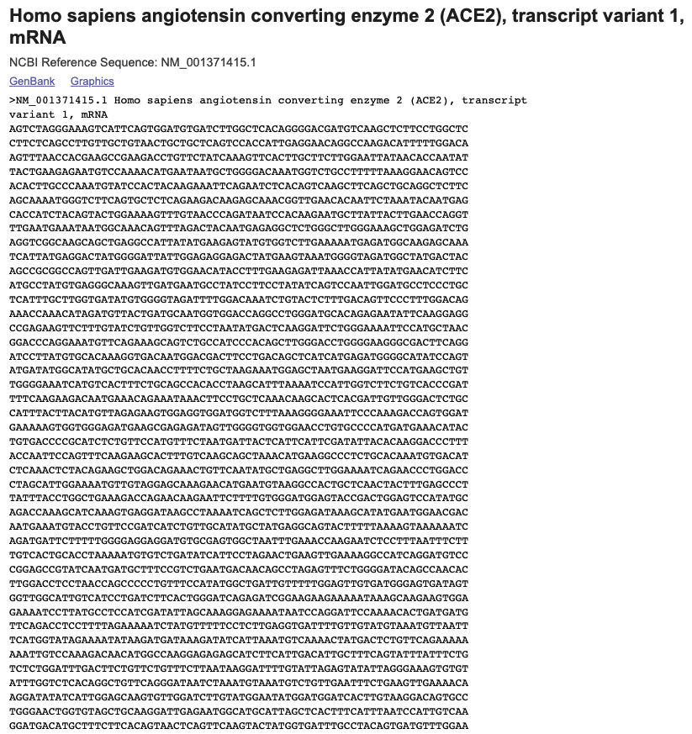

Nucleotide Sequence
Example prediction tasks
DNA accessibility
3D genome organization
Enhancer-promoter interactions
Recommended models
1D CNNs
RNNs
Transformers
Challenges
Repetitive regions in genome
Very long sequences
source: Genbank

Slide 4
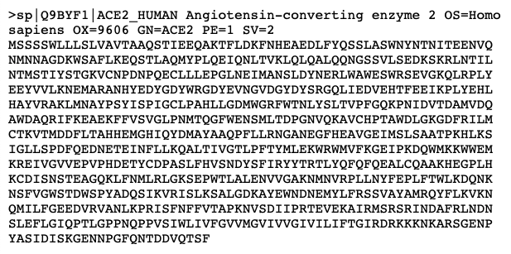
Protein Sequence
Example prediction tasks
Protein structure
Protein function
Protein-protein interactions
Recommended models
2D CNNs and residual networks using co-variation data
Multilayer perceptrons with windowing
Transformers
Challenges
Data leakage (from homology) can make validation difficult
source: UniProt

Slide 5
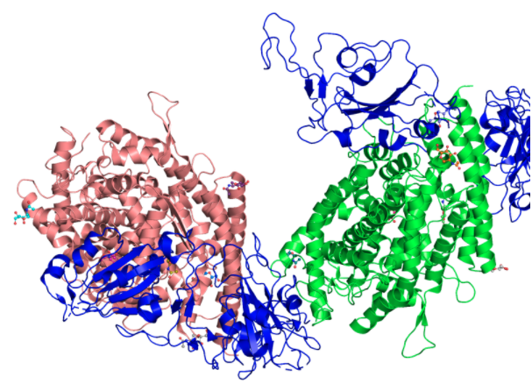
Protein 3D Structure
Example prediction tasks
Protein model refinement
Protein model quality assessment
Change in stability upon mutation
Recommended models
GCNs using molecular graph
3D CNNs using coordinates
Clustering
Challenges
Lack of data, particularly on protein complexes
Lack of data on disordered proteins
source: PDBe

Slide 6
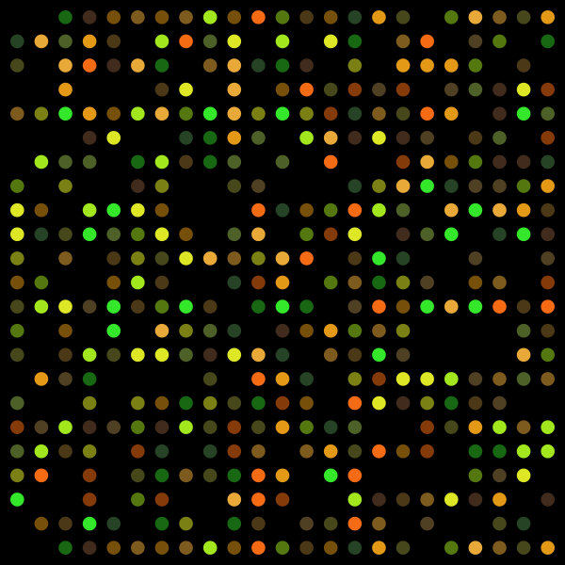
Gene Expression
Example prediction tasks
Intergenic interactions or co-expression
Organization of transcription machinery
Recommended models
Clustering
CNNs
Autoencoders
Challenges
Unclear link between co-expression and function
High dimensionality
High noise
source: kurzweilai.net

Slide 7
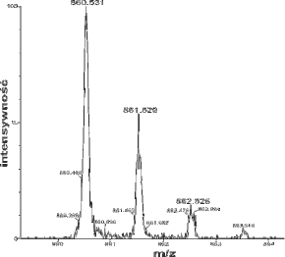
Mass Spectrometry
Example prediction tasks
Detecting peaks in spectra
Metabolite annotation
Recommended models
CNNs using spectral data
Traditional ML methods using derived features
Challenges
Lack of standardized benchmarks
Normalization required between different datasets
source: Wikipedia

Slide 8
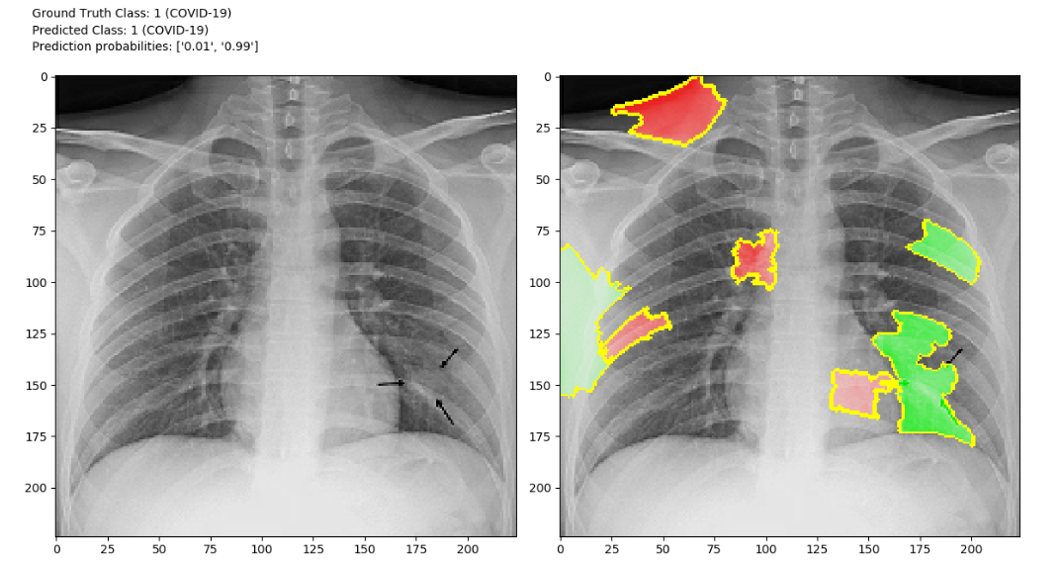
Images
Example prediction tasks
Medical image recognition
Cryo-EM image reconstruction
Recommended models
2D CNNs and residual networks
Autoencoders
Traditional ML methods
Challenges
Systematic difference in data collection affect prediction
Hard to obtain large datasets of consistent data
source: Ross, 2020

Slide 9
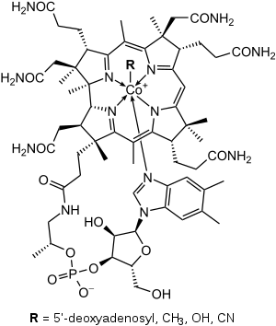
Molecular Structure
Example prediction tasks
Antibiotic activity
Drug toxicity
Protein-ligand docking
Novel drug discovery
Recommended models
CNNs using molecular graph
Traditional ML methods or multilayer perceptrons using molecular properties
RNNs using text-based representations of molecular structure such as SMILES
Autoencoders
Challenges
Experimental data available for only a tiny fraction of possible small molecules
source: Wkipedia

Slide 10
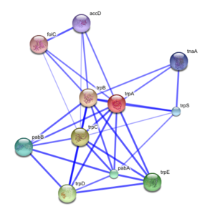
Protein-protein Interaction Network
Example prediction tasks
Polypharmacology side effects
Protein function
Recommended models
CNNs
Graph embedding
Challenges
Interaction networks can be incomplete
Cellular location affects whether proteins interact
source: Wikipedia

Slide 11

References
Greener, J.G., Kandathil, S.M., Moffat, L. et al. A guide to machine learning for biologists. Nat Rev Mol Cell Biol 23, 40–55 (2022). (https://doi.org/10.1038/s41580-021-00407-0)
What is a random forest? (https://www.tibco.com/reference-center/what-is-a-random-forest
Gene-expression data to hit one million deposited data sets. (https://www.kurzweilai.net/gene-expression-data-to-hit-one-million-deposited-data-sets)
Matt Ross. Mar 29, 2020. COVID-CXR: An open source explainable deep CNN model for predicting the presence of COVID-19 in chest X-rays. (https://towardsdatascience.com/covid-cxr-an-open-source-explainable-deep-cnn-model-for-predicting-the-presence-of-covid-19-in-75a83b26cab5)
Ruggles KV, Krug K, Wang X, Clauser KR, Wang J, Payne SH, Fenyö D, Zhang B, Mani DR. Methods, Tools and Current Perspectives in Proteogenomics. Mol Cell Proteomics. 2017 Jun;16(6):959-981. doi: 10.1074/mcp.MR117.000024. Epub 2017 Apr 29. PMID: 28456751; PMCID: PMC5461547.
Jumper, J., Evans, R., Pritzel, A. et al. Highly accurate protein structure prediction with AlphaFold. Nature 596, 583–589 (2021). https://doi.org/10.1038/s41586-021-03819-2

