Slide 1
Model Tuning, Interpretation and Deployment

Slide 2
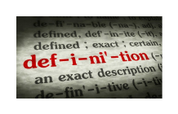
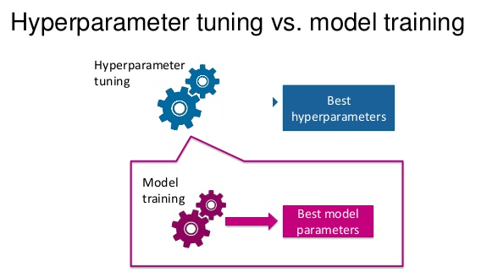
Remember about hyperparameters?
Hyperparameters are meta parameters that are associated with any ML algorithm and are usually set before the model training and building process.
Hyperparameters are different from model parameters since they do not have dependency on the data.
Hyperparameters represent some high-level concepts or knobs that a data scientist can tweak and tune during the model training and building process to improve performance.
(source: Prabhu, 2018)

Slide 3
Example hyperparameters in ML algorithms
Logistic regression
Regularization penalty
Optimization algorithm
Max_Iter
Support Vector Machine
Different Kernels
Neural networks
Number of hidden layers and units
Learning rate
Dropout rate
Number of epochs
Batch size

Slide 4
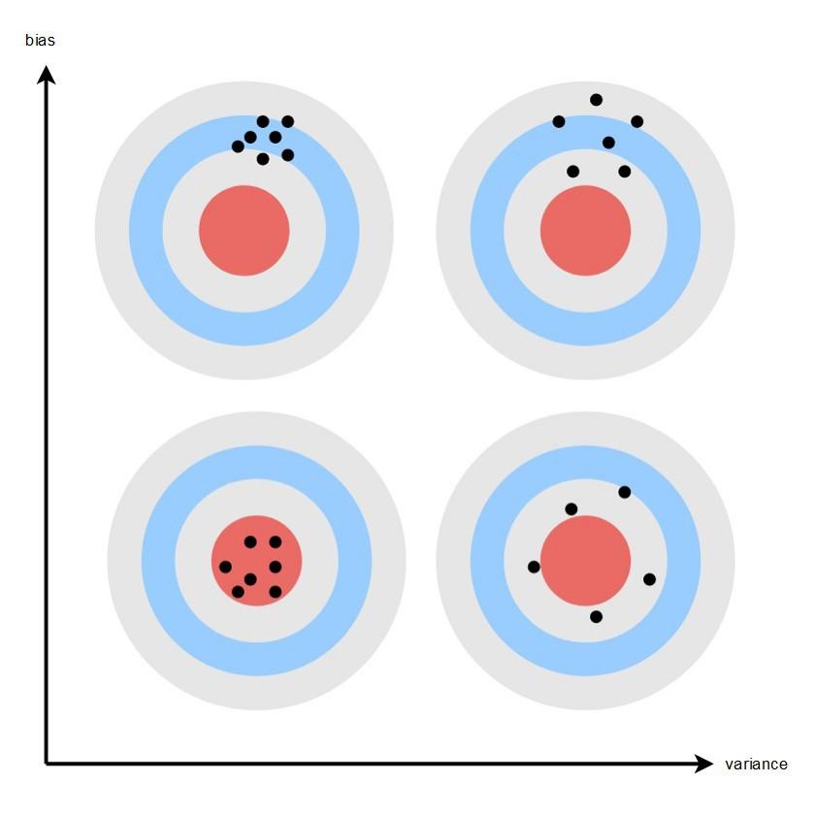
Remember about Bias and Variance?
Make consistent predictions irrespective of datasets.
Not learn necessary relationships and sensitive to data, outliers and noise.
Good general structure of data patterns and relationships
BIAS
Generalize to some extent and perform well on average but sensitive to data
Variance
source: Seth Mottaghinejad,
https://towardsdatascience.com/bias-and-variance-but-what-are-they-really-ac539817e171

Slide 5
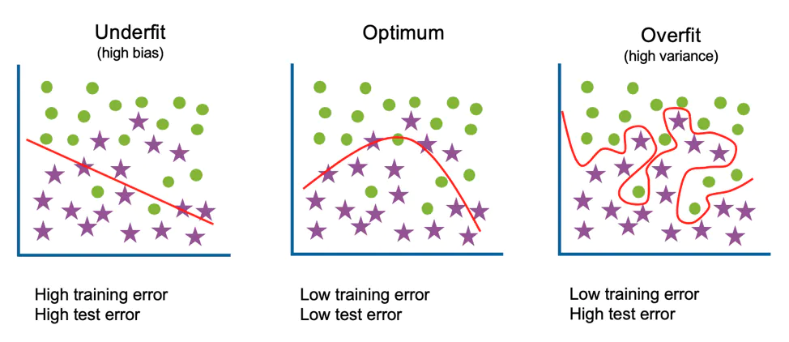
Extreme Cases of Bias-Variance
source: IBM

Slide 6
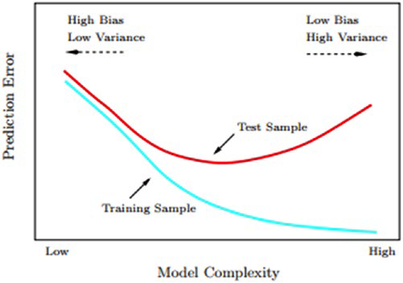
The Bias-Variance Tradeoff
Irreducible error is the error gets introduced due to noise in the training data itself and not much we can do about.
Every model needs to do a tradeoff:
Making assumptions about the structure of data
Fitting itself too closely to the data at hand.
source: Sarkar et al. 2018
Notes:
.

Slide 7
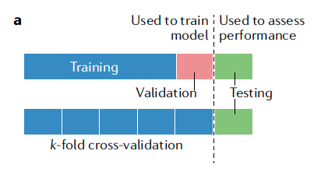
Tuning models: Cross Validation
Most prevalent practices for tuning ML models.
Uses the same data to build different models and also tune their hyperparameters using a simple data partitioning strategy.
Useful when we have less data observations and cannot segregate a specific partition of data as validation set.
source: Greener et al. 2022

Slide 8
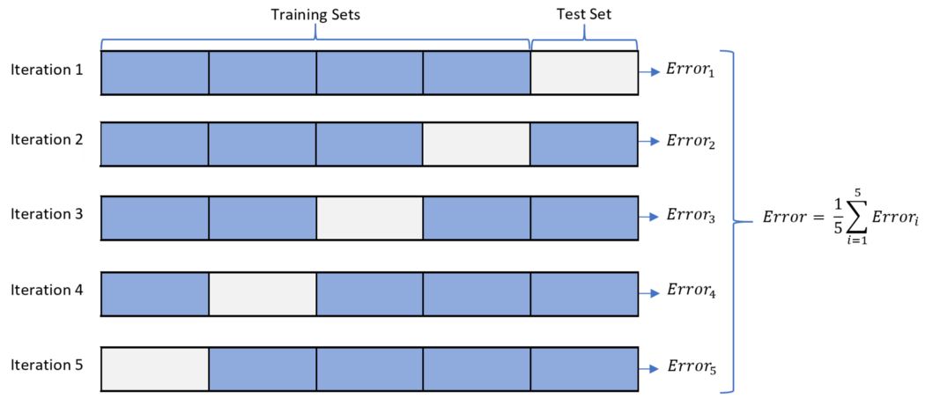
Cross-Validation Strategies
Leave One Out Cross-Validation:
We have a single data point only in our validation set and the rest n-1 observations become the training set. Mostly suitable for small datasets.
K-Fold Cross Validation:
source: Patro, 2021

Slide 9
Hyperparameter tuning strategies
Grid Search
We specify the grid of values (of hyperparameters) we want to try out and optimize to get the best parameter combinations
We then build models on each of those values using cross-validation and report the best parameters’ combination in the whole grid.
The output will be the model using the best combination from the grid.
Drawback: user needs to manually provide the actual parameters, that may not be the most optimal parameters.
Randomized Search
A modification to the grid search. It takes input for grid elements as in normal grid search but it can also take distributions as input.
We get the parameter values from certain distribution and control the number of iterations.

Slide 10
Model Interpretation
Some ML models use interpretable algorithms, for example a decision tree will give you importance of all the variables as an output.
Some ML models are interpretable in nature by default - e.g. generative model such as Bayesian Rule List.
Many ML models are black box and hard to interpret.
Model interpretation can help data scientists understand the interactions among features that can lead to better feature engineering and enhanced performance.
It can also help in model comparisons and explaining the results better to the stakeholders.

Slide 11
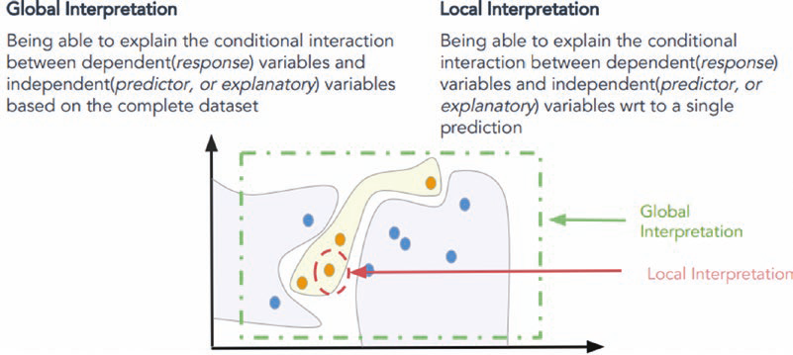
Skater
Open source Python framework to provide model agnostic interpretation of predictive models.
The idea of Skater is to understand black box ML models by querying them and interpreting their learned decision policies.
Skater enables us to do both global and local interpretations.
source: Sarkar et al. 2018

Slide 12
Deployment: Model persistence
The simplest way to deploy a model is to persist the final model on permanent media like hard drive and use it for making predictions in the future.
This deployment scheme performs the necessary data transformations on the raw data and then reads the model from the permanent data store.
Once we have the data and model, we then can make a prediction.
FAIR (Findable, Accessible, Interoperable, and Reusable) data practices.

Slide 13
Deployment: Custom Development
Another option to deploy a model is by developing the implementation of model prediction method separately.
The output of most ML algorithms is the values of parameters that were learned.
We can extract these parameter values and use them for prediction by doing mathematical operation on new data using the extracted parameters.

Slide 14

References
Dipanjan Sarkar, Raghav Bali and Tushar Sharma. 2018. Practical Machine Learning with Python. A Problem-Solver's Guide to Building Real-World Intelligent Systems. Apress. (https://doi.org/10.1007/978-1-4842-3207-1), Chapter 5
Rebecca Patro. Jan 25, 2021. Cross-Validation: K Fold vs Monte Carlo. (https://towardsdatascience.com/cross-validation-k-fold-vs-monte-carlo-e54df2fc179b)
IBM. Underfitting vs Overfitting. (https://www.ibm.com/cloud/learn/underfitting#toc-underfitti-FKaOZyJR)

