Slide 1
Developing an Innovative and Impactful Solution During a pandemic
It takes a variety of strategies and initiatives to address this pandemic. It's about life and death and the survival of humanity.
–Barbara Lee

Slide 2
New Jersey Department of Health analytics Platform
Catalyst
Prior to the covid outbreak. The Department of Health hosted a data warehouse on-premise. The data warehouse was used as an analytical platform to pull reporting data regarding infectious diseases, vaccination records and rates, and other health related data. During the start of the pandemic, we expected that the data warehouse wouldn't be able to handle the amount of data or computational requirements from covid data. We needed a solution that could handle an ever-increasing load.

Slide 3
What did success look like
Key factors
Path forward
Scalable (compute and storage)
SQL compatible
Flexible
Structure and unstructured data
Reasonable processing time of data
Minimal downtime
Modern
Short timeframe to go live
The decision was made to leverage a cloud provider to build on top of their existing infrastructure. Also, during this time management requested we use AWS as the cloud provider.
3

Slide 4
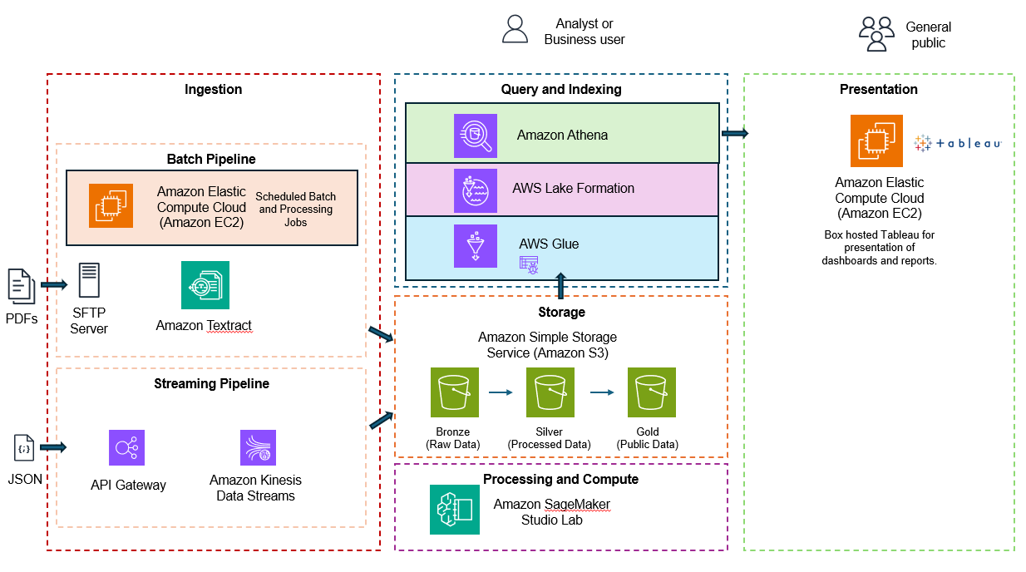
The data lake consists of several parts. The first part is the ingestion layer. The ingestion layer consists of two subparts. A batch and streaming pipelines.
Batch Pipeline:
Designed to take incoming pdfs via sftp. A boto3 script would run hourly. This script would take pdfs from the sftp server, process them through amazon texttract (OCR the files). The results are then sent to the S3 bronze bucket.
Streaming Pipeline:
Designed to take streaming data. This is to take immunization data as json from the api gateway and push to a kinesis stream. The stream would be placed in the S3 bronze bucket. The file name would have a file format of YYYY/MM/DD/[time].json

Slide 5
Query and Indexing:
Starting from the bottom, the AWS glue service is a metadata store of the data in the Storage layer. A glue crawler would periodically scan and index the data in the buckets. The lake formation service would provide data governance. This would prevent PII or HIPPA data from being accessed by unauthorized users.
Athena would take the sql query and query glue data catalog to data from s3.
Storage:
Data at rest would reside here. The data would first go the bronze bucket (raw data), next the data would move to Siver once processed and cleaned. Finally, data ready for the public was placed in the Gold bucket.
Processing and Compute:
Since it was a large amount of data we used sagemaker juyper notebooks with pyspark to process, clean. and transform the data.

Slide 6
Presentation:
Tableau was used to present dashboards. The dashboards would query Athena using a JDBC driver. The SQL query once processed returned a result set of the data residing the Gold bucket.

Slide 7
THANK YOU
Significance
Impact of success
Developed and executed a solution under with a short timeframe that met or exceeded the needs of stakeholders.
Met all key objectives and requirements
Incorporated an element of AI (textract) to the batch automated pipeline.
Develop a new platform for the Department of Health, during a pandemic.
Chris Sommers
302-547-9633
cdsommers@gmail.com

