Slide 1


HTML
HCL Technologies Mexico / USAA

Slide 2
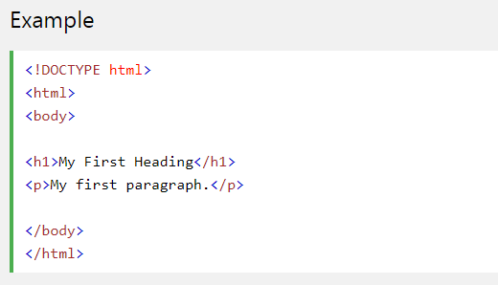
HTML Documents
All HTML documents must start with a document type declaration: <!DOCTYPE html>.
The HTML document itself begins with <html> and ends with </html>.
The visible part of the HTML document is between <body> and </body>.
Try it yourself

Slide 3
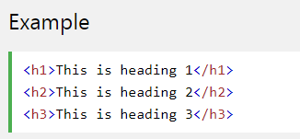
HTML Headings
HTML headings are defined with the <h1> to <h6> tags.
<h1> defines the most important heading. <h6> defines the least important heading:
Try it yoursefl

Slide 4
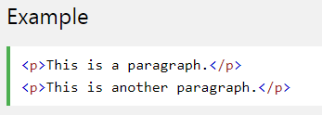
HTML Paragraphs
HTML paragraphs are defined with the <p> tag:
Try it yourself

Slide 5

HTML Links
HTML links are defined with the <a> tag:
The link's destination is specified in the href attribute.
Attributes are used to provide additional information about HTML elements.
Try it yoursefl

Slide 6

HTML Images
HTML images are defined with the <img> tag.
The source file (src), alternative text (alt), width, and height are provided as attributes:
Try it yourself

Slide 7

HTML Elements
An HTML element usually consists of a start tag and end tag, with the content inserted in between:
The HTML element is everything from the start tag to the end tag:

Slide 8
HTML Elements
Basic use of tags
Start tag | Element content | End tag
<h1> | My First Heading | </h1>
<p> | My first paragraph. | </p>
<br>

Slide 9
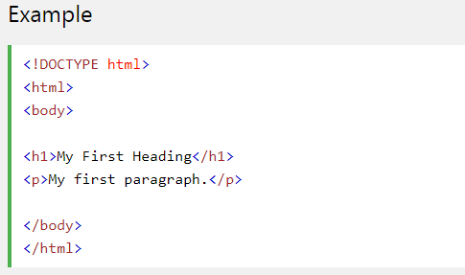
Nested HTML Elements
HTML elements can be nested (elements can contain elements).
All HTML documents consist of nested HTML elements.
This example contains four HTML elements:
Try it yourself

Slide 10
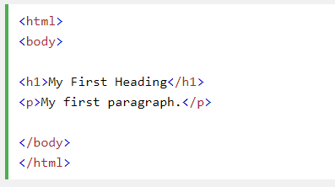
Example Explained
The <html> element defines the whole document.
It has a start tag <html> and an end tag </html>.
The element content is another HTML element (the <body> element).

Slide 11
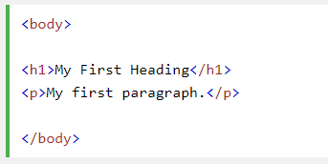
Example Explained
The <body> element defines the document body.
It has a start tag <body> and an end tag </body>.
The element content is two other HTML elements (<h1> and <p>).

Slide 12

Example Explained
The <h1> element defines a heading.
It has a start tag <h1> and an end tag </h1>.
The element content is: My First Heading.

Slide 13

Example Explained
The <p> element defines a paragraph.
It has a start tag <p> and an end tag </p>.
The element content is: My first paragraph.

Slide 14
Empty HTML Elements
HTML elements with no content are called empty elements.
<br> is an empty element without a closing tag (the <br> tag defines a line break).
Empty elements can be "closed" in the opening tag like this: <br />.
HTML5 does not require empty elements to be closed. But if you want stricter validation, or if you need to make your document readable by XML parsers, you must close all HTML elements properly.

Slide 15

Use Lowercase Tags
HTML tags are not case sensitive: <P> means the same as <p>.
The HTML5 standard does not require lowercase tags, but W3C recommends lowercase in HTML, and demands lowercase for stricter document types like XHTML.

Slide 16
HTML Attributes
Attributes provide additional information about HTML elements.
All HTML elements can have attributes
Attributes provide additional information about an element
Attributes are always specified in the start tag
Attributes usually come in name/value pairs like: name="value"

Slide 17

The href Attribute
HTML links are defined with the <a> tag. The link address is specified in the href attribute:
Try it yourself
You will learn more about links and the <a> tag later in this tutorial.

Slide 18

The src Attribute
HTML images are defined with the <img> tag.
The filename of the image source is specified in the src attribute:
Try it yourself

Slide 19

The width and height Attributes
Images in HTML have a set of size attributes, which specifies the width and height of the image:
Try it yourself
The image size is specified in pixels: width="500" means 500 pixels wide.

Slide 20


The alt Attribute
The alt attribute specifies an alternative text to be used, when an image cannot be displayed.
The value of the attribute can be read by screen readers. This way, someone "listening" to the webpage, e.g. a blind person, can "hear" the element.
Try it yourself

Slide 21

The style Attribute
The style attribute is used to specify the styling of an element, like color, font, size etc.
Try it yourself
You will learn more about styling later in this training, and in our CSS training.

Slide 22
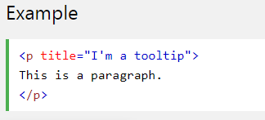
The title Attribute
Here, a title attribute is added to the <p> element. The value of the title attribute will be displayed as a tooltip when you mouse over the paragraph:
Try it yourself

Slide 23

The HTML Style Attribute
Setting the style of an HTML element, can be done with the style attribute.
The HTML style attribute has the following syntax:
The property is a CSS property. The value is a CSS value.
You will learn more about CSS later in this training.

Slide 24
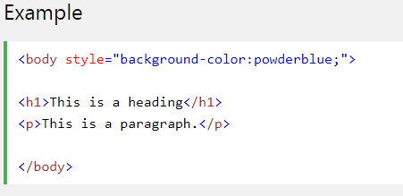
HTML Background Color
The background-color property defines the background color for an HTML element.
This example sets the background color for a page to powderblue:
Try it yourself

Slide 25
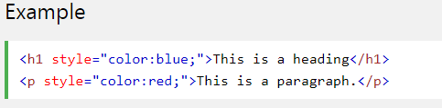
HTML Text Color
The color property defines the text color for an HTML element:
Try it yourself

Slide 26
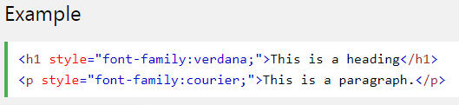
HTML Fonts
The font-family property defines the font to be used for an HTML element:
Try it yourself

Slide 27
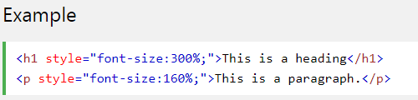
HTML Text Size
The font-size property defines the text size for an HTML element:
Try it yourself

Slide 28
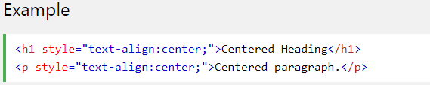
HTML Text Alignment
The text-align property defines the horizontal text alignment for an HTML element:
Try it yourself

Slide 29
HTML Styles Summary
Use the style attribute for styling HTML elements
Use background-color for background color
Use color for text colors
Use font-family for text fonts
Use font-size for text sizes
Use text-align for text alignment

Slide 30


Single or Double Quotes?
Double quotes around attribute values are the most common in HTML, but single quotes can also be used.
In some situations, when the attribute value itself contains double quotes, it is necessary to use single quotes:
Or vice versa:

Slide 31
HTML Text Formatting
HTML also defines special elements for defining text with a special meaning.
HTML uses elements like <b> and <i> for formatting output, like bold or italic text.
Formatting elements were designed to display special types of text:
<b> - Bold text
<strong> - Important text
<i> - Italic text
<em> - Emphasized text
<mark> - Marked text
<small> - Small text
<del> - Deleted text
<ins> - Inserted text
<sub> - Subscript text
<sup> - Superscript text

Slide 32


HTML <b> and <strong> Elements
The HTML <b> element defines bold text, without any extra importance.
The HTML <strong> element defines strong text, with added semantic "strong" importance.
Try it yourself
Try it yourself

Slide 33


HTML <i> and <em> Elements
The HTML <i> element defines italic text, without any extra importance.
The HTML <em> element defines emphasized text, with added semantic importance.
Try it yourself
Try it yourself

Slide 34

HTML <small> Element
The HTML <small> element defines smaller text:
Try it yourself

Slide 35

HTML <mark> Element
The HTML <mark> element defines marked or highlighted text:
Try it yourself

Slide 36

HTML <del> Element
The HTML <del> element defines deleted (removed) text.
Try it yourself

Slide 37

HTML <ins> Element
The HTML <ins> element defines inserted (added) text.
Try it yourself

Slide 38

HTML <sub> Element
The HTML <sub> element defines _{subscripted} text.
Try it yourself

Slide 39

HTML <sup> Element
The HTML <sup> element defines ^{superscripted} text.
Try it yourself

Slide 40

HTML Comments
You can add comments to your HTML source by using the following syntax:
Notice that there is an exclamation point (!) in the opening tag, but not in the closing tag.

Slide 41
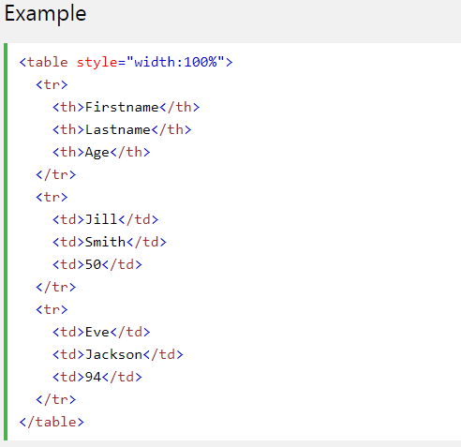

HTML Tables
An HTML table is defined with the <table> tag.
Each table row is defined with the <tr> tag. A table header is defined with the <th> tag. By default, table headings are bold and centered. A table data/cell is defined with the <td> tag.
Try it yourself

Slide 42
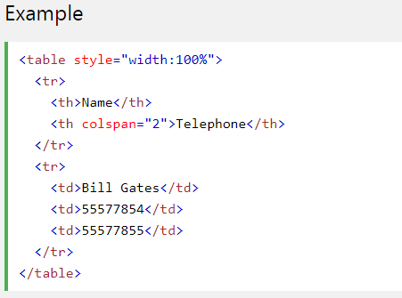
HTML Table - Cells that Span Many Columns
To make a cell span more than one column, use the colspan attribute:
Try it yourself

Slide 43
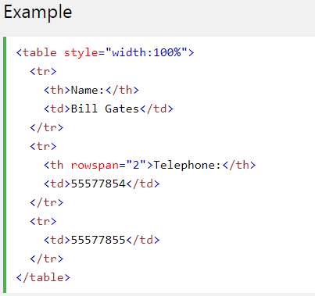
HTML Table - Cells that Span Many Rows
To make a cell span more than one row, use the rowspan attribute:
Try it yourself

Slide 44
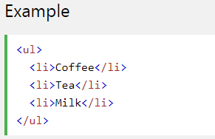
Unordered HTML List
An unordered list starts with the <ul> tag. Each list item starts with the <li> tag.
The list items will be marked with bullets (small black circles) by default:
Try it yourself

Slide 45
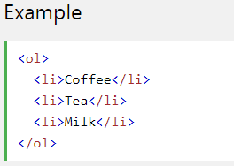
Ordered HTML List
An ordered list starts with the <ol> tag. Each list item starts with the <li> tag.
The list items will be marked with numbers by default:
Try it yourself

Slide 46
Ordered HTML List - The Type Attribute
The type attribute of the <ol> tag, defines the type of the list item marker:
Type | Description
type="1" | The list items will be numbered with numbers (default)
type="A" | The list items will be numbered with uppercase letters
type="a" | The list items will be numbered with lowercase letters
type="I" | The list items will be numbered with uppercase roman numbers
type="i" | The list items will be numbered with lowercase roman numbers

Slide 47
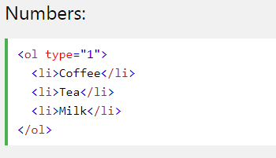
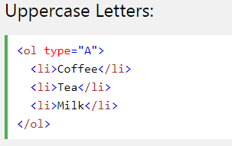
Ordered HTML List - The Type Attribute
Example:
Try it yourself

Slide 48
Styling HTML with CSS
CSS stands for Cascading Style Sheets.
CSS describes how HTML elements are to be displayed on screen, paper, or in other media.
CSS saves a lot of work. It can control the layout of multiple web pages all at once.
CSS can be added to HTML elements in 3 ways:
Inline - by using the style attribute in HTML elements
Internal - by using a <style> element in the <head> section
External - by using an external CSS file

Slide 49

Inline CSS
An inline CSS is used to apply a unique style to a single HTML element.
An inline CSS uses the style attribute of an HTML element.
This example sets the text color of the <h1> element to blue:
Try it yourself

Slide 50
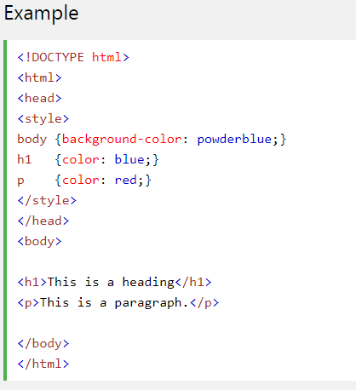
Internal CSS
An internal CSS is used to define a style for a single HTML page.
An internal CSS is defined in the <head> section of an HTML page, within a <style> element:
Try it yourself

Slide 51
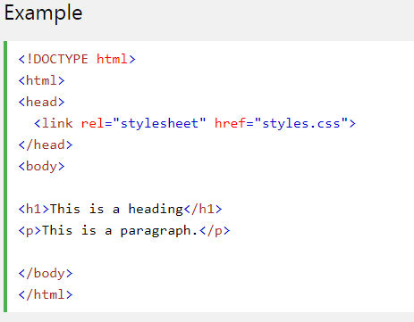
External CSS
An external style sheet is used to define the style for many HTML pages.
With an external style sheet, you can change the look of an entire web site, by changing one file!
To use an external style sheet, add a link to it in the <head> section of the HTML page:
Try it yourself

Slide 52
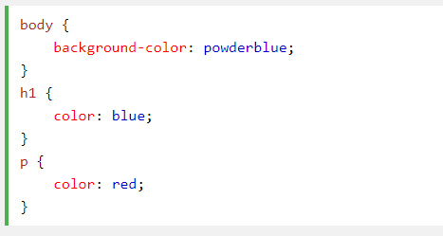
External CSS
An external style sheet can be written in any text editor. The file must not contain any HTML code, and must be saved with a .css extension.
Here is how the "styles.css" looks:

Slide 53
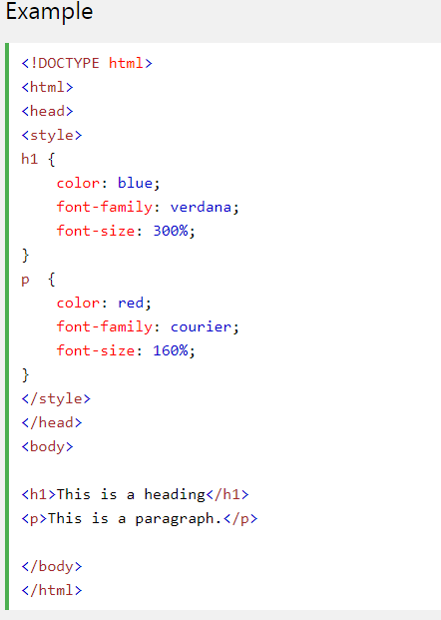
CSS Fonts
The CSS color property defines the text color to be used.
The CSS font-family property defines the font to be used.
The CSS font-size property defines the text size to be used.
Try it yourself

Slide 54

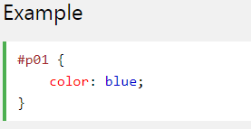
The id Attribute
To define a specific style for one special element, add an id attribute to the element:
then define a style for the element with the specific id:
Try it yourself

Slide 55

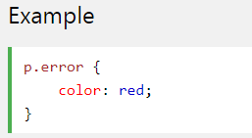
The class Attribute
To define a style for a special type of elements, add a class attribute to the element:
then define a style for the elements with the specific class:
Try it yourself

Slide 56
The HTML <script> Tag
The <script> tag is used to define a client-side script (JavaScript).
The <script> element either contains scripting statements, or it points to an external script file through the src attribute.
Common uses for JavaScript are image manipulation, form validation, and dynamic changes of content.
To select an HTML element, JavaScript very often use the document.getElementById(id) method.

Slide 57
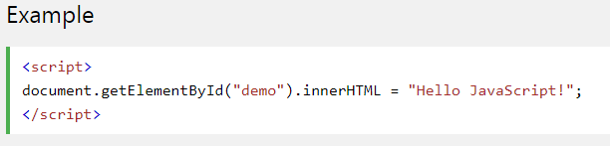
The HTML <script> Tag
This JavaScript example writes "Hello JavaScript!" into an HTML element with id="demo":
Try it yourself

Slide 58

JavaScript can change HTML styles
Example:
Try it yourself

Slide 59

JavaScript can change HTML attributes
Example:
Try it yourself

Slide 60
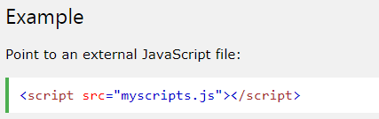
HTML <script> src Attribute
Example:
Try it yourself

