Slide 1

Bank Marketing Dataset: EDA, Regression, Classification, Clustering & Pattern Mining
University of the Cumberlands
Advanced Big Data and Data Mining
Instructor: Dr. Satish Penmatsa
Group Members :
Suresh Ghimire
Sagar Bhetwal
Nirajan Acharya
Umesh Dhakal
Enjal Chauhan
Date: 15 February, 2026
Presentation Link :
https://cumber-my.sharepoint.com/:v:/g/personal/sghimire38288_ucumberlands_edu/IQB1BVQMvYzYRpO1aTxZtL9_AfiIvO3bNbkV5mlvI5MfZrI?nav=eyJyZWZlcnJhbEluZm8iOnsicmVmZXJyYWxBcHAiOiJTdHJlYW1XZWJBcHAiLCJyZWZlcnJhbFZpZXciOiJTaGFyZURpYWxvZy1MaW5rIiwicmVmZXJyYWxBcHBQbGF0Zm9ybSI6IldlYiIsInJlZmVycmFsTW9kZSI6InZpZXcifX0%3D&e=s7rWwT

Slide 2
Roadmap
EDA & Cleaning (Deliverable 1)
Regression Modeling (Deliverable 2)
Classification, Clustering, Association Rules (Deliverable 3)
Key findings + implications

Slide 3
Dataset Overview
Dataset: Bank Marketing (rows ≈ 45,211)
Target used in EDA & classification: y (subscription: 0/1)
Mixed features: numeric + categorical (job, education, loan, etc.)
Common “unknown” coded values; pdays has special meaning

Slide 4
Data Validation & Cleaning Decisions
Validation checks: shape, schema, duplicates, missing values
Cleaning actions from notebook:
Standardize column names
Map target y: {no->0, yes->1}
Convert pdays = -1 to missing + create prev_contacted indicator
Add *_unknown flags for categorical columns containing “unknown”

Slide 5
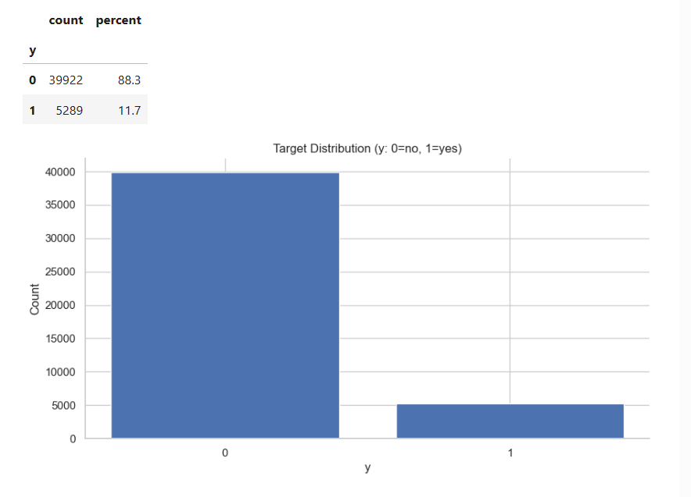
Target Balance (Class Imbalance)
What to show:
  Short explanation: subscription “yes” is minority

Slide 6
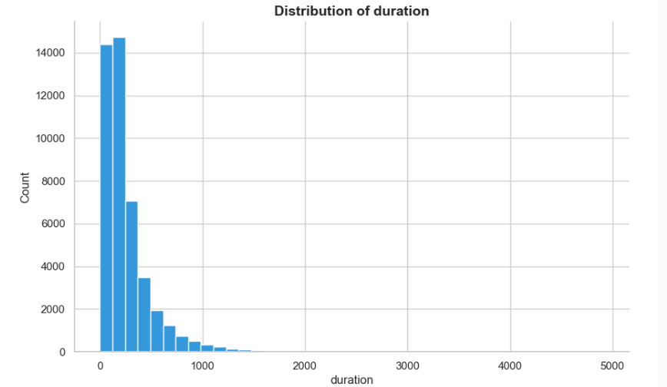
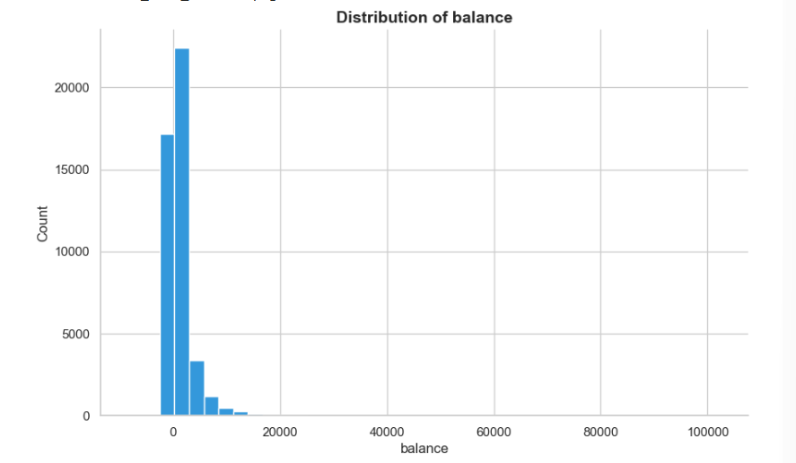
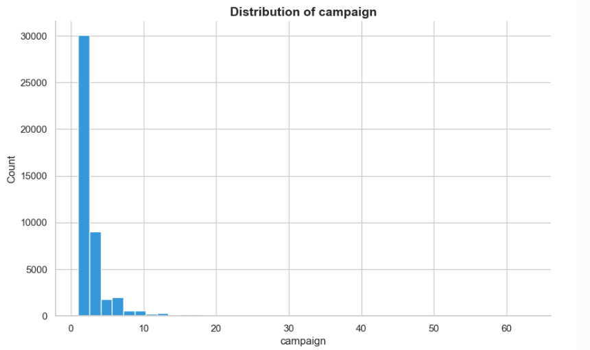
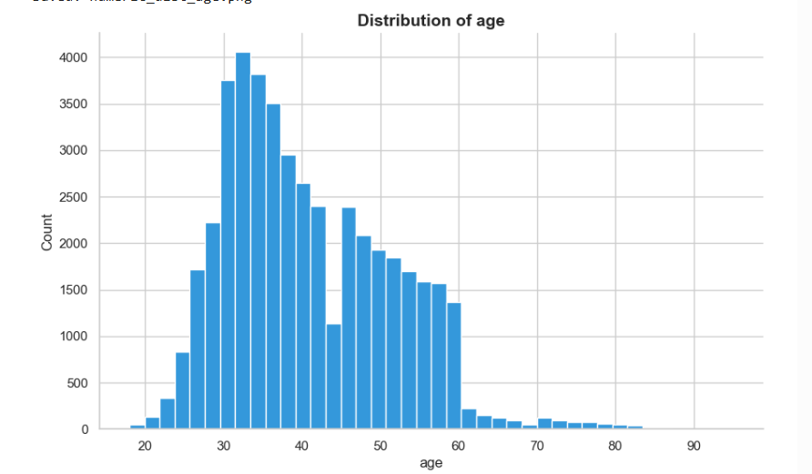
Numeric Feature Distributions
Brief callouts: skew and long tails (balance, duration, campaign)

Slide 7
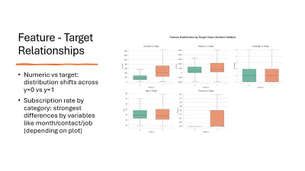
Outliers + Categorical Distributions
Outliers observed in balance, duration, campaign, and previous
Categorical breakdowns show dominant categories and “unknown” presence

Slide 8
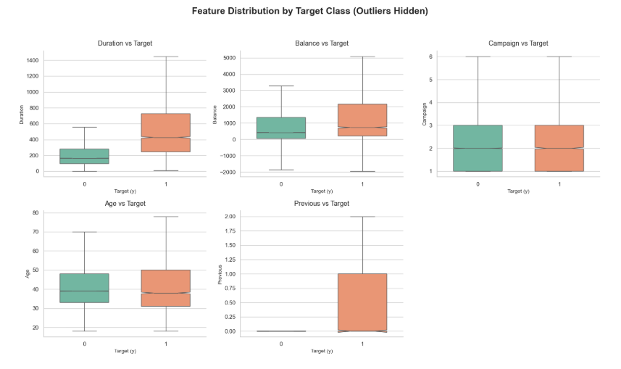
Feature - Target Relationships
Numeric vs target: distribution shifts across y=0 vs y=1
Subscription rate by category: strongest differences by variables like month/contact/job (depending on plot)

Slide 9
Regression Modeling Setup
Regression target in notebook: age
Feature engineering used:
age_squared (nonlinear relationship)
pdays_was_missing, pdays_filled
campaign_per_previous
Preprocessing pipeline:
Numeric: impute median + scale
Categorical: impute most frequent + one-hot encode
Models compared:
Linear Regression, Ridge, Lasso

Slide 10
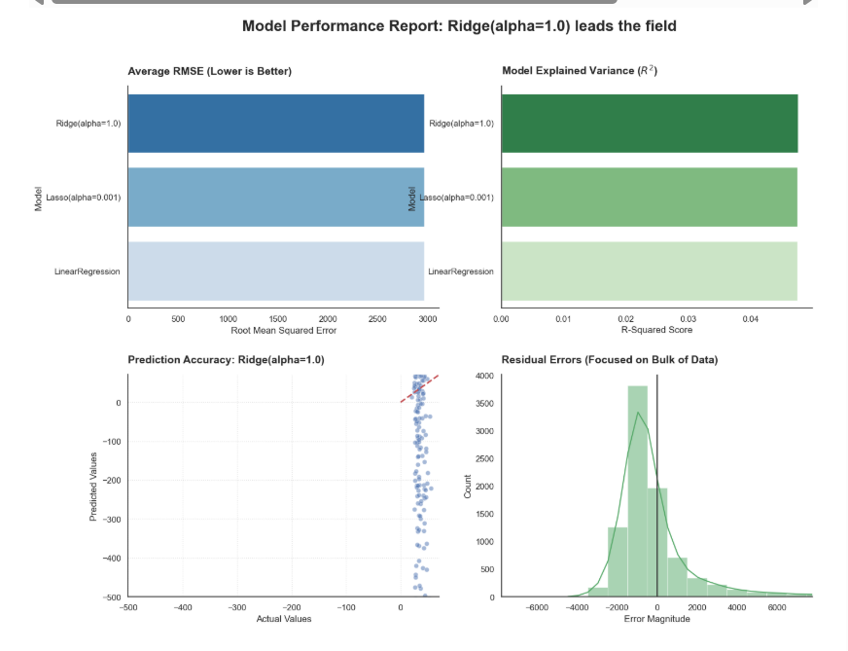
Regression Results + Visualization
Key result: Ridge / Linear Regression / Lasso are extremely close
Reported metrics from notebook (test):
  R² ≈ 0.981
  RMSE ≈ 1.46

Slide 11
Classification Models
Models evaluated:
  Logistic Regression (baseline)
  Decision Tree (baseline)
  Linear SVM (baseline + tuned)
  Why F1 matters: class imbalance (yes ≈ 11.7%)
  Best tuned parameter:
    SVM best C = 0.5 (from GridSearch)

Slide 12
Clustering: Selecting K + Visualizing Clusters
Clustering method: MiniBatch K-Means on preprocessed features (no target column)
  Elbow (inertia) + silhouette
  Best k reported: 2
K selection:
2D visualization: TruncatedSVD projection

Slide 13
Cluster Profiling (What the clusters mean)
Cluster size summary
  Cluster 0: 36,954
  Cluster 1: 8,257
Numeric averages table (age, balance, duration, campaign, previous, pdays)
Top categorical breakdowns (example shown in notebook: job)

Slide 14
Association Rule Mining (Patterns among successful subscriptions)
Association Rule Mining (Patterns among successful subscriptions)
Method: Apriori + association rules
Constraints used:
  min_support = 0.05
  max_len = 3
  rules filtered to confidence ≥ 0.60

Slide 15

Key Findings, Challenges, Next Steps
Key findings
Imbalance drives metric choice (F1/ROC-AUC)
SVM tuned performed best overall in F1 (per notebook table)
Clustering suggests two major customer segments
Association rules reveal recurring profile combinations in subscribers
Challenges
Handling “unknown” + pdays sentinel
Avoiding misleading accuracy
Keeping plots readable (outliers)
Next steps:
Try tree ensembles (Random Forest / Gradient Boosting)
Threshold tuning for business objectives
Deeper cluster interpretation with campaign strategy

