Slide 1

SIDDAGANGA INSTITUTE OF TECHNOLOGY, TUMKUR-3
(An autonomous institution affiliated to VTU, Belagavi, Approved by AICTE, New Delhi and ISO 9001:2015 Certified)
MAJOR PROJECT PRESENTATION
ON
REAL-TIME MANAGEMENT OF WEBSITE LOG FILES
Under the guidance of,
Dr. K C.Narasimhamurthy
Professor and Head,
Dept. of E&TE,
SIT Tumkur
Presented By,
Udhav Mohata
1SI16TE045

Slide 2

About the company:
Arvind Internet is now known as OMUNI.
It is B2B2C company which provides products and services to company for their customers.
There are five pods in the company.
I am Intern Data Engineer in .ai pod.
My work/role is to provide data in required format coming from different sources (Twitter, Website, apps Etc) to all the pods.

Slide 3
Project objective:
Get real time data from logs and to show the count and types of different codes generated in a website.

Slide 4
Technology Used:
Apache Kafka
Apache Spark (PySpark)
Spark SQL
Spark Streaming
Scala
Hive or any other real time Data Warehouse.

Slide 5

Apache Kafka
Best Messaging System Technology!

Slide 6
Apache Kafka:
Apache Kafka is a messaging system developed by Linkedin and later donated it to Apache Foundation which is like a hub for Open Source Big Data technologies.
Apache Kafka is a distributed data store optimized for ingesting and processing streaming data in real-time. Streaming data is data that is continuously generated by thousands of data sources, which typically send the data records in simultaneously.
It has 3 major components: Producer, Broker, Consumer.

Slide 7
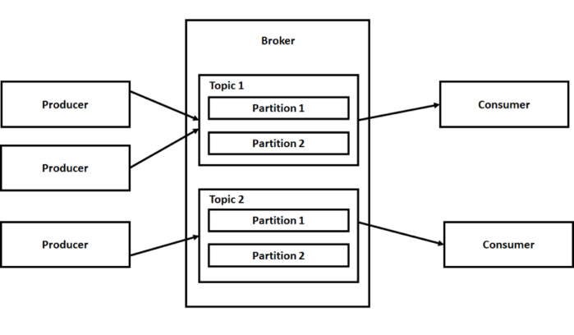
Architecture:

Slide 8

Apache Spark
Most used Big Data Technology!

Slide 9
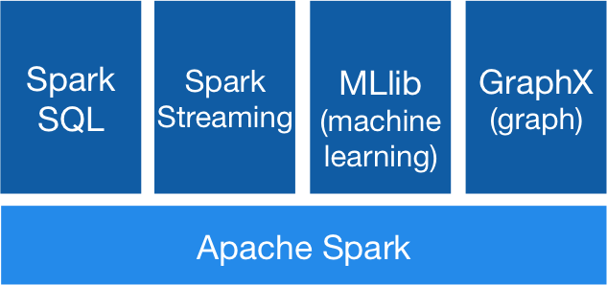
Apache Spark:
Apache Spark is a engine/technology used for large scale data processing.
Documentation: https://spark.apache.org/docs/latest/
Version: Apache Spark 2.4.5

Slide 10
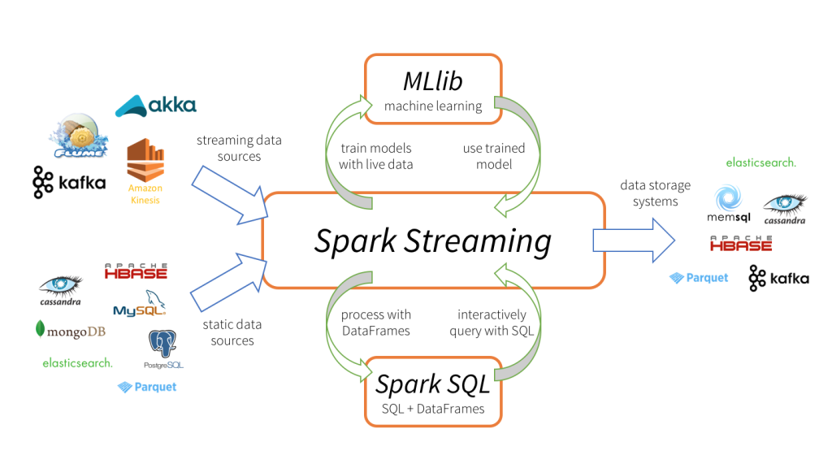
Where Spark fits in Big Data?

Slide 11
Modules in Spark
Spark Core
Spark SQL
Spark Streaming
First Module developed for Apache Spark.
It is used for Batch Processing.
It uses RDD Variables.
It supports languages like Java, Python, Scala.
This module is used to process or manipulate Dataframe(Table).
It is used for both Batch and Real time processing.
It supports languages like Java, Python, Scala, R, SQL.
This is most used module to process data.
It is used for Real time Processing.
It uses DATASET.
It supports languages like Java, Python, Scala, R.

Slide 12
Why Scala?
Scala is a Dynamic and functional Language.
Scala runs in java environment so even Java codes can be executed inside scala
Spark is built on scala so this is prefered.
Scala is more easy to understand.
It falls in between Java and Python

Slide 13


Pipeline Constructed:
Spark consumes
data from
kafka topic
Streaming
data
Processing (Spark SQL or Spark Streaming)
Log Files
Data consumed
from the topic
Processed data to another kafka topic
Received data used for analytics or save the data to HIVE

Slide 14
Http response Status Code:
S.NO | Response | Status Code range
1 | Informational Response | 100-199
2 | Successful Response | 200-299
3 | Redirect | 300-399
4 | Client Error | 400-499
5 | Server Error | 500-599

Slide 15
Log Files:
Files or directories generated automatically to monitor the clicks of website/app of any User is call as log files.
74.124.214.251 - - [30/Nov/2015:15:11:23 +0000] "POST /wp-login.php HTTP/1.1" 200 1691 ………
Ip Add
Time Stamp
Request Type
Website
Status Code

Slide 16
Demonstration

Slide 17
Benefits:
Apache Spark and Apache Kafka is a Open Source Technology.
Spark does not depend on hadoop, it can create its own clusters and run in standalone mode.
Integration of Kafka + Spark and Spark + any DB is very easy.
It can read log files, hdfs files and S3, etc..
It can process TBs of data streaming inside the cluster in seconds.
Spark Streaming can process batch data in Streams.

Slide 18
Future Scope and Conclusion:
It can connect to any type and any number of sources.
It can be used to read details from different sensors and process it in parallel.
The processed data can be sent to any output, like:
Console
Text Message or Email.
Webpage

Slide 19
References
https://spark.apache.org/docs/latest/sql-programming-guide.html
https://spark.apache.org/docs/latest/
https://kafka.apache.org/24/documentation.html#gettingStarted

Slide 20
Thank You!

