Slide 1

SIDDAGANGA INSTITUTE OF TECHNOLOGY, TUMKUR-3
(An autonomous institution affiliated to VTU, Belagavi, Approved by AICTE, New Delhi and ISO 9001:2015 Certified)
MAJOR PROJECT PRESENTATION
ON
BIG DATA TECHNOLOGY USED IN COMPANIES
Presented By,
UDHAV MOHATA (1SI16TE045)

Slide 2

Apache Spark
Most used Big Data Technology!

Slide 3
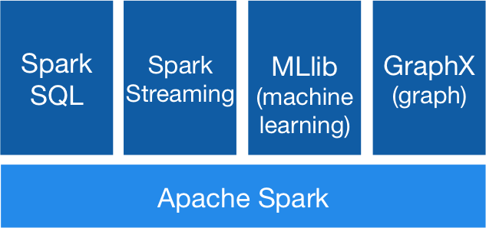
Apache Spark:
Apache Spark is a engine/technology used for large scale data processing.
Documentation: https://spark.apache.org/docs/latest/
Version: Apache Spark 2.4.5

Slide 4
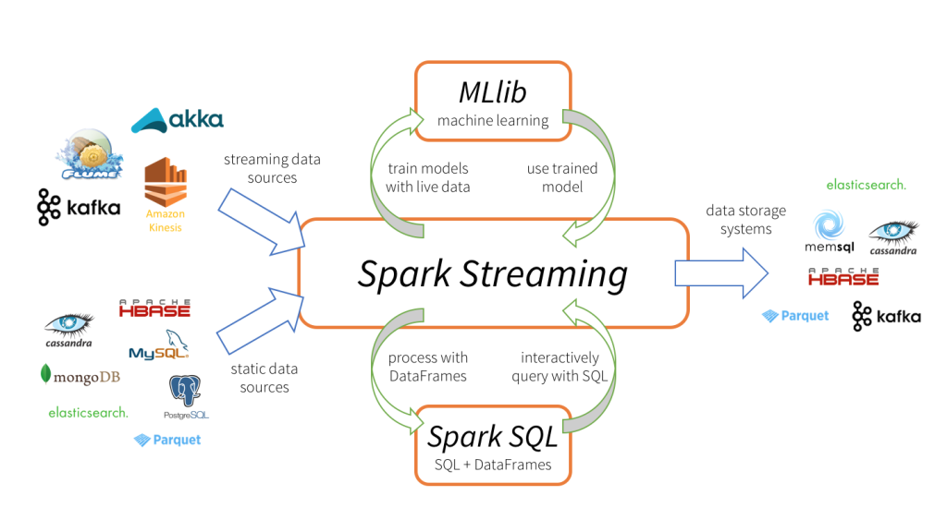
Where Spark fits in Big Data?

Slide 5
Modules in Spark
Spark Core
Spark SQL
Spark Streaming
First Module developed for Apache Spark.
It is used for Batch Processing.
It uses RDD Variables.
It supports languages like Java, Python, Scala.
This module is used to process or manipulate Dataframe(Table).
It is used for both Batch and Real time processing.
It supports languages like Java, Python, Scala, R, SQL.
This is most used module to process data.
It is used for Real time Processing.
It uses DATASET.
It supports languages like Java, Python, Scala, R.

Slide 6
Benefits:
Apache Spark is a Open Source Technology.
Spark does not depend on hadoop, it can create its own clusters and run in standalone mode.
Integration of Kafka + Spark and Spark + any DB is very easy.
It can read log files, hdfs files and S3, etc..
It can process TBs of data streaming inside the cluster in seconds.
Spark Streaming can process batch data in Streams.

Slide 7
Project objective:
Get real time data from log files and to show the count of types of error generated in a website.

Slide 8
Technology Used:
Apache Kafka
Apache Spark (PySpark)
Spark SQL
Spark Streaming
Scala
Hive or any other real time Data Warehouse.

Slide 9
Why Scala?
Scala is a Dynamic and functional Language.
Scala runs in java environment so even Java codes can be executed inside scala
Spark is built on scala so this is prefered.
Scala is more easy to understand.
It falls in between Java and Python

Slide 10
Solution Pipeline
Source
Read data from log files.
Processing
Use spark to count the errors
Sink
To display or store the count of errors.

Slide 11


Pipeline to be Completed:
Spark consumes
data from
kafka topic
Streaming
data
Processing (Spark SQL or Spark Streaming)
Log Files
Data consumed
from the topic
Processed data to another kafka topic
Received data used for analytics or save the data to HIVE

Slide 12
Future Scope and Conclusion:
It can connect to any type and any number of sources.
It can be used to read details from different sensors and process it in parallel.
The processed data can be sent to any output, like:
Console
Text Message or Email.
Webpage

Slide 13
References
https://spark.apache.org/docs/latest/sql-programming-guide.html
https://spark.apache.org/docs/latest/
https://kafka.apache.org/24/documentation.html#gettingStarted

Slide 14
Thank You!

