Slide 1

Presentation on
CLASSIFICATION OF NETWORK TRAFFIC
Carried out as part of Internship during
SUMMER 2020
By
GOPU NAVEEN
Roll No:18311A05T0
VADLAKONDA ROHITH
Roll No:18311A0W8
CHITYALA UDHAY
Roll No : 18311A05R4
Under the guidance of
C.NAVEEN KUMAR
Project Lead
ORBIT SHIFTERS PVT LTD

Slide 2
ABOUT THE PROJECT
Name: CLASSIFICATION OF NETWORK TRAFFIC
Scope:
Today we know information systems are everywhere.
Protection of our information systems is very important.
The main aim of this project is to detect an Instruder who enters through macilious attacks.i.e Intrusion Detection

Slide 3
ABOUT THE COMPANY
Company Name: ORBIT SHIFTERS PVT LTD IN ASSOCIATION WITH GOALSTREET
Address: Address: #724,opp to Indian public school,OU colony, Manikonda, Hyderabad,Telangana,500008
Ph.No.: +917702752021
Size:1 to 50 employees
Type: private
Domain: IT solutions
Credibility: BPO/Tech Support, Inbound & Outbound Support, Data Management, Training & Soft skills, Software Development, Staffing and solutions, Academic projects.
Date of incorporation: 15 March 2018

Slide 4
ABSTRACT
The goal of this project is two-fold. First, we attempt to find the most effective machine learning model for identifying network attacks.
Although scalability and performance are major considerations in every commercial product, our results are targeted at minimizing false positives and negatives.

Slide 5
ABSTRACT
In our society, information systems are everywhere. They are used by corporations to store proprietary and other sensitive data, by families to store financial and personal information, by universities to keep research data and ideas, and by governments to store defense and security information.
It is very important that the information systems that house this vitally sensitive information be secure. In order for information systems to be secure, it is paramount that they utilize robust security mechanisms.
Commonly found security mechanisms are passwords on accounts, encryption of sensitive data, virus protection, and intrusion detection. An Intrusion Detection System (IDS) monitors activity at an access point and can log or prevent activities that are marked as intrusions. Intrusions occur when malicious activity gains access to or affects the usability of a computer resource.

Slide 6
INTRODUCTION
Name:CLASSIFICATION OF NETWORK TRAFFIC
We know that in this world information systems are everywhere like universities,government offices,stock markets etc.
Protection of information is very important in equal with maintaining information.
Now a days we are maintaining many security mechanisms like passwords,firewalls etc,but still there are many chances of instrusion attacks.this is results in stealing of information.
In the current scenario, our single aadhar card can give our whole information.
An Intrusion Detection System (IDS) monitors activity at an access point and can log or prevent activities that are marked as intrusions.
Intrusions occur when malicious activity gains access to or affects the usability of a computer resource.
Example :In our universities there is Admin who does allow other intruders without his intervention.

Slide 7
Existing System:
The existing system uses Support Vector Machine (SVM) one of the main issues with this is that it need the data to be linearly separable.
The system also does not provide enough preprocessing and visualization or Exploratory Data Analysis(EDA).
Disadvantages of Existing System:
The limitations of available systems are not sufficient to deal with the complex data.
In this section, we present some of the limitations that are present in the existing system.
•The model suffers from overfitting due to no generalization of data.
•The error on test data is high due to overfitting.
•The system also requires data extensive data preprocessing and Exploratory Data Analysis(EDA) inorder to perform feature engineering.

Slide 8
Proposed System:
We aim to build other classification models like logistic regression, Naïve Bayes, Decision Trees and others and also fine tune the parameters of the model. These models would be trained on a data set which will be engineered carefully after performing the feature engineering.
Advantages:
The requirement is to come up with novel features based on the functional understanding of the dataset. It is important to keep in mind to avoid correlated features during this process. Each feature should only improve the information contained in the dataset.
visualize the dataset without cleaning the data and understand the distribution of the dataset.
Find the attributes that needs to be handled based on the data visualization task.

Slide 9
Software requirements:
Operating System : Windows 7 , Windows 8, (or higher versions)
Language : Python 3.5 and other libraries likes numpy, pandas, matplotlib, seaborn and scikitlearn.
Mozilla Firefox(or any browser)
Hardware requirements:
Processor : Pentium 3,Pentium 4 and higher
RAM : 2GB/4GB RAM and higher
Hard disk : 40GB and higher

Slide 10
STUDENT CONTRIBUTION (Project Management)
Objective: to learn about Machine Learning
Number of people involved in learning: 200
Number of days spent by us:60
Team members: 3
Outcome :Implemented Machine Learning concepts and Algorithms on Real Time Application.
Resources:
Python,Jupyter,Spyder,Machine Learning Algorithms from Scikit Learn.

Slide 11
ABOUT THE DATASET
This dataset contains 41 features and 1 label.
These features are used as our inputs and label is the one we have to predict which gives whether there is attack or not.
Normal-No attack,and others define there is malicious attack and the type of attack.
Out of all available entries(rows),70% used for training datasets and 30% used for testing .
We perform data pre-processing on features and use only the essential features.

Slide 12
IMPLEMENTATION:
Some of the machine learning algorithms used to implement are:
Logistic Regression
Decision Tree Classifier
Random Forest Classifier
K-Neighbors Classifier
Gaussian NB
The above algorithms are used to detect there is malicious attack or not.
The one with high accuracy is the best algorithm.

Slide 13
First we imported libraries.
Then imported the dataset.
Then we dropped less important features after understanding.
Describe function used to know if there are any missing values.
Then we are encoding the categorical data.
Then we are dividing dataset into training and testing sets.
Next we are scaling the features.
Then appling different machine learning algorithms and calculating their accuracy.

Slide 14
DESIGN AND IMPLEMENTION CODE IN PYTHON
IMPORTING LIBRARIES
import numpy as np
import pandas as pd
import matplotlib.pyplot as plt
import seaborn as sns

Slide 15
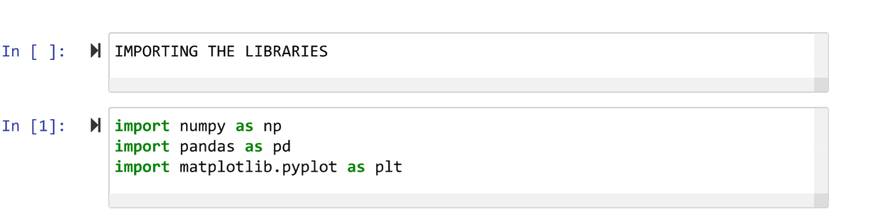

Slide 16
Importing the dataset
path=r"C:\Users\gopun\Downloads\project 13\isd_project.csv"
dataset=pd.read_csv(path)
dataset.info()

Slide 17
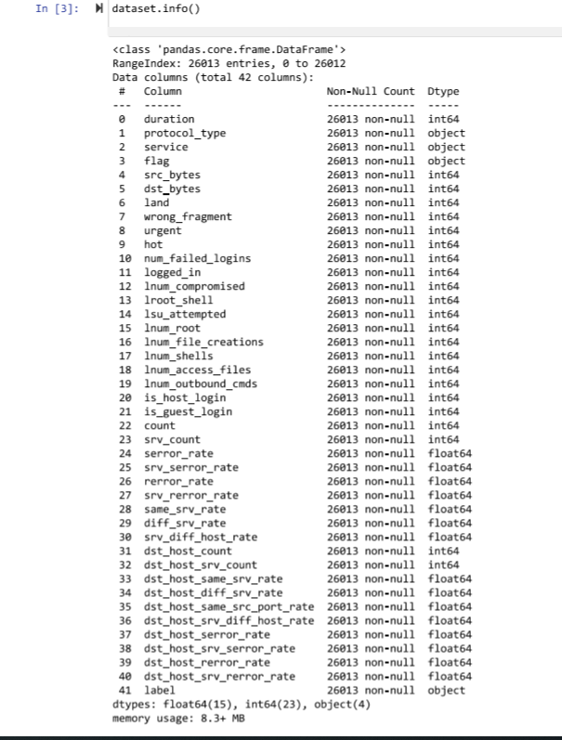
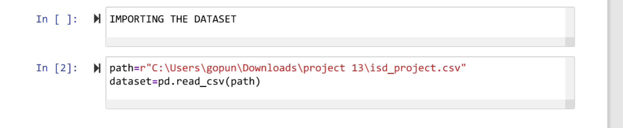

Slide 18
Feature Selection
Here we some less important features
dataset.drop(['protocol_type','service','land','urgent',],axis=1,inplace=True)
dataset.drop(['hot','lnum_file_creations'],axis=1,inplace=True)
temp=pd.get_dummies(dataset['flag'],drop_first=True)
dataset=pd.concat([dataset,temp],axis=1)
dataset.drop('flag',axis=1,inplace=True)
temp1=pd.get_dummies(dataset['label'],drop_first=True)
dataset=pd.concat([dataset,temp1],axis=1)
dataset.drop('label',axis=1,inplace=True)

Slide 19
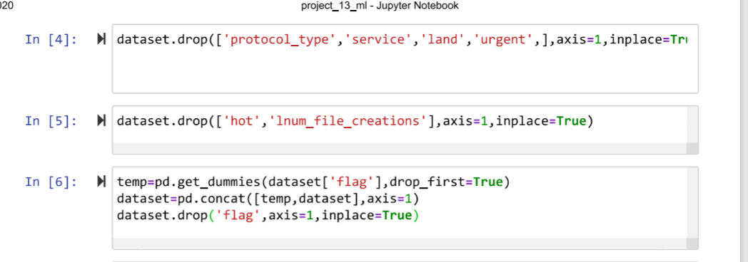

Slide 20
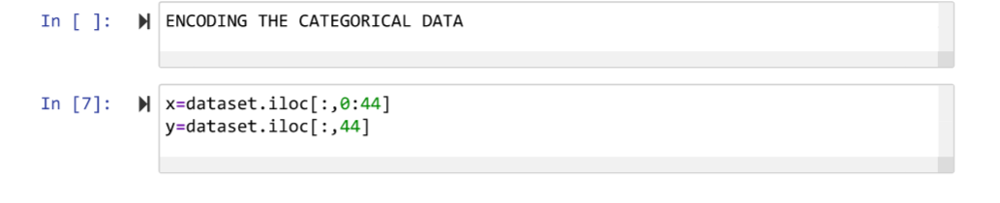
Encoding the categorical data
x=dataset.iloc[:,0:44]
y=dataset.iloc[:,44]

Slide 21
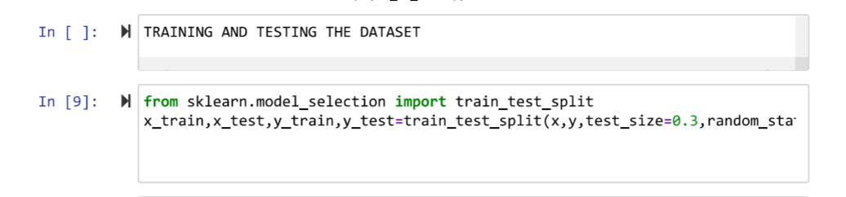
Splitting into Training and Testing data
from sklearn.model_selection import train_test_split
x_train,x_test,y_train,y_test=train_test_split(x,y,test_size=0.3,random_state=1)

Slide 22
Scaling the training and testing data
from sklearn.preprocessing import StandardScaler
sc=StandardScaler()
x_train=sc.fit_transform(x_train)
x_test=sc.transform(x_test)

Slide 23
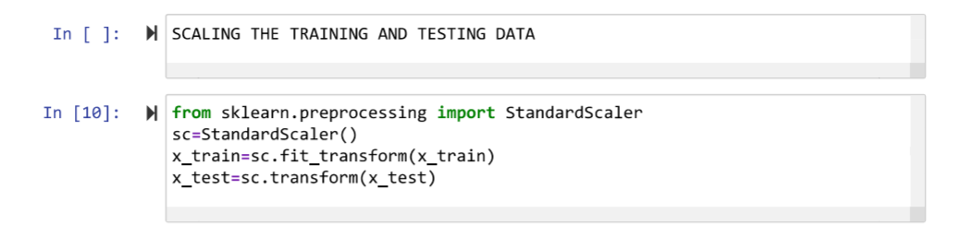

Slide 24
Applying Logistic Regression Algorithm
from sklearn.Linear_model import LogisticRegression
reg=LogisticRegression()
reg.fit(x_train,y_train)
pred_logistic_reg=reg.predict(x_test)

Slide 25
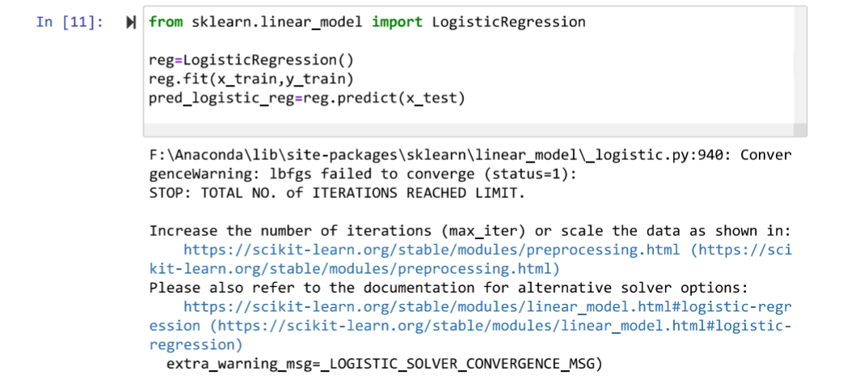

Slide 26
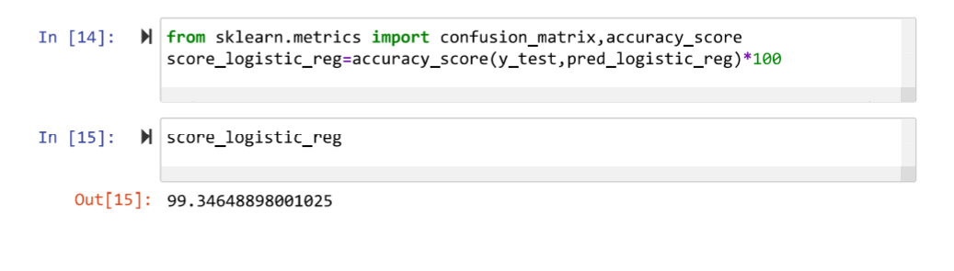
Calculating accuracy of Logistic Regression
from sklearn.metrics import confusion_matrix,accuracy_score
score_logistic_reg=accuracy_score(y_test,pred_logistic_reg)*100

Slide 27
Applying Decision Tree Classifier Algorithm and its accuracy score
from sklearn.tree import DecisionTreeClassifier
classifier=DecisionTreeClassifier(criterion='entropy',random_state=0)
classifier.fit(x_train,y_train)
y_pred_decision_tree=classifier.predict(x_test)
score_decision_tree=accuracy_score(y_test,y_pred_decision_tree)**100

Slide 28
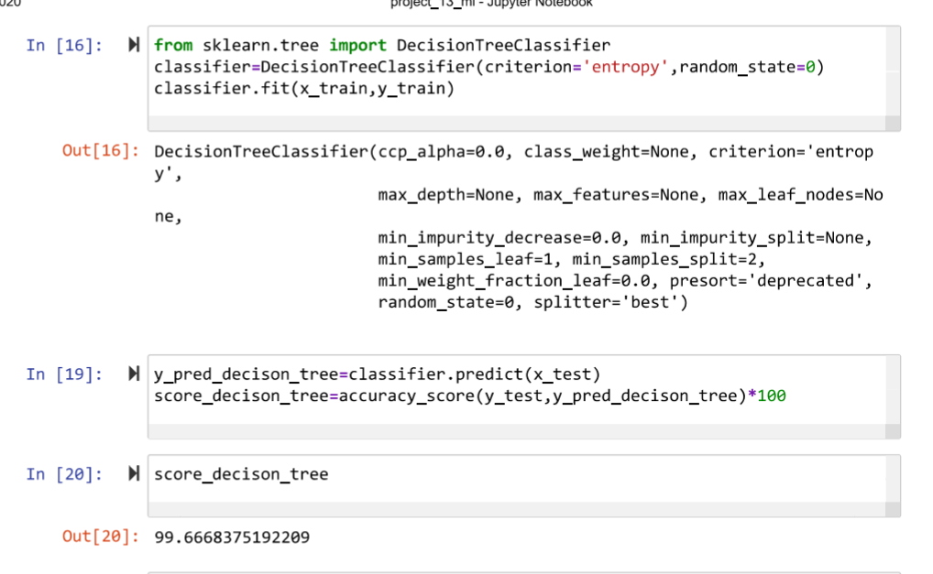

Slide 29
Applying Random Forest Classifier Algorithm
from sklearn.ensemble import RandomForestClassifier
rfclassifier=RandomForestClassifier(n_estimators=10,criterion='entropy',random_state=0)
rfclassifier.fit(x_train,y_train)
y_pred_random_forest=rfclassifier.predict(x_test)
score_random_forest=accuracy_score(y_test,y_pred_random_forest)

Slide 30
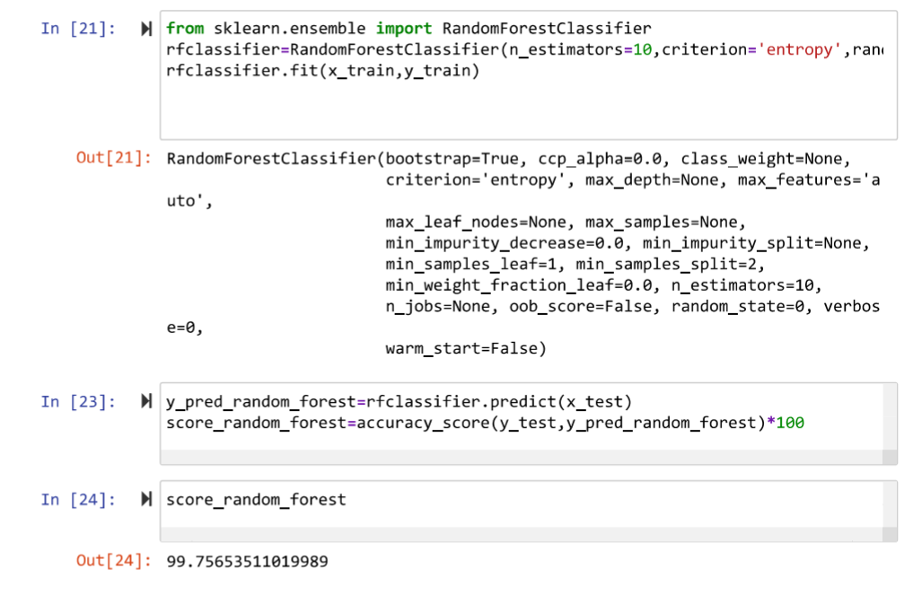

Slide 31
Applying k neighbors Algorithm
from sklearn.neighbors import KNeighborsClassifier
knn=KNeighborsClassifier(n_neighbors=5)
knn.fit(x_train,y_train)
y_pred_knn=knn.predict(x_test)
score_knn=accuracy_score(y_test,y_pred_knn)*100

Slide 32
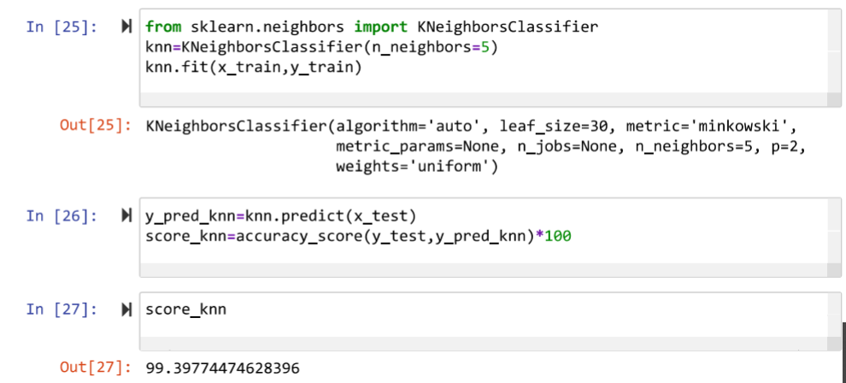

Slide 33
Applying Gaussion NB Algorithm
from sklearn.naivebayes import GaussianNB
model=GaussianNB()
model.fit(x_train,y_train)
y_pred_naive_bayes=model.fit(x_test)
score_naive_bayes=accuracy_score(y_test,y_pred_naive_bayes)

Slide 34
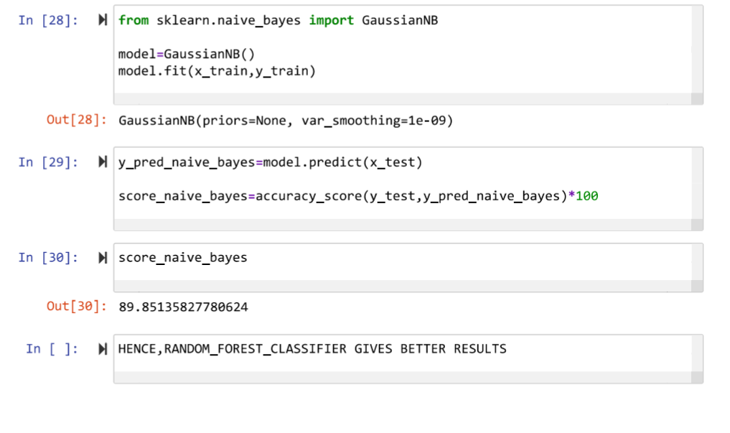

Slide 35
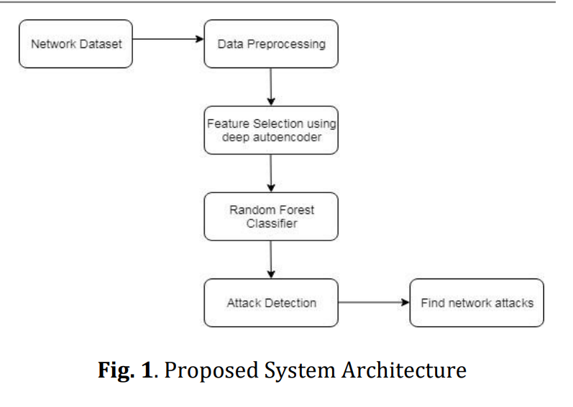
SYSTEM DESIGN
Architectural design

Slide 36
The Proposed system consists of mainly three steps. In this section, we discuss each step in detail. 1. Data Preprocessing: This phase is made up of preprocessing, normalization and transformation. a) Preprocessing Neural network-based classification only uses numerical values for training and testing.dataset consists of different data types. Hence a preprocessing stage is needed to convert the nonnumerical values to numerical values.
Two main tasks in pre-processing are:
1) Converting the non-numerical features in the dataset to numerical values.
2) Convert the attack types into its numeric categories b) Normalization

Slide 37
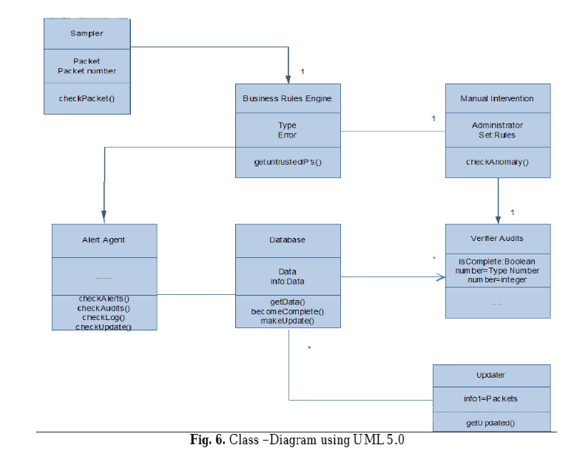
UML DIAGRAM

Slide 38
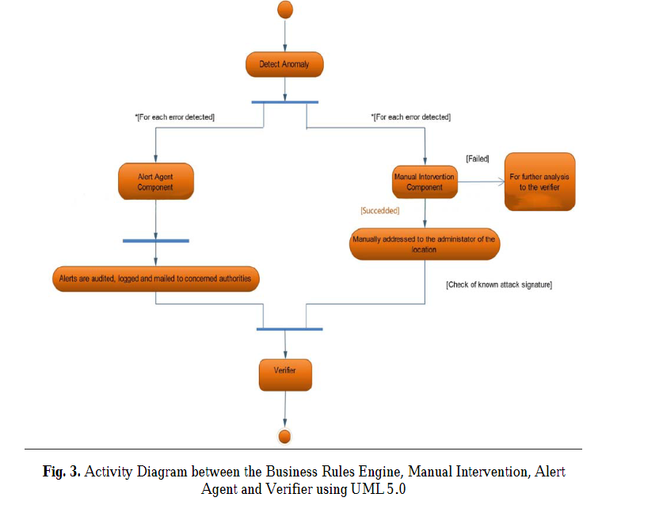
Activity diagram

Slide 39
EXPEREINCE
The overall environment of the online class room was pleasant and joyful.
The lab work was quite useful and helped us in gaining the inputs to build our project.
We had a great time with our fellow members and learnt a lot from them.

Slide 40
CONCLUSION
The internship was very knowledgable and interesting.
We gained the knowledge of machine learning and its application in Real Time.
For the above dataset Random Forest Classifier is the best algorithm because it was having higher accurcy of 99.7%
By using machine learning we are able to predict whether there is any malicious attack or not.
It was very helpful for us.

Slide 41
BIBLIOGRAPHY
https://archive.ics.uci.edu/ml/machine-learning-databases/kddcup99-mld/
https://scikit-learn.org/stable about the machine learning techniques we used scikit learn.
www.wikipedia.com

Slide 42
THANK YOU
We take this opportunity to express our profound gratitude and deep regards to our external guide Naveen kumar C (Project Lead),OrbitShifters Pvt.Ltd, for valuable information and guidance.
We are obliged to trainers at GoalStreet, Tarnaka Hyd, for the valuable information provided by them in their respective fields. We are grateful for their cooperation during the period of our internship.

