Slide 1
Old Photo Restoration using Deep Latent Space Translation
Group Members
Project Guide Gundla Kavya (18311A05T3)
Dr.K.Basavaraju Chityala Udhay (18311A05R4)
Rishabh Semwal (18311A05W2)

Slide 2
Abstract
To restore old photos that suffer from severe degradation through a deep learning approach. Unlike conventional restoration tasks that can be solved through supervised learning, the degradation in real photos is complex and the domain gap between synthetic images and real old photos makes the network fail to generalize. Therefore, a novel triplet domain translation network is used by leveraging real photos along with massive synthetic image pairs. Specifically, we train two variational autoencoders (VAEs) to respectively transform old photos and clean photos into two latent spaces. And the translation between these two latent spaces is learned with synthetic paired data. This translation generalizes well to real photos because the domain gap is closed in the compact latent space. Besides, to address multiple degradations mixed in one old photo, we design a global branch with a partial nonlocal block targeting to the structured defects, such as scratches and dust spots, and a local branch targeting to the unstructured defects, such as noises and blurriness. Two branches are fused in the latent space, leading to improved capability to restore old photos from multiple defects. Furthermore, we apply another face refinement network to recover fine details of faces in the old photos, thus ultimately generating photos with enhanced perceptual quality. With comprehensive experiments, the proposed pipeline demonstrates superior performance over state-of-the-art methods as well as existing commercial tools in terms of visual quality for old photos restoration.

Slide 3
Objective
The main concern of this project is to solve the gap between data and the real old vintage photos, It comes with a new method called triplet domain translation network. More specifically, trained two variational autoencoders(VAEs) to transform and clean old photos into two latent spaces. And the translation between these latent spaces is learned with synthetic paired data. So that leaned network can generalize well to real photos.
Designed for global branch with partial non-block targeting to structured defects, like scratch and dust spots.
For targeting the unstructured detects like noise and blurriness in photos, another local branch is designed.
These Two branches are fused in the latent space, which leads to improved capability and more accuracy to restore old photos from multiple defects.

Slide 4
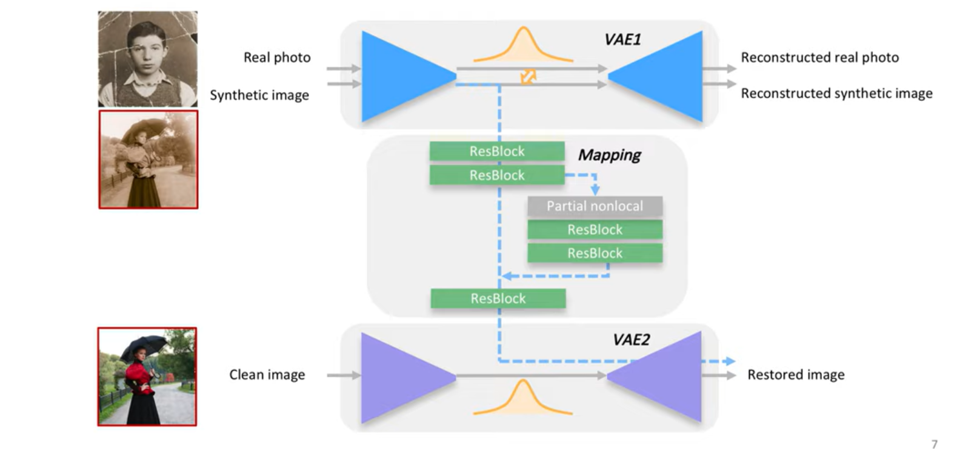

Slide 5
The framework is trained on two VAEs(variational autoencoders):
VAE1 is trained for images in real photos r ∈ R and synthetic images x ∈ X,
and VAE2 is trained for clean images y ∈ Y.
With VAEs, images are transformed to compact latent space. Then, the mapping restores the corrupted(blurry, noise, damaged) images to clean ones in the latent space with a partial non-local block.
There’s one last step in order to produce even better results since the main purpose is to restore the faces, so a face refinement network is added to recover fine details of the faces.

Slide 6
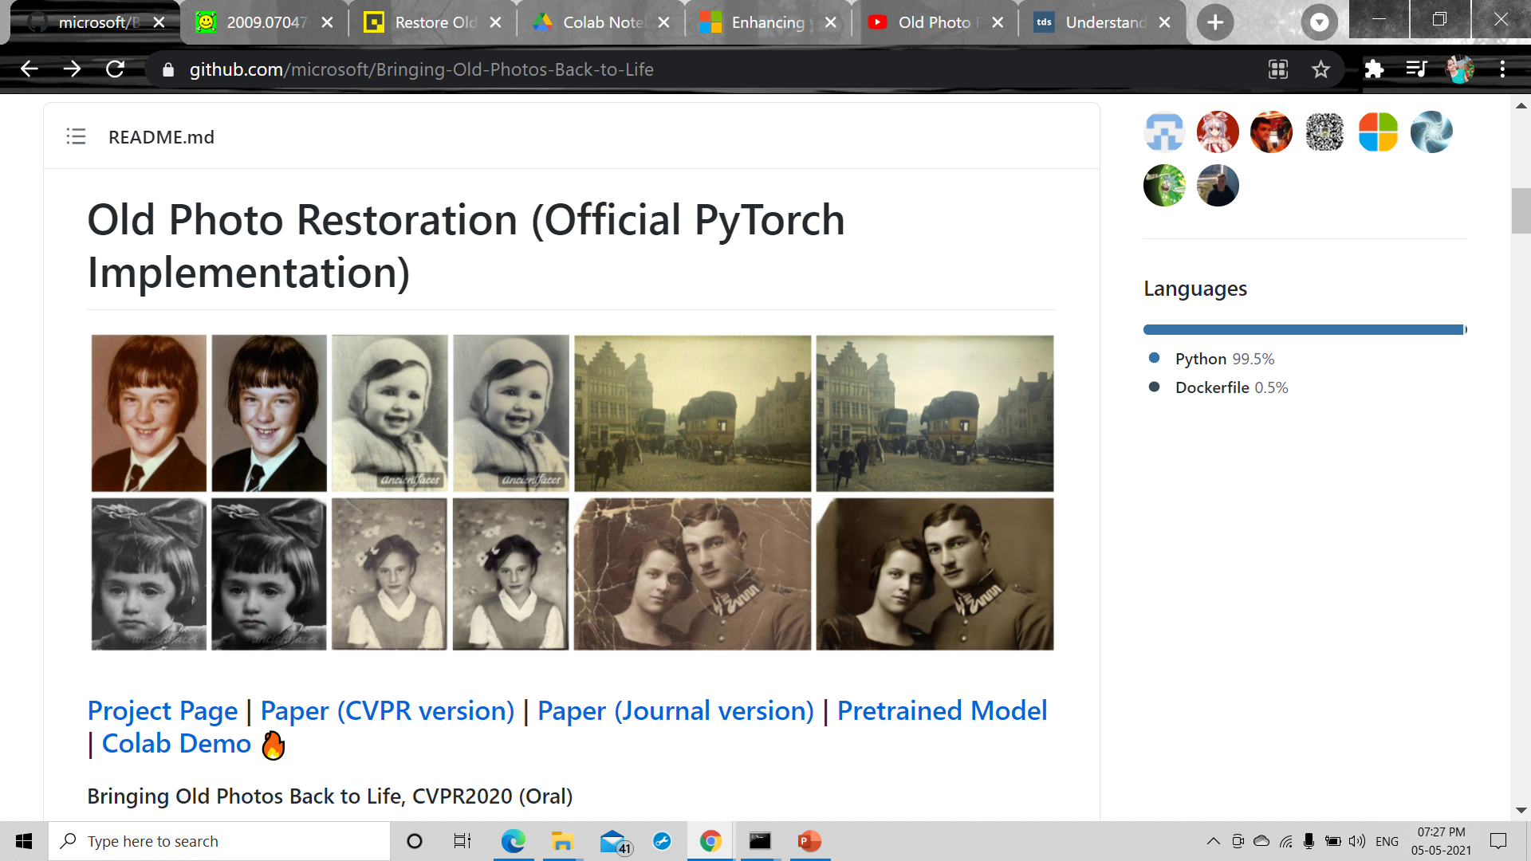
THANK YOU

