Slide 1
ONLINE NEWS PORTAL SYSTEM
NAKKA SATISH KUMAR(18311A05V2)
UDHAY CHITYALA(18311A05R4)

Slide 2
Abstract
•The purpose of Online News Portal is to automate the existing manual system by
the help of computerized equipments and full-fledged computer software, fulfilling their
requirements, so that their valuable data/information can be stored for a longer period
with easy accessing and manipulation of the same. The required software and hardware
are easily available and easy to work with.
•Online News Portal, as described above, can lead to error free, secure, reliable
and fast management system. It can assist the user to concentrate on their other
activities rather to concentrate on the record keeping. Thus it will help organization in
better utilization of resources. The organization can maintain computerized records
without redundant entries. That means that one need not be distracted by information
that is not relevant, while being able to reach the information.

Slide 3
Introduction
•Now-a-days we live in age of Information Communication and Technology . We can’t think a single moment without technology.
•From morning to night, we need help of the technology. This is the revolutionary time of computer technology.
•Most of the works depends on web application. For this reason, anytime, anywhere, anyone can access a website by internet at low cost and we can find our expectable and most update information from website. At present information is one the most valuable resource of the current world. We have developed our project so that we can aware the people.

Slide 4
.
The objective of this project is to develop a web application for Online News Paper
website that can aware the people. The objective of this project is to provide the daily news.
* The objective of this project is to provide the breaking news.
* It makes use of various technologies to get required crime oriented information more
quickly, easily, colorfully and attractively.
* To do this for more widely coverage of distribution and faster dissemination of
information in a more timely manner.
* Anytime, anywhere, anyone can know about the news or information by internet at
low cost.
* Dynamically provides facility.
* To add any new information without any complexity.

Slide 5
.
EXISTING SYSTEM:
❑ In the present system a customer has to approach various agencies to find the news portal to read news online.
❑ This often requires a lot of time and effort.
❑ A customer may not get the desired information from these offices and often the customer may be misguided.
❑ It is tedious for a customer to plan a particular News and have it executed properly.
PROPOSED SYSTEM:
❑ The proposed system is a web based application and maintains a centralized repository of all related information.
❑ The system allows one to easily access the relevant information and make necessary online news arrangements.
❑ Users can read news online want to visit and read the specific they want according to their interests.

Slide 6
.
Software Requirements:
Operating System – Windows10
Language used–php
Database:mysql
Software:xampp
Web browser:Google Chrome
Hardware Requirements:
RAM – 8GB
Processor – intel i5

Slide 7
FUNCTIONAL REQUIREMENTS:
Number of Modules
After careful analysis the system has been identified to have the following modules:
1. Admin module
2. User module
3.Sub-admin module
1.ADMINISTRATOR MODULE:
Secure admin login system
Admin Dashboard: In this section admin can view, listed categories & sub categories, total published news & trashed news.
Sub-admin: In this section, admin can add/edit/delete sub-admin. Category – In this section admin can add/update/delete the category. Admin can also restore
deleted category.
Sub- Category – In this section admin can add/update/delete the Subcategory. Admin can
also restore deleted Subcategory.

Slide 8
.
Post – Admin can add /update / delete news posts. admin can also view deleted news post in trash post section and restore deleted posts.
Pages – Admin can manage the contact of about us and contact us page.
Comments – Admin can approve/ unapproved / delete reader comments.
Signup- Admin can register your self for bookig. Sign in- Here Admin can login with valid username and password. Forgot Password—Admin can recover his/her own password. Change Password---- Admin can own Password.mments

Slide 9
.
2• SUB-ADMIN MODULE Sub-Admin and Admin features are the same except Sub-Admin creation. Sub-Admin can’t create the Sub-Admins.
3.USER MODULE:
Anyone can read the news and also search for particular news. The reader can leave comments on the particular news.

Slide 10
Implementation
The data in the system has to be stored and retrieved from database. Designing the database is part of system design. Data elements and data structures to be stored have been identified at analysis stage. They are structured and put together to design the data storage and retrieval system.
A database is a collection of interrelated data stored with minimum redundancy to serve many users quickly and efficiently. The general objective is to make database access easy, quick, inexpensive and flexible for the user. Relationships are established between the data items and unnecessary data items are removed. Normalization is done to get an internal consistency of data and to have minimum redundancy and maximum stability. This ensures minimizing data storage required, minimizing chances of data inconsistencies and optimizing for updates. The MySQL database has been chosen for developing the relevant databases.

Slide 11
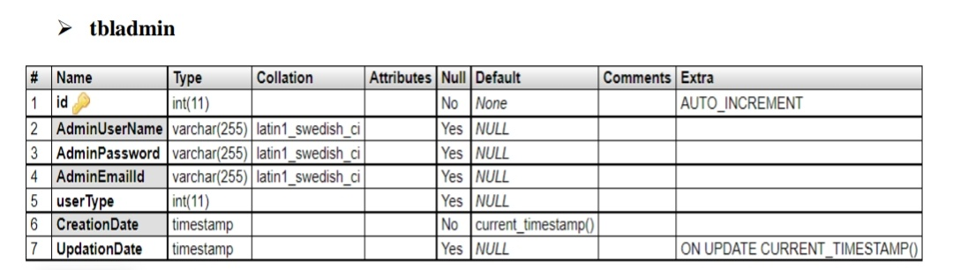
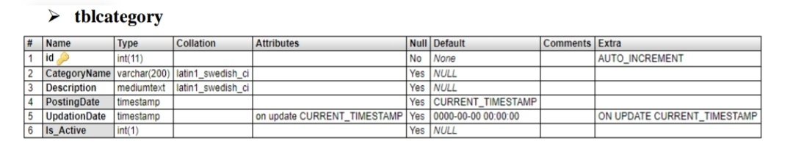
Database tables and Structure

Slide 12
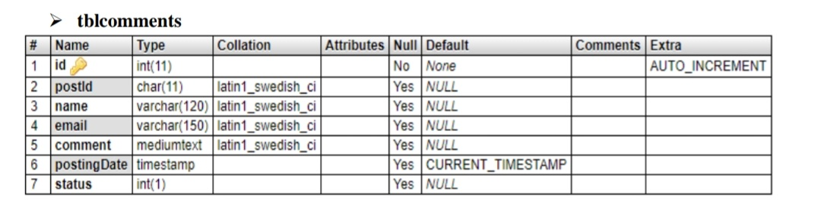
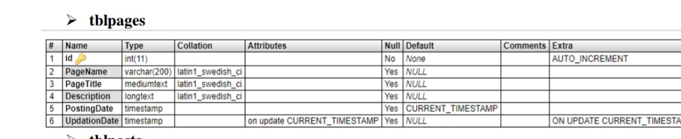

Slide 13
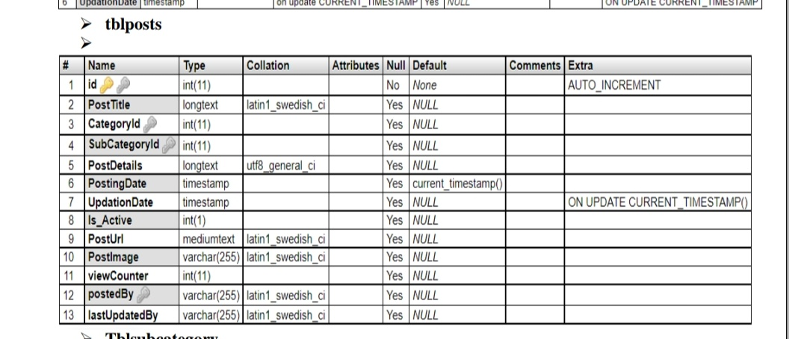

Slide 14
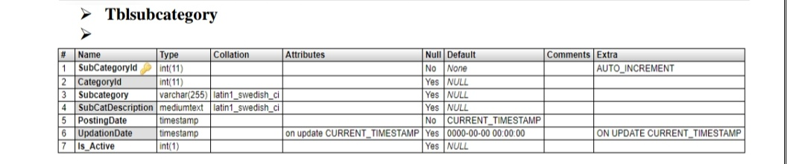

Slide 15
Implimentation steps:
Create a folder(Online-News-Portal-System-using-PHP-MySQL-ONPS) which has the all input code files and input images.
Copy the folder and tms folder inside root directory(xampp/htdocs)
open phpmyadmin
create database tms
import database tms.sql (from the Online-News-portal-System-using-PHP-MySQL-ONPS folder)

Slide 16
.
run the script http://localhost/newsportal (frontend)
For admin panel http://localhost/newsporta/admin credential for admin panel : usernam: admin Password : Test@123 credential for Sub-admin panel : username: subadmin Password : Test@123

Slide 17
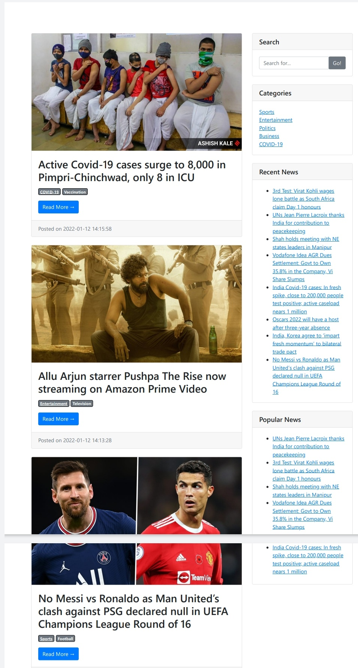
outputs

Slide 18
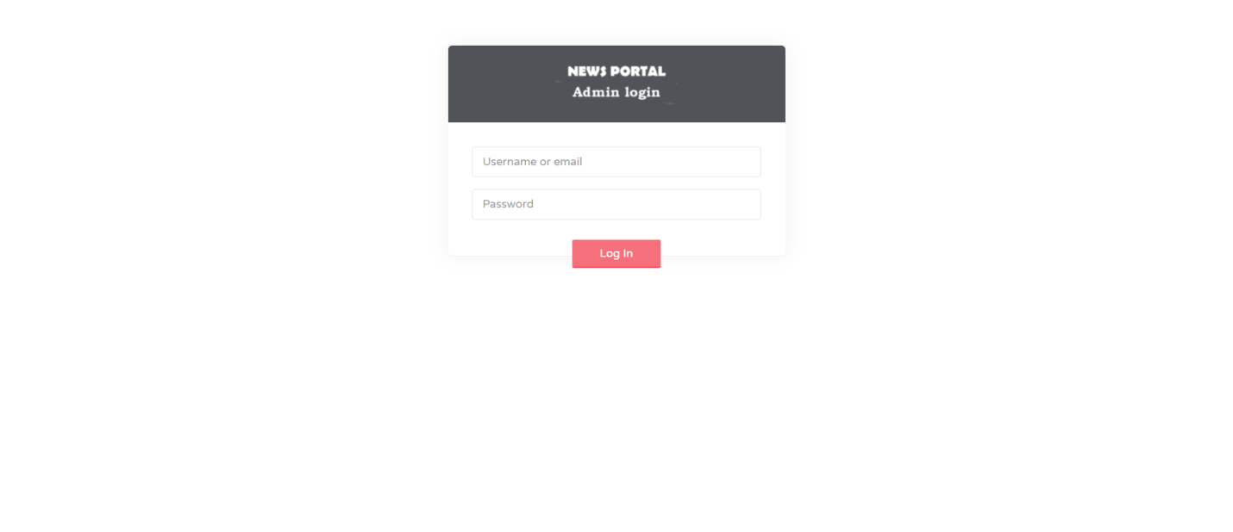
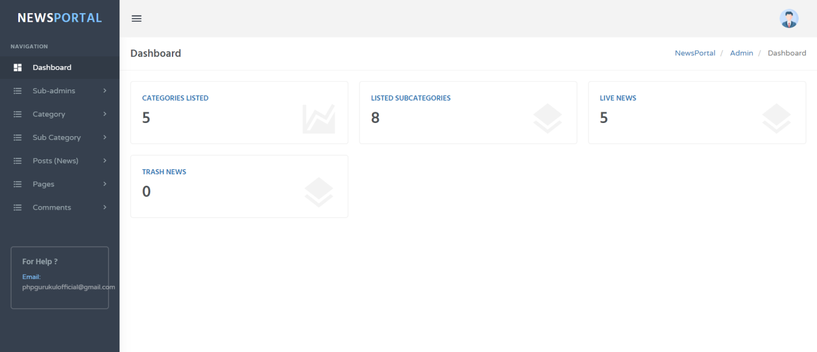
.

Slide 19
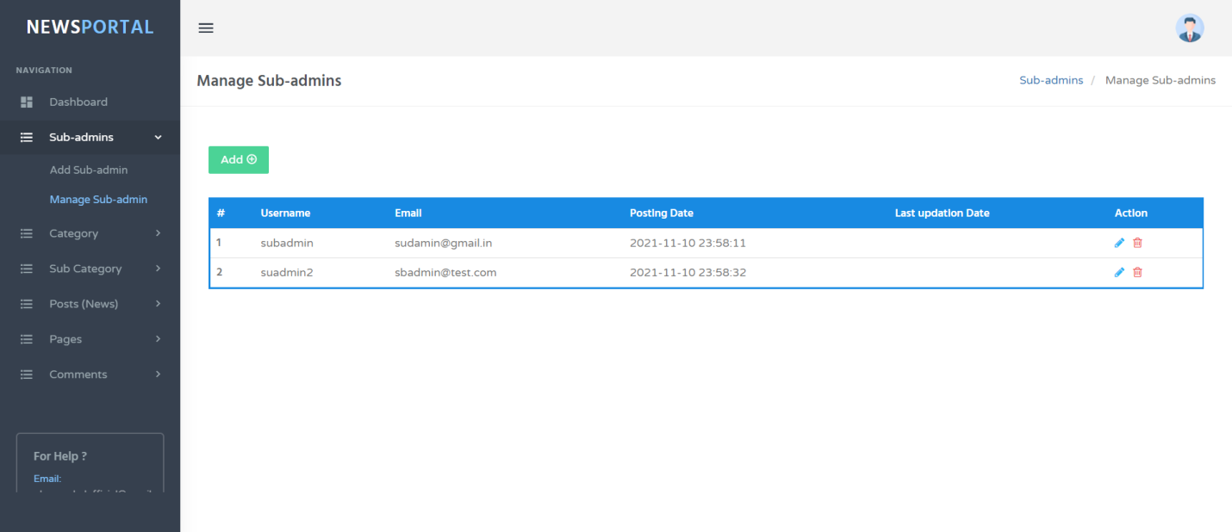
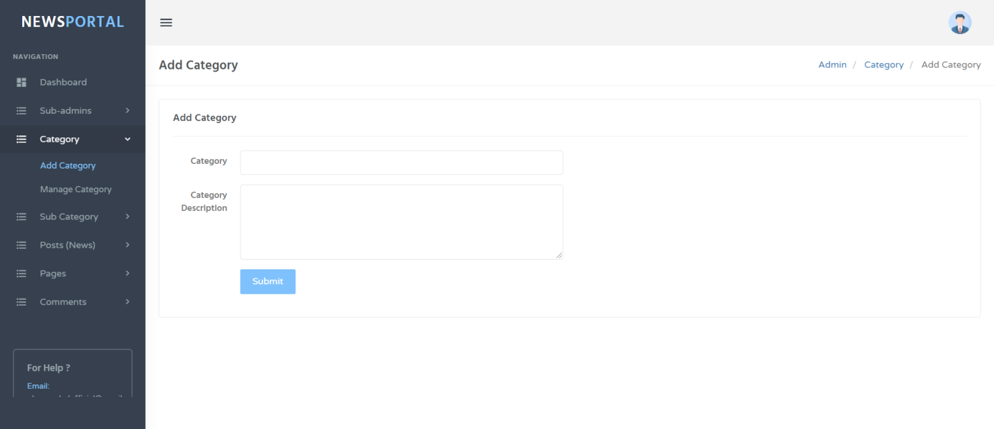
.

Slide 20
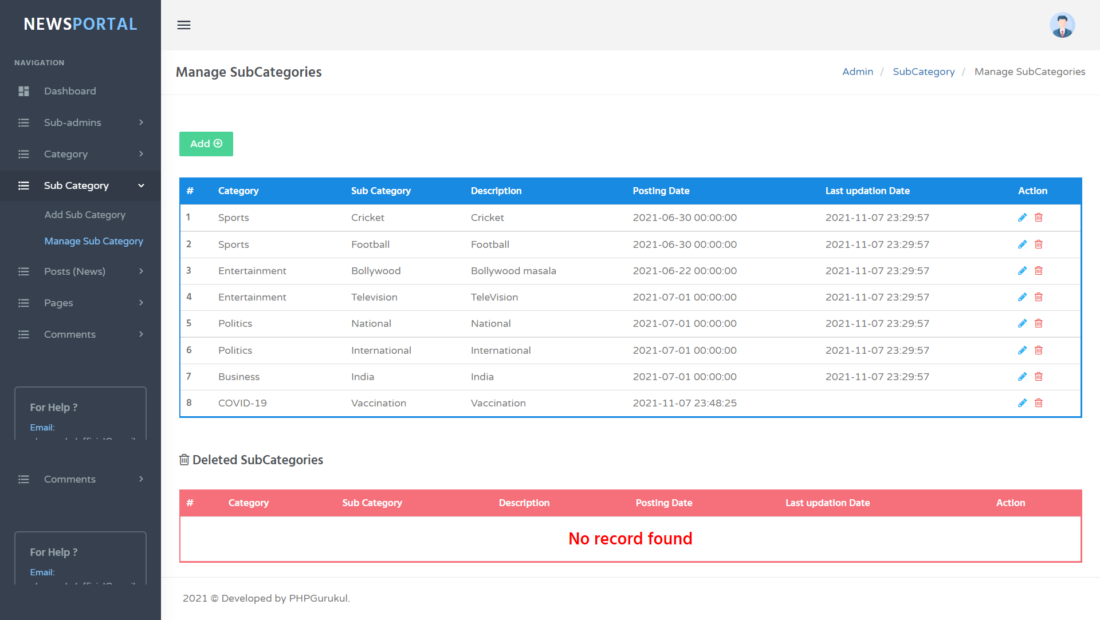
.

Slide 21
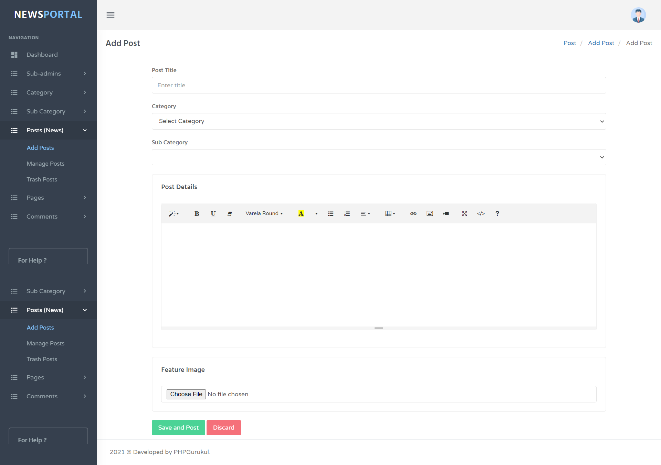
.

Slide 22
Conclusion
In our project work, an attempt has been made to develop News or information based web site.
We develop this project that helps the people and make them aware so that they can know any news. To establish this website we use various methodologies. To develop this project we have faced many problem but we hardly tried to develop this project. Our supervisor helps us by giving his valuable opinion, decision and time.

Slide 23
.
Future scope
The future scope of our project is valuable. Our project time duration was only one years .In this time interval we developed our project. It was very difficult to complete project within this time duration. In future if we get chance we will develop this website for large volume.
As for other future developments, the following can be done:
We will manage news reporting system.
We can make video conferencing system.
We update our database.
Sensibility level could add be added.

Slide 24
References
For PHP
https://www.w3schools.com/php/default.asp
https://www.sitepoint.com/php/
https://www.php.net/
For MySQL
https://www.mysql.com/
http://www.mysqltutorial.org
For XAMPP
https://www.apachefriends.org/download.html

