Slide 1

Quality Analysis and Classification of
Rice using Image Processing
18311A05R4-Chityala Udhay
18311A05W2-Rishabh Semwal
18311A05U5 -Krishna Goel

Slide 2
WE THANK OUR TEACHERS FOR MENTORING US DURING THE PROJECT
HOD OF THE DEPARTMENT-DR.ARUNA VARANASI
PROJECT COORDINATOR-MS.N SHIVANI
INTERNAL GUIDE-MR.GUGULOTHU RAVI

Slide 3
Abstract
Grain quality analysis is a huge challenge in agricultural industries. Internal control is critical in the food industry because food products are characterized and rated into various categories after quality data has been collected. Grain quality assessment is performed by hand, but the results are subjective, lengthy, and pricey. To overcome the limitations and drawbacks of image processing techniques, different resolutions are used for grain quality analysis. Using image processing techniques, this paper proposes a method for grading and analyzing rice based on grain size and form. An edge detection algorithmic software is used in particular to determine the area of each grain's borders. we discover the endpoints of each grain using this technique.

Slide 4
Introduction
Rice is favourable and high consumed cereal grain in Asian countries. It can be easily found all over the world. Many values added products are produced by using rice for human beings. In the rice market, key determinant of milled rice is quality. The quality measurement becomes more important with the import and export trade. Rice samples contain different dispensable objects like paddy, chaff, damaged grains, weed seeds, stones etc. Rice quality is varying according to these impurity content.
The main purpose of the proposed method is, to offer an alternative way for quality control and analysis which reduce the required effort, cost and time. Image processing is significant and advanced technological area where important developments have been made.

Slide 5
OBJECTIVE
Use of image processing algorithms to analyse grains quality by its size. To analysis and classify the quality of rice grains.
The proposed method’s primary goal is to provide an alternative solution for quality analysis that reduces the required time and cost. Image processing is a vital and advanced technological field that has seen significant advancement. Attempts are underway to replace the traditional human sensory panel.

Slide 6
Existing System
Frame works like R, Numpy, pandas exist to preprocess the data using the environments like Rstudio, Jupyter notebook, anaconda which requires programming skills and frame work knowledge.
Python
Python Flask

Slide 7
Proposed System
Use of image processing algorithms to analyse grains quality by its size. To analysis and classify the quality of rice grains.
The image processing technique is used for counting the number of rice seeds and classifies them on the basis of length, breadth and length - breadth ratio.
Length is the average length of rice grain while breadth is the average breadth of rice grain and length-breadth ratio is calculated as: L/B = [(Average length of rice grain)/(average breadth of rice)]*10.
In first pre-processing step image registration takes place and noise is removed from the image by using filter.
Shrinkage algorithm used for segmenting the touching kernels which is second step.
In third step we perform edge detection to find out the region of boundaries.
In fourth step rice seed measurement is done and in the same step length, breadth and length-breadth is also measured.
In the fifth step of the algorithm rice is classified according to its size and shape.

Slide 8
Requirements
Software Requirements:
OS : windows / mac / linux
Browser : chrome / safari / edge / firefox
Frame works: pandas, numpy, flask
Hardware Requirements:
RAM: 16GB DDR4
Hard Disk: 256GB ssd drive.
Processor: i5 / i7 /i9 take latest version.
Graphics: Media latest version.

Slide 9
SYSTEM ARCHITECTURE
Rice Granule Image
Image Acquisition and Pre-processing
Morphological Operations
Edge detection
Object classification
Quality Analysis

Slide 10

Use case diagram
Load image
Install & import libraries
Image acquisition
Image processing
Python libraries
Segmentation
user
Feature extraction
System
classification

Slide 11
Class diagram
User
-Input Image
+Import libraries()
System
+Image acquisition() +Image processing() +Segmentation() +Feature extraction() +Classification()
Libraries
+Install libraries()

Slide 12
Activity diagram
User | System | Libraries
Image acquisition
Image processing
Import libraries
Install libraries
Segmentation
Feature extraction
Input Image
Classification

Slide 13
Sequence diagram
User
Libraries
System
Input Image
Image acquisition
Import & install libraries
Image processing
Segmentation
Feature extraction
classification

Slide 14
Methods Used
Image pre-processing
Filter is applied to remove noise which occurs during the acquisition of image. Filter also sharpens the image. Threshold algorithm is used to segment the rice grains from the black background.
Shrinkage morphological operation
Erosion is applied to separate the touching features of rice grains without losing the integrity of single feature. Dilation process follows erosion process. The goal of dilation is to grow the eroded features to their original shape without re-joining the separated features.
Edge detection
Edge detection helps to find out the region of boundaries of rice grains. We use sobel algorithm to detect the edges.

Slide 15
Object measurement
Measurement indicates the count of rice grains. After getting the count of rice grains, edge detection algorithms applied on the image and outcome of the applied algorithm is we get endpoint values of each grain. We use calliper to join the endpoints and measure the value of length and breadth of each grain. After getting the value of length and breadth we can calculate length-breadth ratio.
Object classification
Classification requires all standard, measured and calculated results. The standard database for rice size and shape measurement is referred from laboratory manual on rice grain quality, Directorate of Rice Research, Rajendra nagar, Hyderabad. The classification of rice grains as per the standard database is shown in following tables.

Slide 16
Table below indicates classification of rice grains on the basis of length and length- breadth ratio:
SLENDER | Aspect ratio>=3 and aspect ratio<3.5
MEDIUM | Aspect ratio>=2.1 and aspect ratio<3
BOLD | Aspect ratio>=1.1 and aspect ratio<2.1
ROUND | Aspect ratio>=0.9 and aspect ratio<1
DUST | Aspect ratio>3.5 and aspect ratio<0.8

Slide 17
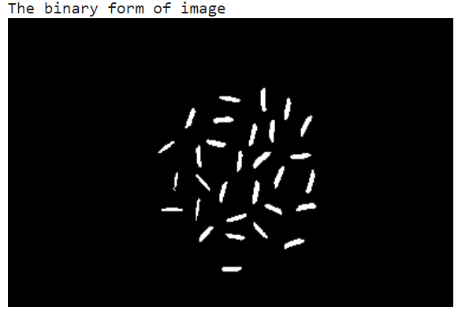
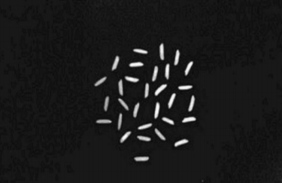
Project demonstration
Input image

Slide 18
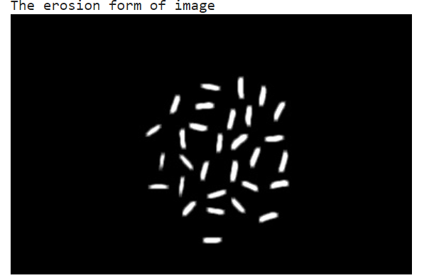
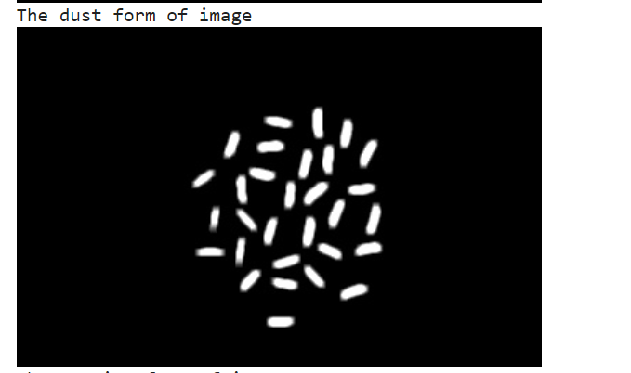
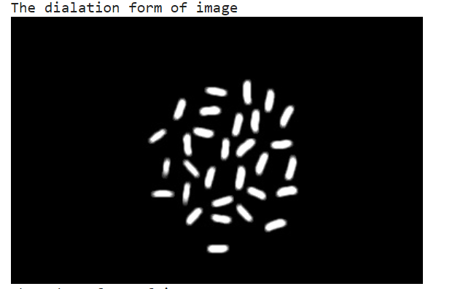
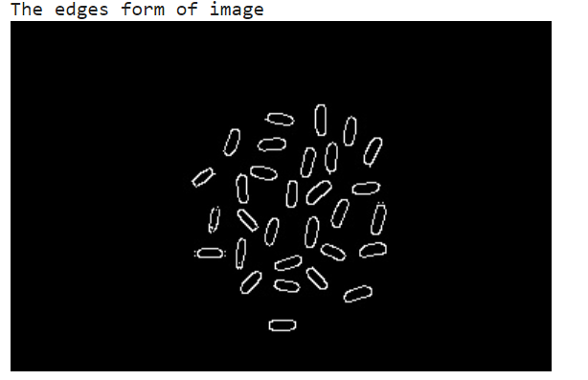

Slide 19
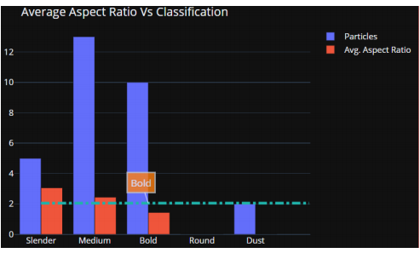
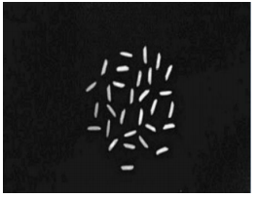
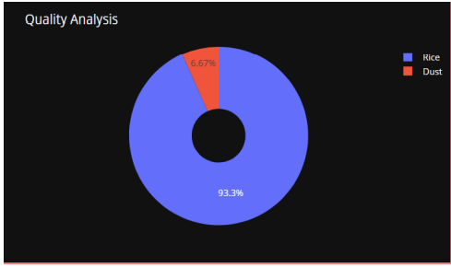
Comparision
S.no | INPUT | OUTPUT
1

Slide 20
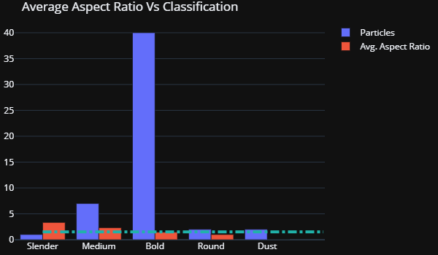
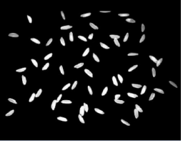
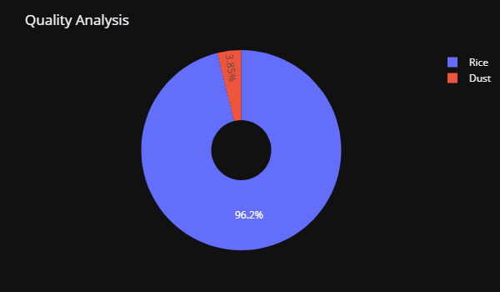
S.no | INPUT | OUTPUT
2

Slide 21
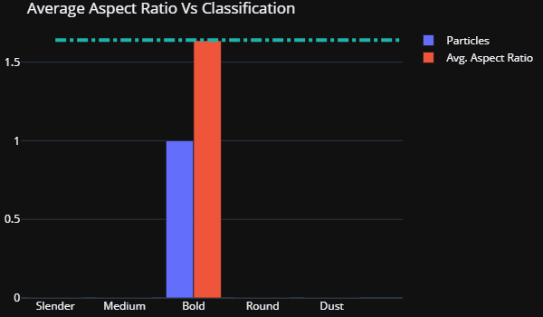
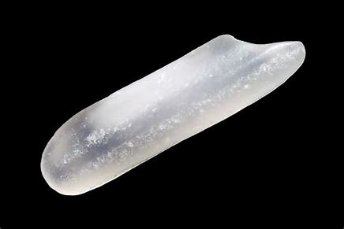
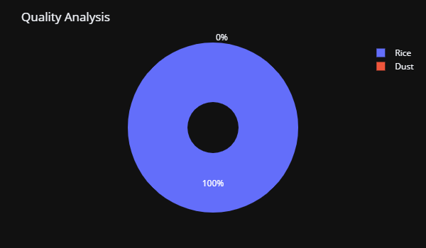
S.no | INPUT | OUTPUT
3

Slide 22
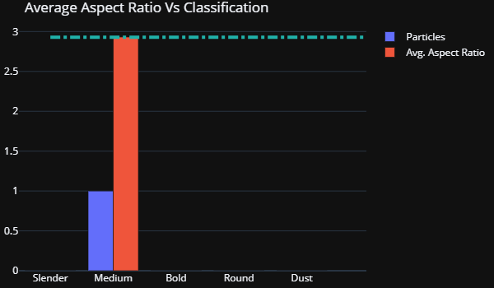
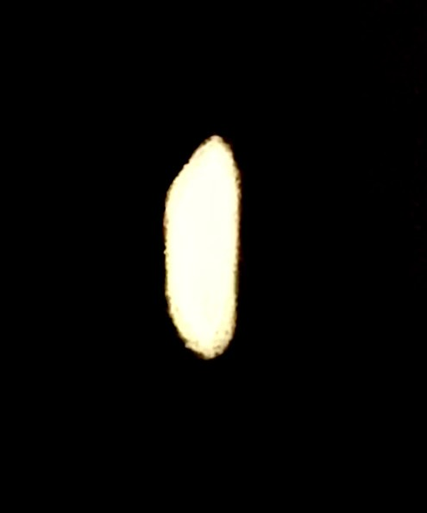
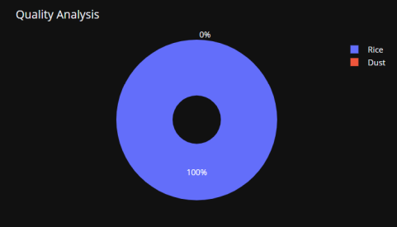
S.no | INPUT | OUTPUT
4
S.no
INPUT
OU

Slide 23
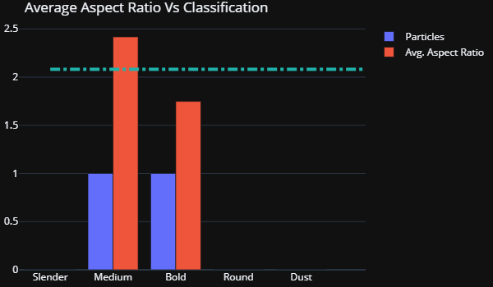

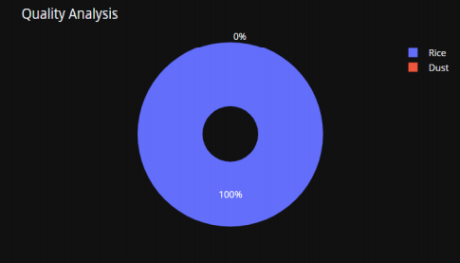
S.no | INPUT | OUTPUT
5

Slide 24
Grouped Bar chart – Used for Classification purpose
Blue Bar indicates the Number of Rice grains.
Red Bar indicates Average Aspect Ratio.
Pie chart – Used for Quality Analysis purpose
Blue Section indicates percentage of Rice grains in the given sample
Red Section indicates percentage of Dust in the given sample.

Slide 25
Conclusion
In this project, we are classifying the rice grain sample taken into various categories and also analysing its quality based on its aspect ratio, so it is not possible to compare with other works. Existing works only detect the rice grains, or calculate number of rice grains in the given sample but our work helps to analyse the quality of rice sample and classify them into particular category.
Quality of grains in the samples should be nearly 100% accurate and it should be suitable to grade large quality of grains efficiently, which otherwise will consume lot of time in manual analysis, this feature will be able to save lot of time & human effort

Slide 26
Future Scope
The majority of quality analysis factors must be measured using image processing techniques. This research could be expanded to develop a method for identifying granules based on any attribute that can be used to improve rice quality. The cost of such a system should be low, as should the time spent on quality analysis.

Slide 27
References
“Laboratory Manual on Rice Grain Quality”, Directorate of Rice Research, Rajendranagar, Hyderabad, September 2013.
Mahale, Bhagyashree, and Sapana Korde. "Rice quality analysis using image processing techniques." International Conference for Convergence for Technology-2014. IEEE, 2014.
Ali, S.F., Jamil, H., Jamil, R., Torij, I. and Naz, S., 2017, November. “Lowcost solution for rice quality analysis using morphological parameters and its comparison with standard measurements”. In 2017 International Multi-topic Conference (INMIC) (pp. 1-6). IEEE.
“Documentation Python”. Online: https://www.python.org/doc/
“Documentation Open CV”. Online: https://opencv.org/about/
IBPGR-IRRI Rice Advisory Committee, “Descriptors for Rice Oryza Sativa L”. International Rice Research Institute and International Board for Plant Genetic Resources, 2020.
Divya Mohan, M.Raj., Semanticscholar 2016, ”Quality Analysis of rice grain using ANN and SVM”

Slide 28
THANK YOU

