Slide 1
A Comparison of Clustering Measures on Raw Signals of Welding Production Data
Ch.Udhay
18311A05R4
CSE-E

Slide 2
aBstract
Production data from industries today have a heterogeneous structure, which makes it difﬁcult to analyze and derive some viable inferences. Because of the varying pattern of data, whether labeled or unlabeled, numerical or categorical , any strict standard or optimization procedure using production data is a difﬁcult task. Applying machine learning (ML) algorithms to analyze production data has therefore become an essential requirement for industries. In this study, production data obtained from welding seams is used. We analyze raw signals of electrical current and voltage in the form of arrays obtained from welding processes by applying clustering algorithms. Each process is represented by a group number in the procured data and the corresponding welds of a group are divided into optimal number of clusters on the basis of results given by metrics such as Silhouette Scores and Adjusted Rand’s Index. As a validation of the metrics, we use Davies-Bouldin Index to compare and optimize our results. We conclude that a multi-clustering technique can be devised to proﬁle clusters of welding data using only current and voltage signals.

Slide 3
introduction
Seam welding is a resistance welding process, where two similar or dissimilar metals are joined using high current passing through electrodes connected to seam welding wheels to form continuous nugget in form of butt or overlapping welding components.
A properly welded joint formed by resistance welding can easily be stronger than the material from which it is formed.
As a result, its effective functioning is a crucial aspect in manufacturing and automotive industries.
we use current and voltage signals obtained from welding seams to detect closely knitted groups using K-Means and Hierarchical techniques
This study aims to simplify detection processes using only current and voltage signals of welding along with implementable clustering techniques from a data modeling point of view.

Slide 4
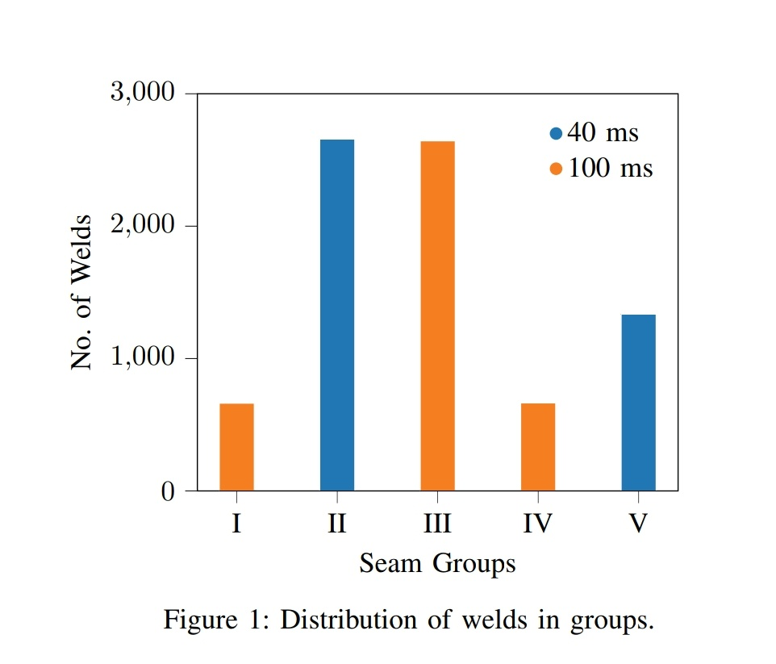
Challenges in clustering
Data clustering involves solving two main problems. The ﬁrst problem is deﬁning exactly what makes a good clustering of data. It includes the notion of deﬁning ’distance’ measure between the clusters since it is essential to know how far apart two clusterings of the same data are. The second problem is determining an effective technique to search through all possible combinations of clustering to ﬁnd the best clustering
In this study, we use K-Meanss and Hierarchical clusterings on each number of clusters and use the above mentioned metrics to determine the optimal clusterings

Slide 5
Overview of Data
A. Data Acquisition
The welding data used in this study was obtained from a manufacturing company located in Germany. Each weld was sampled at either 40 milliseconds or 100 milliseconds interval at a welding station which is fed with a program number defining the axis parameters.
B. Exploratory Analysis
Each weld comprises of current array, voltage array, sampling interval, seam group, program number as well as other variables. The length of current and voltage arrays of welds is non-uniform due to different processes, the minimum being 10 and the maximum 578 across the entire data. The welds are distributed exclusively into 5 groups, namely I, II, III, IV and V . Individual group analysis is essential to obtain patterns.

Slide 6
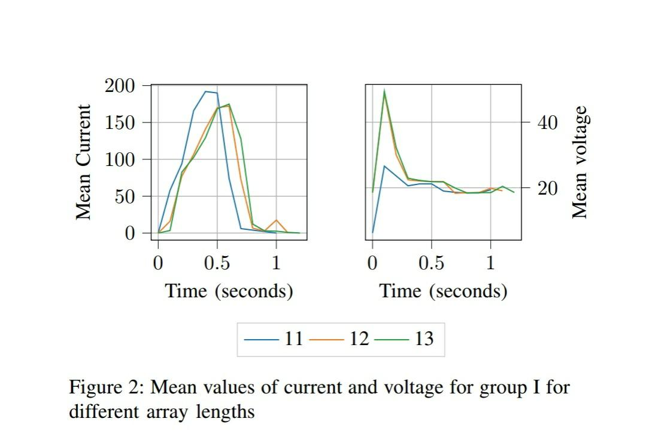
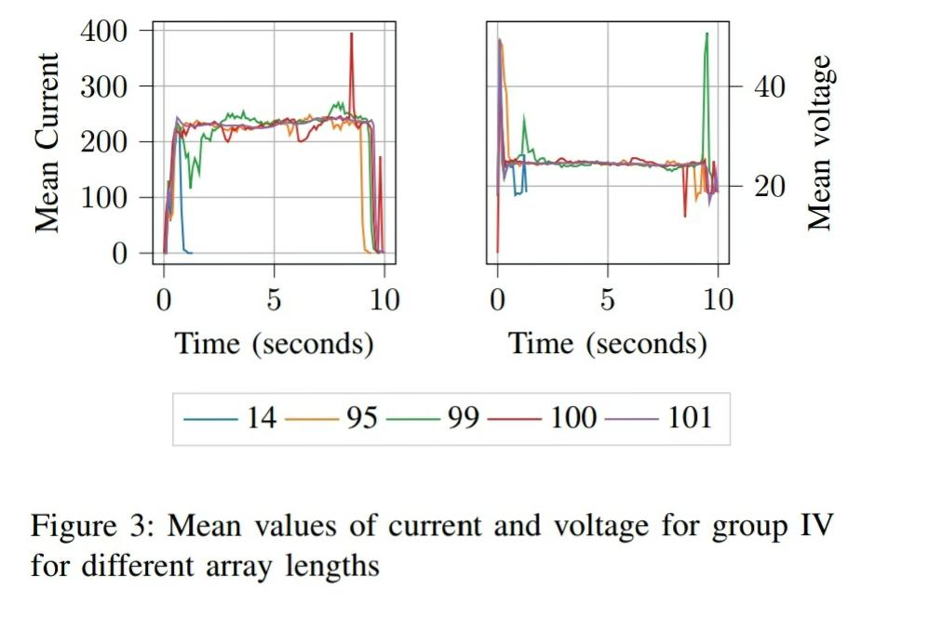

Slide 7
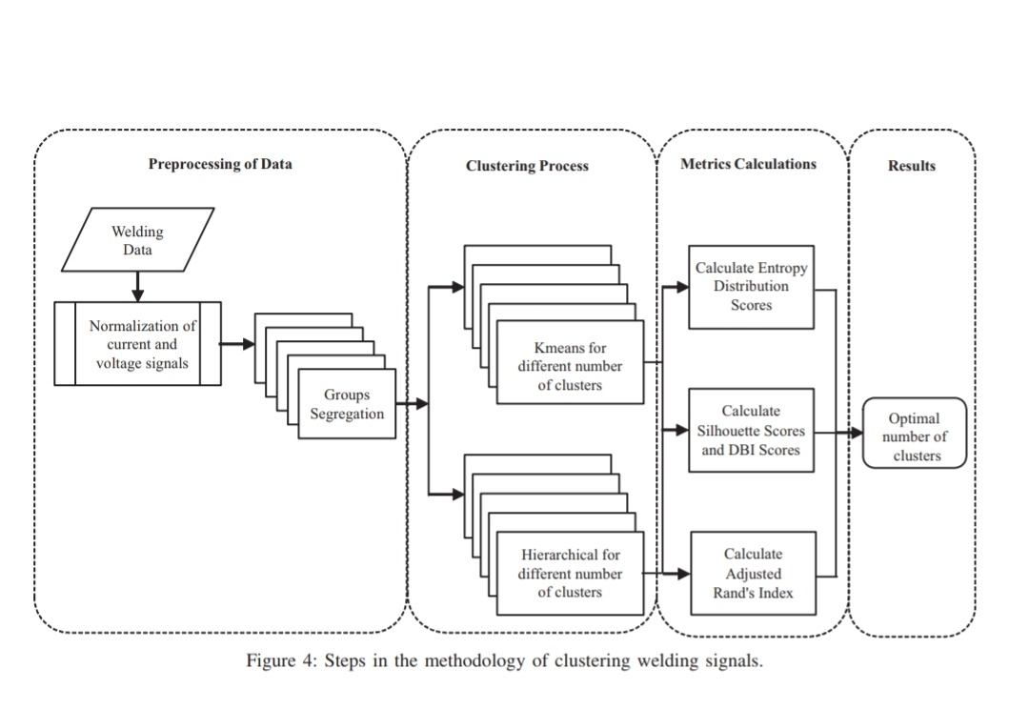
Methodology

Slide 8
A.Data Preprocessing
The approach to use clustering analysis on current and voltage arrays is as shown in Fig. 4. The input arrays are normalized using their l2 norms for analysis. For the purpose of uniformity, they are padded to the maximum length found in the entire data with zero values at the end of the arrays.
Hence, the data consists of a total of 1156 features, each representing a recorded value in either the current array or The voltage array. Further, the groups of welds are segregated As mentioned in Section III-B. Each group is clustered.

Slide 9
B. Clustering Algorithms
To solve a classification or a prediction problem, depending on the data, a correct application of ML methods is essential.
• K-Means (KM): This algorithm aims to partition observations into clusters in which each observation belongs to the cluster with the nearest mean, serving as a prototype of the cluster.
• Agglomerative (HC): Also known as Hierarchical clustering, initially each point is considered as a separate Cluster, then it recursively clusters the points together depending upon the distance between them.

Slide 10


C. Metrics for Evaluation
As discussed in Section II, to address the first problem of defining a criteria for good clustering, we use two main metrics for comparison:
*Entropy: This metric measures the amount of disorder
in a vector, and is calculated as follows
where X is the zero-indexed label vector having n
unique labels. Each xi of X has a probability measure

Slide 11

*Silhouette Score: It is a measure of how similar an object is to its own cluster. This is an internal validityindex, where score is computed from the clustered data itself. We use this score in algorithms to determine the best number of clusters after entropy minimization. Itis computed as follows:
where b(xi) is the smallest average distance of xi to all points in any other cluster other than its own, and a(xi) Is the average distance between xi and all other data
Points within its own cluster.
The average S(xi) over all xi in a cluster is a measure of how tightly grouped
All the points in the cluster are. It lies between 0 and 1.

Slide 12
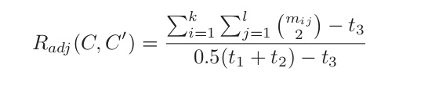
We use Adjusted Rand’s Index (ARI) for such a comparison. This score computes a similarity measure between two clusterings by considering all pairs of samples and counting pairs that are assigned in the same or different
clusters in both clusterings.
It is computed as per following equation:
with C, C’ as clusterings, mij is the corresponding value in the confusion matrix of C and C‘ ,and t1,t2,t3 are the total number of points. It lies between -1 and 1 inclusive, with -1 indicating complete disagreement and 1 as complete agreement.

Slide 13
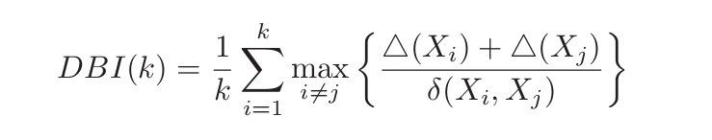
As a validation step, we use Davies–Bouldin Index (DBI) to ascertain the results obtained by KM/HC algorithms.
DBI is an internal evaluation scheme, where the validation of how well the clustering has been done is made using quantities and features inherent to the dataset. It is calculated
as follows:
where k is the number of clusters, δ(Xi, Xj ) is the intercluster distance between clusters Xi and Xj while (Xi) is the intra-cluster distance i.e distance within the cluster Xi.

Slide 14
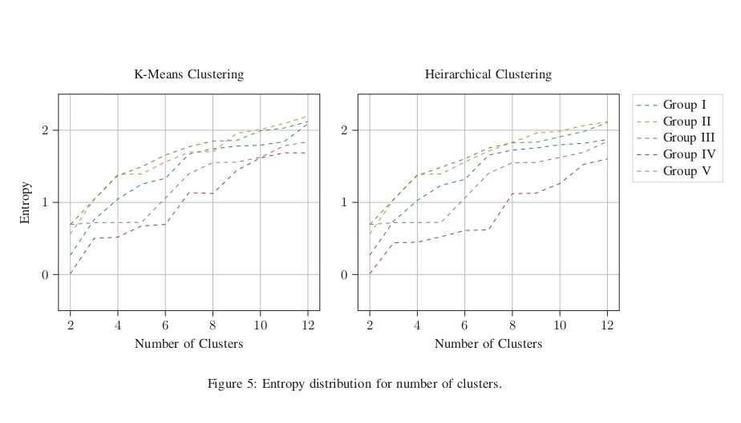
RESULTS
Entropy Evaluation
From the entropy distribution shown in Fig. 5, we can Conclude that for the given data, a lower range of number of clusters would be optimal in either of the two techniques.
The entropy increases as the number of clusters rises. As clusters increase beyond the cardinality of 6, a steep rise is detected. This is not true in general and hence, entropy evaluation is an essential step in our methodology. The Entropy values may also vary with data values over time,
when new data is procured. This also helps in the algorithms eneralizingg to new unseen data. In this study, further Analysis is conducted only for the number of clusters ranging
from 2 to 6.

Slide 15
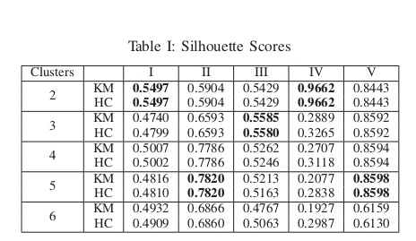
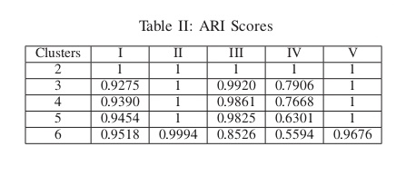
B. Silhouette Scores and ARI Evaluation
A summary of the Silhouette Scores is shown in Table I. The clustering algorithms are compared for every number of clusters from 2 to 6. The highest value indicates the best number of clusters. Both techniques show almost the same scores, which shows that the behaviour of techniques though applied individually, give approximately the same number of clusters. Furthermore, the scores indicate that even the best scores are not consistent across all the groups.
The ARI values in Table II show strong similarities in sultslusters formed by KM and HC techniques. From these Results, it can be concluded that both techniques show approximately the same clusters in the data for corresponding best Silhouette Scores.

Slide 16
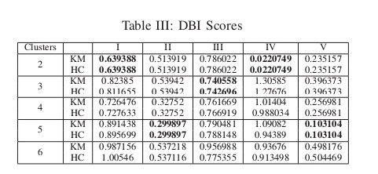
C. Validation Metric
The DBI values shown in Table III suggest the same
results as provided by the Silhouette Scores. This confirms
that the techniques applied for the analysis of the raw signals
are accurate enough to make decisions when monitoring
the welding stations. Over time, these algorithms can be
retrained on new data, thereby widening the scope of identifying new clusters if they exist.

Slide 17
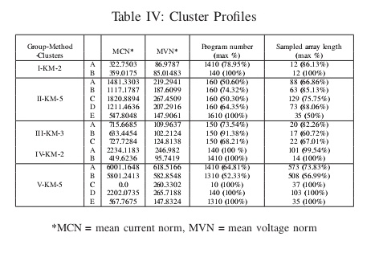
D. Cluster Profiles
From the results, a summary of cluster statistics is presented in Table IV. A typical cluster profile shows the average norms of the current and voltage arrays, the welding program number from the machines and the sampled length
of the arrays with the highest frequencies in the cluster. These welds might correspond to poor penetration
of welds in the joint at the start of a welding run and/or
inaccurate data recording.

Slide 18
CONCLUSION
In this paper, an approach using basic clustering techniques on current and voltage signals of welding processes to identify variations is suggested. A cluster formed using the methodology can be profiled by its corresponding features, giving indicators of possible welds under a certain process run and prompting an inspection if necessary. A direct application of such a methodology is to connect attributes of welds like oxidation levels, distortion and heat effects
With cluster labels and construct a classification problem particular to that process.
Using these results, it is possible to construct a multistage algorithm using the group names as classes for a classification problem. A neural network to predict these classes can also be implemented. With an optimal classifier, incoming current and voltage signals can be placed in a
group and knowing the clusters formed in it, these signals can be placed within a cluster and its attributes identified in advance. Research in these directions are planned in future works.

Slide 19
THANK YOU

