Slide 1
Sentiment Analysis of Social Networking Sites (SNS) Data using Machine Learning Approach for the Measurement of Depression
Ch.Udhay
18311A05R4
CSE-E

Slide 2

ABSTRACT
—The advent of different social networking sites has enabled anyone to easily create, express, and share their ideas, thoughts, opinions, and feelings about anything with millions of other people around the world. With the advancement of technology, mini computers and smartphones have come to human pockets and now it is very easy to share your idea about anything on social media platforms like Facebook, twitter, Wikipedia, LinkedIn, Google+, Instagram etc.

Slide 3
Due to the tremendous growth in population and communication technologies during the last decade, use of social networks is on the rise and they are being used for many different purposes. One such service for which their use may be explored is an analysis of users post to diagnosis depression. We present how to find the depression level of a person by observing and extracting emotions from the text, using emotion theories, machine learning techniques, and natural language processing techniques on different social media platforms.

Slide 4

INTRODUCTION
Depression has become the worlds fourth major disease. Depression is also called clinical depression or depressive disorder that is a mental disorder characterized the disruption in the mood, sadness, deliberation, loss of interest, feeling of guilt that affects how you feel, thinks, and handles daily activities.

Slide 5
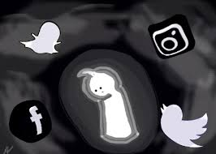
Sentiment analysis is the process of determining the emotional tone behind a series of words, used to gain an understanding of the attitudes, opinions, and emotions expressed in a text. It is a way to evaluate written or spoken language to determine if the expression is positive, or negative, or neutral. The applications of sentiment analysis are broad and powerful. The ability to extract sentiment and emotions insights from social data is a practice that is being widely adopted by organizations across the world.

Slide 6
PROPOSED METHODOLOGY
There are two types of sentiment classification techniques, binary classification technique and multi-class sentiment classification technique.
In binary classification technique each document di in D where D = {d1,d2,d3,.....dn} are classified into category C where C = {Positive,Negative} and the in di is multi-class classified sentiment into category.
classification C {StrongPositive,Positive,Neutral,Negative, = StrongNegative} . In our proposed methodology, there are four main components that are preprocessing, feature extraction, meta learning and training data

Slide 7
A.Preprocessing
In this step, we first split the paragraph into sentences and then tokenize the sentences into words. From words vector then we remove the stop words. Stop words are those words that are often useless and do not convey much meaning e.g in English the, much, under, over in, from, on, of, and etc. are stop words. On the remaining words we apply the stemming i.e find the root words e.g the root word of stems, stemmer, stemmed and stemming is stem.
B.Feature Extraction
The detection of features from raw text is related to whether a word or a sequence of words can be a feature or not. The main approaches to the problem of feature representation are bag of words, a bag of opinions, lexicons base, and dictionary based data adjective, adjectival phrases, nouns, and adverbs. Some of the feature extraction methods are the following.

Slide 8

• N-grams Features : N-grams are basically co-occurring words, syllables, multiple words (bigrams, trigrams and more), or phenomes within a given sequence of text or speech.
Parts of Speech (POS) Tagging : Part of speech tagger is a piece of software that reads text in some language and assigns parts of speech to each word such as nouns, verb adjective etc.
Negation : Negation words can change sentiment meaning of a word from negative to positive and from positive to negative e.g not bad, not good etc.
Sentimental Analyzer: Sentiment analyzer analyze positive and negative sentiment of words in given document e.g wonderful express a positive sentiment orientation.

Slide 9
C.Meta learning/Voting
The simplest way to combine multiple classifiers is to use the voting approach, and choose which ever label gets the most votes. Voting is a well-known aggregation procedure that combines different opinions of voters classifiers into consensus. The voting operator is nested operator which uses majority vote for classification and regression on top of predictions of the inner learners. Here we use three classifiers, Support Vector Machine (SVM), Naïve Bayes (NB), and Maximum Entropy (ME) classifiers as inner learners.

Slide 10
• Support Vector Machine (SVM): SVM is a machine learning classifier which can be used for both classif ication and regression challenges. Single kernel SVM is widely used for data analysis in different domains including social media and linear SVM is known to be one of the best performing methods for text classification. In this algorithm we plot each data item as a point in ndimensional space with the value of each feature being the value of each coordinate, where n is the number of features we have.
• Nave Bayes (NB): Nave Bayes is a machine learning model which can be used for both classification and regression challenges. Single kernel SVM is widely used for data analysis in different domains including social media. In this algorithm we plot each data item as a point in n-dimensional space with the value of each feature being the value of each coordinate, where n is the number of features we have.
P(label|features)= P(label) ∗ P(features|label)/ P(features)

Slide 11
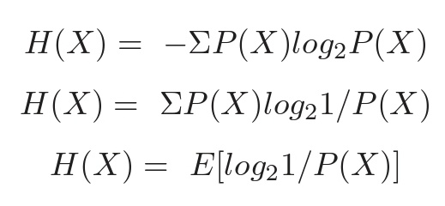
Maximum Entropy: Maximum Entropy is also known as a conditional exponential classifier or logistic regression classifier. The maximum entropy classifier converts labeled feature sets to vectors using encoding. This encoded vector is then used to calculate weights for each feature that can then be combined to determine the most likely label for a feature set.
The range of entropy is based on the number of outcomes that is 0 ≤ H(X) ≤ log(n)

Slide 12
Measuring depressive behavior : We presented a set of attributes like emotional process, temporal process, and linguistic style that can be used to characterize the depressive behaviors of users.
Our dataset consists of five emotional variables (positive, negative, sad, anger, anxiety), three temporal categories (present focus, past focus and future focus), and 9 standard linguistic dimensions (e.g., articles, prepositions, auxiliary verb, adverbs, conjunctions, pronoun, verbs and negations). We calculate their values by the standard LIWC2015 scales.

Slide 13
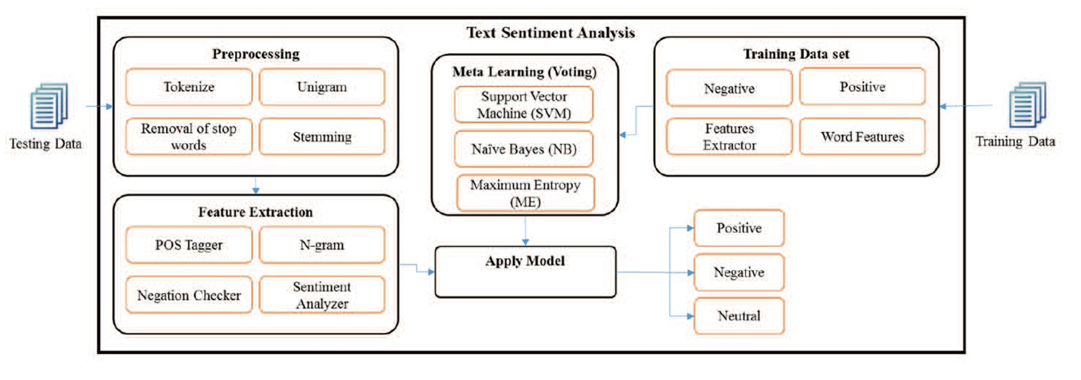
Sentiment Analysis for the Measurement of Depression

Slide 14
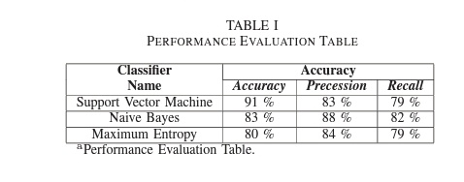
CONCLUSION
In this paper we have made a comparison among SVM, NB and ME classifiers regarding sentence level sentiment analysis for depression measurement. We have adopted voting model and feature selection technique. We examined the performance of our proposed methods on two datasets, twitter dataset and 20newsgroups. Our experiment indicates that SVM shows superior result as compare to Nave Bayes and Maximum Entropy classifiers. We observed that the accuracy of SVM is 91 %, the accuracy of Nave base is 83 % and the accuracy of Maximum Entropy is 80 %.

Slide 15
REFERENCES
Peng, Zhichao, Qinghua Hu, and Jianwu Dang. ”Multi-kernel SVM based depression recognition using social media data.” International Journal of Machine Learning and Cybernetics (2017): 1-15.
Banitaan, Shadi, and Kevin Daimi. ”Using data mining to predict possible future depression cases.” International Journal of Public Health Science (IJPHS) 3.4 (2014): 231-240.
Abhyankar, Anjali. ”Social networking sites.” SAMVAD 2 (2011): 1821.
Braithwaite, Scott R., et al. ”Validating machine learning algorithms for twitter data against established measures of suicidality.” JMIR mental health 3.2 (2016).

Slide 16
Thank
You

