Slide 1
Car Dekho: Used Car Price Prediction Machine Learning Model – UDHAYA KUMAR V

Slide 2
Problem Statement:
The primary objective of this project is to create a data science solution for predicting used car prices accurately by analysing a diverse dataset including,
Car model,
no. of owners,
age,
mileage,
fuel type,
kilometres driven,
features and
location.
The aim is to build a machine learning model that offers users to find current valuations for used cars.

Slide 3
Tools Used
Python -- Programming Language
Pandas -- Python Library for Data Visualization
Numpy -- Fundamental Python package for scientific computing
Streamlit -- Python framework to build and share machine learning and data science web apps
Scikit-learn -- Machine Learning library for Python

Slide 4
Approaches
Extracted the data from Given data source
Cleaned the data by handling Null values, duplicate values.
Changing Data types
Finding outliers, skewness
EDA
Feature selection
Model Building

Slide 5
Exploratory Data Analysis
Resale Prices for cars on cities like Bangalore, Chennai, Delhi, Jaipur, Hyderabad and Kolkata which varied by different types of factors, in here I have analysed some important factors like Seats, transmission, Mileage, Top speed, fuel type, KM driven which influenced the re-sale prices.
Lets starts with city wise total re-sale Prices on cars.
5

Slide 6
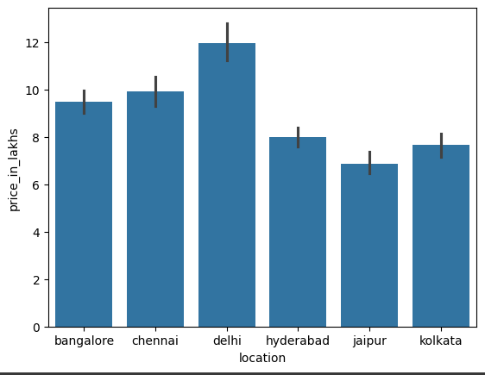
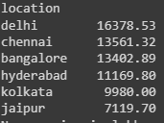
Data Visualization
Delhi and Chennai had overall high re-sale Price collection while comparing to other cities.
This was from year range of 1985 to 2023.
In which highest price was around by Delhi was 16378.53 in lakhs and lowest by Jaipur, in the amount of 7119.70 In lakhs.
Detailed information were shown by the image:

Slide 7
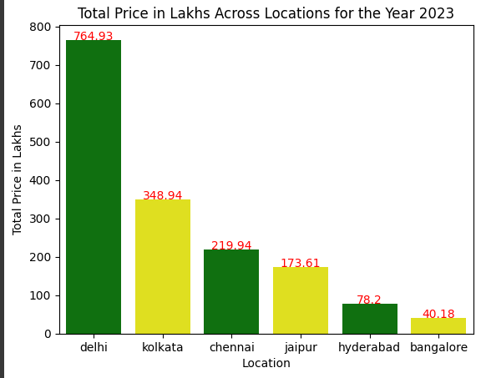
Latest – Resale Price Trends On City Wise:
The above graph clearly shown the result for 2023 highest sales across cities.
Yes, Delhi and Kolkata were on 1st and 2nd place and this time, there was slight drop on Chennai car sales, hence it was moved to 3rd place. As Delhi was in 1st place, there are other reasons which may applicable like population in Delhi may high.
There was improvement in Kolkata sales, where it was moved from 4th place to 2nd place.

Slide 8
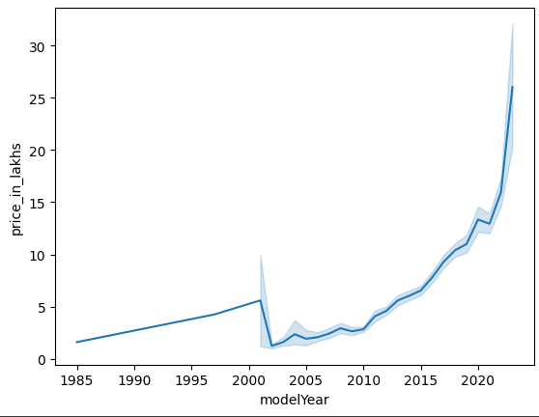
Year Wise Sales Trend
The above line graph shows the trend of prices from 1985 to 2020. In this, we can see there was a huge drop on 2021 to 2005.
After that, the car resale market had started increasing again and now, it clearly shows that re-sale market for cars in good trend.
By this, we can see that peoples before 2015, does not shown much interest in selling their used cars.

Slide 9
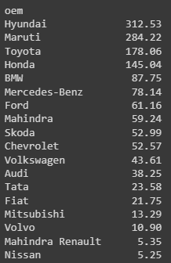
Sales from 2002 to 2010
So, in the dropped years from 2002 to 2010, it seems Hyundai shows high sales even others shows drop in re-sale by this, we can understand that, Hyundai, Maruti, and Toyota had high re-sale prices even in some low market conditions.
Also, we can see that Mahindra, Renault, Nissan had very low in dropped years while comparing to other models
Average sales of cars by manufacturer as shown in details amount:
By this, we can understand that from 2002 to 2010, manufacturer like
Mahindra & Nissan had only average of 5.35 lakhs which was very low,
Which means those manufacturer cars like one cars was sold.

Slide 10
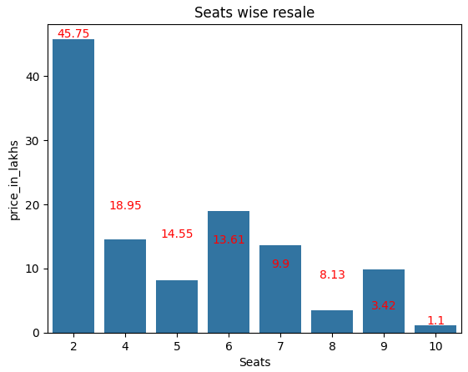
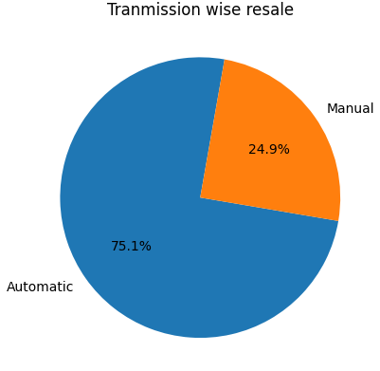
The Factors Like Number Of Seats Which Affects The Re-sale Price By Below Graph:
Lets find the factors like Transmission which affects the re-sale price by below graph:

Slide 11
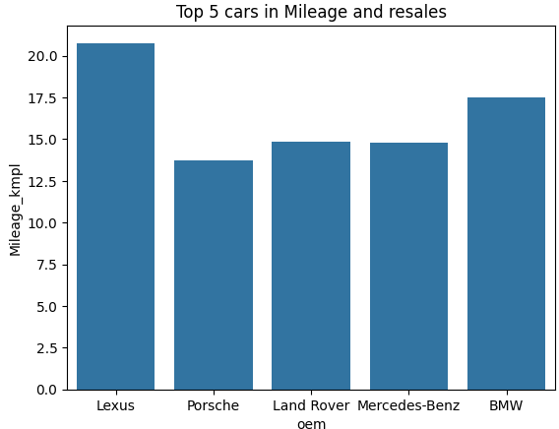
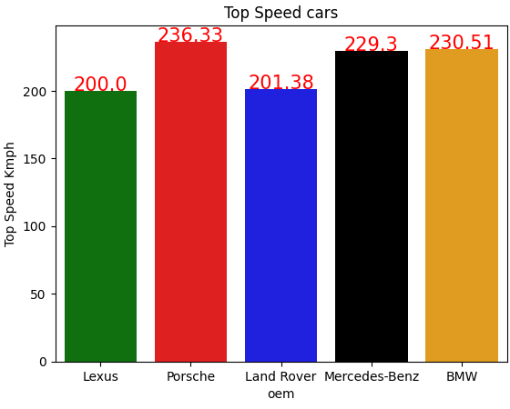
Mileage & Top speed
Cars like Lexus, Porsche, land rover, Mercedes-benz and BMW were good in resale price in terms of mileage and top speed wise while comparing to other cars.

Slide 12

Fuel Wise Range In Sales
It clearly shows, while comparing to other cars, petrol cars had high re-sale value.
Total cars sold by fuel type:

Slide 13
Model Selection
Feature selection: Considering the important features, after go-through the given data and problem statement, you can find the feature,
After selecting features, below models were tried and checked the predicted values.
Decision Tree Regressor
Random Forest Regressor
Linear Regression
Gradient Boosting Regressor
13

Slide 14
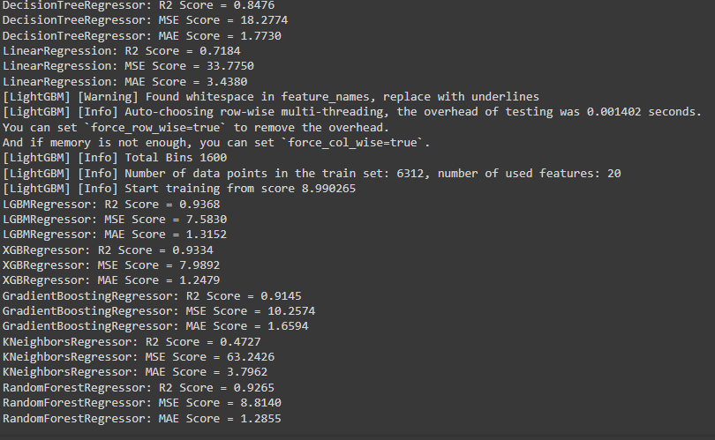
Model Performance:
Upon checking the performance of Random Forest regression gave above 85% as R2_score.
14

Slide 15
Conclusion:
As per the problem statement, we can see that many factors had affect the re-sale prices for cars like fuel type, engine, transmission, Kilometres driven etc. Upon checking with the data and solution which we can suggest was the cars like Porche, Lexus, Land Rover, Benz, BMW had high re-sale value in all terms even in luxurious facilities.
15

Slide 16
Thank you

