Slide 1
Used Car Price Prediction
A Leakage-Free Machine Learning Regression Framework
Featuring Regex Parsing, Domain Feature Engineering, 6-Algorithm CV Benchmarking, and Segment Error Profiling
Vellore Institute of Technology, Andhra Pradesh (VIT-AP) | Machine Learning Course Project

Slide 2
EXECUTIVE OVERVIEW
Problem Statement & Market Motivation
The Valuation Challenge
- Used car pricing suffers from significant information asymmetry between buyers and sellers.
- Manual appraisals are subjective, time-intensive, and prone to individual dealer biases.
- Vehicle depreciation exhibits strong non-linearities: rapid drops in early years followed by plateauing decay.
- Complex feature interdependencies: brand prestige, mileage decay, fuel efficiency, engine output, and odometer wear.
Business & Technical Motivation
- Algorithmic Transparency: Provide instant, objective market valuations for resale platforms (CarDekho, Spinny, Cars24).
- Asset Underwriting: Deliver reliable residual asset value estimates for auto-lenders and insurance underwriters.
- Methodological Rigor: Eliminate pervasive data leakage found in academic literature through strict split isolation.
- Empirical Explainability: Understand exact monetary impact of mileage, vehicle age, and mechanical specifications.

Slide 3
METHODOLOGY
Core Project Objectives & Anti-Leakage Rules
Key Project Objectives
Strict Data Hygiene: Split dataset 80/20 before any outlier capping, imputation, or scaling to eliminate data leakage.
Domain Feature Extraction: Parse numeric units (kmpl, CC, bhp, Nm, rpm) and create depreciation rate metrics (car_age, km_per_year).
Multi-Algorithmic Benchmark: Train and tune 6 regression models across Linear, Regularized, Decision Tree, Bagging, and Boosting families.
Dual-Scale Valuation Tracking: Evaluate all models on both log-transformed scale (variance stability) and real-world INR rupee scale.
Ablation & Segmentation: Quantify exact predictive lift of engineered features and isolate prediction error across price and brand tiers.

Slide 4
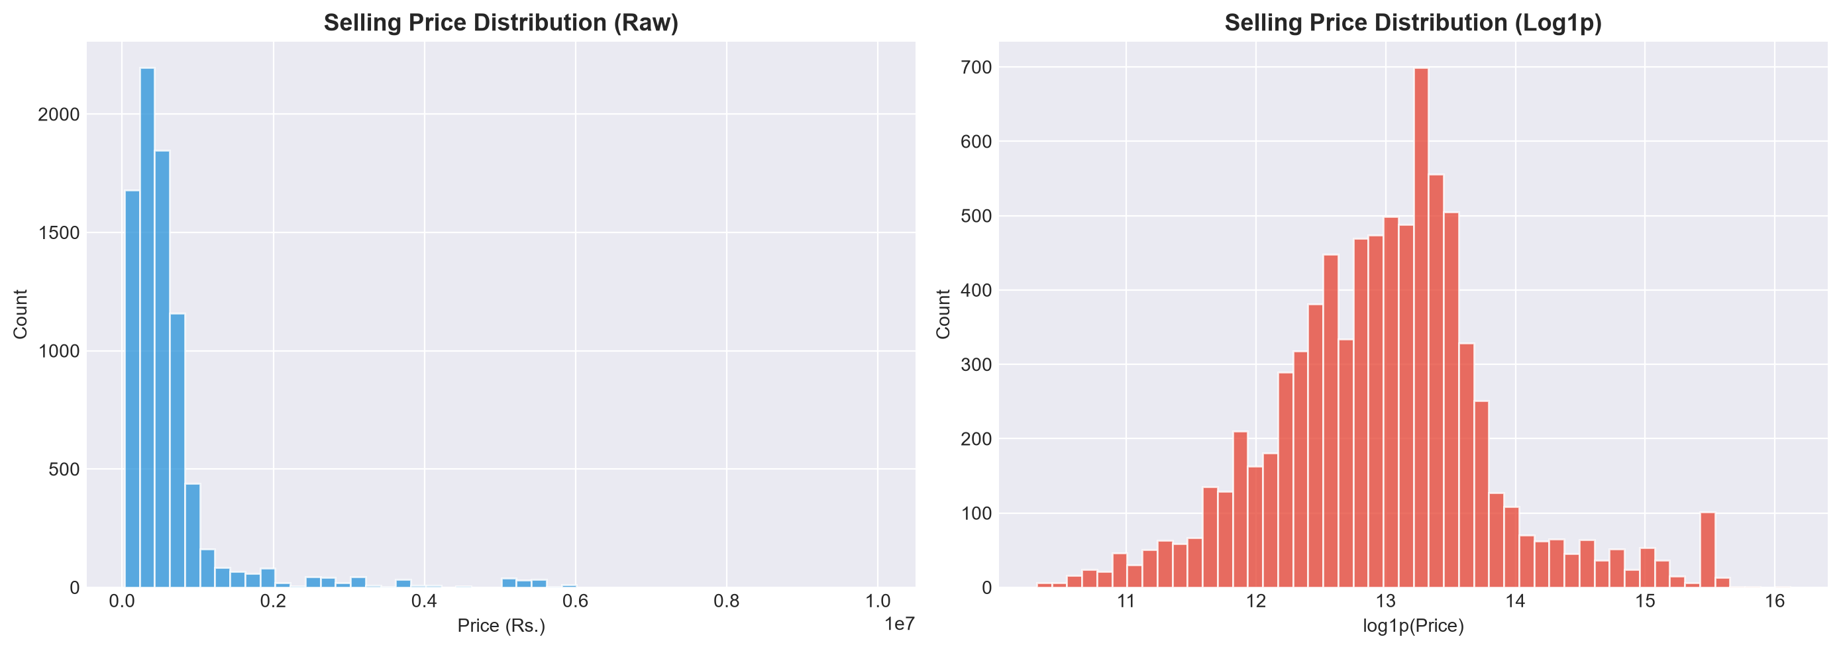
DATA EXPLORATION
Dataset Overview: CarDekho Used Car Corpus
Corpus Characteristics
Raw Dataset: 8,128 records with 13 original attributes.
De-duplication: Identified and pruned 1,679 duplicate listings (6,449 unique records retained).
Target Variable: selling_price (INR)
- Min: Rs. 29,999 | Max: Rs. 10,000,000
- Mean: Rs. 638,272 | Median: Rs. 450,000
Target Transformation: Extreme right-skewness corrected via log1p(y) mapping to stabilize variance.

Slide 5
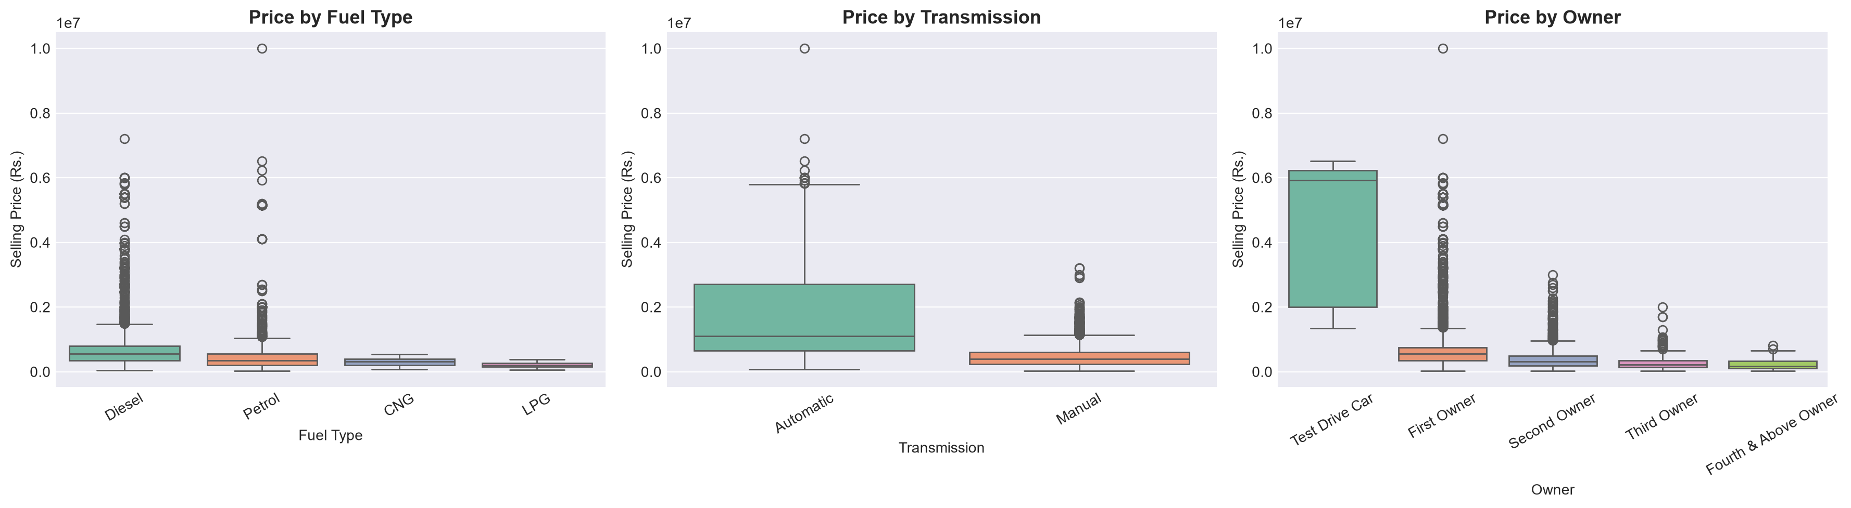
DATA EXPLORATION
Price Segmentation by Category & Fuel Type
Key EDA Insights: Diesel vehicles command a premium over Petrol due to fuel economy and commercial utility; Automatic transmissions exhibit significantly higher median values than manuals; First owners retain the highest valuation.

Slide 6
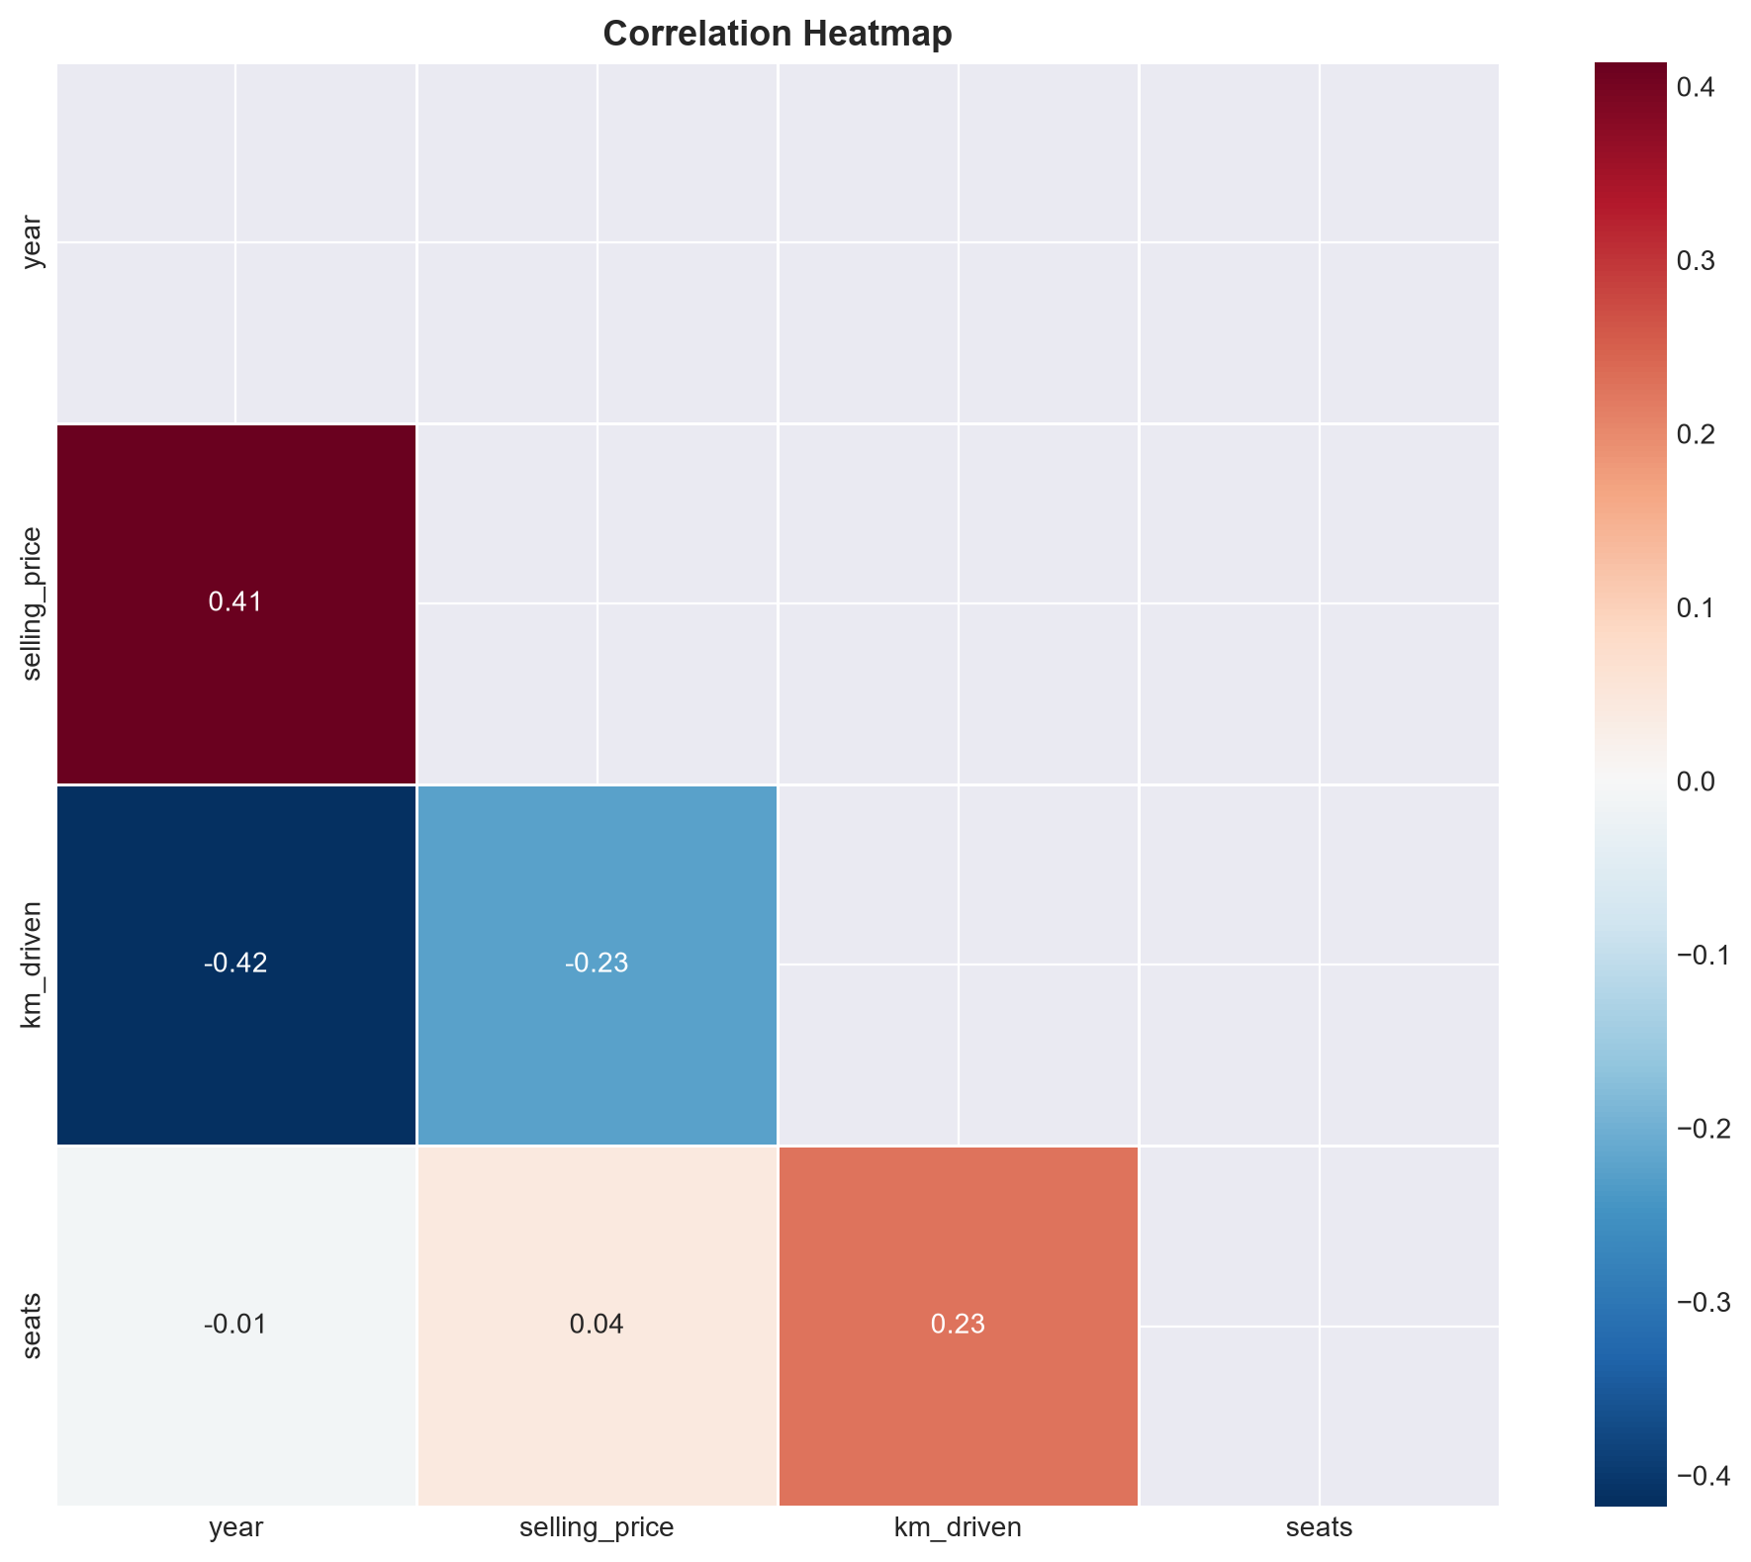
DATA EXPLORATION
Feature Relationships & Correlation Analysis
Correlation Takeaways
- Manufacturing Year vs Price: Strong positive correlation (+0.41); newer vehicles retain high value.
- Kilometers Driven: Modest negative correlation (-0.23); high odometer readings discount prices non-linearly.
- Engine & Power: High positive correlation (+0.50 to +0.70) with selling price; larger displacements command premiums.
- Multicollinearity: Engine CC and Max Power show strong collinearity, requiring regularization or tree-based splits.

Slide 7
FEATURE PIPELINE
Regex String Parsing & Domain Feature Engineering
Derived & Extracted Feature Set
mileage -> mileage_kmpl: Regex extraction of numeric efficiency from strings (e.g., '23.4 kmpl', '18.9 km/kg').
engine -> engine_cc: Displacement volume parsed from CC strings (e.g., '1248 CC').
max_power -> max_power_bhp: Brake horsepower extracted as clean float (e.g., '103.52 bhp').
torque -> torque_nm & max_torque_rpm: Automated parsing handling units, kgm-to-Nm conversion (x9.80665), and RPM range extractions.
name -> brand: Manufacturer brand token extracted from vehicle name (Maruti, Hyundai, BMW, Toyota, etc.).
year -> car_age: Calculated depreciation span: car_age = 2024 - year.
km_driven & car_age -> km_per_year: Annual usage density metric capturing odometer wear rate per year of ownership.

Slide 8
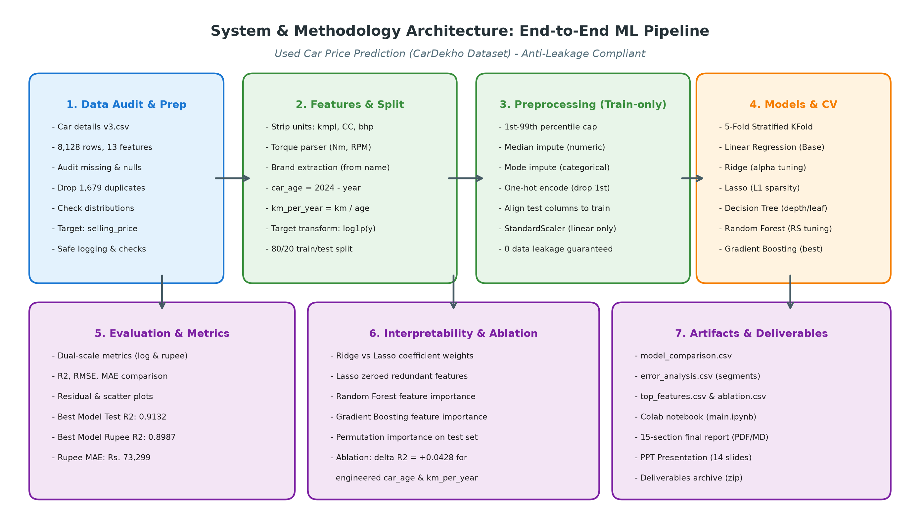
ARCHITECTURE
System Architecture: End-to-End Leakage-Free Pipeline

Slide 9
MODEL EVALUATION
Benchmark Results Across 6 Regression Algorithms
Comprehensive evaluation using 5-Fold Cross Validation on the training split, evaluated on unseen test data across both log1p and Indian Rupee (INR) scales.
Model | CV R2 | Test R2 (Log) | Test RMSE (Log) | Test R2 (INR) | Test RMSE (INR) | Test MAE (INR)
Gradient Boosting | 0.9150 | 0.9132 | 0.2201 | 0.8987 | Rs. 149,075 | Rs. 73,299
Random Forest | 0.9135 | 0.9067 | 0.2283 | 0.8866 | Rs. 157,688 | Rs. 73,933
Linear Regression | 0.8894 | 0.8835 | 0.2551 | 0.8852 | Rs. 158,685 | Rs. 89,022
Ridge Regression | 0.8894 | 0.8835 | 0.2550 | 0.8829 | Rs. 160,267 | Rs. 89,101
Lasso Regression | 0.8895 | 0.8833 | 0.2554 | 0.8756 | Rs. 165,186 | Rs. 89,576
Decision Tree | 0.8806 | 0.8765 | 0.2627 | 0.8567 | Rs. 177,300 | Rs. 88,422

Slide 10
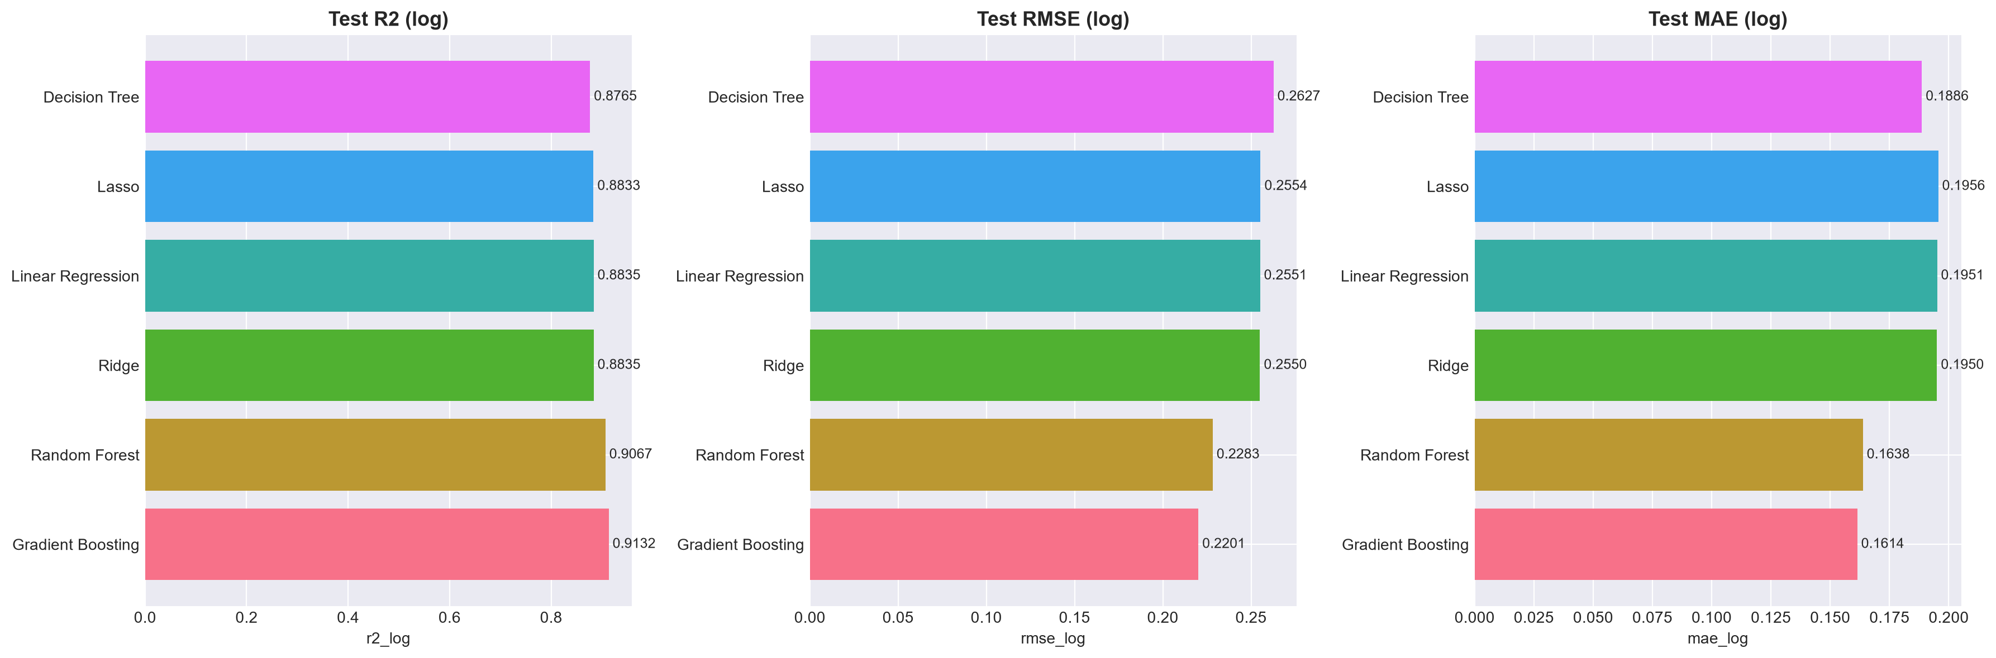
MODEL EVALUATION
Model Comparison: R2, RMSE & MAE Profiles

Slide 11
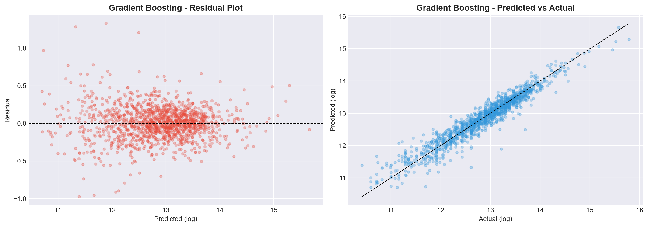
DIAGNOSTICS
Champion Model Diagnostics: Gradient Boosting

Slide 12
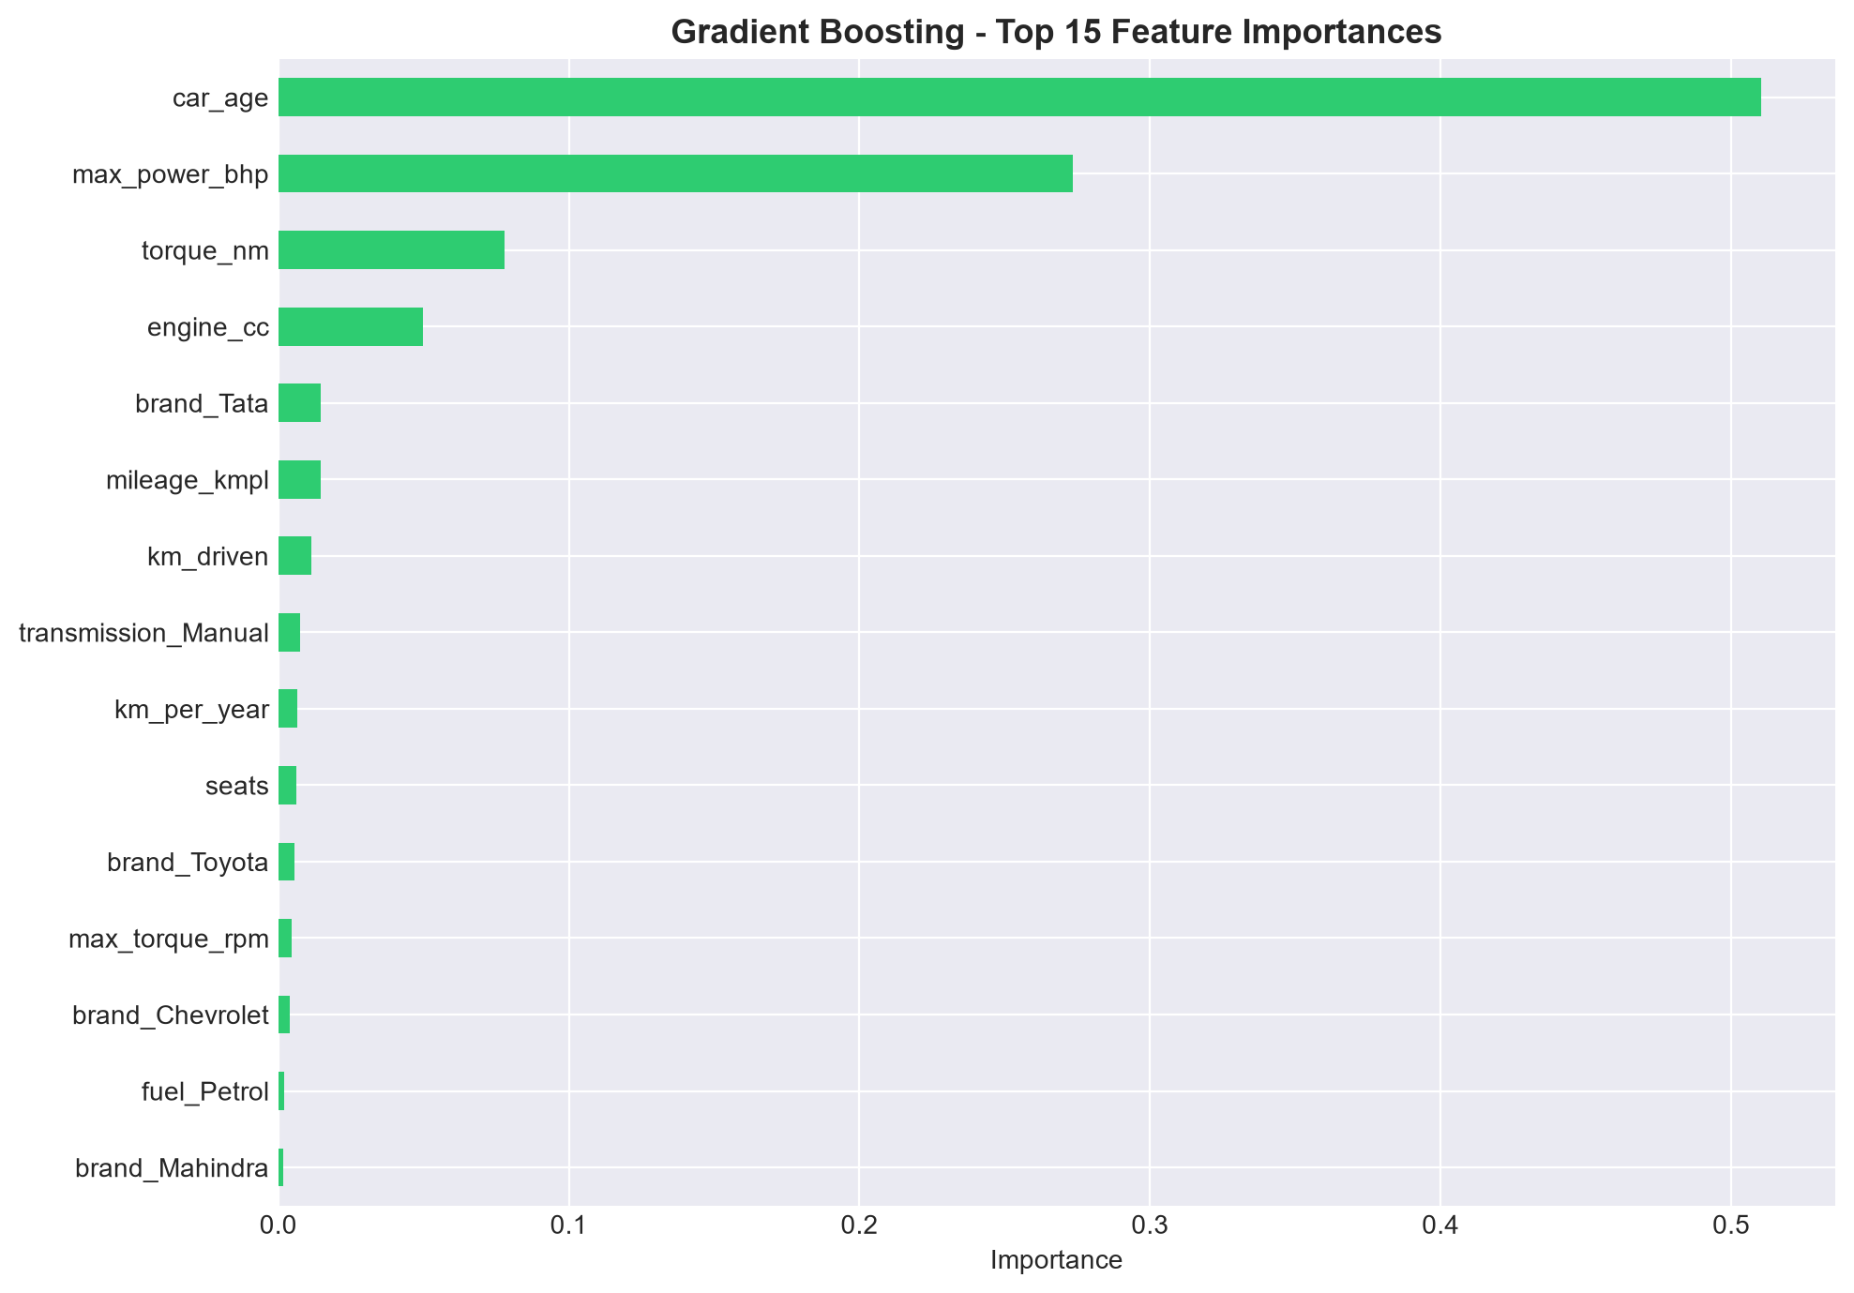
INTERPRETABILITY
Model Interpretability: Key Price Drivers
Key Driver Insights
- Maximum Power (bhp): Single highest predictor of vehicle price, capturing vehicle performance class.
- Car Age: Leading negative price determinant; confirms exponential initial depreciation.
- Engine CC: Strong contributor reflecting vehicle size and prestige tier.
- Brand Prestige: German luxury brands (BMW, Mercedes-Benz, Audi) add substantial price premiums.
- Transmission: Automatic transmissions command durable resale margins.

Slide 13
VALIDATION
Feature Ablation: Quantifying Engineering Value
Ablation Experiment: Removing car_age and km_per_year
- Hypothesis: Raw year and mileage alone are insufficient; explicit age and annual wear metrics improve predictive resolution.
- Full Pipeline Model Test R2: 0.9132 | RMSE: 0.2201
- Ablated Model (No car_age & km_per_year) Test R2: 0.8704 | RMSE: 0.2690
- Performance Impact: Delta R2 = -0.0428 | RMSE increases by +22.2%
- Conclusion: Derived depreciation features provide statistically significant explanatory power and are indispensable.

Slide 14
DIAGNOSTICS
Error Profiling Across Vehicle Price & Age Tiers
Segment Error Findings (results/error_analysis.csv)
Budget Segment (< Rs. 205,000): Median absolute error is just Rs. 24,651 with Mean Absolute Percentage Error (MAPE) of 25.9%.
Midrange Segment (Rs. 350,000 - Rs. 700,000): Lowest relative error with MAPE of 13.0% - 13.5% and median error of Rs. 48,000 - Rs. 61,000.
Luxury Segment (> Rs. 700,000): Higher absolute error (median Rs. 103,100) but consistent percentage error (13.3%), validating model stability across tiers.
Brand Accuracy: Top volume brands Maruti (N=419, median error Rs. 30,706) and Hyundai (N=271, median error Rs. 42,484) exhibit tight error bounds.
Vehicle Age Tiers: Vehicles aged 3-6 years exhibit the lowest MAPE (10.75%), while 10+ year vehicles show higher variance (21.4% MAPE) due to mechanical condition heterogeneity.

Slide 15
CONCLUSION
Project Summary & Verified Deliverables
Summary of Contributions
- End-to-End Leakage-Free Pipeline: Built with scikit-learn, joblib, and pandas, executing all scaling and imputing strictly on training partitions.
- Superior Champion Model: Tuned Gradient Boosting achieved Test R2 = 0.9132 (Log) and 0.8987 (Rupee), with MAE of Rs. 73,299.
- Ablation Confirmed: Feature engineering provides +0.0428 boost in R2.
- Deliverables Complete: Runnable main.ipynb notebook, full 15-section report, literature review table, architecture diagrams, sample data, and 15-slide presentation deck.

