Slide 1
Array
  Introduction
  Types of array
  1D array
  2D array
  Sorting algorithm
  Applications of array
  Properties of array

Slide 2
Introduction
An array in C, is a collection of items stored at contiguous memory locations and elements can be accessed randomly using indexes of an array.
They are used to store similar type of elements as in the data type must be the same for all elements.
They can be used to store collection of primitive data types such as int, float, double, char, etc of any particular type.

Slide 3
Introduction
An array is a collection of one or more values of the same type.
Each value is called an element of the array.
The elements of the array has its own unique index number ( also known as subscript )
An array can be of any type.
For example : int , float , char etc.

Slide 4
Declaring Array Variables
Syntax :
Data type array name [ index ] ;
Example :
int score [ 10 ] ;
char num [ 15 ] ;
float val [ 20 ] ;

Slide 5
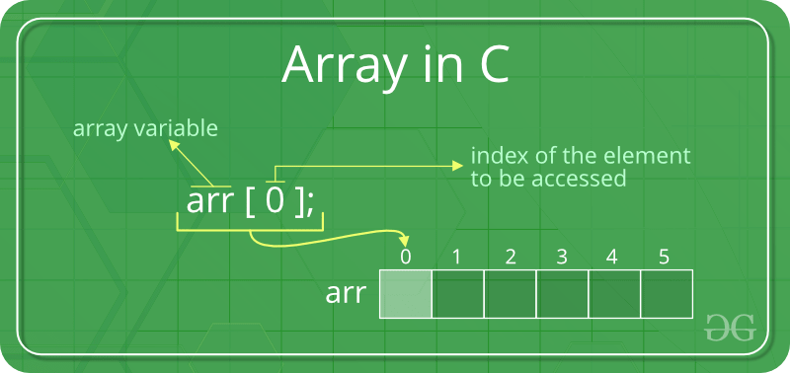
Array in C

Slide 6
Types of indexing in array
0 (zero-based indexing): The first element of the array is indexed by subscript of 0.
1 (one-based indexing): The first element of the array is indexed by subscript of 1
n (n-based indexing): The base index of an array can be freely chosen.
Usually programming languages allowing n-based indexing also allow negative index values and other scalar data types like enumerations, or characters may be used as an array index.

Slide 7
Name of Array
Variable type Size of array
Int a [ 1 0 ] ;
Name of array

Slide 8
Creating Arrays
Example :
int marks [ 5 ] ;
marks [ 0 ] references the first element in the array.
marks [ 4 ] references the last element in the array.
Here ,
int is the data_type
marks are the array_name
5 is the array_size

Slide 9
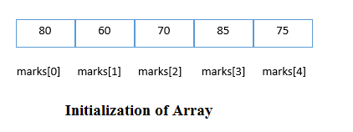
Initialization of Arrays
The simplest way to initialize an array is by using the index of each element. We can initialize each element of the array by using the index. Consider the following example.
marks[0]=80; //initialization of array
marks[1]=60;
marks[2]=70;
marks[3]=85;
Marks[4]=75;

Slide 10
Array Example in C
Example :
int main()
{
int i=0;
int marks[5];//declaration of array
marks[0]=80;//initialization of array
marks[1]=60;
marks[2]=70;
marks[3]=85;
marks[4]=75;
//traversal of array
for(i=0;i<5;i++)
{
printf("%d \n",marks[i]);
} //end of for loop
}

Slide 11
Array Example in C
Example :
int main()
{
int i=0;
int marks[5]={20,30,40,50,60}; //declaration,initialization
for(i=0;i<5;i++)
{
printf("%d \n",marks[i]);
}
}

Slide 12
Run time initialization
An array can also be initialized at runtime using scanf() function.
This approach is usually used for initializing large arrays, or to initialize arrays with user specified values.
Whenever we declare an array, we initialize that array directly at compile time.
if we assign certain set of values to array element before executing program. i.e at compilation time

Slide 13
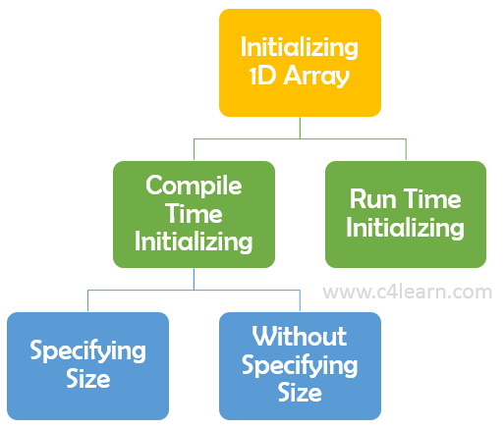
Initializing 1D array

Slide 14
How to find size of Array
Example : #include <stdio.h>
int main(void)
{
int a [ ] = {2,3,4,5};
int size;
size = sizeof ( a ) / sizeof ( a [0] );
printf ("size = %d",size);
}

Slide 15
Types of Array
There are 2 types of C arrays. They are,
1) One dimensional array
2) Multi dimensional array
        a)Two dimensional array
        b)Three dimensional array
        c) Four dimensional array etc…

Slide 16
One Dimensional Array in C
Syntax :
data-type arr_name [ array_size ];
Array declaration, initialization and accessing
Example :
Array declaration syntax :
data_type arr_name [ arr_size ];
Array initialization syntax :
data_type arr_name [ arr_size ]=(value1, value2, value3,….);
Array accessing syntax : arr_name[ index ];

Slide 17
One Dimensional Array in C
Example :
int main()
{
int i;
int arr [ 5 ] = { 10,20,30,40,50 } ;
/* Above array can be initialized as below also
arr [ 0 ] = 10;
arr [ 1 ] = 20;
arr [ 2 ] = 30;
arr [ 3 ] = 40;
arr [ 4 ] = 50; */
for (i=0;i<5;i++)
{
printf("value of arr[%d] is %d \n", i, arr [ i ]);
}
}

Slide 18
Two Dimensional Array in C
Two dimensional array is nothing but array of array.
Syntax : data_type array_name [ num_of_rows ] [ num_of_column ];
Array declaration, initialization and accessing
Array declaration syntax :
data_type arr_name [num_of_rows][num_of_column];
Array initialization syntax :
data_type arr_name[2][2] = {{0,0},{0,1},{1,0},{1,1}};
Array accessing syntax :
arr_name[index];

Slide 19
Two Dimensional Array in C
Example : int main()
{
int i,j;
int arr [ 2 ] [ 2 ] = { 10,20,30,40 };
/* Above array can be initialized as below also
arr [ 0 ] [0 ] = 10;
arr [ 0 ] [ 1 ] = 20;
arr [ 1 ] [ 0 ] = 30;
arr [ 1 ] [ 1 ] = 40; */
for (i=0;i<2;i++)
{
for (j=0;j<2;j++)
{
printf("value of arr[%d] [%d] : %d\n",i,j,arr [ i ][ j ]);
}
}}

Slide 20
Two Dimensional Array in C
In C programming , your can create an array of arrays.
These arrays are know n as multidimensional arrays
An array of arrays is known as 2D array.
The two dimensional (2D) array in C programming is also known as matrix.
A matrix can be represented as a table of rows and columns

Slide 21
Two Dimensional Array in C
Example :
int main(){
int disp[2][3]; /* 2D array declaration*/
int i, j;
for(i=0; i<2; i++) {
for(j=0;j<3;j++) {
printf("Enter value for disp[%d][%d]:", i, j);
scanf("%d", &disp[i][j]);
}}
printf("Two Dimensional array elements:\n");
for(i=0; i<2; i++) {
for(j=0;j<3;j++) {
printf("%d ", disp[i][j]);
if(j==2){
printf("\n");
}}}
}

Slide 22
Two Dimensional Array in C
output :
Enter value for disp [ 0 ] [ 0 ] : 1
Enter value for disp [ 0 ] [ 1 ] : 2
Enter value for disp [ 0 ] [ 2 ] : 3
Enter value for disp [ 1 ] [ 0 ] : 4
Enter value for disp [ 1 ] [ 1 ] : 5
Enter value for disp [ 1 ] [ 2 ] : 6
Two Dimensional array elements:
1 2 3
4 5 6

Slide 23
Initialization of 2D Array
There are two ways to initialize a two Dimensional arrays during declaration.
int disp[2][4] = {
{10, 11, 12, 13},
{14, 15, 16, 17}
};
OR
int disp [ 2 ] [ 4 ] = { 10, 11, 12, 13, 14, 15, 16, 17 };

Slide 24
Initialization of 2D Array
Although both the above declarations are valid, I recommend you to use the first method as it is more readable, because you can visualize the rows and columns of 2d array in this method.
Things that you must consider while initializing a 2D array
We already know, when we initialize a normal array (or you can say one dimensional array) during declaration, we need not to specify the size of it. However that’s not the case with 2D array, you must always specify the second dimension even if you are specifying elements during the declaration.

Slide 25
Initialization of 2D Array
/* Valid declarations*/
int abc [ 2 ] [ 2 ] = { 1, 2, 3 ,4 }
int abc [ ] [ 2 ] = {1, 2, 3 ,4 }
/* Invalid declarations */
int abc [ ] [ ] = { 1, 2, 3 ,4 }
int abc [ 2 ] [ ] = { 1, 2, 3 ,4 }

Slide 26
To store user input data into 2D array
We can calculate how many elements a two dimensional array can have by using this formula
The array arr [ n1 ] [ n2 ] can have n1*n2 elements.
The array that we have in the example below is having the dimensions 5 and 4. These dimensions are known as subscripts. So this array has first subscript value as 5 and second subscript value as 4.
So the array abc [ 5 ] [ 4 ] can have 5*4 = 20 elements.

Slide 27
To store user input data into 2D array
To store the elements entered by user we are using two for loops, one of them is a nested loop.
The outer loop runs from 0 to the (first subscript -1) and the inner for loops runs from 0 to the (second subscript -1).
This way the the order in which user enters the elements would be abc [ 0 ] [ 0 ], abc [ 0 ] [ 1 ] , abc [ 0 ] [ 2 ]…so on.

Slide 28
Sorting Algorithms
Sorting is nothing but arranging the data in ascending or descending order. The term sorting came into picture, as humans realised the importance of searching quickly.
That are ,
1) Bubble sort
2) Insertion sort
3) Selection sort
4) Quick sort
5) Merge sort
6) Heap sort

Slide 29
Introduction to Sorting
There are so many things in our real life that we need to search for, like a particular record in database, roll numbers in merit list, a particular telephone number in telephone directory, a particular page in a book etc.
All this would have been a mess if the data was kept unordered and unsorted, but fortunately the concept of sorting came into existence, making it easier for everyone to arrange data in an order, hence making it easier to search.
Sorting arranges data in a sequence which makes searching easier.

Slide 30
Sorting Efficiency
If you ask me, how will I arrange a deck of shuffled cards in order, I would say, I will start by checking every card, and making the deck as I move on.
Well, thank god, computers don't work like this.
Since the beginning of the programming age, computer scientists have been working on solving the problem of sorting by coming up with various different algorithms to sort data.
The two main criterias to judge which algorithm is better than the other have been:
Time taken to sort the given data.
Memory Space required to do so.

Slide 31
Bubble Sort Algorithm
Bubble Sort is a simple algorithm which is used to sort a given set of n elements provided in form of an array with n number of elements. Bubble Sort compares all the element one by one and sort them based on their values.
If the given array has to be sorted in ascending order, then bubble sort will start by comparing the first element of the array with the second element, if the first element is greater than the second element, it will swap both the elements, and then move on to compare the second and the third element, and so on.
If we have total n elements, then we need to repeat this process for n-1 times.

Slide 32
Bubble Sort Algorithm
It is known as bubble sort, because with every complete iteration the largest element in the given array, bubbles up towards the last place or the highest index, just like a water bubble rises up to the water surface.
Sorting takes place by stepping through all the elements one-by-one and comparing it with the adjacent element and swapping them if required.

Slide 33
Implementing Bubble Sort Algorithm
Following are the steps involved in bubble sort (for sorting a given array in ascending order)
1)Starting with the first element(index = 0), compare the current element with the next element of the array.
2)If the current element is greater than the next element of the array, swap them.
3) If the current element is less than the next element, move to the next element. Repeat Step 1.

Slide 34
Implementing Bubble Sort Algorithm
Let's consider an array with values {5, 1, 6, 2, 4, 3}
Below, we have a pictorial representation of how bubble sort will sort the given array.
So as we can see in the representation above, after the first iteration, 6 is placed at the last index, which is the correct position for it.
Similarly after the second iteration, 5 will be at the second last index, and so on.

Slide 35
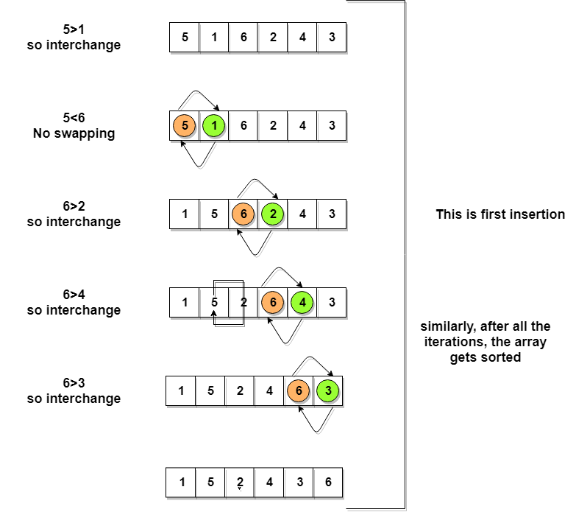
Implementing Bubble Sort Algorithm

Slide 36
Selection Sort Algorithm
Selection sort is conceptually the most simplest sorting algorithm. This algorithm will first find the smallest element in the array and swap it with the element in the first position, then it will find the second smallest element and swap it with the element in the second position, and it will keep on doing this until the entire array is sorted.
It is called selection sort because it repeatedly selects the next-smallest element and swaps it into the right place.

Slide 37
How Selection Sort Works?
Following are the steps involved in selection sort ( for sorting a given array in ascending order )
1) Starting from the first element, we search the smallest element in the array, and replace it with the element in the first position.
2) We then move on to the second position, and look for smallest element present in the subarray, starting from index 1, till the last index.
3) We replace the element at the second position in the original array, or we can say at the first position in the sub array, with the second smallest element. This is repeated, until the array is completely sorted.

Slide 38
Selection Sort
Let's consider an array with values {3, 6, 1, 8, 4, 5}
In the first pass, the smallest element will be 1, so it will be placed at the first position.
Then leaving the first element, next smallest element will be searched, from the remaining elements. We will get 3 as the smallest, so it will be then placed at the second position.
Then leaving 1 and 3 (because they are at the correct position), we will search for the next smallest element from the rest of the elements and put it at third position and keep doing this until array is sorted.

Slide 39
Finding Smallest Element in a sub array
In selection sort, in the first step, we look for the smallest element in the array and replace it with the element at the first position.
Consider that you have an array with following values {3, 6, 1, 8, 4, 5}. Now as per selection sort, we will start from the first element and look for the smallest number in the array, which is 1 and we will find it at the index 2. Once the smallest number is found, it is swapped with the element at the first position.
In the next iteration, we will have to look for the second smallest number in the array

Slide 40
Finding Smallest Element in a sub array
If you look closely, we already have the smallest number/element at the first position, which is the right position for it and we do not have to move it anywhere now.
So we can say, that the first element is sorted, but the elements to the right, starting from index 1 are not.
So, we will now look for the smallest element in the sub array, starting from index 1, to the last index.

Slide 41
Finding Smallest Element in a sub array
After we have found the second smallest element and replaced it with element on index 1 (which is the second position in the array), we will have the first two positions of the array sorted.
Then we will work on the sub array, starting from index 2 now, and again looking for the smallest element in this sub array.

Slide 42
Importance of array in c
Arrays a kind of data structure that can store a fixed size sequential collection of elements of the same type.
An array is used to store a collection of data, but it is often more useful to think of an array as a collection of variables of the same type.
It is used to represent multiple data items of the same type by using only a single name.
Arrays are more efficient and beneficial when compared to linked lists and hash tables.
Faster and can be utilized anywhere. Store data of similar data types together and can be used anywhere in the code.

Slide 43
How arrays are stored ?
An array stores its elements in contiguous memory locations.
If You created the array locally it will be on stack. Where the elements are stored depends on the storage specification.
An array declared globally or statically would have different storage specification from an array declared locally. Technically, the where part is implementation defined but usually implementations would use similar usage patterns.
An local array will be (usually)created on stack while
A global or static array will be (usually)created on bss/data segments.
A dynamically created array will be created on heap.

Slide 44
Features of array
1)An array holds elements that have the same data type.
2) Array elements are stored in subsequent memory locations.
3) Two-dimensional array elements are stored row by row in subsequent memory locations.
4) Array name represents the address of the starting element.
5) Array size should be mentioned in the declaration. Array size must be a constant expression and not a variable.

Slide 45
Basic operations of array
Following are the basic operations supported by an array.
Traverse − print all the array elements one by one.
Insertion − Adds an element at the given index.
Deletion − Deletes an element at the given index.
Search − Searches an element using the given index or by the value.
Update − Updates an element at the given index.
In C, when an array is initialized with size, then it assigns defaults values to its elements in following order.

Slide 46
Applications of array
Arrays are used to implement mathematical vectors and matrices, as well as other kinds of rectangular tables.
Many databases, small and large, consist of one dimensional arrays whose elements are records.
Arrays are used to implement other data structures, such as lists, heaps, hash tables, dequeues, queues and stacks.
One or more large arrays are sometimes used to emulate in-program dynamic memory allocation, particularly memory pool allocation. Historically, this has sometimes been the only way to allocate "dynamic memory" portably.

Slide 47
Properties of Arrays
Each element of an array is of same data type and carries the same size, i.e., int = 4 bytes.
Elements of the array are stored at contiguous memory locations where the first element is stored at the smallest memory location.
Elements of the array can be randomly accessed since we can calculate the address of each element of the array with the given base address and the size of the data element.

Slide 48
Needs of array
Arrays a kind of data structure that can store a fixed-size sequential collection of elements of the same type.
An array is used to store a collection of data, but it is often more useful to think of an array as a collection of variables of the same type.
It is better and convenient way of storing the data of same data type with same size.
It allows us to store known number of elements in it.

Slide 49
Advantages of using arrays
Arrays allow random access of elements. This makes accessing elements by position faster.
Arrays have better cache locality that can make a pretty big difference in performance. Less code to the access the data.
By using the for loop, we can retrieve the elements of an array easily.
To sort the elements of the array, we need a few lines of code only. We can access any element randomly using the array.

Slide 50
Disadvantages of using arrays
Whatever size, we define at the time of declaration of the array, we can't exceed the limit.
We must know in advance that how many elements are to be stored in an array is static structure.
It means that array is of fixed size. The memory which is allocated to array can not be increased or reduced.
Insertion and deletion are quite difficult in array. As the elements are stored in consecutive memory locations.

