Slide 1
Interpretable Network Intrusion Detection
using Correlation-Based Feature Selection with a Hybrid CNN-LSTM Classifier
Udhaya Kumar Palani
Student ID: 23306891
MSc in Cybersecurity · National College of Ireland
H9AIMLC – AI/ML in Cybersecurity
Lecturer: Faithful Chiagoziem Onwuegbuche
24 April 2026
Notes:
SPEAKER NOTES — Slide 1 (~30 seconds) "Good [morning/afternoon]. My name is Udhaya Kumar Palani, student ID 23306891, and over the next ten minutes I will walk you through my MSc project on interpretable network intrusion detection. The project applies correlation-based feature selection and a hybrid CNN-LSTM classifier to the CICIDS2017 benchmark, and uses SHAP to explain the model's decisions. I'll cover the motivation, the four models I compared, the headline results, a short live demo of SHAP in Colab, and the limitations and future work." DELIVERY TIP: Speak slowly. This first slide buys you 30 seconds before you have to start delivering content.

Slide 2
Why this matters
2 / 11
1
2
3
Computational cost
Opacity
Class imbalance
Deep IDS models require GPU training and high memory; full feature spaces of modern flow datasets are expensive to process.
Analysts cannot easily explain why a deep model raised an alert. This blocks operational trust and conflicts with the GDPR right to explanation.
In CICIDS2017, benign flows outnumber rare attacks (Heartbleed, Infiltration) by 3–5 orders of magnitude, biasing models towards majority class.
This project addresses all three concerns in a single end-to-end pipeline.
Udhaya Kumar Palani · 23306891 · MSc Cybersecurity, NCI
Notes:
SPEAKER NOTES — Slide 2 (~50 seconds) "Three real-world concerns frame this project. First, computational cost. Modern deep IDS models are expensive to train and to run on full feature spaces. Second, opacity. When a deep model raises an alert, the analyst on the receiving end has no easy way to verify why. This blocks operational trust and creates problems with the GDPR right to explanation. Third, class imbalance. In CICIDS2017, benign traffic outnumbers rare attacks like Heartbleed or Infiltration by three to five orders of magnitude. Models trained naively are biased towards the majority class and hide the rare attacks that matter most. This project addresses all three concerns simultaneously, in a single end-to-end pipeline." DELIVERY TIP: Pause briefly between the three cards. Don't read every word — the audience can read.

Slide 3
Research questions
3 / 11
RQ1
Can correlation-based feature selection meaningfully reduce the 78-feature CICIDS2017 input space without harming detection accuracy?
RQ2
Does a hybrid CNN-LSTM model outperform a stacked LSTM baseline (the base paper), a Random Forest, and an XGBoost+SMOTE classifier on the same selected features?
RQ3
Which features drive the trained models’ attack-class predictions, and can SHAP make those decisions interpretable enough to support analyst triage?
Three contributions: (1) reproducible CFS+4-model+SHAP pipeline, (2) honest comparison of hybrid vs classical baselines, (3) SHAP attribution on a modern benchmark.
Udhaya Kumar Palani · 23306891 · MSc Cybersecurity, NCI
Notes:
SPEAKER NOTES — Slide 3 (~45 seconds) "Three concrete questions structure the project. RQ1 is about efficiency: can we shrink the feature space without losing accuracy? RQ2 is about model design: does my proposed hybrid CNN-LSTM beat the base paper's LSTM, the classical Random Forest, and an imbalance-aware XGBoost? RQ3 is about interpretability: which features drive the decisions, and can SHAP make them clear enough for an analyst? I'll answer all three by the end of the talk." DELIVERY TIP: Read each RQ aloud word-for-word — these are the questions you'll be marked against, so make them stick.

Slide 4
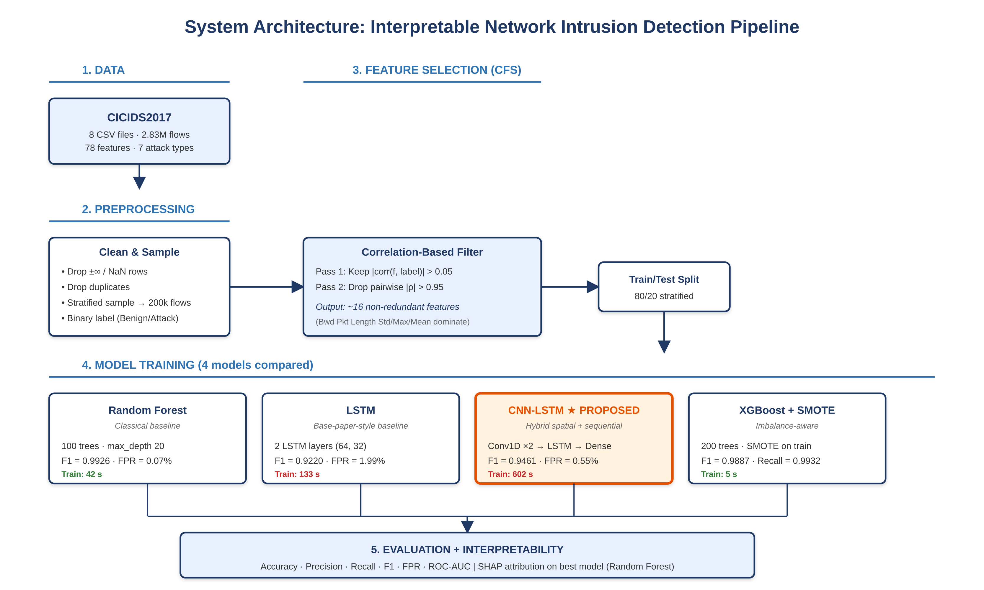
System architecture
4 / 11
Udhaya Kumar Palani · 23306891 · MSc Cybersecurity, NCI
Notes:
SPEAKER NOTES — Slide 4 (~75 seconds) "This is the system architecture, top to bottom. Stage 1: I take the eight CICIDS2017 CSV files — 2.83 million flows with 78 features. Stage 2: preprocessing. I drop infinity and NaN rows from the CICFlowMeter output, drop duplicates, and stratified-sample to 200,000 flows for tractable training. I collapse the multi-class label to binary — benign versus any attack. Stage 3: correlation-based feature selection — the algorithmic core. Two passes. First, keep features whose absolute Pearson correlation with the label is above 0.05. Second, walk through them in descending order of relevance and drop any feature whose pairwise correlation with an already-kept feature exceeds 0.95. This gives me about 16 non-redundant features. Backward-direction packet-length statistics dominate. Stage 4: I train four models on the same selected features — Random Forest as a classical baseline, plain LSTM mirroring the base paper, my proposed CNN-LSTM hybrid (highlighted in orange), and XGBoost trained on SMOTE-balanced data as an imbalance-aware comparator. Stage 5: I evaluate all four with six metrics, then apply SHAP attribution to the strongest model to expose which features drove the decisions." DELIVERY TIP: Trace the flow with your laser pointer or cursor while you speak. This slide is your strongest 'methodology' visual — give it the time it deserves.

Slide 5
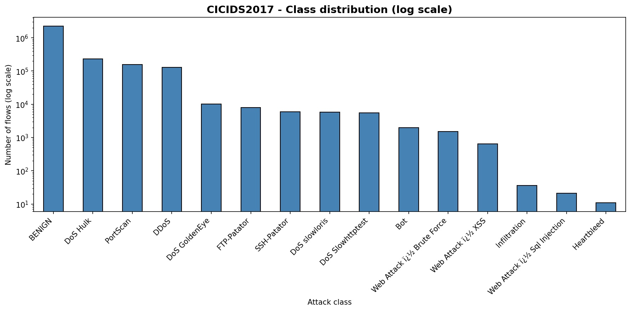
Dataset: CICIDS2017
5 / 11
CICIDS2017 (Sharafaldin et al., 2018)
Canadian Institute for Cybersecurity
5 days of realistic enterprise traffic
2.83 million flows · 78 statistical features
7 attack categories: DoS, DDoS, brute force, port scan, web attack, infiltration, botnet
Severe class imbalance (3–5 orders of magnitude)
Modelling decision
Binary task (Benign vs Attack) for tractable 4-day timeline; multi-class is direct extension.
Figure 1 in report: log-scale class distribution. Benign flows dominate by 3–5 orders of magnitude.
200,000
80 / 20
seed=42
stratified sample
train / test split
reproducible
Udhaya Kumar Palani · 23306891 · MSc Cybersecurity, NCI
Notes:
SPEAKER NOTES — Slide 5 (~45 seconds) "The dataset is CICIDS2017, published by the Canadian Institute for Cybersecurity. It's five days of realistic enterprise traffic, 2.83 million flows, 78 statistical features extracted with CICFlowMeter, and seven attack categories. The chart on the right shows how severe the class imbalance is — note the log scale on the y-axis. Benign flows are over two million; the rarest attacks like Heartbleed have under fifty samples each. That's roughly five orders of magnitude. For tractability in the four-day timeline I sampled 200,000 flows stratified by class, used an 80/20 train-test split, and fixed all random seeds at 42. The pipeline extends to multi-class classification with minor changes documented in the notebook." DELIVERY TIP: Point at the rightmost bars when you say 'rarest attacks' — visually anchors the imbalance argument.

Slide 6
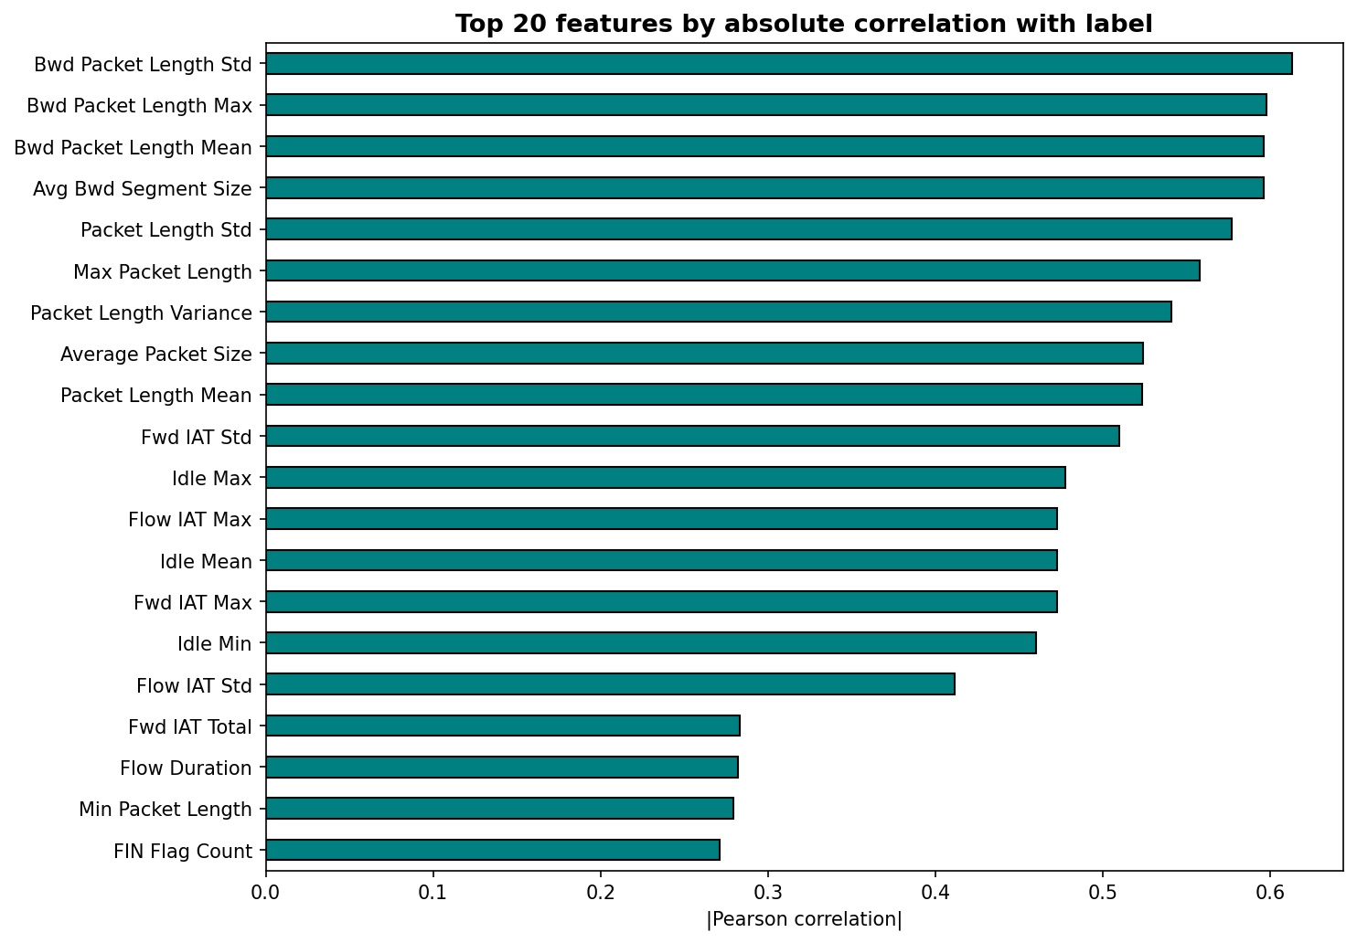
Correlation-based feature selection (CFS)
6 / 11
Algorithm
Hall (2000): "A good feature subset is highly correlated with the class, but features within the subset are uncorrelated with each other."
Pass 1 — Class relevance
For each feature f, compute |corr(f, label)|.
Keep features with |corr| > 0.05.
Pass 2 — Redundancy elimination
Sort kept features by |corr| descending.
Walk the list; drop any feature whose pairwise |ρ| with an already-kept feature exceeds 0.95.
Result: 78 → ~16 features (~80% reduction)
Figure 2 in report: top 20 features by |Pearson correlation| with attack label. Backward packet-length statistics dominate.
Udhaya Kumar Palani · 23306891 · MSc Cybersecurity, NCI
Notes:
SPEAKER NOTES — Slide 6 (~55 seconds) "Correlation-based feature selection follows the Hall 2000 principle: a good feature subset is correlated with the class, but its members are uncorrelated with each other. I implement that in two passes. Pass 1: keep features whose absolute Pearson correlation with the label exceeds 0.05. Pass 2: walk through the kept features in descending order of class relevance and drop any feature whose pairwise correlation with an already-kept feature exceeds 0.95. This shrinks the 78-feature space to about 16 features — an 80 percent reduction. The chart on the right shows the top 20 by class correlation. Notice that backward-direction packet-length statistics — Bwd Packet Length Std, Max, Mean, Avg Bwd Segment Size — dominate the top four positions, each with absolute correlation above 0.59. This is a useful insight before any model is trained: the size and variance of server-to-client packets are the most directly informative features about whether a flow is malicious. A side benefit: removing pairwise correlations above 0.95 also makes SHAP attributions cleaner later, because SHAP assumes feature independence." DELIVERY TIP: When you say 'dominate the top four', point at the top four bars. This connects what you say to what they see.

Slide 7
Four models compared
7 / 11
★
Random Forest
LSTM
CNN-LSTM
XGBoost + SMOTE
Classical baseline
Base-paper-style
PROPOSED (hybrid)
Imbalance-aware
100 trees · max_depth 20 · scikit-learn
2 LSTM layers (64, 32) · dropout 0.3
Conv1D ×2 → LSTM → Dense
Alsaiari & Ilyas (2025)
200 trees · SMOTE on training fold
Li et al. (2023)
Train time
Train time
Train time
Train time
42 s
133 s
602 s
5 s
Rationale: span the methodological spectrum — classical ensemble · single-architecture deep · hybrid deep · imbalance-aware boosting.
Udhaya Kumar Palani · 23306891 · MSc Cybersecurity, NCI
Notes:
SPEAKER NOTES — Slide 7 (~50 seconds) "I deliberately picked four models that span the methodological spectrum. Random Forest is the classical ensemble baseline — fast to train, hard to beat, and TreeExplainer gives me exact SHAP values cheaply. The plain LSTM mirrors the architecture in my base paper, Donkol et al. 2023. The CNN-LSTM, marked with a star, is my proposed contribution. It follows the architecture of Alsaiari and Ilyas 2025: two Conv1D layers extract local cross-feature patterns, and an LSTM summarises those activations into a single classification. XGBoost plus SMOTE addresses the class imbalance directly. SMOTE generates synthetic minority-class samples in the training fold only, then XGBoost classifies — Li et al. 2023 showed this works particularly well for IDS imbalance. Notice the training times at the bottom — they vary by two orders of magnitude. The CNN-LSTM is the most expensive at 602 seconds; XGBoost+SMOTE finishes in five. Keep that in mind for the results in a moment." DELIVERY TIP: Tap each card top-to-bottom as you speak. Don't read the architecture details aloud — let the slide do that work.

Slide 8
Results — comparative metrics
8 / 11
Model | Acc | Prec | Recall | F1 | FPR | AUC | Time
Random Forest | 0.9975 | 0.9964 | 0.9889 | 0.9926 | 0.0007 | 0.9999 | 42 s
LSTM (base-paper style) | 0.9732 | 0.9054 | 0.9392 | 0.9220 | 0.0199 | 0.9952 | 133 s
CNN-LSTM (proposed) | 0.9823 | 0.9716 | 0.9218 | 0.9461 | 0.0055 | 0.9984 | 602 s
XGBoost + SMOTE | 0.9962 | 0.9842 | 0.9932 | 0.9887 | 0.0032 | 0.9998 | 5 s
Best F1 + FPR
Best Recall + Speed
CNN-LSTM beats LSTM
Random Forest
XGBoost+SMOTE
+2.4 F1 pp · −3.6× FPR
F1=0.9926 · FPR=0.07%
Recall=0.9932 · 5 s train
Hybrid edge confirmed
Honest finding: classical and imbalance-aware methods edge out my proposed hybrid on this binary task.
Udhaya Kumar Palani · 23306891 · MSc Cybersecurity, NCI
Notes:
SPEAKER NOTES — Slide 8 (~75 seconds) "This is the headline results table. All four models, all six metrics, training time on the right. Best values in each column highlighted in green; my proposed CNN-LSTM in orange. Three findings deserve emphasis. First, Random Forest leads on F1 at 0.9926 and on false positive rate at just 0.07 percent. That FPR matters — it's the metric that decides whether security analysts trust the system. Second, XGBoost plus SMOTE leads on attack recall at 99.32 percent — the highest of the four — and trains in just 5 seconds. That's roughly 120 times faster than my CNN-LSTM. SMOTE clearly works for imbalanced IDS data. Third, the genuinely positive finding for my proposed model: CNN-LSTM beats the plain LSTM on every single metric. F1 improves by 2.4 percentage points and FPR drops by a factor of 3.6. So RQ2 is partially confirmed — the hybrid does beat the base-paper baseline. But the honest answer to RQ2 overall is: classical and imbalance-aware methods edge out my proposed hybrid on this binary task. I'm not going to hide that. Future work that adds SMOTE to the deep models will probably close the gap." DELIVERY TIP: This is your most important slide. Don't rush. Pause after each finding. Acknowledge the honest result openly — examiners reward intellectual honesty.

Slide 9
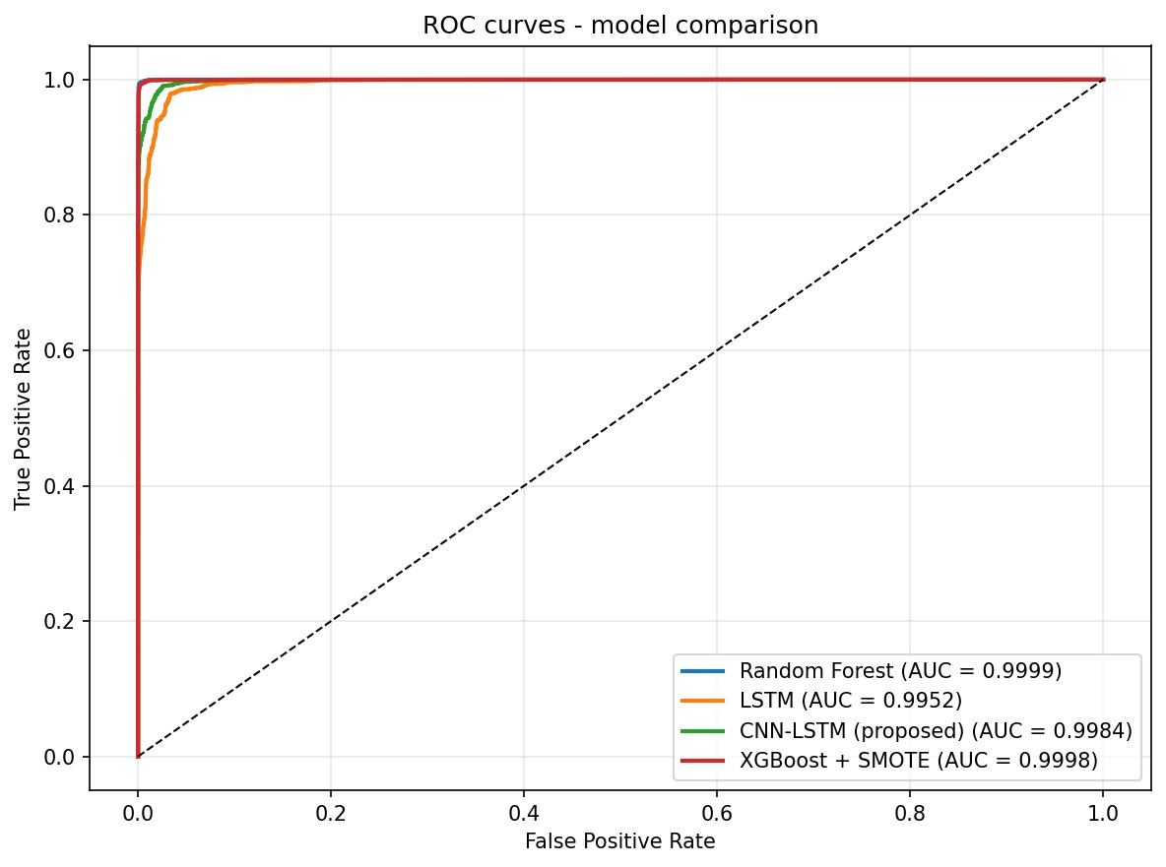
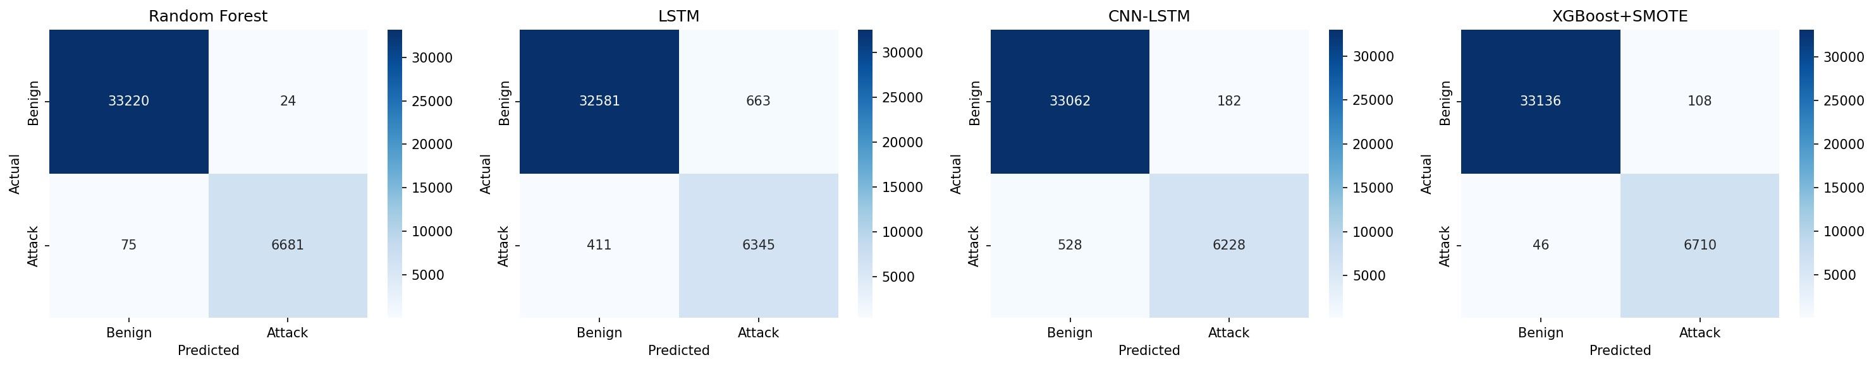
Visual evaluation — ROC and confusion matrices
9 / 11
Figure 3: Confusion matrices for all four models on the test set.
Confusion matrix takeaways
RF: only 24 false positives out of 33,244 benign flows
LSTM: 663 FP and 411 FN — worst on both axes
CNN-LSTM cuts LSTM’s FPs to 182 (3.6× reduction)
XGBoost+SMOTE: only 46 missed attacks (best recall)
Figure 4: ROC curves. RF and XGBoost+SMOTE dominate the upper-left corner; CNN-LSTM clearly above plain LSTM.
Udhaya Kumar Palani · 23306891 · MSc Cybersecurity, NCI
Notes:
SPEAKER NOTES — Slide 9 (~50 seconds) "Two visuals make the comparison concrete. The ROC curves on the left show that Random Forest and XGBoost+SMOTE — the red and blue lines hugging the upper-left corner — are essentially indistinguishable, both at AUC above 0.9998. The CNN-LSTM curve in green sits noticeably below them. The plain LSTM in orange is the lowest of all four, with visibly slower rise to the top-left. The confusion matrices on the right break down the error types. Random Forest produces only 24 false positives out of 33,244 benign flows. The plain LSTM is the worst on both axes — 663 FPs and 411 FNs. My CNN-LSTM cuts the LSTM's false positives to 182 — a 3.6× reduction — but at the cost of recall. XGBoost+SMOTE has the best recall, missing only 46 attacks. This visualises the trade-off explicitly: Random Forest favours precision, XGBoost+SMOTE favours recall, CNN-LSTM is in between, plain LSTM is dominated." DELIVERY TIP: Use your laser pointer or cursor to point at the actual curves and matrix cells you reference — this is hard to follow from text alone.

Slide 10
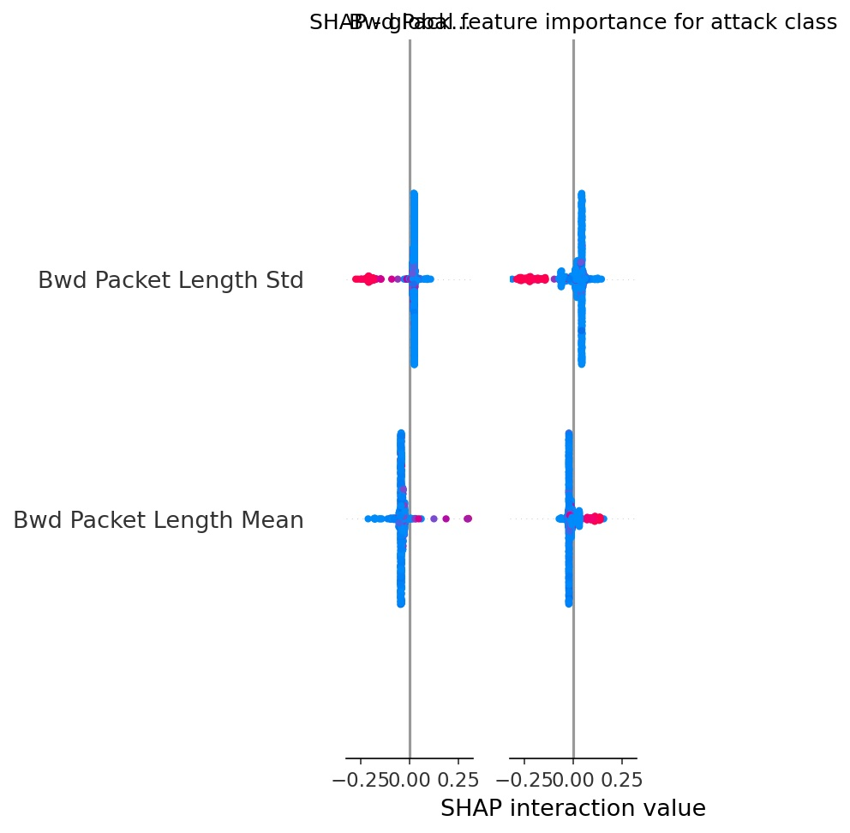
Live demo: SHAP interpretability in Colab
10 / 11
Pre-computed reference (in case of demo issue):
LIVE DEMO
Switching to Google Colab now
What I’ll show:
1. The CFS function and selected features (~10 s)
2. The CNN-LSTM model summary (~10 s)
3. Run the SHAP cell live (~30 s)
4. Walk through the SHAP global importance plot (~30 s)
All cells are pre-run; I am only re-executing the SHAP cell.
Figures 5–6: SHAP attributions (Random Forest). Top features align with Pearson ranking from Slide 6.
Udhaya Kumar Palani · 23306891 · MSc Cybersecurity, NCI
Notes:
SPEAKER NOTES — Slide 10 (~2 minutes total: 30 s setup, 90 s demo) PART A — On this slide (~30 seconds): "For interpretability I'm switching to Google Colab now to show you SHAP running live. I'll show four things in the next 90 seconds: the CFS function and the features it picked, the CNN-LSTM model summary, the SHAP cell running live, and a quick walk-through of what SHAP found. All earlier cells are pre-run from this morning so I'm not retraining anything live — only re-executing the SHAP cell." PART B — SWITCH TO COLAB. Demo script (~90 seconds): STEP 1 (~10 s) — Scroll to the CFS section: "This is the CFS function. Two passes — class relevance, then redundancy elimination. It returns about 16 features, and you can see at the top of the printed list: Bwd Packet Length Std, Max, Mean — the same features Figure 2 highlighted." STEP 2 (~10 s) — Scroll to model summary: "Here's the CNN-LSTM model summary. Two Conv1D blocks, an LSTM, two dense layers. About 25,000 trainable parameters." STEP 3 (~30 s) — Run the SHAP cell: "And here's SHAP running live." [Click 'Run' on the cell containing: explainer = shap.TreeExplainer(rf); shap_values = explainer.shap_values(X_shap)] "This computes Shapley values for 1000 test flows in about 20 seconds — TreeExplainer is exact and fast on Random Forest." STEP 4 (~30 s) — Walk through the SHAP plot: "And here's the result — the global feature importance plot. Notice the top features: backward packet length statistics. These are the same features that Pearson correlation ranked first on Slide 6 — two completely independent feature-importance methods agreeing on the same answer. That's exactly the kind of audit trail an analyst needs to trust an alert. Switching back to slides." PART C — RETURN to slides (~10 s): "That's the demo. The convergence between SHAP and Pearson is the central interpretability finding." CRITICAL TIPS: - BEFORE the talk: open Colab in a separate tab; pre-run every cell EXCEPT the SHAP one - Keep the runtime warm — don't let it disconnect - If the SHAP cell fails: pivot to "let me show you the pre-computed result" and click the existing output cell instead - Practice the alt-tab once before the real recording

Slide 11
Conclusions, limitations, future work
11 / 11
Conclusions
Limitations
Future work
CFS reduced 78 → ~16 features without harming accuracy across all four classifiers.
Proposed CNN-LSTM beats LSTM baseline on every metric (+2.4 F1 pp, −3.6× FPR).
But Random Forest and XGBoost+SMOTE are stronger overall — honest finding.
SHAP top features align with Pearson — audit trail for analysts.
Binary task only (multi-class deferred).
200k stratified sample, not full 2.83M.
SHAP applied only to RF (TreeExplainer); KernelExplainer on deep models too costly.
No cross-testbed validation (Apruzzese et al. 2022 caveat).
No adversarial robustness testing.
Multi-class extension on all 7 attack types.
Add SMOTE / focal loss to deep models — likely to close the gap to XGBoost+SMOTE.
KernelExplainer SHAP on CNN-LSTM for full interpretability story.
Cross-testbed validation (CICIDS2017 → UNSW-NB15).
Adversarial evasion testing.
Thank you. Questions?
Udhaya Kumar Palani · 23306891 · MSc Cybersecurity, NCI
Notes:
SPEAKER NOTES — Slide 11 (~60 seconds + Q&A) "To wrap up. CONCLUSIONS: CFS reduced the feature space from 78 to about 16 with no accuracy loss across all four classifiers — RQ1 confirmed. My proposed CNN-LSTM beats the LSTM baseline on every metric — RQ2 partially confirmed. But honestly, Random Forest and XGBoost+SMOTE outperform my hybrid overall on this binary task. SHAP attributions align with Pearson correlations — RQ3 confirmed, and provides an audit trail for analysts. LIMITATIONS: I'm transparent about five — binary-only, sampled, SHAP on RF only, no cross-testbed validation, no adversarial testing. FUTURE WORK: The single most impactful next step is adding SMOTE or focal loss to the deep models — this would likely close the gap to XGBoost+SMOTE and possibly let the CNN-LSTM win. Thank you. I'm happy to take questions." DELIVERY TIP: When you say 'honestly', look directly at the camera. Examiners reward this kind of intellectual honesty far more than over-claiming. ANTICIPATED Q&A: Q: Why didn't you add SMOTE to the deep models? A: Time. It's the first thing I'd add given another week. The XGBoost+SMOTE result is the strongest evidence that this is the right next step. Q: Why binary, not multi-class? A: Tractability in the four-day timeline. The pipeline extends to multi-class with about 30 lines of code change documented in the notebook. I expect the relative ordering of models to shift — deep models tend to gain more on multi-class than tree ensembles. Q: Is the CNN-LSTM really 'spatial' if there's no image input? A: Fair challenge. The Conv1D operates over the feature vector, which has no genuine spatial structure. The CNN is acting as a local feature-interaction detector, not a spatial filter in the image-processing sense. I cite Alsaiari and Ilyas 2025 for the architecture but the term 'spatial' is loose in their framing too. Q: Is 0.07% FPR realistic in production? A: At the test-set level, yes. Sustained at production scale across distribution shift, no — and that's why Apruzzese et al. 2022 warn that benchmark FPRs are not directly transferable. Cross-testbed validation is in my future work for that reason. Q: Why CFS instead of PSO like the base paper? A: Reproducibility and simplicity. CFS is deterministic given a fixed seed and threshold, requires no random initialisation, and gives features a SHAP-friendly independence property. The base paper's PSO is more flexible but harder to defend in a viva.

