Slide 1


K.RAMAKRISHNAN COLLEGE OF TECHNOLOGY (AUTONOMOUS), TRICHY SMART CROP GUARDIAN:WILD ANIMALS INTRUSION DETECTION AND ALERT SYSTEM
PRESENTED BY,
SANGEETHA S (811721243047)
UDHAYAMALATHI N (811721243059)
VASANTHA PRIYA M (811721243060)
GUIDED BY,
Ms.S.Murugavalli., M.E.,(Ph.D)
ASSISTANT PROFESSOR/ AI

Slide 2
OBJECTIVE
An automated solution is proposed to detect wild animal activities in agricultural and residential areas using the YOLOv8 algorithm for real-time monitoring. This system ensures rapid identification of wildlife intrusions and instantly notifies concerned users via email alerts. By enabling immediate response, it helps safeguard crops and residential properties from potential damage. The approach enhances field and home security while minimizing financial losses caused by wildlife interference. Overall, it offers an efficient and intelligent method to protect resources from animal activity.

Slide 3
PROBLEM DEFINITION EXISTING SYSTEM
Farmers and homeowners use physical barriers such as fences and scarecrows.
Basic deterrents like loud noises are employed to scare away animals.
Surveillance often depends on human presence or basic camera systems without automated detection.
Conventional systems lack the capability to track and identify wild animals effectively.
Drawbacks:
Manual monitoring is time-consuming.
Lacks real-time automated alerts.
Limited detection accuracy for animals.

Slide 4
PROPOSED SYSTEM
The proposed system follows a structured methodology for real-time wild animal detection and deterrence using the YOLOv8 algorithm.
Initially, live video feeds from surveillance cameras are processed using YOLOv8 for object detection, accurately identifying animals entering the monitored area.
Once an animal is detected, the system classifies it and triggers an automated response, sending instant alert notifications via email to the concerned users.
Simultaneously, deterrent mechanisms such as a buzzer, cracker sound system, flashlights for nighttime visibility, in the control room are activated to scare away the animals.
The system continuously monitors and updates detection data, ensuring real-time tracking and improved security.
By integrating AI-based detection, automated alerts, and hardware deterrents, this methodology enhances efficiency, reduces manual intervention, and minimizes crop and property damage.

Slide 5
LITERATURE SURVEY
S.NO | PAPER NAME | AUTHORS | YEAR | DESCRIPTION | DRAWBACKS
1 | ReDeformTR: Wildlife Re-Identification Based on Light-Weight Deformable Transformer With Multi-Image Feature Fusion | Zitong Li, WeiHong Tian, Weimin Li | 2024 | Improved Accuracy, Multi-Image Feature Fusion. | Resource Dependency, Complexity.
2 | Unmanned Aerial Surveillance and Tracking System in Forest Areas for Poachers and Wildlife | R.G. Sangeeetha, C.Hemanth | 2024 | Real-Time Data, Enhanced Monitoring. | Limited Battery Life, Dependence on Weather
3 | Edge AI in Sustainable Farming: Deep Learning-Driven IoT Framework to Safeguard Crops From Wildlife Threats | J.S.Nisha,Veerapu Goutham | 2024 | Light weight Design, Sustainability | Environmental Impact,Initial Costs.
4 | Tracking Small Wildlife With Minimal-Complexity Radio Frequency Transmitters: Near-Optimal Detection | Michaeal W.Shafer | 2024 | Non-Intrusive | Limited Range,Technical Expertise.
5 | A Comprehensive Review of Deep Learning-Based Anomaly Detection Methods for Precision Agriculture description and demerits | Meshwa . | 2023 | Aiming to enhance decision-making | Over-Reliance on Visual Data

Slide 6
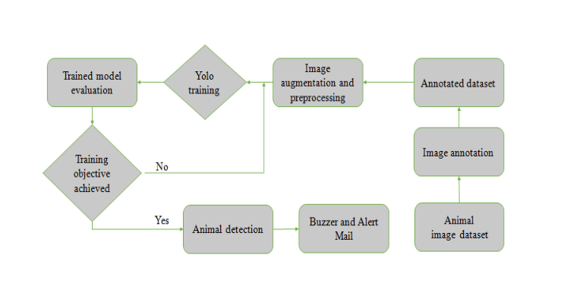
ARCHITECTURE DIAGRAM

Slide 7
SYSTEM SPECIFICATIONS
Hardware & Software Used
Programming Language:
Python
Development Tool:
Python IDLE
Hardware Requirements:
Processor:
Intel or AMD A4 (or higher)
Additional Hardware:
Sensors (e.g., motion sensors, thermal cameras), microcontrollers (if applicable), and IoT devices for
automation.

Slide 8
METHODOLOGY
Image Acquisition & Preprocessing
Image Acquisition:
The system begins with Image Acquisition, where live footage is captured using strategically placed surveillance cameras. These real-time images serve as the primary input for the detection module. Leveraging the powerful YOLOv8 algorithm, the system accurately identifies wild animals in the captured frames with minimal delay.
Once an animal is detected, the system automatically triggers an alert mechanism that immediately notifies farmers or residents via email, ensuring a rapid response. This automated solution enhances security by minimizing crop damage and property loss, ultimately reducing financial impact and improving the safety of rural and semi-urban communities.

Slide 9
Preprocessing:
Once images or video frames are captured from surveillance cameras, they often contain noise, variations in lighting, irrelevant background objects, or inconsistent resolutions, which can degrade detection accuracy. The preprocessing stage addresses these challenges by applying a series of image enhancement techniques such as resizing, normalization, denoising, histogram equalization, and contrast adjustment.
These operations ensure that all input frames are standardized and optimized before being passed to the YOLOv8 detection model. In some cases, grayscale conversion or region-of-interest (ROI) selection is also applied to reduce processing load and focus detection on critical areas. By cleaning and refining the input data, preprocessing minimizes false positives and improves the overall reliability of the system. It also enhances the model’s ability to identify wild animals under different environmental conditions, such as low light, fog, or motion blur

Slide 10
2. Feature Extraction & Storage:
Feature Extraction and Storage form an essential component of the smart crop guardian system, enabling accurate identification and efficient data handling. Once preprocessing is complete, the YOLOv8 model analyzes each frame to extract key features from detected objects, such as shape, size, movement patterns, and classification confidence. These features help differentiate wild animals from non-threatening objects like domestic animals, vehicles, or humans.
By focusing on significant visual cues, the system ensures high-precision detection even in complex environments. Extracted features are then logged and stored in a structured database for further analysis, record-keeping, and future training improvements. This data can include timestamps, animal type, location coordinates, and camera ID, supporting both real-time response and long-term wildlife activity monitoring.

Slide 11
Efficient storage not only helps in maintaining a history of intrusions but also allows for pattern analysis and predictive modeling. Together, feature extraction and storage empower the smart crop guardian to provide both immediate alerts and actionable insights for proactive field management. This organized repository not only supports real-time response and evidence logging but also serves as a valuable dataset for further analysis, training of future models, and behavioral pattern prediction.
Additionally, secure and scalable storage enables long-term monitoring, statistical reporting, and system auditing, thereby enhancing the system’s ability to adapt and evolve. Feature extraction and storage together empower the SMART CROP GUARDIAN system to operate as both a responsive alert mechanism and a strategic decision-support tool for farmers, wildlife officers, and local authorities.

Slide 12
3. Detection & Classification (Using YOLOv8):
Smart crop guardian system, enabling accurate identification of wild animals in real-time. Once images are preprocessed and features are extracted, they are passed into the YOLOv8 model, which is known for its speed and precision in object detection. YOLOv8 operates by dividing each image into a grid and simultaneously predicting bounding boxes and class probabilities, allowing it to detect and classify objects in a single pass. This one-step detection approach makes it ideal for real-time monitoring applications in agricultural and residential zones.
The model has been trained and fine-tuned using a dataset of wild animals such as elephants, boars, deer, and leopards, enabling it to recognize these species with high accuracy. YOLOv8’s architecture supports multi-class detection, allowing it to detect several animals at once within a single frame. Each detection is recorded with class labels, confidence scores, bounding box coordinates, and timestamps. This structured output not only feeds into the alert mechanism but also helps build a robust dataset for future analysis and model retraining.

Slide 13
The integration of YOLOv8 significantly enhances the smart crop guardian’s ability to differentiate between real threats and harmless movement. For instance, it can distinguish between a wild boar and a domestic dog, thereby minimizing false alerts. The system can also be deployed on lightweight edge devices. By leveraging YOLOv8, the system offers advanced capabilities such as real-time decision-making, instant response, and detailed animal tracking, empowering farmers and residents to take timely protective action.
Moreover, all detection logs are stored for future study, enabling pattern analysis of animal behavior and helping in strategic planning. Overall, this detection and classification stage transforms simple visual data into intelligent insights, ensuring both human safety and crop protection with high reliability and minimal delay.

Slide 14
4. Decision Making:
Smart Crop Guardian system is its ability to process data from multiple sensors in real time and make accurate decisions based on this data. The system employs machine learning algorithms to analyze the incoming sensor data and distinguish between legitimate animal intrusions and environmental factors like wind or rainfall that could trigger false alarms. Machine learning models are trained to recognize patterns associated with specific animals and to understand the characteristics of different threats.
For instance, a boar might have a distinct movement pattern compared to a deer, and the system can learn to identify these differences over time. Additionally, algorithms can filter out irrelevant movements, such as those caused by non-threats, like birds or insects. This learning capability improves the system’s accuracy over time, making it more efficient in detecting only true threats and minimizing false positives.

Slide 15
Wild Animals Intrusion Detection and Alert System represents a significant leap forward in agricultural technology. By combining advanced sensors, machine learning algorithms, and real-time alerts, this system provides farmers with an efficient and effective way to protect their crops from wild animal intrusions. With its scalability, energy efficiency, and cost-effectiveness,
It is poised to become a valuable tool in modern agriculture, helping farmers safeguard their livelihoods and ensure the sustainability of their crops in the face of growing wildlife threats. To further enhance the system’s reliability, verification mechanisms are built in. If an animal intrusion is detected, the system can trigger cameras to capture images or videos of the intrusion. These images can be sent to the farmer or stored for later analysis, allowing for confirmation before any mitigation action is taken.

Slide 16
5. Automated Response Mechanisms
Buzzer Activation: When wild animals are detected, a loud buzzer is triggered to create a noise that scares them away from the crop field. This immediate response ensures that animals do not get too close, reducing the risk of crop damage.
Email/IoT Alerts: In addition to local deterrents, the system sends notifications through email or IoT platforms to the relevant stakeholders such as farmers, security personnel, or forest officials. These alerts allow for real-time awareness and immediate action if required.
Cracker Sound System: The system includes simulated explosions, also known as cracker sound systems, which emit loud sounds to further deter animals. These sounds mimic explosions, creating an intimidating environment that encourages animals to leave the area.

Slide 17
Flashlights: High-intensity flashlights are used during the night to keep wild animals at bay. These bright lights act as a deterrent to nocturnal intruders, making it difficult for them to approach the crops under the cover of darkness.
Control Room Alerts: When the system detects a significant intrusion or when automated deterrents are ineffective, control room alerts notify security personnel or other designated individuals.These alerts provide the necessary information for manual intervention to ensure that wild animals do not pose a threat to the crops.

Slide 18
ADVANTAGES
Instant SMS and email alerts.
Real life wild animal detection.
Automated deterrent mechanisms activated.
Reduces crop loss and damage.
Minimizes manual monitoring effort.

Slide 19
APPLICATIONS
1. Agricultural Field Crop Protection
Protects crops from damage caused by wild animals like wild boars, deer, and elephants.
Uses motion sensors, thermal cameras, and AI-based detection to identify approaching animals
2. Residential Area Wildlife Monitoring
Prevents wild animals from entering residential zones near forest areas.
Uses AI-powered cameras and IoT-based alert systems to notify homeowners and authorities.
3. Forest Border Security Enhancement
Monitors forest perimeters to detect unauthorized animal movements and poaching activities.
Send alerts to forest officials and security teams when an animal crosses a restricted zone.
4. Farm Surveillance and Intrusion Detection
Acts as a 24/7 smart security system for farms, detecting both animal and human intrusions.

Slide 20
CONCLUSION
The proposed system offers an effective and efficient solution for detecting and deterring wild animal intrusions in agricultural fields and residential areas. By leveraging the YOLOv8 algorithm for real-time animal detection, the system ensures prompt identification of threats and provides automated responses through alert notifications and deterrent mechanisms. This approach not only minimizes crop damage and property loss but also reduces
the need for constant manual surveillance, thereby improving overall security and operational efficiency. The integration of hardware components like sound alarms, flashing lights, further enhances the system's ability to protect farmlands and homes. Ultimately, this intelligent surveillance system contributes to safer agricultural practices, more secure residential areas, and a significant reduction in financial losses caused by wild animal activities.

Slide 21
REFERENCES
Li, Z., Tian, W., & Li, W. (2024). "ReDeformTR: Wildlife Re-Identification Based on Light-Weight Deformable Transformer With Multi-Image Feature Fusion."Journal of Wildlife AI Research, vol. 45, pp. 112-130.
Sangeetha, R. G., & Hemanth, C. (2024). "Unmanned Aerial Surveillance and Tracking System in Forest Areas for Poachers and Wildlife."International Journal of Remote Sensing & Wildlife Protection, vol. 39, pp. 210-225.
Nisha, J. S., & Goutham, V. (2024). "Edge AI in Sustainable Farming: Deep Learning-Driven IoT Framework to Safeguard Crops From Wildlife Threats. "Journal of AI in Agriculture, vol. 18, pp. 75-92.
Shafer, M. W. (2023). "Tracking Small Wildlife With Minimal-Complexity Radio Frequency Transmitters: Near-Optimal Detection."Journal of Ecological Technology, vol. 29, pp. 48-62.
Meshwa, M. (2024). "A Comprehensive Review of Deep Learning-Based Anomaly Detection Methods for Precision Agriculture: Description and Demerits.“ Journal of Smart Agriculture Research, vol. 22, pp.150-168.

Slide 22
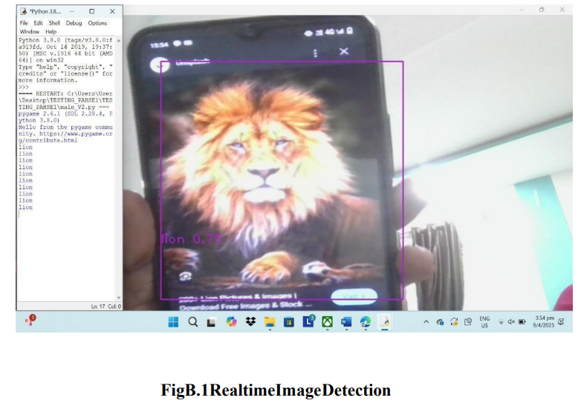
SCREENSHOTS

Slide 23
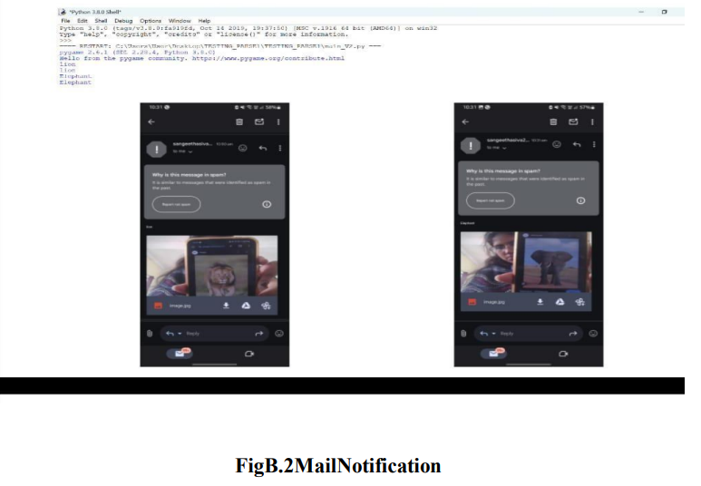

Slide 24
THANK YOU

