Slide 1
The Go Programming Language

Slide 2


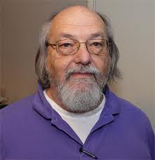
Go
developed ~2007 at Google by
Robert Griesemer, Rob Pike, Ken Thompson
open source
compiled, statically typed
  very fast compilation
C-like syntax
garbage collection
built-in concurrency
no classes or type inheritance or overloading or generics
  unusual interface mechanism instead of inheritance

Slide 3
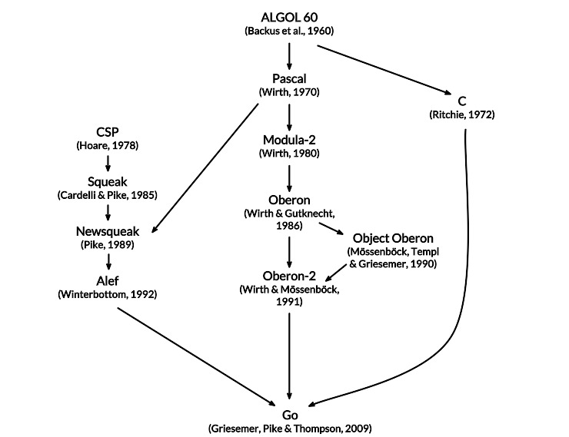
Influences

Slide 4
Negative influences
"When the three of us got started, it was pure research. The three of us got together and decided that we hated C++. We started off with the idea that all three of us had to be talked into every feature in the language, so there was no extraneous garbage put into the language for any reason." (Ken Thompson)

Slide 5
Outline
history
basic constructs, simple programs
arrays & slices
maps
methods, interfaces
concurrency, goroutines

Slide 6
Hello world in Go
package main
import "fmt"
func main() {
fmt.Println("Hello, 世界")
}
$ go run hello.go # to compile and run
$ go build hello.go # to create a binary
$ go help # for more

Slide 7
Types, constants, variables
basic types
  bool string int8 int16 int32 int64 uint8 … int uint
  float32 float64 complex64 complex128
  quotes: ‘世’, “UTF-8 string”, `raw string`
variables
  var c1, c2 rune
  var x, y, z = 0, 1.23, false // variable decls
  x := 0; y := 1.23; z := false // short variable decl
  Go infers the type from the type of the initializer
  assignment between items of different type requires an explicit conversion, e.g., int(float_expression)
operators
  mostly like C, but ++ and -- are postfix only and not expressions
  assignment is not an expression
  no ?: operator

Slide 8
Echo command:
// Echo prints its command-line arguments.
package main
import (
"fmt"
"os"
)
func main() {
var s, sep string
for i := 1; i < len(os.Args); i++ {
s += sep + os.Args[i]
sep = " "
}
fmt.Println(s)
}

Slide 9
Echo command (version 2):
// Echo prints its command-line arguments.
package main
import (
"fmt"
"os"
)
func main() {
s, sep := "", ""
for _, arg := range os.Args[1:] {
s += sep + arg
sep = " "
}
fmt.Println(s)
}

Slide 10
Arrays and slices
an array is a fixed-length sequence of same-type items
  months := [...]string {1:"Jan", 2:"Feb", /*...,*/ 12:"Dec"}
a slice is a subsequence of an array
summer := months[6:9]; Q2 := months[4:7]
elements accessed as slice[index]
  indices from 0 to len(slice)-1 inclusive
  summer[0:3] is elements months[6:9]
summer[0] = "Juin"
loop over a slice with for range
  for i, v := range summer {
  fmt.Println(i, v)
  }
slices are very efficient (represented as small structures)
most library functions work on slices

Slide 11
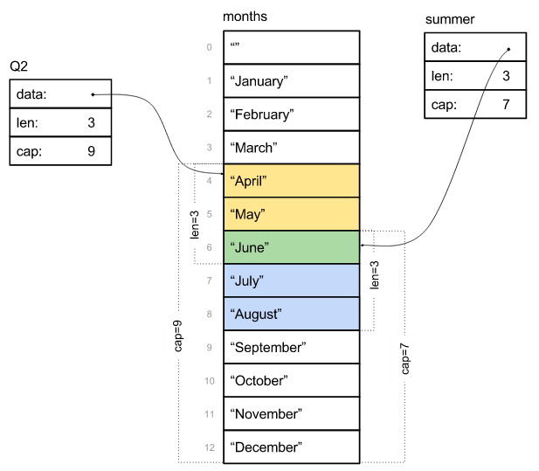

Slide 12
Maps (== associative arrays)
unordered collection of key-value pairs
  keys are any type that supports == and != operators
  values are any type
  // Find duplicated lines in stdin.
  func main() {
  counts := make(map[string]int)
  in := bufio.NewScanner(os.Stdin)
  for in.Scan() {
  counts[in.Text()]++
  }
  for line, n := range counts {
  if n > 1 {
  fmt.Printf("%d\t%s\n", n, line)
  }
  }
  }

Slide 13
Methods and pointers
can define methods that work on any type, including your own:
type Vertex struct {
X, Y float64
}
func (v *Vertex) Scale(f float64) {
v.X = v.X * f
v.Y = v.Y * f
}
func (v Vertex) Abs() float64 {
return math.Sqrt(v.X*v.X + v.Y*v.Y)
}
func main() {
v := &Vertex{3, 4}
v.Scale(5)
fmt.Println(v, v.Abs())
}

Slide 14
Interfaces
an interface is satisfied by any type that implements all the methods of the interface
completely abstract: can't instantiate one
can have a variable with an interface type
then assign to it a value of any type that has the methods the interface requires
a type implements an interface merely by defining the required methods
  it doesn't declare that it implements them
Writer: the most common interface
type Writer interface {
Write(p []byte) (n int, err error)
}

Slide 15
Sort interface
sort interface defines three methods
any type that implements those three methods can sort
algorithms are inside the soft package, invisible outside
package sort
type Interface interface {
Len() int
Less(i, j int) bool
Swap(i, j int)
}

Slide 16
Sort interface (adapted from Go Tour)
type Person struct {
Name string
Age int
}
func (p Person) String() string {
return fmt.Sprintf("%s: %d", p.Name, p.Age)
}
type ByAge []Person
func (a ByAge) Len() int { return len(a) }
func (a ByAge) Swap(i, j int) { a[i], a[j] = a[j], a[i] }
func (a ByAge) Less(i, j int) bool { return a[i].Age < a[j].Age }
func main() {
people := []Person{{"Bob",31}, {"Sue",42}, {"Ed",17}, {"Jen",26},}
fmt.Println(people)
sort.Sort(ByAge(people))
fmt.Println(people)
}

Slide 17
Tiny version of curl
func main() {
url := os.Args[1]
resp, err := http.Get(url)
if err != nil {
fmt.Fprintf(os.Stderr, "curl: %v\n", err)
os.Exit(1)
}
_, err = io.Copy(os.Stdout, resp.Body)
if err != nil {
fmt.Fprintf(os.Stderr, "curl: copying %s: %v\n",
url, err)
os.Exit(1)
}
}

Slide 18
Tiny web server
func main() {
http.HandleFunc("/", handler)
http.ListenAndServe("localhost:8000", nil)
}
// handler echoes Path component of the request URL r.
func handler(w http.ResponseWriter, r *http.Request) {
fmt.Fprintf(w, "URL.Path = %q\n", r.URL.Path)
}
http.ResponseWriter implements Writer interface

Slide 19
Concurrency: goroutines & channels
channel: a type-safe generalization of Unix pipes
  inspired by Hoare's Communicating Sequential Processes (1978)
goroutine: a function executing concurrently with other goroutines in the same address space
  run multiple parallel computations simultaneously
  loosely like threads but much lighter weight
channels coordinate computations by explicit communication
  locks, semaphores, mutexes, etc., are much less often used

Slide 20
Example: web crawler
want to crawl a bunch of web pages to do something
  e.g., figure out how big they are
problem: network communication takes relatively long time
  program does nothing useful while waiting for a response
solution: access pages in parallel
  send requests asynchronously
  display results as they arrive
  needs some kind of threading or other parallel process mechanism
takes less time than doing them sequentially

Slide 21
Version 1: no parallelism
func main() {
start := time.Now()
for _, site := range os.Args[1:] {
count("http://" + site)
}
fmt.Printf("%.2fs total\n", time.Since(start).Seconds())
}
func count(url string) {
start := time.Now()
r, err := http.Get(url)
if err != nil {
fmt.Printf("%s: %s\n", url, err)
return
}
n, _ := io.Copy(ioutil.Discard, r.Body)
r.Body.Close()
dt := time.Since(start).Seconds()
fmt.Printf("%s %d [%.2fs]\n", url, n, dt)
}

Slide 22
Version 2: parallelism with goroutines
func main() {
start := time.Now()
c := make(chan string)
n := 0
for _, site := range os.Args[1:] {
n++
go count("http://" + site, c)
}
for i := 0; i < n; i++ {
fmt.Print(<-c)
}
fmt.Printf("%.2fs total\n", time.Since(start).Seconds())
}
func count(url string, c chan<- string) {
start := time.Now()
r, err := http.Get(url)
if err != nil {
c <- fmt.Sprintf("%s: %s\n", url, err)
return
}
n, _ := io.Copy(ioutil.Discard, r.Body)
r.Body.Close()
dt := time.Since(start).Seconds()
c <- fmt.Sprintf("%s %d [%.2fs]\n", url, n, dt)
}

Slide 23
Version 2: main() for parallelism with goroutines
func main() {
start := time.Now()
c := make(chan string)
n := 0
for _, site := range os.Args[1:] {
n++
go count("http://" + site, c)
}
for i := 0; i < n; i++ {
fmt.Print(<-c)
}
fmt.Printf("%.2fs total\n", time.Since(start).Seconds())
}

Slide 24
Version 2: count() for parallelism with goroutines
func count(url string, c chan<- string) {
start := time.Now()
r, err := http.Get(url)
if err != nil {
c <- fmt.Sprintf("%s: %s\n", url, err)
return
}
n, _ := io.Copy(ioutil.Discard, r.Body)
r.Body.Close()
dt := time.Since(start).Seconds()
c <- fmt.Sprintf("%s %d [%.2fs]\n", url, n, dt)
}

Slide 25
Python version, no parallelism
import urllib2, time, sys
def main():
start = time.time()
for url in sys.argv[1:]:
count("http://" + url)
dt = time.time() - start
print "\ntotal: %.2fs" % (dt)
def count(url):
start = time.time()
n = len(urllib2.urlopen(url).read())
dt = time.time() - start
print "%6d %6.2fs %s" % (n, dt, url)
main()

Slide 26
Python version, with threads
import urllib2, time, sys, threading
global_lock = threading.Lock()
class Counter(threading.Thread):
def __init__(self, url):
super(Counter, self).__init__()
self.url = url
def count(self, url):
start = time.time()
n = len(urllib2.urlopen(url).read())
dt = time.time() - start
with global_lock:
print "%6d %6.2fs %s" % (n, dt, url)
def run(self):
self.count(self.url)
def main():
threads = []
start = time.time()
for url in sys.argv[1:]: # one thread each
w = Counter("http://" + url)
threads.append(w)
w.start()
for w in threads:
w.join()
dt = time.time() - start
print "\ntotal: %.2fs" % (dt)
main()

Slide 27
Python version, with threads (main)
def main():
threads = []
start = time.time()
for url in sys.argv[1:]: # one thread each
w = Counter("http://" + url)
threads.append(w)
w.start()
for w in threads:
w.join()
dt = time.time() - start
print "\ntotal: %.2fs" % (dt)
main()

Slide 28
Python version, with threads (count)
import urllib2, time, sys, threading
global_lock = threading.Lock()
class Counter(threading.Thread):
def __init__(self, url):
super(Counter, self).__init__()
self.url = url
def count(self, url):
start = time.time()
n = len(urllib2.urlopen(url).read())
dt = time.time() - start
with global_lock:
print "%6d %6.2fs %s" % (n, dt, url)
def run(self):
self.count(self.url)

Slide 29
Where will Go go?
comparatively small but rich language
efficient; compilation is very fast
concurrency model is convenient and efficient
object model is unusual but seems powerful
significant use at Google and elsewhere
mostly for web server applications
  "C for the 21st century" ?

Slide 30
Go source materials
official web site:
golang.org
Go tutorial, playground
Rob Pike on why it is the way it is:
http://www.youtube.com/watch?v=rKnDgT73v8s
Russ Cox on interfaces, reflection, concurrency
http://research.swtch.com/gotour

Slide 31
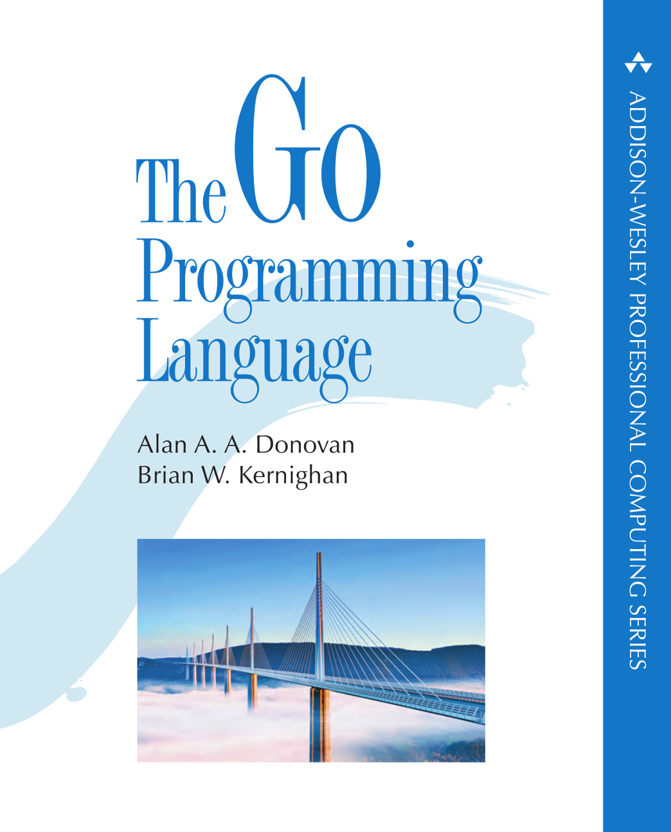
Advertisement:

