Slide 1
15-440 Distributed Systems
Lecture 03 – Classical Synchronization
GO Style Concurrency
Thursday, September 8th, 2016

Slide 2
Logistics Updates
P0 Released Monday (Sept 12th)
  Due: (TBA, likely 11:59pm EST, Sept 23rd)
  Monday 9/12 Recitation
HW1 released Monday (Sept 12th)
  Due Sept 9/27 (*No Late Days*).
As always, check for due date on the web / writeup
Waitlists: working through them to enroll people

Slide 3
Today's Lecture Outline
Concurrency Management - Synchronization
Part I: Review of Classical Concurrency
  Concepts, Locks, Condition Variables,
Part II: Concurrency Model in GO
  Initial walk through, details in GO overview on Monday

Slide 4
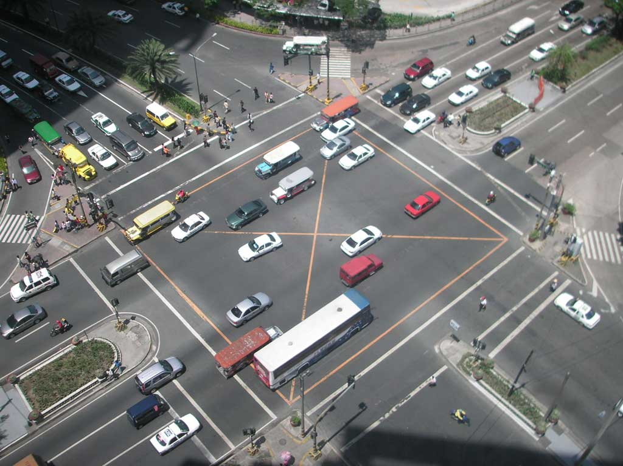

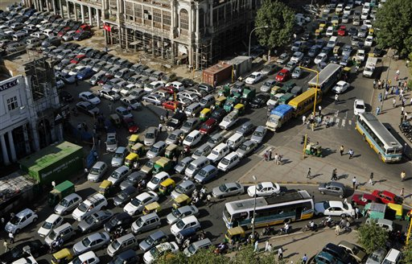
Concurrency
We will use concurrency concepts repeatedly
Recap: Why is concurrency important/useful?
  Allows safe/multiplexed access to shared resources
  i.e. safe operation with multiple independent entities
    Single core CPUs to wide area distributed systems
  Why is sharing resources useful? Real life example?
With (some at least!)
Concurrency Control
…or not!
Notes:
What are example of multiple entities? (thread, processes, computers, etc)
Why is sharing resources useful? ==> overcommit resources so that the same CPU/memory can be used my multiple processes, multiple computers (in a DS),
What are examples of us using concurrency in real life? (not in the computing sense) ➔ we are all sharing the air in the room (no synchronization). When we are at a traffic stop, we have some sort of synchronization (with the lights), without which there would be chaos!

Slide 5
Concurrency is key in DS
Today, we start with threads on a single node
…. we will expand them to multiple machines
  Key assumption: ignore independent failures
Code Concurrency: Terms (Ref: Dijkstra ‘65,’68)
  Critical Section: piece of code accessing a shared resource, usually variables or data structures
  Race Condition: Multiple threads of execution enter CS at the same time, update shared resource, leading to undesirable outcome
  Indeterminate Program: One or more Race Conditions, output of program depending on ordering, non deterministic
  So, what is the solution?
    Mutual Exclusion!
Notes:
Ignore independent failures: that means if that if a node dies or loses power, all the concurrent threads die. (catastrophic failure). This is not the case with real distributed systems when you could have a subset of nodes die.

Slide 6
Achieving Mutual Exclusion
Mutual Exclusion: guarantee that only a single thread/process enters a CS, avoiding races
Desired Properties of Mutual Exclusion
  Mutual Exclusion (Correctness): single process in CS at one time
  Progress (Efficiency): Processes don’t wait for available resources, or no spin-locks => no wasted resources
  Bounded Waiting (Fairness): No process waits for ever for a resource, i.e. a notion of fairness
  Trivial solution if we didn’t care about fairness! What is it?
  Can you give an example of concurrent access to files in an OS which does not lead to concurrency problems or need mutex?
Notes:
Answer: If no fairness constraint, just have them wait forever and no one enters the CS ==> no race condition! :)
Bonus Point: Can you give an example of entites sharing resources in the computing sense that is guaranteed to not lead to concurrency problems? Hint: Multiple threads/processes ONLY reading data from files (none writing to it).

Slide 7
Achieving Mutual Exclusion
Mutual Exclusion: Usually need some H/W support
  Test-and-Set instruction (atomic testing/setting of a value)
TS (<memloc>)
{ if <memloc>==1
{
<memloc>=0;
return 1;
}
else
return 0;
}
Note: Atomic/Non-interruptable
We can use Test-and-Set to implement Mutex
// Do this before entering CS
Acquire_Mutex(<mutex>)
{
while(!TS(<mutex>))
}
{CS: Critical Section of Code}
// After Exiting CS
Release_Mutex(<mutex>)
{
<mutex> = 1
}
Build more complex primitives around this H/W
Notes:
Note, there are other hardware support that can be present, for example compare and swap etc. You can find them on the linked material in the class page.
Instructors note: Changed this example to be reverse of the original example, to make it consistent with the semantics on the next page.
right now, Mutex = 1 means resource available while Mutex = 0 means unavailable.

Slide 8
Classical Model of Concurrency
Threads running within an address space
  Private/Shared state => primitive to access shared state
  E.g. Semaphores: Integer variable ‘x’ with 2 operations
x.P():
while (x == 0) wait;
x–
x.V():
x++
Note: `P’ and `V’ operations are Atomic, not interruptable
What is a Binary Semaphore then?
// binary Semaphore = Mutex
x=1; Unlocked, Resource Available
x=0; Locked, Must wait for resource
Notes:
Binary Semaphore == Mutex

Slide 9
Semaphones to Create a FIFO
Idea: Want to create (thread safe) FIFO queue
  Similar to GO channel, without a capacity limit
b.Init():
Initialize values
b.Insert(x)
Insert item into queue
b.Remove()
Block until queue not empty (if necessary)
Return element at head of queue
b.Flush():
Clear queue
// Assume we have a sequential implementation of a FIFO buffer
// b represents a structure with fields
sb: Sequential buffer implementation
mutex: Mutual exclusion lock
What do we need to do next? Wrap with Mutex
Notes:
So, we really want a FIFO queue that can support thread safe operations like (insert, remove, flush, Init)

Slide 10
Thread Safe FIFO Queue
b.Init():
b.sb = NewBuf()
b.mutex = 1
b.Insert(x):
b.mutex.lock()
b.sb.Insert(x)
b.mutex.unlock()
b.Remove():
b.mutex.lock()
x = b.sb.Remove()
b.mutex.unlock()
return x
b.Flush():
b.mutex.lock()
b.sb.Flush()
b.mutex.unlock()
.
.
.
.
b.Remove():
retry:
b.mutex.lock()
if !(b.sb.len() > 0) {
b.mutex.unlock()
goto retry
}
.
.
.
Potential Fix. Does this do it?
No, not really. This is a spin-lock. Wastes resources and
unclear if a Insert(x) will ever make progress.
This is inefficient and can be a potential LIVELOCK.
Is this correct?
No, what is Remove is called
and the buffer is empty?
Notes:
Init: Initialize New Buffer, set the Mutex to 1 (means unlocked).
Insert: first you lock the mutex, insert a new value x, and then unlock it.
Remove: lock the mutex, remove a single item => pass to x and then unlock the mutex.
Flush: locks the mutex, Flushes all items and then unlocks the Mutex again.
Question: Could this solution ever make progress?

Slide 11
Thread Safe FIFO Queue
Use semaphore “items” (Bryant and O’hallaron)
b.Init():
b.sb = NewBuf()
b.mutex = 1
b.items = 0
b.Insert(x):
b.mutex.lock()
b.sb.Insert(x)
b.mutex.unlock()
b.items.V()
b.Remove():
b.items.P()
b.mutex.lock()
x = b.sb.Remove()
b.mutex.unlock()
return x
b.Flush():
b.mutex.lock()
b.sb.Flush()
b.items = 0
b.mutex.unlock()
.
.
.
b.Remove():
b.mutex.lock()
b.items.P()
x = b.sb.Remove()
b.mutex.unlock()
return x
.
.
.
OK, now we are good!
No, not really. We avoid the race condition but prone
to a DEADLOCK. Can reach point where no one is able
to proceed. How?
Lets say you call Remove when buffer is empty.
Remove gets lock. Somewhere else, want to Insert,
but can't get past lock.
This fixes it.
No, what if Flush is called after
b.items.P() and the buffer is empty?
Hard to fix, need different approach.
Notes:
Semaphore ”items” can be used to count the number of items in the buffer. Remember, a Binary Semaphore is a Mutex, while a semaphore can “count”.
Left Solution: No, not correct. For Inserts and Remove, this would work OK. But Flush messes things up.
If flush occurs at point of vulnerability in Remove, then again find self trying to remove from empty buffer.
Right solution: Can get to deadlock if:
Lets say you call Remove when buffer is empty. Remove gets lock. Somewhere else, want to Insert, but can't get past lock.

Slide 12
Buffer using ConditionVars
Lets use Condition Variables (cvars)
  cvars provide a sync point, one thread suspended until activated by another. (more efficient way to wait than spin lock )
  cvar always associated with mutex
  Wait() and Signal() operations defined with cvars
cvar.Wait():
Must be called after locking mutex.
Atomically: release mutex & suspend operation
When resume, lock mutex (but maybe not right away)
cvar.Signal():
If no thread suspended, then NO-OP
Wake up (at least) one suspended thread.
(Typically do within scope of mutex, but not required) _x000c_
Notes:
Cvar essentially allows one thread to check whether a condition is true before continuing (i.e. the sync point)
Unique mutex per cvar, same mutex can be used my multiple cvars.

Slide 13
Buffer using ConditionVars
b.Init():
b.sb = NewBuf()
b.mutex = 1
b.cvar = NewCond(b.mutex)
b.Insert(x):
b.mutex.lock()
b.sb.Insert(x)
b.sb.Signal()
b.mutex.unlock()
b.Remove():
b.mutex.lock()
if b.sb.Empty() {
b.cvar.wait()
}
x = b.sb.Remove()
b.mutex.unlock()
return x
b.Flush():
b.mutex.lock()
b.sb.Flush()
b.mutex.unlock()
// Signal() If no thread suspended, then NO-OP
Wake up (at least) one suspended thread.
(Typically do within scope of mutex, but not required) _x000c_
// wait() Note that lock is first released & then retaken
Atomically: release mutex & suspend operation
When resume, lock mutex (but maybe not right away)
Notes:
Cvar essentially allows one thread to check whether a condition is true before continuing (i.e. the sync point)
Unique mutex per cvar, same mutex can be used my multiple cvars.

Slide 14
Buffer using ConditionVars
b.Init():
b.sb = NewBuf()
b.mutex = 1
b.cvar = NewCond(b.mutex)
b.Insert(x):
b.mutex.lock()
b.sb.Insert(x)
b.sb.Signal()
b.mutex.unlock()
b.Remove():
b.mutex.lock()
if b.sb.Empty() {
b.cvar.wait()
}
x = b.sb.Remove()
b.mutex.unlock()
return x
b.Flush():
b.mutex.lock()
b.sb.Flush()
b.mutex.unlock()
Cvar.wait() // 3 steps
Atomically {release lock + suspend operation)
.
.
.
Resume Execution
.
// point of vulnerability, someone can flush here
.
Lock Mutex
What a signal means:
Mesa semantics (looser) vs Hoare Semantics (tighter)
Still a small problem.
Notes:
Cvar essentially allows one thread to check whether a condition is true before continuing (i.e. the sync point)
Unique mutex per cvar, same mutex can be used my multiple cvars.
Signaling a thread only wakes them up; it is thus a hint that the state of the world has changed (in this case, that a value has been placed in the buffer), but there is no guarantee that when the woken thread runs, the state will still be as desired. This interpretation of what a signal means is often referred to as Mesa semantics, after the first research that built a condition variable in such a manner [LR80]; the contrast, referred to as Hoare semantics, is harder to build but provides a stronger guarantee that the woken thread will run immediately upon being woken [H74]. Virtually every system ever built employs Mesa semantics. (REF, http://pages.cs.wisc.edu/~remzi/OSTEP/threads-cv.pdf)

Slide 15
Buffer using ConditionVars
b.Init():
b.sb = NewBuf()
b.mutex = 1
b.cvar = NewCond(b.mutex)
b.Insert(x):
b.mutex.lock()
b.sb.Insert(x)
b.sb.Signal()
b.mutex.unlock()
b.Remove():
b.mutex.lock()
while b.sb.Empty() {
b.cvar.wait()
}
x = b.sb.Remove()
b.mutex.unlock()
return x
b.Flush():
b.mutex.lock()
b.sb.Flush()
b.mutex.unlock()
// What happens
Lock
if !sb.empty() goto ready
Unlock
wait for signal
Lock
if !sb.empty() goto ready
Unlock
wait for signal
Lock
. . .
ready: Can safely assume have lock & that buffer nonempty
// wait() Note that lock is first released & then retaken
Atomically: release mutex & suspend operation
When resume, lock mutex (but maybe not right away)
Simple Rule: With Mesa semantics, use while loops
to recheck the condition. Always safe to do so.
Additional examples for Cvars in the Remzi Ref.
Change “if” to While
Notes:
Cvar essentially allows one thread to check whether a condition is true before continuing (i.e. the sync point)
Unique mutex per cvar, same mutex can be used my multiple cvars.
Signaling a thread only wakes them up; it is thus a hint that the state of the world has changed (in this case, that a value has been placed in the buffer), but there is no guarantee that when the woken thread runs, the state will still be as desired. This interpretation of what a signal means is often referred to as Mesa semantics, after the first research that built a condition variable in such a manner [LR80]; the contrast, referred to as Hoare semantics, is harder to build but provides a stronger guarantee that the woken thread will run immediately upon being woken [H74]. Virtually every system ever built employs Mesa semantics. (REF, http://pages.cs.wisc.edu/~remzi/OSTEP/threads-cv.pdf)

Slide 16
Today's Lecture Outline
Concurrency Management - Synchronization
Part I: Review of Classical Concurrency
  Concepts, Locks, Condition Variables,
Part II: Concurrency Model in GO
  Initial walk through, details in GO overview on Monday

Slide 17
Concurrency model for GO
Set up a mini Client/Server within programs
  “Channels” and “GOroutines”
Channels are used for:
  Passing information around (are typed: int, char, …)
  Synchronizing GOroutines
  Providing pointer to return location (like a "callback")
GoRoutines:
  Independently executing function, launched by “go”
  Independent call stack, very inexpensive, 1000s of them
Concept: Instead of communicating by sharing memory, share memory by communicating
Notes:
Pike: Analogy GoRoutines are like running a shell program with an “&” at the end
The last concept is a nice way to think about the concurrency model of GO. Instead of processes communication using shared memory and then arbitrating access to it using mutexes and semaphores, the idea in GO is to share memory by communicating – i.e. have communicating processes pass data back and forth

Slide 18
Concurrency vs Parellelism
Source: GO concurrency Bob Pike (Google)
Concurrency is not parallelism, although it enables parallelism
1 Processor: Program can still be concurrent but not parallel
However a well written concurrent program may run well on multiprocessor platform
Notes:
GO Concurrency Model: https://www.youtube.com/watch?v=f6kdp27TYZs

Slide 19
GO Concurrency
Make Channel of any object Type Source
  Bounded FIFO queue
  c := make(chan int, 17)
  d := make(chan string, 0)
  Insertion (If channel full, wait for receiver).
  Then put value at the end.
  c <- 21
  Removal (If channel empty, then wait for sender. Then get first value)
  s := <- d
  Note, when channel capacity is 0, Insert/Remove is a rendezvous. i.e. sync point
Notes:
GO Concurrency Model: https://www.youtube.com/watch?v=f6kdp27TYZs

Slide 20
GO Concurrency – Examples
Patterns
  Capacity = 0; Sync Send/Rcv
  insert remove
  ------> | ------->
  Capacity = 1: Pass token from sender to receiver
  insert _ remove
  ------> |X| ------->
  Capacity = n: Bounded FIFO (e.g. n=5)
  insert _________ remove
  ------> |X X X X X| ------->
Notes:
GO Concurrency Model: https://www.youtube.com/watch?v=f6kdp27TYZs

Slide 21
GO Concurrency – Mutex
Use GO Channels to implement a Mutex
type Mutex struct {
mc chan int
}
// Create an unlocked mutex
func NewMutex() *Mutex {
m := &Mutex{make(chan int, 1)}
m.Unlock() # Initially, channel empty == locked
return m
}
// Lock operation, take a value from the channel
func (m *Mutex) Lock() {
<- m.mc # Don't care about value
}
func (m *Mutex) Unlock() {
m.mc <- 1 # Stick in value 1. }
Notes:
GO Concurrency Model: https://www.youtube.com/watch?v=f6kdp27TYZs

Slide 22
GO Concurrency – Limitations
GO Channels have some limitations
  Size: Bounded when initialized, cannot have unbounded buffer
  No way to test for emptiness. When read from channel cannot put back value to head of channel.
  No way to flush channel
  No way to examine first element
Point 1: GO channels low level primitives. Most Apps will need you to build more structure on top
Point 2: GO also has support for mutex/cvars/etc
Notes:
GO Concurrency Model: https://www.youtube.com/watch?v=f6kdp27TYZs

Slide 23
Additional GO
Recitation on Monday 9/12
  Pick a section, go to it.
  If class full, pick a separate section.
  If you have flexibility, please pick a later section
  This Monday we will have all the sections
Content on Monday
  More GO: syntax, examples, concurrency model
  Introduce P0: First programming assignment
  Would be useful if you have done GOLANG tour before
  URL: https://www.youtube.com/watch?v=f6kdp27TYZs
    (If time permits we can watch 5min – 25min in class)
Notes:
GO Concurrency Model: https://www.youtube.com/watch?v=f6kdp27TYZs

Slide 24
Summary
Concurrency is a style of programming
  Different scales, from single node to large DSs
  Requires Mutual Exclusion: Mutex, Efficiency, Fairness
Various Primitives:
  Semaphores, Mutexes, Condition Variables
  Hard to write concurrent programs that are correct under all conditions
GO Concurrency Model
  Channels and GoRoutines
  Use channels for communication, instead of Mutex/Sem
  Different concurrency patterns, several limitations

Slide 25
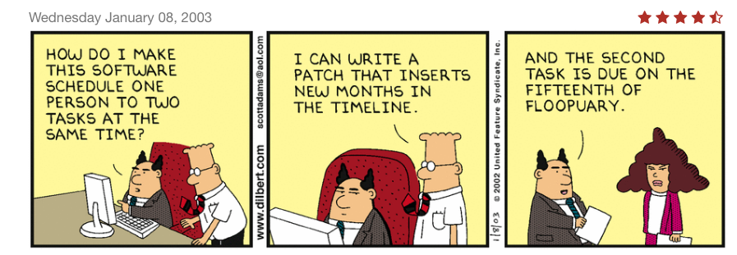
Questions?

Slide 26
Backup

