Slide 1
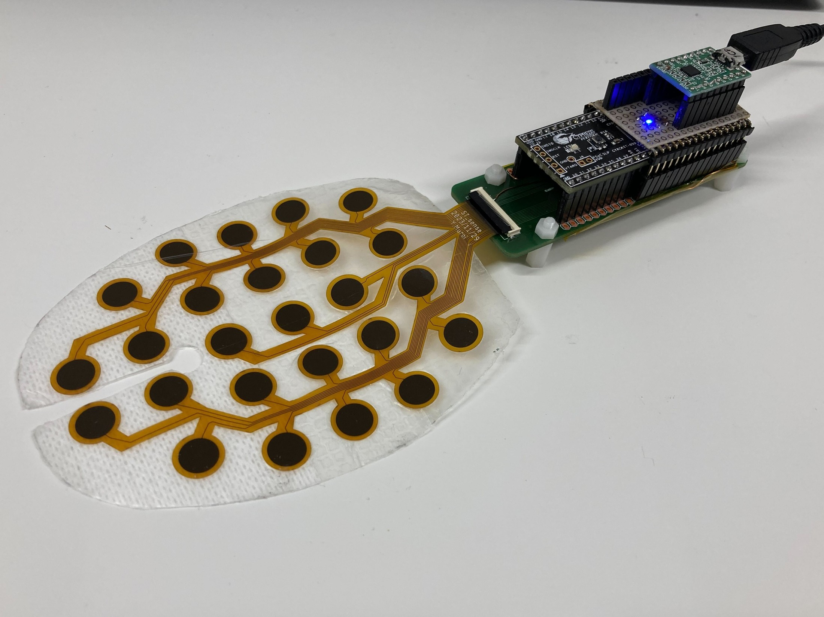
SMART EXTUBATION EARLY WARNING
Real-Time AI & Software Pipeline
for Smart Extubation Early Warning
25-channel capacitive matrix ingestion, spatial-temporal classification and clinical annunciation
Warns before an unplanned extubation, instead of recording it afterwards.
Browser bridge, server-side inference, and an annunciator that decides when to speak.
81 bench recordings: every pull episode caught, at 7.8 alarms an hour.
Asynchronous server pipeline
Gradient-boosted tree ensemble
Browser serial ingest
0.127 ms per frame
Yuya Sakaguchi · Takayuki Fujita · Syoji Kobashi
University of Hyogo — Graduate School of Engineering / Advanced Medical Research Institute
Biomedical Engineering Seminar · France · 12 September 2026
The 25-pad dressing and its microcontroller board, from our own bench.
Notes:
Today's talk is the software and algorithm half of this project, not the hardware paper. Three things I want you to leave with: what the sensor can physically see, how the pipeline turns 25 numbers into one clinical decision, and — most importantly — where it still fails. The headline number is 100% episode sensitivity on 81 bench recordings, but I will show you the confidence interval and the blind spot behind it, because that is the honest position.

Slide 2
SMART EXTUBATION EARLY WARNING
2026
Background (1/2)
2
What an unplanned extubation costs
What it is
A patient removes their own breathing tube.
What follows
Bleeding and infection. Re-intervention, and the cost that comes with it.
Why it cannot wait
With an endotracheal tube, removal can be serious immediately.
Background as set out in this group's KES 2025 presentation.
Notes:
Thirty seconds on why this problem is worth a sensor at all. A self-extubation is not a monitoring gap that gets caught on the next round - with an airway tube the harm is immediate. That is what makes detection before the event, rather than after it, the thing worth building.

Slide 3
SMART EXTUBATION EARLY WARNING
2026
Background (2/2)
3
Every countermeasure in use today trades one harm for another
Nursing rounds
Reinforced fixation
Physical restraint
High burden on staff
Skin inflammation
Ethical problems
There are limits to what the ward can do on its own.
Automatic detection is the remaining route.
Countermeasures and their costs as set out in this group's KES 2025 presentation.
Notes:
The point of this slide is that nobody is ignoring the problem - the ward already has three answers, and each one buys safety with a different harm. Rounds cost staff time, tighter fixation costs skin, restraint costs something harder to quantify. A passive sensor is worth building because it is the only option that does not trade.

Slide 4
SMART EXTUBATION EARLY WARNING
2026
Previous Research
4
Three attempts, and what each one leaves open
RFID tag on the line
Detects removal, not the approach to it.
Nakajima & Takahashi, 2015
Camera and deep learning
Early warning shown, at the cost of continuous video of a patient.
Yang et al.
Our own capacitive dressing
Autoencoder anomaly detection. F1 0.882 vertical, 0.833 horizontal, with false detections.
KES 2025
The sensor has never been characterised as a sensor. Every result so far is an algorithm result on an uncharacterised front end.
Prior-method scores read from this group's own earlier autoencoder study on the same dressing.
Notes:
Two external approaches and one of our own. The RFID work tells you the tube is gone, which is too late. The camera work gives real early warning but asks a ward to accept continuous video of a patient, and that is a cost some units will not pay. Our own autoencoder is the honest comparison point - and note the horizontal figure, 0.833 with false detections, because that number comes back later in this talk.

Slide 5
SMART EXTUBATION EARLY WARNING
2026
Purpose
5
What this half of the work sets out to do
01
Turn 25 numbers into one clinical decision
A pipeline that reads the dressing continuously, judges every frame, and decides when the bedside should hear about it.
02
Report what the signal actually supports
Including a negative result. Where the sensor cannot see, the deck says so rather than reporting an accuracy around it.
The hardware characterisation is the companion deck; this one is the software and the evaluation.
Notes:
Two objectives, and the second is the one I would ask you to hold me to. It is easy to present a pipeline and an accuracy. It is harder to present the scenario the sensor cannot see, which is what slide eighteen does. I would rather you hear it from me than find it in questions.

Slide 6

SMART EXTUBATION EARLY WARNING
2026
Sensor Structure
6
What the pad measures, and the physics the algorithm is anchored in
ATTACHED
LIFTING AT ONE EDGE
No public benchmark exists
No open dataset exists. Every choice is justified by measured physics on this patch.
Dielectric loading — touch
skin
Tissue permittivity ≈50–80 against ≈1 for air. Presses measure +456 to +1,717 counts.
air
skin
no gap → steady reading
Air gap opens — peel
gap opens → reading collapses
medical tube
dressing
sensor pad
Air under the pad, and the reading collapses. Median −866 counts, 10 of 10 cross −300.
C = ε · A / d
Rises with permittivity and pad area. Falls as the gap opens.
Shear without lift-off — horizontal pull
Tension travels, but no gap opens. Median −64 counts, 0 of 10 cross −300.
59.85 counts per picofarad — so −300 counts is about −5 pF, and the +60 gate about +1 pF.
Counts-per-pF is the published figure; every delta measured on our own 81-recording corpus.
Notes:
The point of this slide is that we could not start from a public dataset, so we started from the capacitor equation. Two of the three mechanisms give us a strong signal. The third — shear without lift-off — is where the device is blind, and I want to put that on the table early rather than bury it in the last slide. A horizontal pull moves the patch sideways without opening an air gap, so the quantity the sensor measures barely changes.

Slide 7
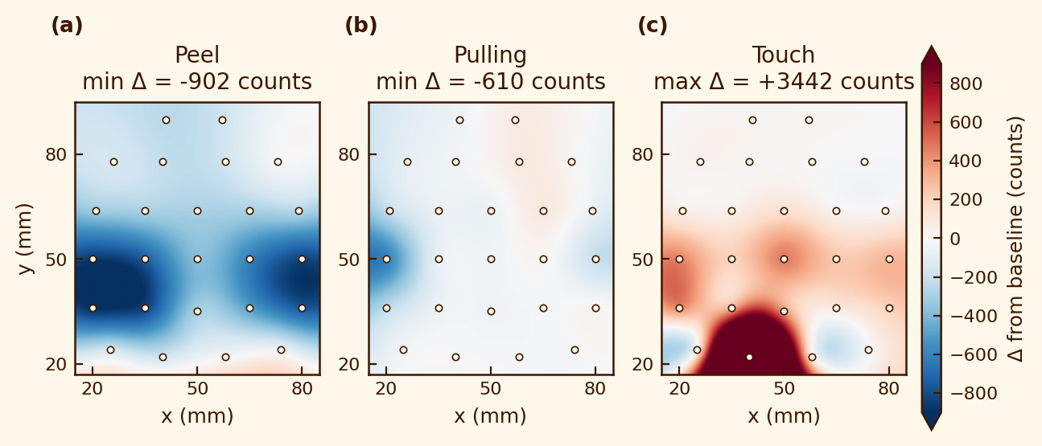
SMART EXTUBATION EARLY WARNING
2026
Proposed Method (1/7)
7
Four physical interaction classes, and the physical scenario that refuses to separate
1
2
3
4
Baseline
Touch & Rubbing
Peeling
Pulling
Patient at rest
Accidental tap & gown friction
Edge detachment
Grasping and pulling the tube
Thermal drift only,
within 60 counts
Transient localized peak or
travelling wave; fast recovery
Deep negative trough,
below -300 counts
Sustained multi-pad load,
high signal energy
Safe · Level 0
Advisory · Level 1
Warning · Level 2
Critical · Level 3
Three of them, measured on our own recordings
The scenario that does not separate
Median deepest −64 counts — quieter than Friction, which is a normal class. 0 of 10 cross −300.
What moves is the contact side, +456. So it reads as a press, not a detachment.
And the separation runs on press magnitude: the heaviest presses produce no pull frames at all. Backwards, for a safety device.
In sample, 13.4% of normal frames already read as pull. The annunciator keeps them off the bedside.
Most active frame of one peel, one vertical-pull and one touch recording. The scale clips; horizontal pull is quantified on slide 14.
Notes:
Four of these five scenarios separate cleanly and I will not spend long on them. The fifth is the one worth your questions. Horizontal pull produces no lift signal on this patch at all — it is quieter than a blanket rubbing against the dressing. Anything the system catches there, it catches for the wrong reason, and the press-magnitude ordering is inverted. That is a physical limit of the current sensor, not a modelling failure, which is why the next slide is about changing the hardware readout.

Slide 8
SMART EXTUBATION EARLY WARNING
2026
Proposed Method (2/7)
8
End-to-end pipeline: where each decision is made
1
2
3
4
5
6
7
8
Sense
Carry
Steady
Filter
Describe
Judge
Wait
Tell
25 pads report a reading about every 0.6 s.
The browser forwards the raw numbers untouched.
Cancel the slow drift. Only a sudden change counts.
Throw away small wobble. Mark a deep collapse as lifting.
Turn 25 numbers into 34 — where, how large, how deep.
A tree ensemble gives each state a probability.
One odd moment is not an alarm. Six of seven must agree.
Hold it long enough to be seen. Map, dial, sound.
ON THE PATIENT'S SIDE
ON THE SERVER
AT THE BEDSIDE
The browser never decides anything
The model is sealed
Speed is not the constraint
It moves bytes and draws pixels. Every judgement happens in one place, so the audit trail is complete by construction.
Stored with a fingerprint, so a swapped model is refused rather than quietly used.
A judgement costs 0.127 ms. The wait for agreement sets the response time — a median of 5.6 s.
Inference cost over 100 grouped-CV repeats; time-to-alarm measured out of fold.
Notes:
Read this left to right. The two things I want to defend are the separation and the timing. Separation: the ingest client is deliberately dumb, because if the browser could classify, two bedsides running different browser versions could reach different conclusions from the same data, and no audit would be trustworthy. Timing: people assume the bottleneck is the model. It is not — the model costs a tenth of a millisecond. The delay is deliberate, and it lives in stage seven, where we wait for agreement rather than react to one frame.

Slide 9
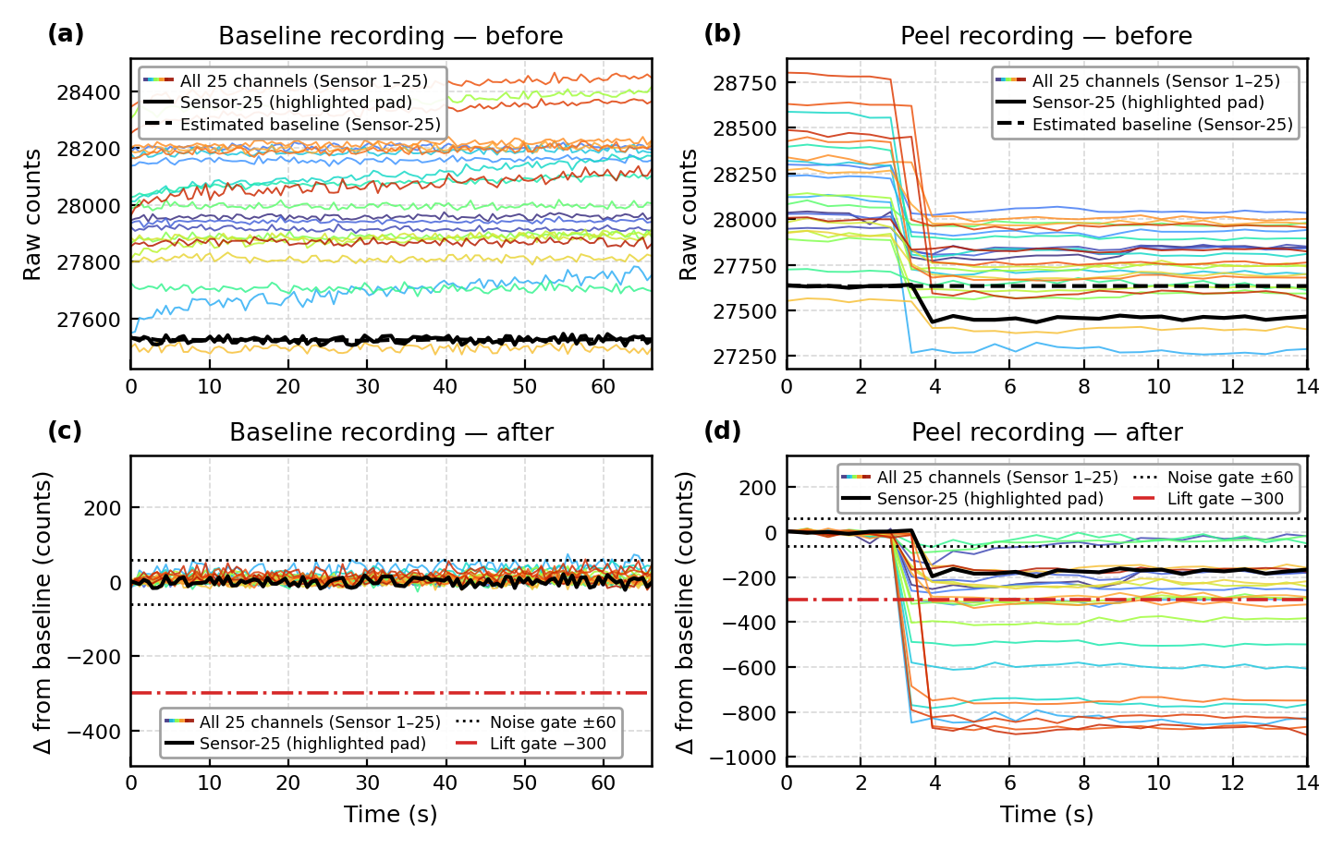
SMART EXTUBATION EARLY WARNING
2026
Proposed Method (3/7)
9
Signal conditioning: cancelling drift without swallowing the event
The problem
Sweat and body heat move every pad over a shift. A reference taken at start-up is wrong an hour later.
The fix
Each pad carries its own estimate of quiet. Everything downstream works on the distance from it.
The trap it avoids
If it chased the reading, a long press would become the new normal. Past 120 counts it stops following and coasts — the flat dashed lines above.
Quiet: stays inside ±60 for 67 seconds. Peel: crosses −300 within two frames.
Our own recordings, through the shipped baseline tracker — not a reconstruction of it.
Notes:
This is the stage people skip past, and it is the one that decides whether the device survives a real shift. The top row is what the sensor actually sends: a slow wander of a few hundred counts driven by body heat and sweat. The bottom row is what the rest of the pipeline sees. Notice what happens on the right: when the peel starts, the dashed baseline stops following. That gate is the whole design — without it a sustained pull would be absorbed into the reference within a minute and the system would go quiet exactly when it should be loudest.

Slide 10
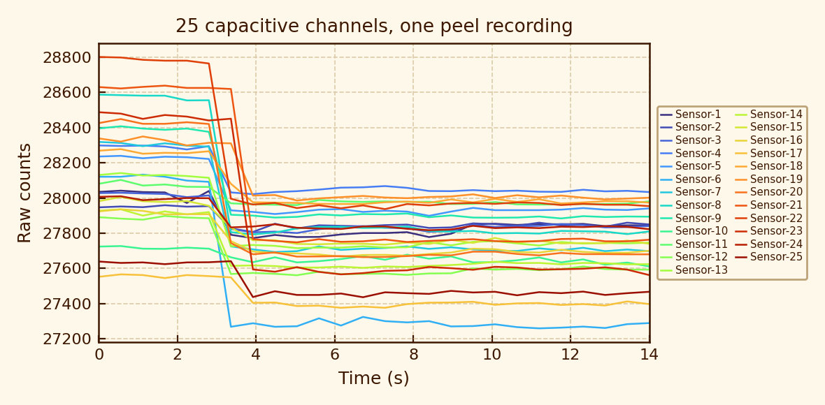
SMART EXTUBATION EARLY WARNING
2026
Proposed Method (4/7)
10
Feature extraction: the map itself, and nine summaries of it
What the raw signal looks like
Why not just the summaries?
An earlier version kept the nine summaries and threw the map away. At the same alarm budget it catches 70% of pull episodes against 100%.
25
The map itself
4
How big
5
How many, and how deep
One value per pad, left where it is. No summary recovers geometry once averaged away.
Smallest, largest, average and spread across the patch.
Pads past five marks — −300, −600, −1000 lifting; +300, +1000 pressing.
Not in the shipped vector: the optional gradient mode is off everywhere. 34 = 25 pads + these nine.
Notes:
Two things to take from this slide. First, the design principle: we refuse to average away the geometry, and the bar on the right is what that refusal buys — thirty points of episode sensitivity at the same alarm budget. Second, an honest correction. An earlier draft of this talk described the nine summaries as spatial gradients and a signal-energy term. They are not. They are four magnitude statistics and five threshold counts, and the gradient features that do exist in the code are switched off in everything that ships. I would rather show you the feature list that is actually fitted.

Slide 11
SMART EXTUBATION EARLY WARNING
2026
Proposed Method (5/7)
11
Classifier selection: three candidates, one hundred repeats
It wins on the metric the device is judged by
98.2% against 86.8% for the forest — and it leads in 100 of 100 repeats.
It is the steadiest
Shortest box on every measure. Moving least when the data changes is worth as much as the best average.
Episode sensitivity over 100 grouped-CV repeats — 1,500 fits.
It is fastest where speed is spent
A retraction worth showing
0.127 ms a frame against about 1.04 ms. Slower to train, which a device pays once.
An earlier comparison reported 100.00% accuracy, and that justified shipping it. The feature matrix had every pad duplicated. On the correct 34 columns it scores 97.53%.
A perfect score across 81 files is a bug report. Every figure here carries an interval.
The column it does not lead
The forest is quieter — 6.92 against 7.93 an hour — but pays 11.4 points of sensitivity for it.
Folds grouped by recording, so no frame appears on both sides.
Notes:
I want to be careful about how this comparison was run, because the first time we ran it we got it wrong. Folds are grouped by recording, so no frame from a file can appear on both sides. We repeat the split a hundred times, because with only 81 recordings which files land in which fold moves the answer more than the gap between two estimators. And the box at the bottom is a real retraction from this project — a duplicated feature matrix produced a perfect score that we briefly believed. That is why every number today has an interval attached.

Slide 12
SMART EXTUBATION EARLY WARNING
2026
Proposed Method (6/7)
12
Temporal annunciator: deciding when to speak
Two rules, in plain terms
Wait for agreement
Six of the last seven must agree — about 3.4 seconds of evidence.
Then hold it
Held about five seconds, so it cannot be missed or flicker.
Each escalation raised the alarm exactly once.
Every setting holds 100% sensitivity except the last, which drops to 97.5%.
7.8 / hr
4.9%
5.60 s
100%
Alarm burden at the shipped setting
False alarms per recording
Median time from pull to alarm
Episode sensitivity held
Down from 13.0 at the previous setting
95% CI 1.3 - 16.1
Worst case 17.36 s
95% CI 91.2 - 100.0
Is 7.8 alarms an hour acceptable? We cannot claim it is, and we do not.
An intensive-care cohort reports about 5 alarms an hour, and no threshold defining a high rate. So this is roughly double an existing burden — not a figure under a published safe limit.
Curve, burden and latency from the generated metrics file. Cohort: Sci Rep 2022, s41598-022-26261-4.
Notes:
This is where the clinical judgement lives, not in the model. The curve on the right is a straight trade: demand more agreement and the alarm burden falls from about twenty-six an hour to about five, and sensitivity holds at one hundred percent until the very last setting. We ship the second-quietest point. The bottom box is the part I want to be honest about — we cannot tell you 7.8 alarms an hour is safe, because the literature does not define a safe rate. We can only tell you what it is relative to current practice.

Slide 13
SMART EXTUBATION EARLY WARNING
2026
Proposed Method (7/7)
13
Operator console: what a nurse sees
1
Capacitive map
Blue where the dressing lifts, red where it is loaded.
2
Cumulative risk dial
A running index, so a slow pull shows before any single frame does.
SCREENSHOT TO BE INSERTED BEFORE 7 SEPTEMBER
3
Channel strip chart
1600 × 900, light theme, English, replayed to a level-3 frame.
All 25 channels, for tracing an alarm back to its pads.
4
Severity banner
Four states, with colour and a frequency-scaled tone.
5
Ward slots
Empty until an operator assigns a bed. No fabricated identity.
Zero install
No classification in the interface
Three languages
Research prototype. Not assessed against IEC 62304. Not a certified medical device.
Standard browser, hospital tablet or workstation.
It renders what the server concluded, and never decides.
Thai, English and Japanese, switchable mid-alarm.
Notes:
Two design commitments on this screen. The interface does no classification of its own — it draws what the server decided, which is what makes the audit trail meaningful. And the ward view stays empty until an operator assigns a bed: an earlier build filled it with plausible-looking patient names and identifiers, which is exactly the kind of thing that looks like a working feature in a demonstration and is a fabrication. The disclaimer in the corner is not decorative; it is asserted by the test suite, so it cannot be quietly removed.

Slide 14
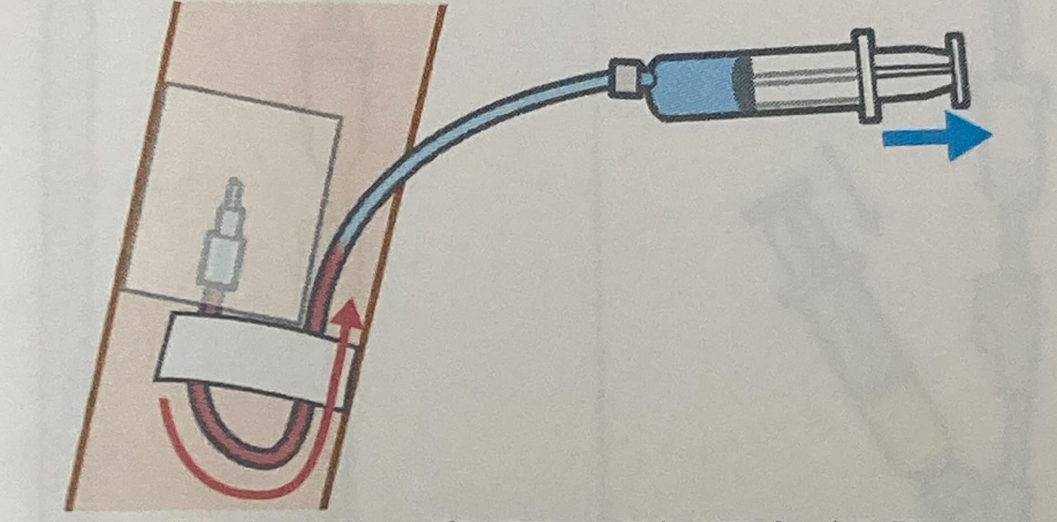
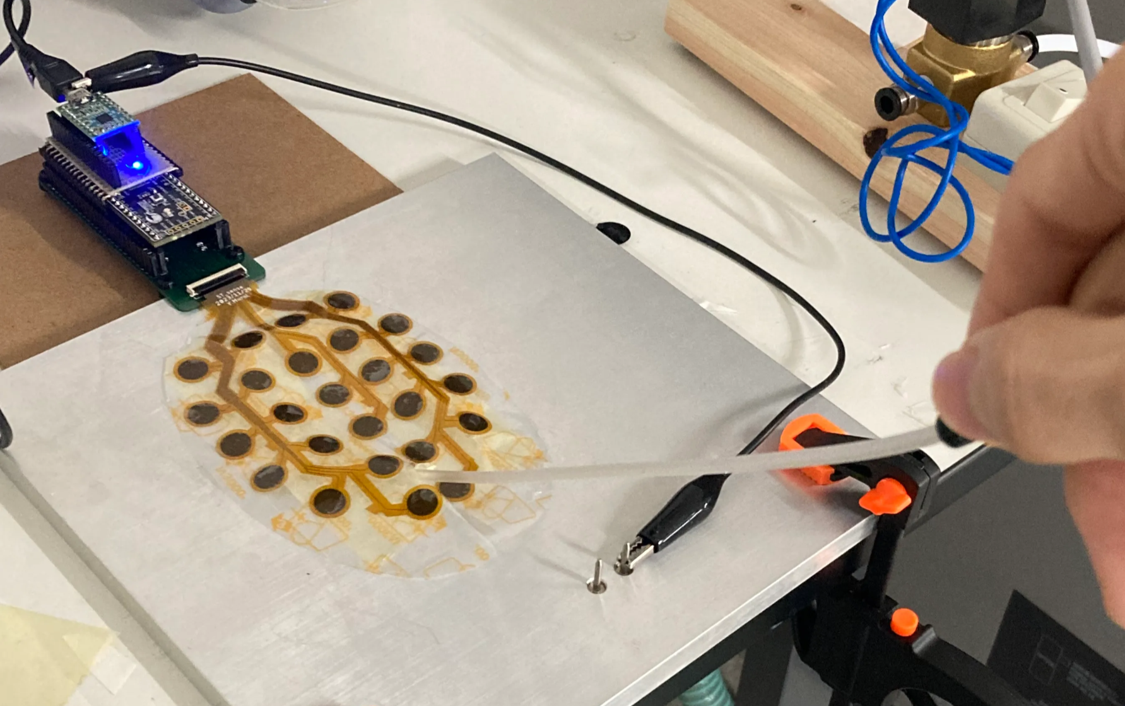
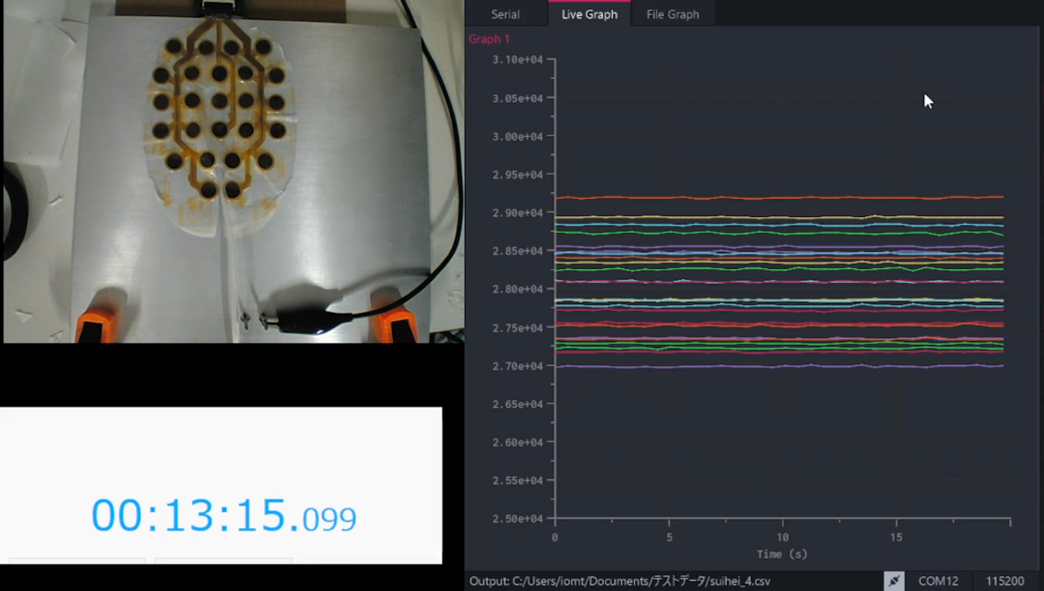
SMART EXTUBATION EARLY WARNING
2026
Experimental Method
14
Bench, fixation and synchronised capture
Fixation and pull mechanics
Adhesion upgrade — the reason for round 2
Round 1: vacuum rig, no adhesive, one session, one mounting.
High-suction source and a reworked backing membrane.
So shear reaches the pads instead of a loose mount.
The honest first fix for the horizontal blind spot.
Slack-loop fixation, drawn at a controlled rate so the mechanics repeat.
Synchronised capture
TO BE CAPTURED BEFORE 7 SEPTEMBER
Action and response on one timeline, so a disputed frame can be traced back.
Dual-feed demonstration video
Webcam above, live console below, one clock across both. Two takes: a touch that stays silent, a pull that escalates.
Our own bench. The dual-feed capture is not yet recorded.
Notes:
Two points here. First, the fixation matters more than it sounds: if the dressing is loosely mounted, a pull at the tube is absorbed before it reaches the pads, and you end up measuring your rig rather than the patient. The new high-suction bench exists to close that path, and it is the honest first attempt at the horizontal-pull problem — before blaming the model, make sure the force actually arrives. Second, the synchronised capture is what lets anyone in this room challenge a specific frame and get an answer.

Slide 15
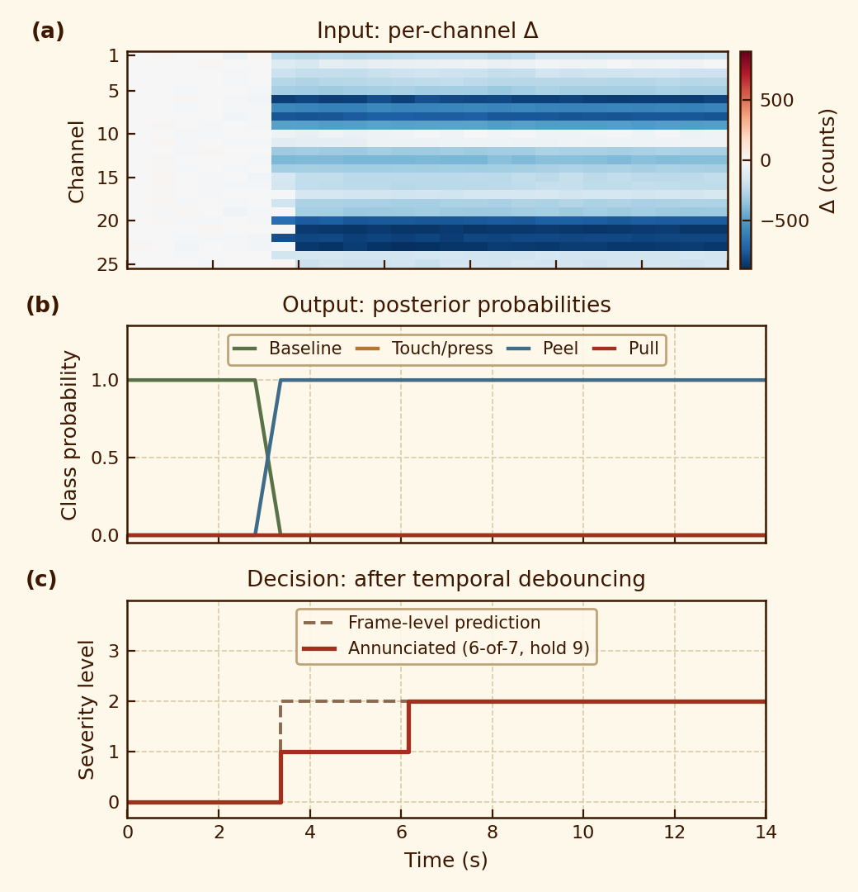
SMART EXTUBATION EARLY WARNING
2026
Results (1/4)
15
One peel recording, frame by frame through the shipped model
1
Going in — 25 numbers a frame
One change value per pad, per frame. Frames under 60 counts never reach the model.
2
Coming out — four probabilities
A probability for each state, every frame. No serving path hand-codes a level.
3
The decision — agreement, not reaction
The model calls peel at once. The annunciator waits for six of seven — about three seconds.
One round-1 peel recording, replayed through the stored model.
Notes:
This is the slide to come back to in questions, because it shows the two things people most often assume are the same. The model's opinion, in the middle panel, is instant and confident. The system's behaviour, in the bottom panel, is deliberately later. That gap is not latency we failed to remove — it is the mechanism that takes the alarm burden from twenty-six an hour down to under eight. And the top panel is the honest answer to what the classifier is given: twenty-five numbers, nothing about the patient, nothing about the past except through the vote.

Slide 16
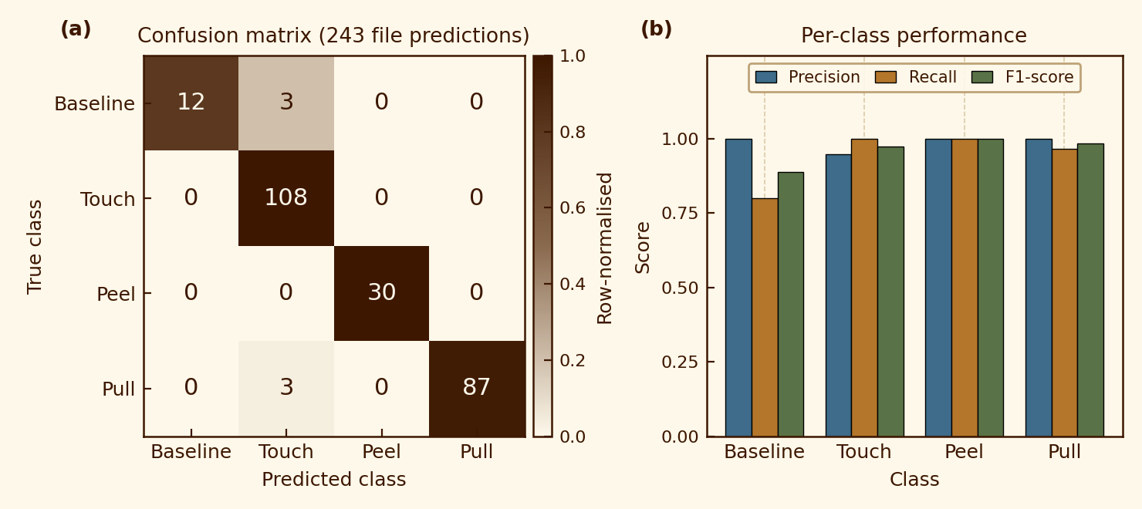
SMART EXTUBATION EARLY WARNING
2026
Results (2/4)
16
Quantitative validation over 81 bench recordings
100.0%
7.8 / hr
5.60 s
97.53%
Episode sensitivity
Alarm burden
Median time to alarm
File-level accuracy
95% CI 91.2 - 100.0 · 0 missed of 30 pull files
4.9% of recordings false-alarm · CI 1.3 - 16.1
Worst observed 17.36 s · 1.00 onsets / event
Wilson 95% CI 91.4 - 99.3 · see caveat
Where the errors are, and what each class costs
How to read these two units
Episode level is the clinical unit.
When a pull happened, did the system raise an alarm? Independent of clip length.
File level is not, and we do not lead with it.
A majority vote across frames, so it moves with clip length. Re-voted at round-2 length, pull recall goes to zero while episode detection stays at one.
Six errors in 243 predictions. Peel is called perfectly — which on 30 files is not evidence of perfection.
81 recordings, 3,349 frames, 34 features, leave-one-file-out, single session.
Notes:
Four numbers, each with its interval. The one I expect to be challenged is one hundred percent sensitivity, and rightly — with thirty pull recordings the confidence interval runs down to ninety-one, so the honest statement is that we missed nothing in this corpus, not that we will miss nothing. The right-hand box is the methodological point I most want to land: we report at episode level because file-level accuracy is an artefact of clip length. The same model on the same events scores ninety-seven and a half now and zero on pull recall if the clips are lengthened.

Slide 17
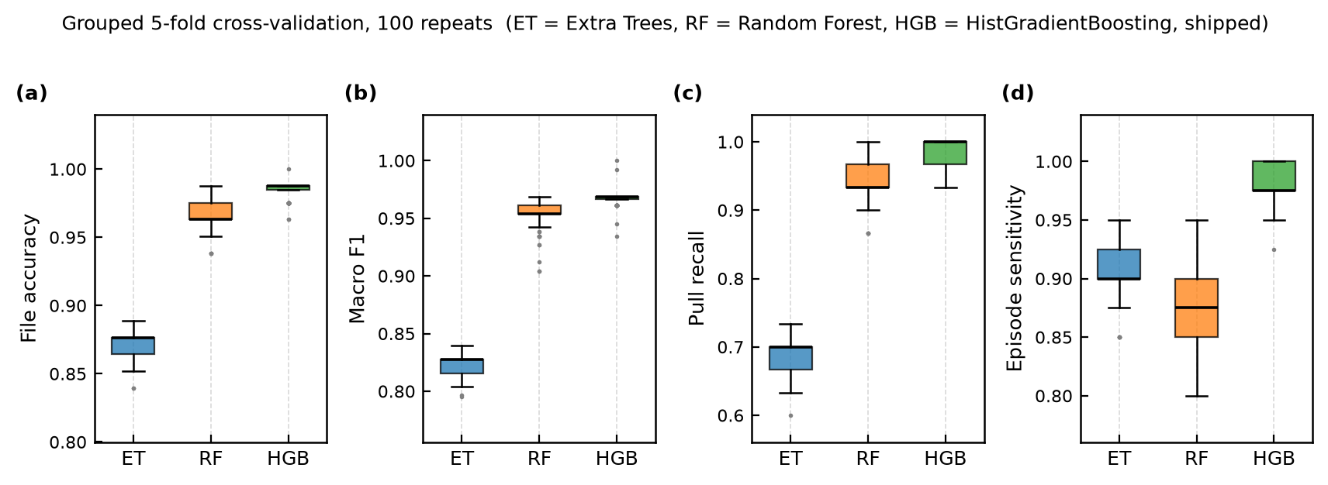
SMART EXTUBATION EARLY WARNING
2026
Results (3/4)
17
Stability across 100 re-splits
Why re-split at all
What the boxes say
What they do not say
With 81 recordings, the split moves the answer more than the estimator does. So it is drawn a hundred times.
Gradient boosting leads on all four, with the shortest box on every one.
Every dot is one mounting, one session. Stable under re-splitting is not the same as general.
Grouped 5-fold, 100 repeats per estimator — 1,500 fits, from our own benchmark output.
Notes:
This slide exists because of a mistake this project already made. An earlier comparison reported a perfect score from a single split and that number justified a production change. Perfect scores over 81 files are bug reports. So the estimator decision is made on the distribution, not on one draw: gradient boosting leads on all four measures and it leads in one hundred repeats out of a hundred on episode sensitivity. The red box on the right is the limit of what this figure can prove — stability under re-splitting is not the same thing as generalisation to a new patch.

Slide 18
SMART EXTUBATION EARLY WARNING
2026
Results (4/4)
18
What this does not yet show
1
Horizontal detachment is invisible to this patch
No lift signal at all. Whatever is flagged there is flagged as a press.
2
One session, one mounting
All 81 recordings share one attachment. Nothing shows it survives re-application.
How far the reading falls when the dressing leaves the skin. The threshold is 300 counts.
3
The alarm setting is tuned in-sample
Chosen on this corpus. It must be measured on round 2 without retuning.
This is continuity, not a new failure
Our own earlier autoencoder reported F1 0.882 vertical against 0.833 horizontal, with false detections.
Two independent methods, same hardware, same wall. The wall is the sensor.
4
Spatial output from live hardware is unverified
Confirmed for the recorded corpus, never through the live path.
Round-1 corpus; prior-method scores from our earlier autoencoder study.
Notes:
I would rather show you this slide than have you find it in questions. The chart is the core of it: horizontal pull, the scenario a safety device most needs, is quieter on this patch than a blanket rubbing against it. The box at the bottom matters for how you weigh that — our earlier autoencoder work hit exactly the same wall on the same hardware, with a lower F1 on horizontal pulling and explicit false detections. Two unrelated methods failing identically points at the sensor. That is what the next hardware generation and the new bench are for.

Slide 19
SMART EXTUBATION EARLY WARNING
2026
Discussion
19
From relative delta to absolute capacitance
TODAY
NEXT GENERATION
Relative reading
Absolute reading
Every pad is measured against a baseline taken at start-up — never an absolute value.
A capacitance-to-digital converter reports each pad in real units — no assumed starting point.
Attached at power-on and detached at power-on give two references for one state.
So it knows something changed, but not what state it began in.
A patch already lifted at power-on reads as normal all session.
No start-up calibration, and no dependence on how the patch was sitting.
Tube placement confirmable at the moment of attachment.
An already-lifted patch is visible immediately.
Features and classifier unchanged — only the input units move.
Resting attached ≈ 28,000 counts. Deepest anomaly measured: 27,251.
The classifier, the features and the annunciator all survive the change — but every figure in this deck must then be re-measured.
Notes:
This is the single largest planned change and it is a hardware change with a software consequence. Right now we subtract a start-up baseline, which quietly assumes the patch was in a known good state when the system was switched on. In an ICU that assumption will not hold. Absolute capacitance removes it. The important engineering point is that the pipeline above the input layer does not need rewriting — but every number I show you today would have to be re-measured on the new readout.

Slide 20
SMART EXTUBATION EARLY WARNING
2026
Conclusion
20
Where this stands, and what has to be measured next
Before 7 September
Engineering road ahead
Dual-feed demonstration video
Not started
Now
Re-measure the alarm setting on round 2 — without retuning it.
Webcam and console on one clock.
This slide deck
Draft ready
Q4 2026
Port to the absolute readout and re-validate every figure.
English, every figure traceable to the metrics file.
Console screenshot
Not started
Q1 2027
Several mountings, several people, per-session results.
Light theme, English, level-3 frame.
Round-2 recordings
In progress
Beyond
Simulated ICU pilot, multi-bed from one station.
First acquisition on the high-suction bench.
Where this stands
Every pull episode caught, at 7.8 alarms an hour, in a median of 5.6 seconds — and it cannot see a horizontal detachment at all, on one mounting, with an interval running down to 91%.
The work ahead is not a better classifier. It is a sensor that responds when the patch slides.
Status 3 September 2026. Measured figures traceable to the generated metrics file.
Notes:
I want to close on the honest summary rather than the headline. On this corpus the system catches everything, reasonably quietly, in about six seconds. It also cannot see one of the three ways a tube comes out, and every figure comes from one sensor mounting. So the next milestone is not a better model — the model is comfortably ahead of the data it has. It is a readout that responds to sliding, and a corpus recorded across enough attachments that these numbers mean something outside this room. Thank you — I am happy to take questions, particularly on the horizontal-pull problem.

