Slide 1
GIT & GITHUB
Daniel Mawalla (fierylion)
Github Campus Expert

Slide 2
Big Idea
Git: is a version control system that helps you keep track of changes made to your files over time. It allows you to easily view, revert to previous versions, and collaborate on changes with others.
It enables your to:
Track code changes.
Tracking who made changes.
Coding collaboration.

Slide 3
Local Vs Remote
Local Repository
Definition: The local repository is the copy of the project that resides on your computer.
Control: You have direct control over it. You can work on it without an internet connection.
Operations: You can perform various Git operations locally:

Slide 4
Remote Repository (e.g., GitHub):
Definition: The remote repository is hosted on a server, usually on platforms like GitHub, GitLab, or Bitbucket.
Collaboration: Multiple users can access and work on it simultaneously. It facilitates collaboration among team members.
Operations: Some typical operations involving the remote repository:

Slide 5
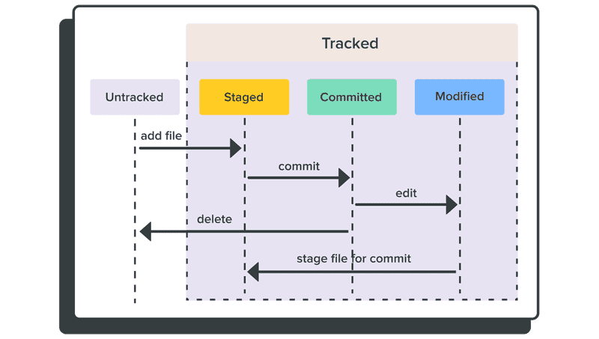
Git Stages:

Slide 6
Working Directory:
Definition: The current state where files are actively worked on.
Commands:
git status: Shows the status of files in the working directory.
Files can be in various states:
Untracked: New files not added to version control.
Modified: Files with changes since the last commit.
Staged: Modified files that are marked to be included in the next commit.

Slide 7
2. Staging Area (Index):
Definition: An intermediate area where changes are prepared for the next commit.
Commands:
git add <filename>: Adds changes in a file to the staging area.
git reset <filename>: Unstages changes for a specific file.

Slide 8
3. Local Repository:
Definition: The database where committed changes are stored.
Commands:
git commit -m "message": Commits staged changes to the local repository with a descriptive message.
git diff: Shows changes between the working directory, staging area, and the last commit.

Slide 9
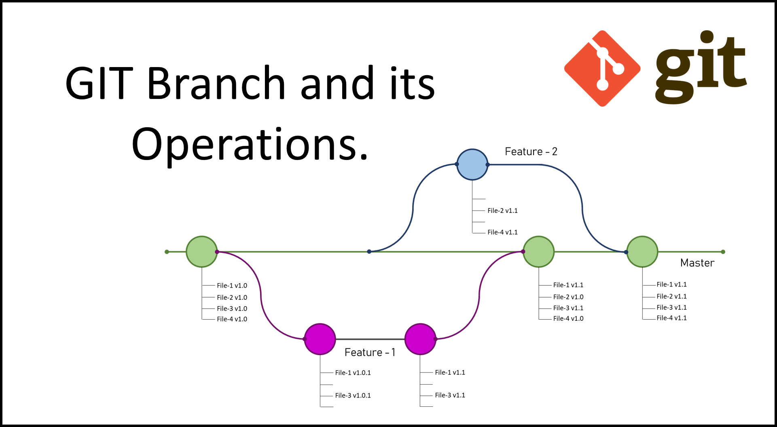
Branching in GIT

