Slide 2
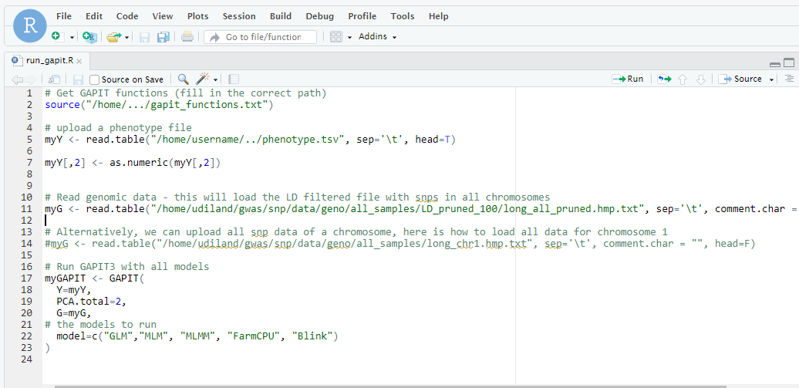
path to GAPIT functions
path to phenotype table
path to genomic data
GAPIT models to run

