Slide 1

Project Title - Seasonal Agriculture Performance Analysis
Student Name - Udipti Nagar
College Name - Sagar Institute of Research and Technology
AICTE STU ID : STU684af1354fd1a1749741877

Slide 2

PROBLEM STATEMENT
Agricultural activities are influenced by seasonal variations in environmental conditions, farming practices, resource availability and market conditions. As a result, agricultural performance may differ from one season to another.
However, raw agricultural data does not clearly explain how agricultural performance changes across seasons or what patterns can be observed in different seasonal conditions.
The problem is to analyze the given agricultural dataset and investigate seasonal differences in agricultural performance by identifying meaningful patterns, trends, relationships and variations within the available data.

Slide 3
Project Description
Seasonal Agriculture Performance Analysis is a data analytics project that examines agricultural activities across different seasons, crops, geographical areas, and farming conditions.
The project analyzes environmental factors, farming practices, resource usage, crop yield, production, and economic performance to identify meaningful seasonal patterns, trends, relationships, and variations.
The analysis uses data cleaning, statistical analysis, visualization, correlation analysis, and seasonal comparisons to understand differences in agricultural performance. The findings are used to develop data-driven insights and recommendations for better seasonal agricultural planning.

Slide 4

WHO ARE THE END USERS?
End Users: Farmers, Agricultural Planners & Government Departments, Agricultural Researchers & Data Analysts, Agricultural Consultants/Agronomists, and Farm Management Organizations.
The project provides these stakeholders with data-driven insights into seasonal crop performance, resource usage, environmental conditions, profitability, and agricultural trends to support better planning and decision-making.

Slide 5

Technology Used
Python – Main programming language for data analysis
Google Colab – Cloud-based environment for developing and executing the project
Pandas – Data loading, cleaning, manipulation, and aggregation
NumPy – Numerical computations and data processing
Matplotlib – Data visualization and plotting
Seaborn – Statistical and comparative visualizations
SciPy – Statistical analysis and hypothesis testing
CSV – Dataset/file format
GitHub – Project code and notebook version control/storage

Slide 6
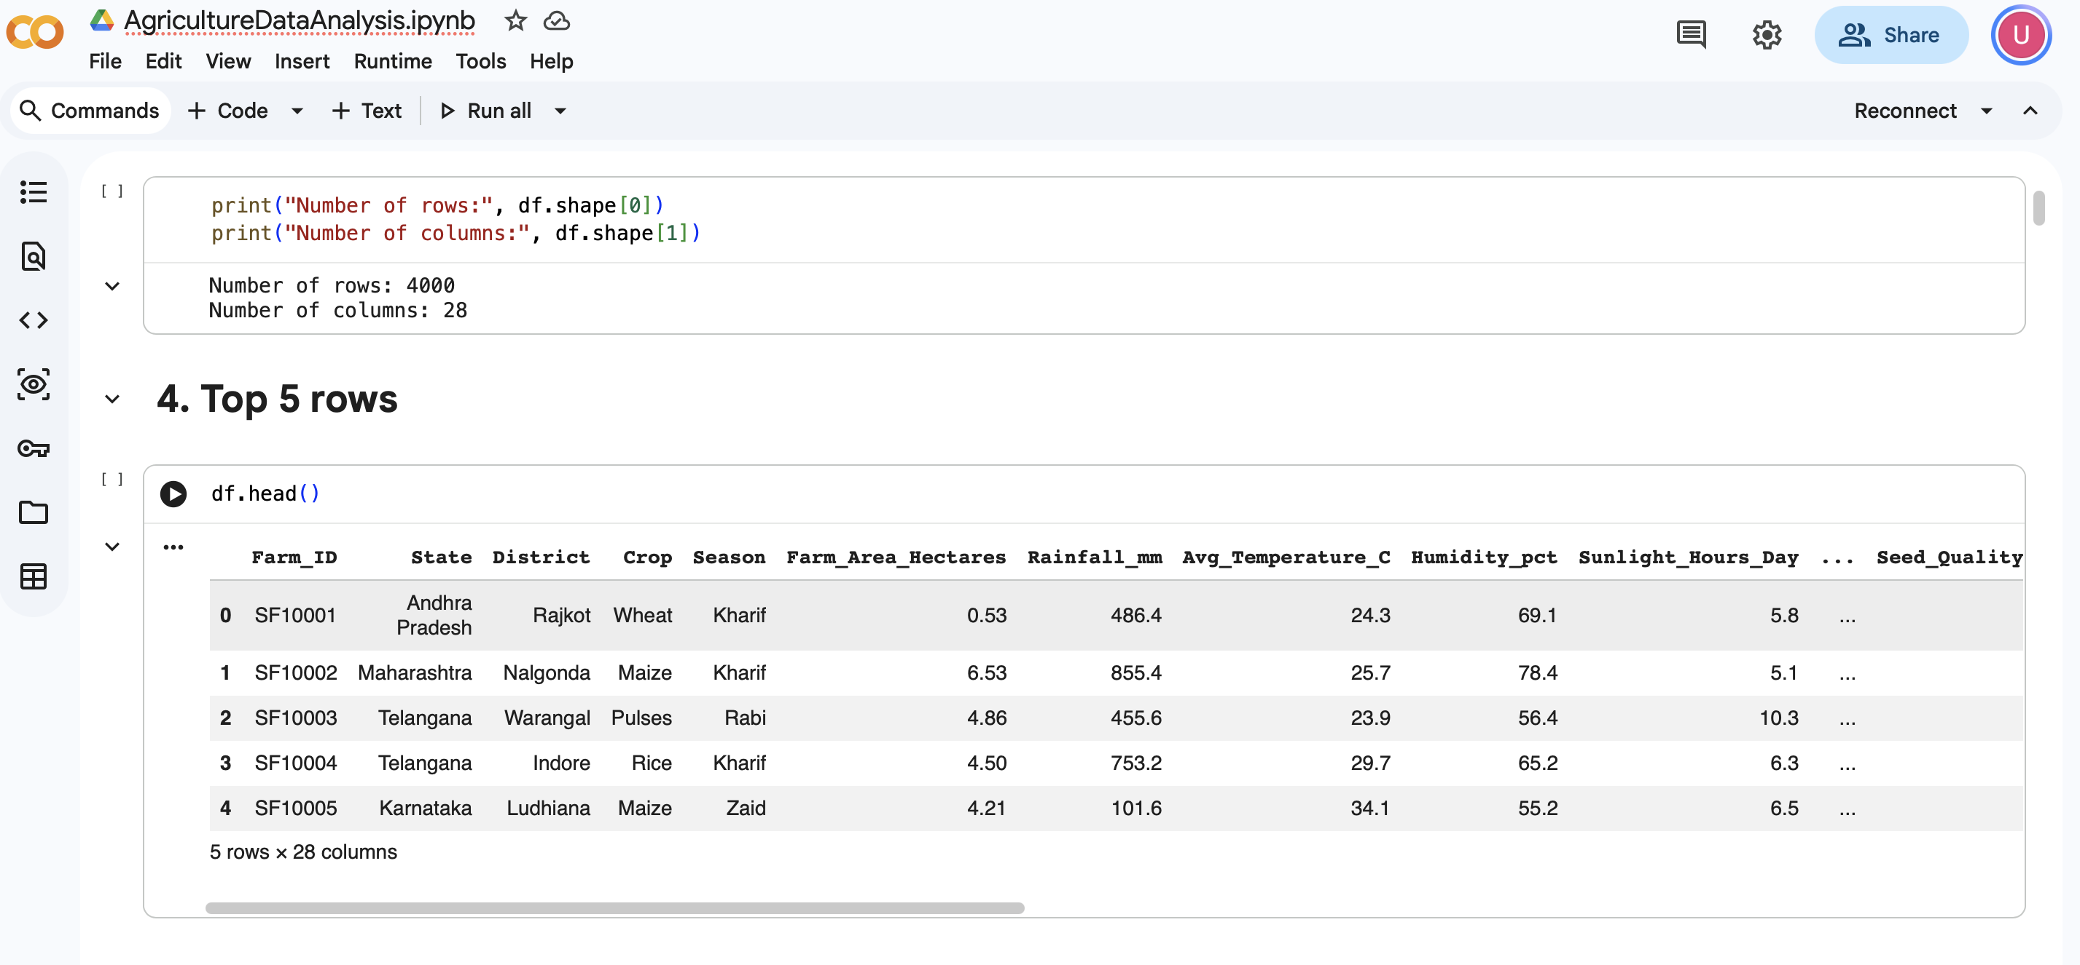
RESULTS
Caption

Slide 7
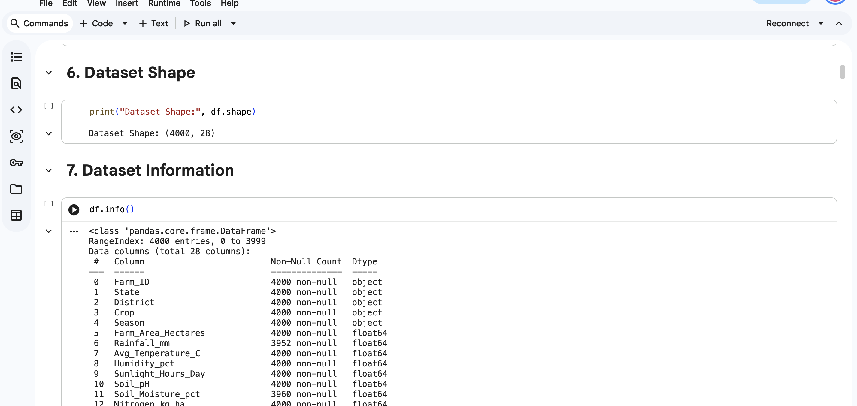
RESULTS
Caption

Slide 8
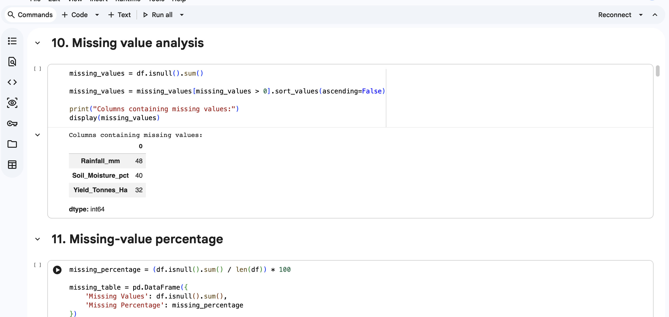
RESULTS
Caption

Slide 9
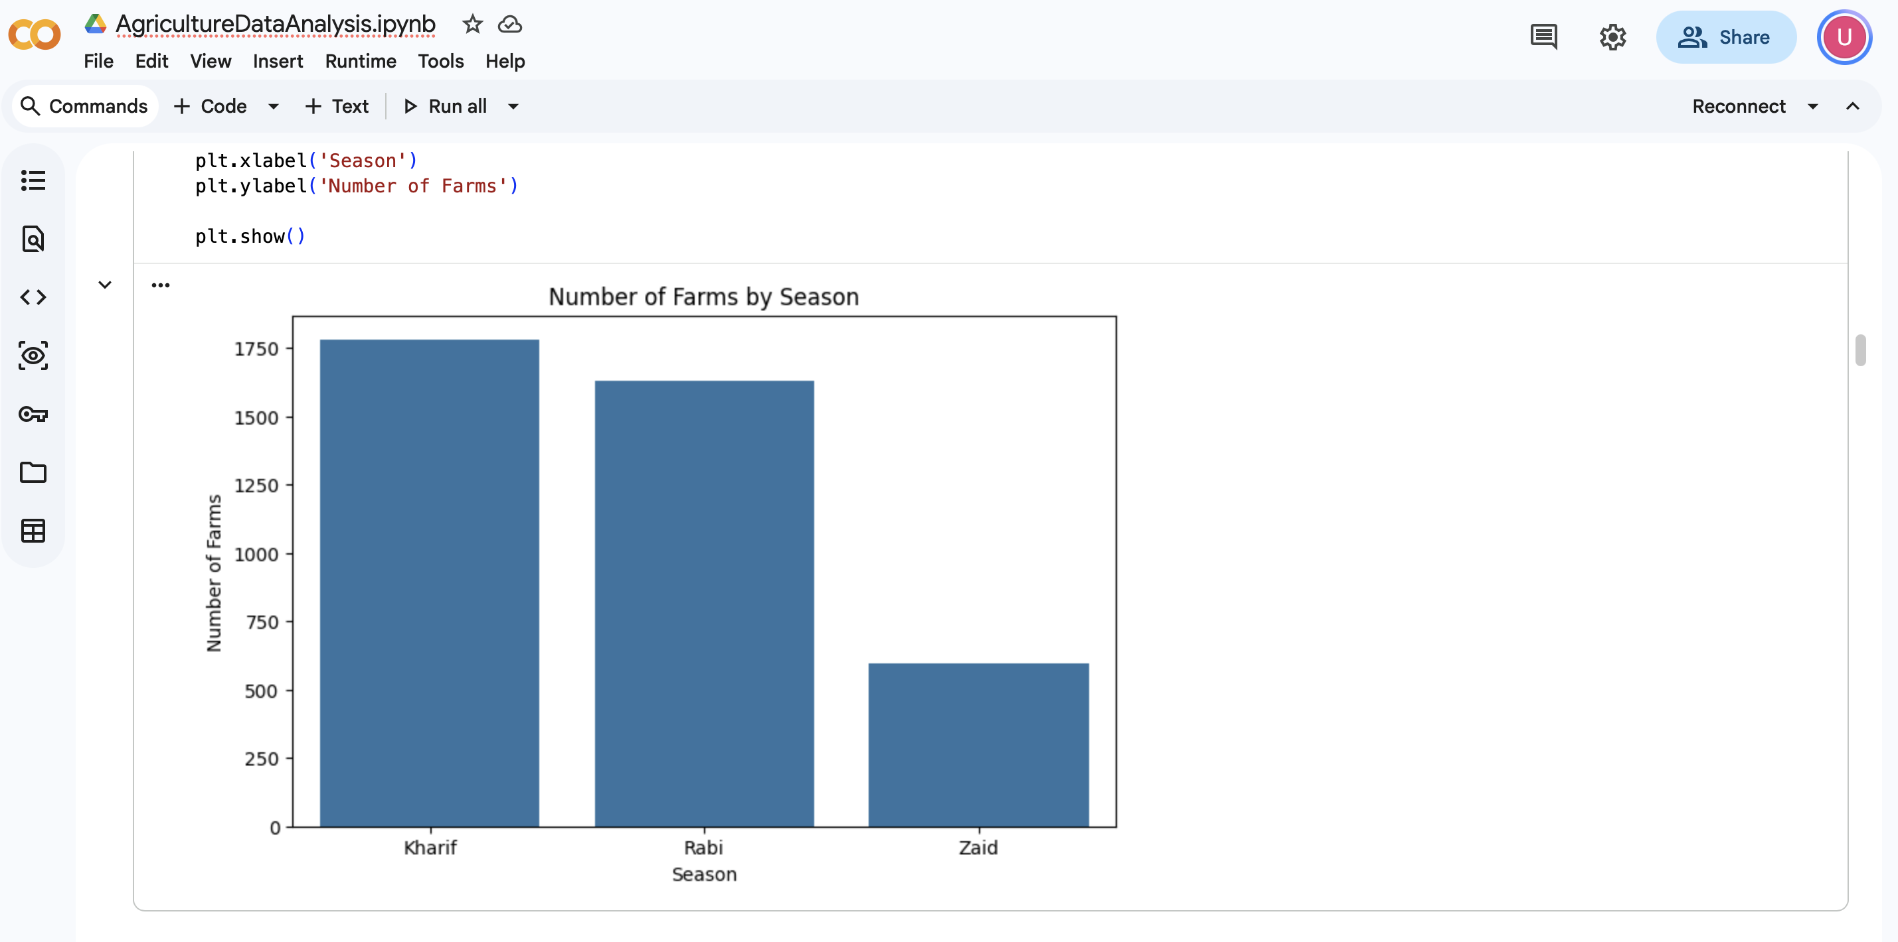
RESULTS
Caption

Slide 10
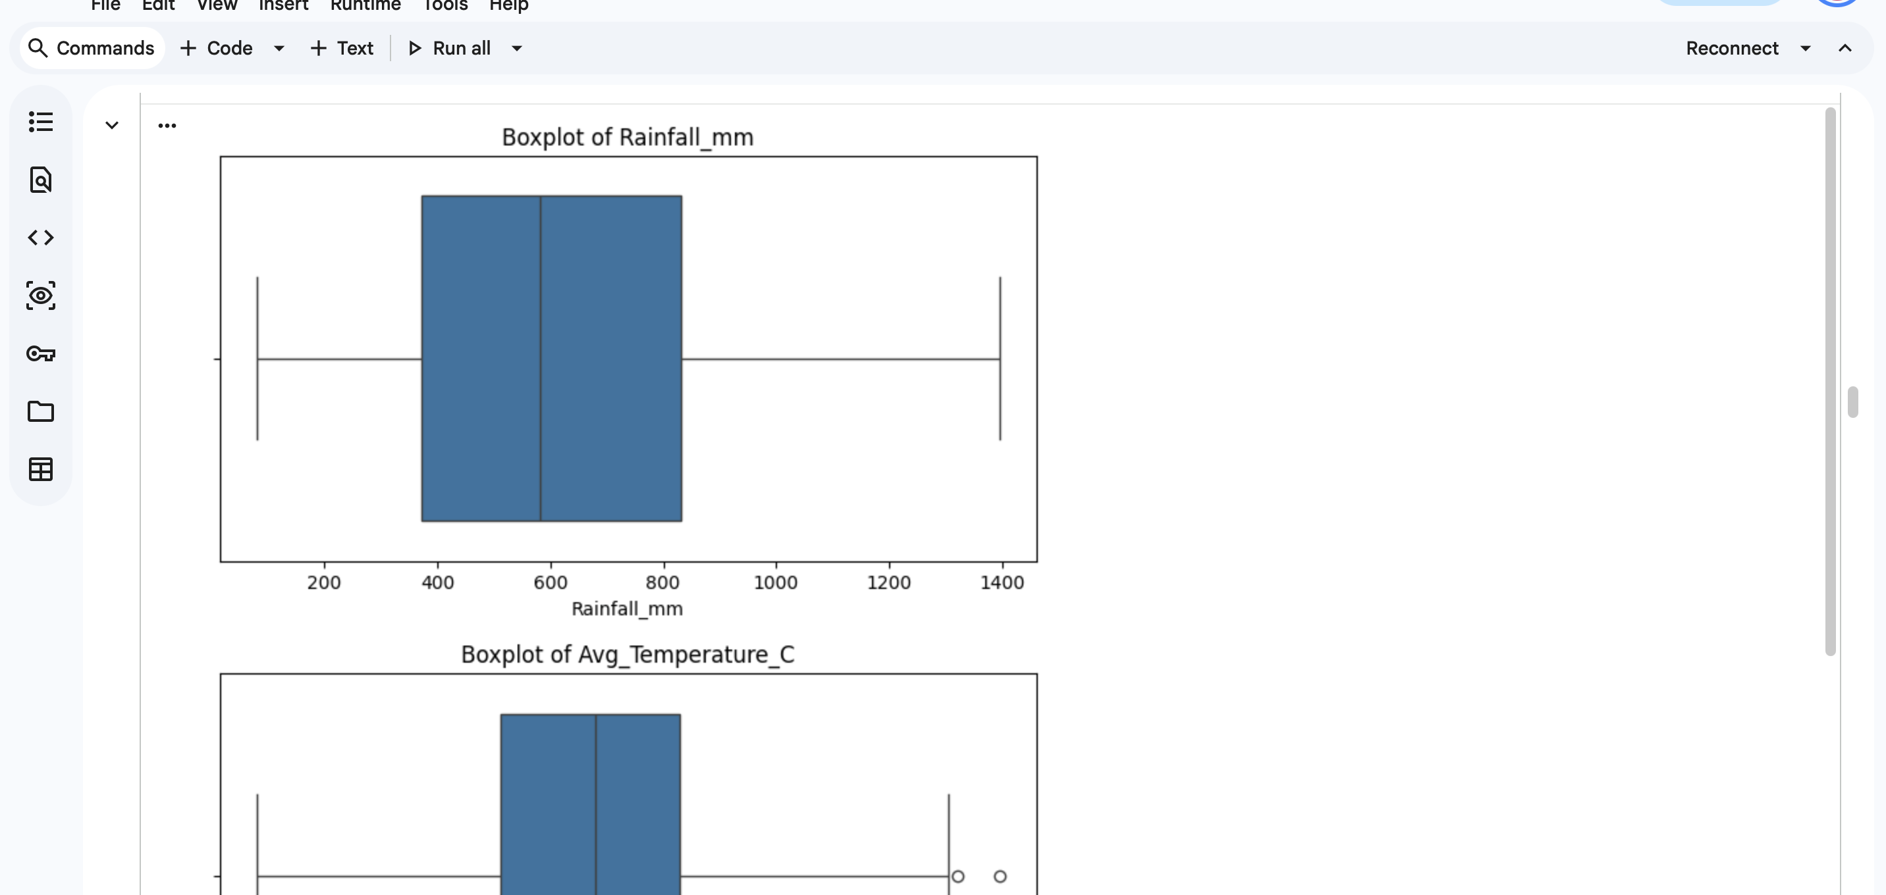
RESULTS
Caption

Slide 11
Future scope
The project can be extended by integrating real-time weather data, machine learning-based yield prediction, crop recommendation systems, resource optimization, disease and pest prediction, larger geographical datasets, and interactive dashboards.
These enhancements can transform the current analytical study into a more comprehensive agricultural decision-support system.

Slide 12
GitHub Link
https://github.com/udiptinagar/Major-Project---Agriculture-Data-Analysis

Slide 13
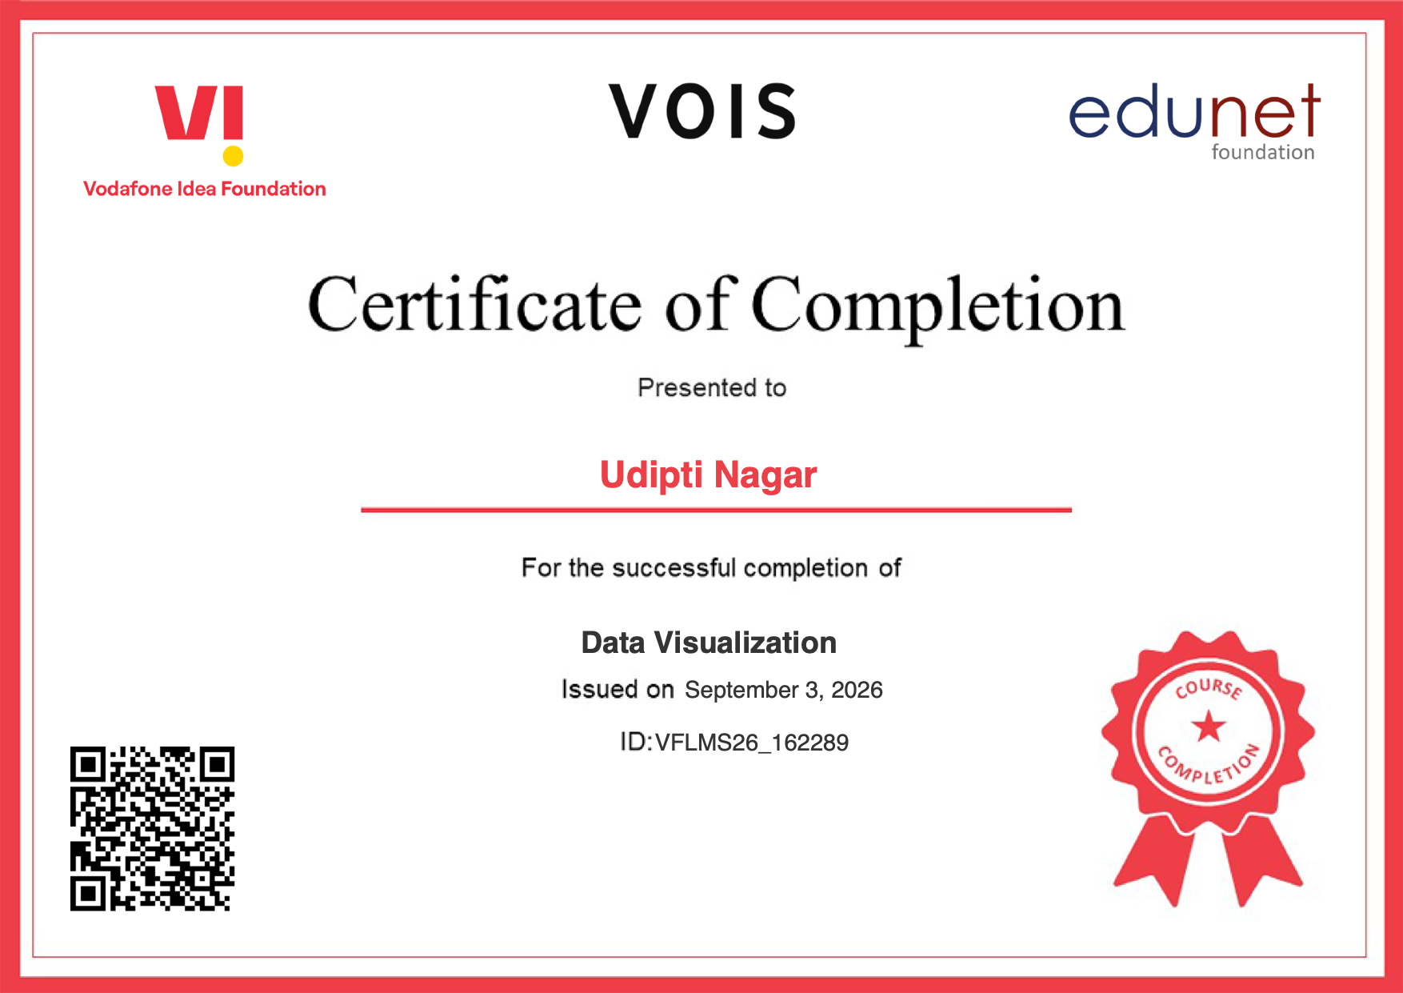
VOIS Course completion certificate - Course name- Data Visualization
Caption

Slide 14
Thank you
.
.

