Slide 1

Automated Code Review System
Group 17:
Dhruv Panchal | 40226430
Udisha Kaura | 40266183
Khushal Nirmal Jain | 40233877
Aman Kumar | 40278443
Github Link - LINK

Slide 2




Abstract
Our proposal introduces an Automated Code Review System, leveraging AI and machine learning to revolutionize traditional code review practices. By offering real-time feedback, customizable rulesets, and seamless integration, this system addresses the inefficiencies of manual review processes. In essence, our System represents a pivotal step towards efficiency and innovation in software development.

Slide 3
Introduction
Overview
In today's fast-paced world of software development, manual code review processes present a significant bottleneck. These processes are not only time-consuming but also prone to errors, leading to potential quality issues and project delays. However, amidst these challenges lies a remarkable opportunity for innovation. Imagine a solution that could revolutionize the way code is reviewed and validated—a solution that not only speeds up the process but also enhances accuracy and reliability.

Slide 4
Introduction
Proposed Solution
This cutting-edge system leverages the power of Artificial Intelligence to provide real-time feedback during the code review process.
By automating tedious tasks and offering actionable insights, it promises to streamline workflows and elevate the overall quality of software development.

Slide 5
Market Analysis
Relevance and Potential Success:
Stakeholder Analysis:
We've conducted a comprehensive stakeholder analysis, identifying key players such as Software Engineers, QA Professionals, Project Managers, System Administrators, and End Users.
Through this analysis, we've gained valuable insights into their concerns and expectations regarding code review systems.
Alignment with Industry Needs:
Our project directly addresses the pressing challenges faced by stakeholders, including inefficiencies, security concerns, and compliance requirements.
We've meticulously demonstrated how our Automated Code Review System perfectly aligns with these needs, ensuring its relevance and potential success in the market.

Slide 6
Market Analysis
Relevance and Potential Success:
Scalability and Adaptability:
With a focus on scalability and adaptability, our system is designed to support a wide array of programming languages and coding standards.
We've meticulously optimized its performance to cater to projects of varying sizes, ensuring seamless integration into existing workflows.
Security, Compliance Assurance & Market Potential:
Prioritizes security and compliance with robust measures.
Mitigates potential vulnerabilities associated with automated systems.
Identifies diverse target audience segments, highlighting broad market potential.

Slide 7
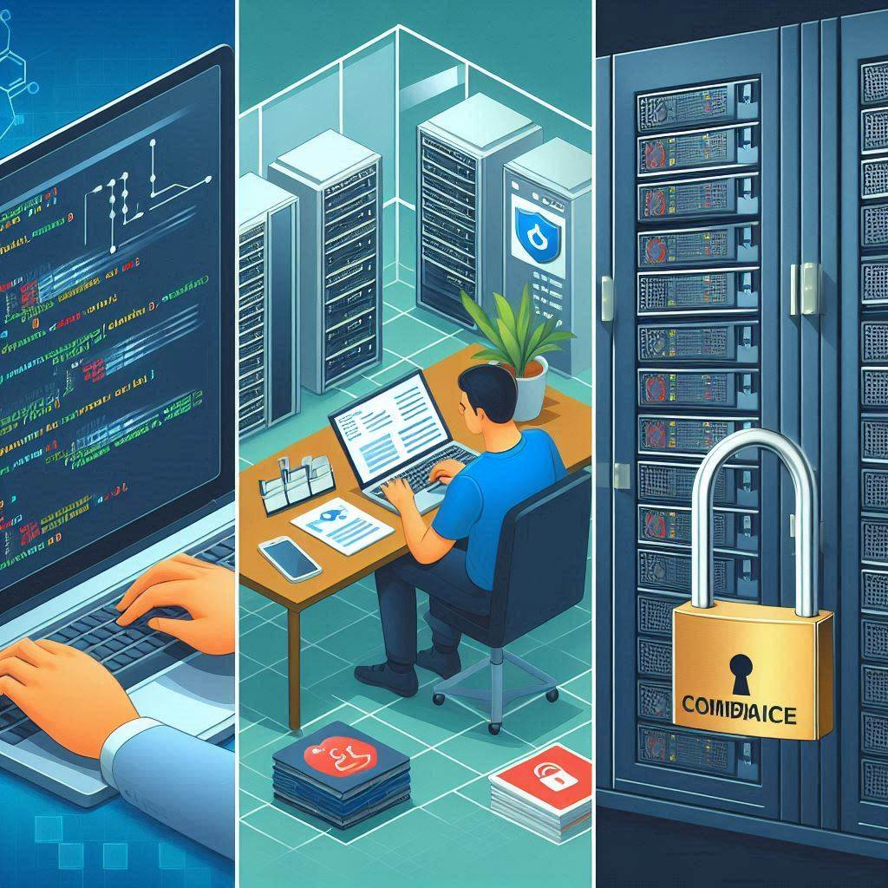
Feasibility and Viability
Technical Feasibility:
Development Approach: Utilizing the Django framework ensures seamless functionality across various platforms, setting a strong foundation for our project.
System Lifespan: With an anticipated lifespan of at least 5 years, our system is designed to remain relevant and effective amidst evolving technological landscapes.
Hosting: Leveraging Amazon Web Services (AWS) provides the flexibility and reliability necessary to support our system's scalability and performance requirements.
Compliance Requirements: Adhering to regulatory standards and data protection laws is paramount, and we are committed to maintaining compliance to safeguard sensitive data and uphold user trust.

Slide 8

Feasibility and Viability
Operational Feasibility:
Resource Availability: Our team is equipped with the right blend of skills and tools to drive the project forward effectively.
Training and Support: We offer comprehensive training and ongoing assistance to ensure every team member is proficient in utilizing our system.
Timely Completion: By breaking down tasks and setting clear timelines, we ensure on-time delivery of project milestones.
Incremental Development: We adopt an iterative approach, continuously refining and enhancing our system with each iteration.

Slide 9

Feasibility and Viability
Economic Feasibility:
Budget: We commence with an initial budget of $250,000 CAD, meticulously allocated to kickstart our project.
Total Costs: Through careful estimation, we assess the expenses required for both development and maintenance to ensure financial stability.
Revenue and Profit Expectations: We anticipate revenue generation by offering a streamlined code review solution, aiming to make financial gains while simplifying the process for our users.
Risk Mitigation and Cost Management: Vigilant monitoring and strategic resource allocation safeguard against unforeseen challenges, enabling efficient use of resources.

Slide 10
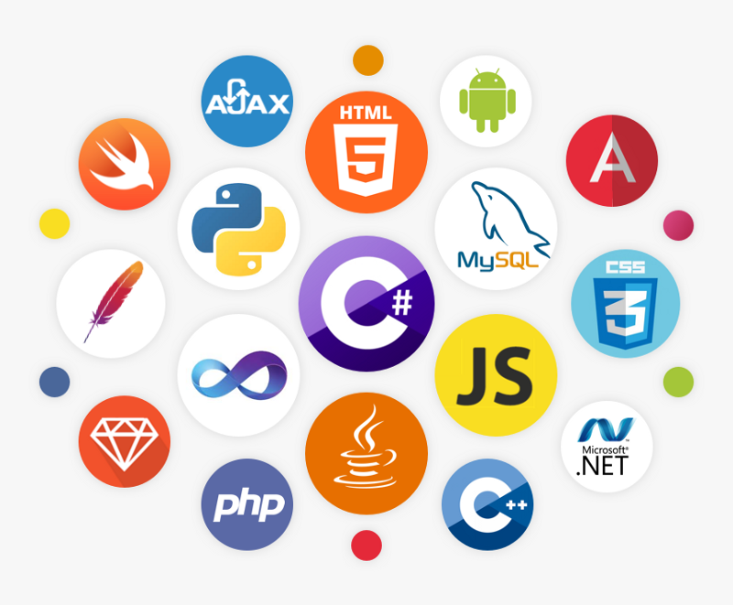
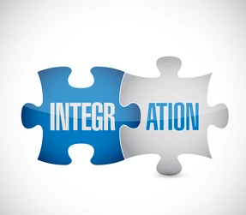
Solution Highlights
Intelligent Code Analysis: ACRS's smart code analysis looks at every detail of the code, finding mistakes, like bugs or parts that aren't safe, and spots where the code doesn't follow the rules, no matter what programming language it's written in. This helps make sure the code is solid and does what it's supposed to do without causing any problems.
Customizable Feedback Mechanisms: ACRS offers customizable feedback options for developers, allowing them to prioritize specific issues and adjust alert severity to tailor feedback to their project requirements.
Multi-Language Support: ACRS provides versatile multi-language support, enabling developers to use it with various programming languages and coding standards, fostering effective collaboration among diverse teams.
Integration with Existing Tools: ACRS seamlessly integrates with popular version control systems, project management tools, and continuous integration pipelines, preserving productivity by fitting into existing workflows without disruptions.
Scalability and Performance: ACRS efficiently scales with project complexity and size, delivering timely feedback and maintaining productivity levels without performance degradation.

Slide 11
Project Plan
Phase | Milestone | Resources | Timeline
Initiation Phase | Technical Feasibility Assessment Completed | Business Analyst, Technical Writer | 10 days
Requirement Phase | Completion of Requirement Documentation | Business Analyst, Technical Writer | 15 days
Design Phase | Completion of System Design | System Architect, UI/UX Designer | 1 Month
Construction Phase | Completion of Core Functionality | Front End Developer, Back End Developer | 25 days
Testing Phase | Completion of Testing Phase | QA Engineer, Test Engineer | 20 days
Implementation Phase | Successful Deployment of ACRS | DevOps Engineer, Deployment Team | 10 days
Project Closure | Project Sign-Off and Handover | Project Manager, Technical Writer | 10 days

Slide 12
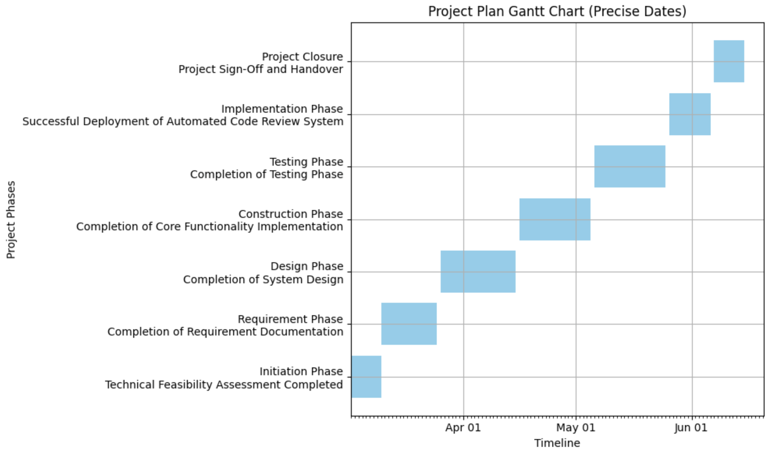
Project Plan

Slide 13
Risk Managament
Risk Identification
Ten risks have been identified and their IDs are listed below.
R1: Incomplete Requirements
R2: Estimated cost is less than the actual cost of requirements.
R3: Technology Integration Challenges
R4: Compromised Security System
R5: Unpredicted scalability issues
R6: More resources are needed.
R7: Delay in third-party component deliveries
R8: User accepted challenges
R9: Changes in government regulations
R10: Business Partners Acceptance

Slide 14
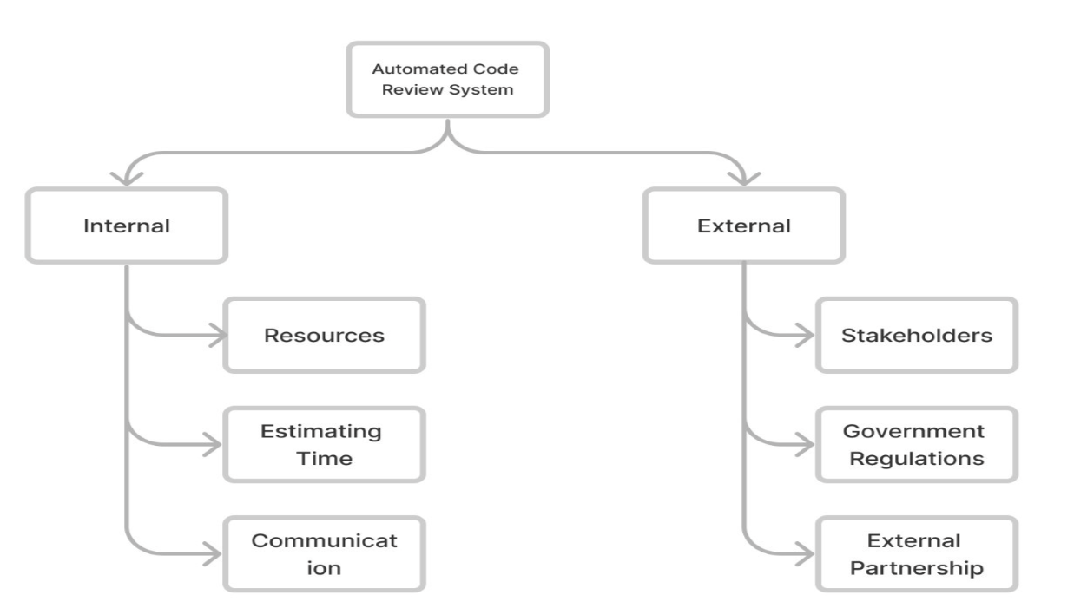
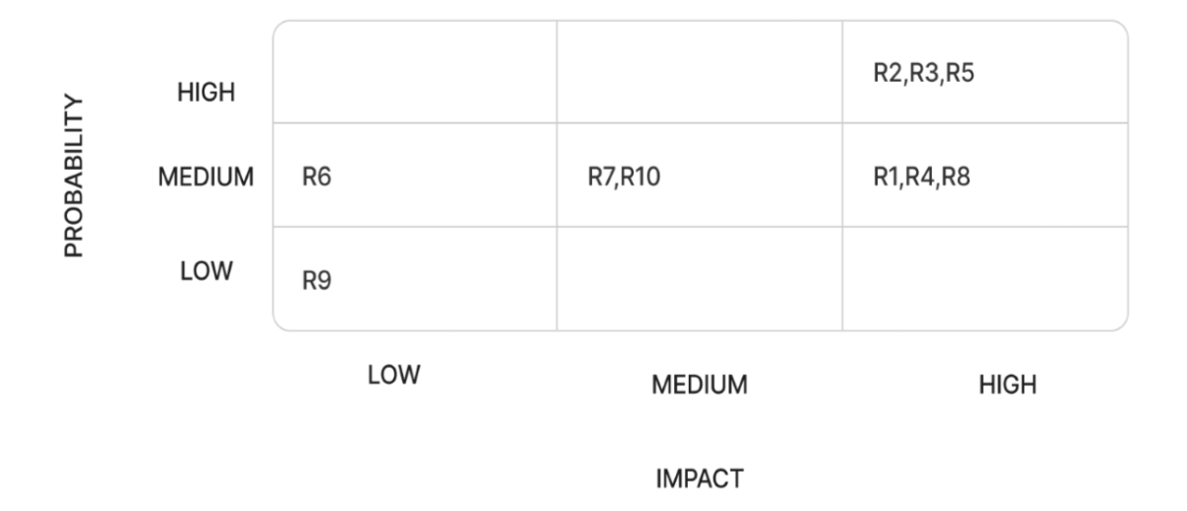
Risk Managament
Risk Breakdown Structure
Probability Impact Matrix

Slide 15
Risk Managament
Risk Response Planning
Risk Mitigation Strategies
Risk response planning involves creating strategies to address identified risks, ensuring project readiness. Strategies include avoidance, mitigation, transfer, or acceptance. These methods aim to eliminate, reduce, shift, or acknowledge risks, respectively. The plan details actions, responsibilities, and timing, enhancing the project's ability to minimize risks for success.
Regular Backups and Version Control
Training and Documentation
Testing Regularly
Keep Software Updated
Risk Reviews
Diversify Technologies
Communication Plan
By adhering to these strategies, we strive to maintain the Automated Code Review System project's safety and reliability, preventing significant difficulties and preparing to efficiently resolve minor issues.
Risks | Response Strategies
R1, R2, R6 | Risk acceptance
R8 | Risk avoidance
R9 | Risk transference
R3, R4, R5, R7, R10 | Risk mitigation

Slide 16
Software Development Budget
Cost Categories
Resource Cost
Resource cost refers to the total amount of money needed to get all the things and people required for our Automated Code Review System project.
Development Environment (Azure)
Human Resources
Server Fees
Administrator Workstation
SN | Work Breakdown Structure Item | Vendor | Amount
1 | Human Resources |  | $ 30,500.00
2 | Development Environment (Azure) | Microsoft | $ 4,500.00
3 | Servers Fees | HP | $ 7,667.00
4 | Administrator Workstation | HP | $ 500.00
5 | Miscellaneous |  | $ 1,958.00
Total Cost Estimate |  |  | $ 45,125.00

Slide 17
Software Development Budget
Contingency Cost
This budget plan sets aside extra funds, $4,512.50 to $9,025, to cover unexpected costs like price increases, more staff, or new equipment. It prevents project delays by preparing for unforeseen expenses, suggesting 10%-20% of total costs for this.
Preparedness for Unexpected Costs
Unexpected Costs: Allocating funds for unforeseen expenses, such as an unexpected increase in server fees, ensures the project can continue without interruption.
Emergency Fixes: The contingency budget is designed to address urgent issues, such as critical bugs, quickly and effectively.
Additional Resources: Should the project require extra manpower to meet deadlines, the contingency budget provides financial flexibility to accommodate this need.
Decision Making: The project manager plays a crucial role in deciding when to utilize the contingency funds, ensuring that spending is justified and necessary.

Slide 18
Software Development Budget
Cost Saving Measures
To make sure we do not spend too much, we are also planning to save money wherever we can. Here are our strategies:
Using Open-Source Software: Leveraging free, open-source software can significantly reduce costs compared to purchasing expensive licenses.
Negotiating with Vendors: Engaging in negotiations with service and product providers, like Microsoft and HP, could lead to discounts or better deals, further stretching the budget.
Optimizing Resource Usage: Efficiently using servers and cloud services, including shutting them down when not in use, will decrease operational costs.
Reusing Resources: Repurposing code, tools, and hardware from previous projects not only saves money but also accelerates development times.
Regular Budget Reviews: Continuously monitoring expenditure allows for real-time adjustments, ensuring funds are allocated where most needed and identifying opportunities to reallocate underspent budgets.
These cost-saving measures are essential for maintaining financial health and ensuring the project's success without compromising on quality or timelines.

Slide 19
Software Development Budget
The cost estimate is divided on the initial work breakdown structure and might change as the project progresses.
Task Name | Fixed Cost | WBS L-1 Total | Percentage
Requirements gathering | $0.0 | $7800 | 17.28%
Web app design | $0.0 | $6150 | 13.62%
Web app implementation | $0.0 | $15375 | 34.09%
Web app testing and quality assurance | $0.0 | $7700 | 17.07%
Web app deployment | $0.0 | $2200 | 4.87%
6. Go live | $0.0 | $3900 | 13.07%
7. Web app deployment | $0.0 | $2000 | 4.6%

Slide 20
Conclusion
In conclusion, our automated code review system enhances code quality, speeds up the development process, and reduces errors. It saves time for developers and ensures coding standards are met. We've shown how it can streamline workflow and improve project outcomes. We encourage stakeholders to adopt this system for better efficiency and accuracy in coding projects. The next step is to plan a pilot phase, where we can build the system with a small team before a full-scale testing. Your support in this initiative is crucial for its success.

