Slide 1
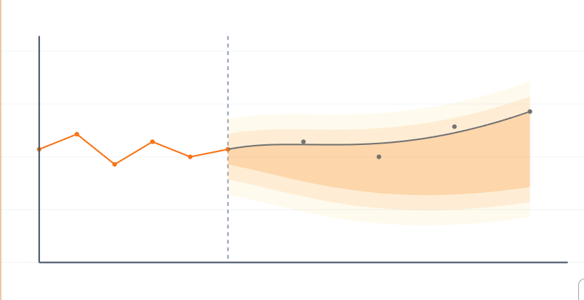
PyData NYC 2024
Udisha Dutta Chowdhury
Joint work with Abhishek Murthy,
Schneider Electric
Adopting Open-Source Tools for Time Series Forecasting: Opportunities and Pitfalls

Slide 2





About Me
Udisha Dutta Chowdhury
Master’s Student in Computer System’s Engineering at Northeastern University, Boston, MA.
Teaching Assistant for Machine Learning for IoT Systems Course at Northeastern University.
Data Science Intern at Schneider Electric, Andover, MA.
Cyber Security Intern and Solution Delivery Analyst at Deloitte USI, Bangalore, India.
Undergrad in Electronics and Communication Engineering, PES University, Bangalore, India.

Slide 3
Outline of the Talk
Introduction to Time Series Forecasting
Open-Source Tools
3 critical aspects of forecasting libraries
Data Understanding
Data Preparation
Backtesting
Conclusion and Key Takeaways

Slide 4
Time Series Forecasting
Forecast Time
Evolution of Forecasting Models
M Competitions benchmark forecasting models, showcasing advancements from traditional statistical methods to modern machine learning approaches
Forecasting Horizon
Milestones in the M Competitions
Time
M5 (2020)
Dominance of Pure Machine Learning and Ensemble Methods
Past Target Inputs (Endogenous Values)
Predicted Target Values
M4 (2018)
Rise of Machine Learning and Hybrid Combinations
Forecasting Model
M3 (2000)
Inclusion of Hybrid Methods
Past Exogenous Values
Future Exogenous Values
M2(1993)
Enhanced Statistical Methods with Real-World Adaptation
M1 (1982)
Introduction of Basic Statistical Methods
Known Inputs

Slide 5
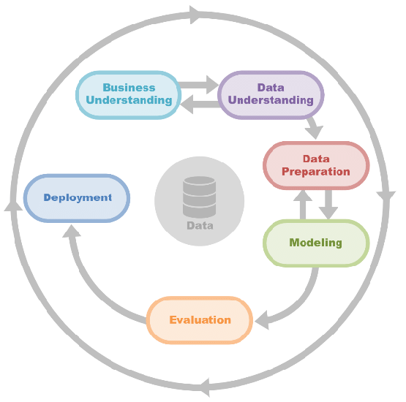
Common Stages in a Forecasting Project
Business Understanding:
Define the forecasting objective: What do we need to predict, and why is it important?
Data Understanding:
Explore time-series data: Identify trends, seasonality, and patterns.
Data Preparation:
Preprocess data for forecasting: Handle missing values, NaNs, duplicate values.
Modeling:
Apply forecasting methods: Choose models (e.g., ARIMA, neural networks) based on data characteristics.
Evaluation (Backtesting):
Test model accuracy under realistic settings.
Deployment:
Rollout the model in production.

Slide 6




Open-Source Tools for Time Series Forecasting
Advantages of Open-Source Solutions
Accessibility and Cost-Effectiveness
Flexibility and Customizability
Community-Driven Innovation
Integration with Existing Ecosystems

Slide 7
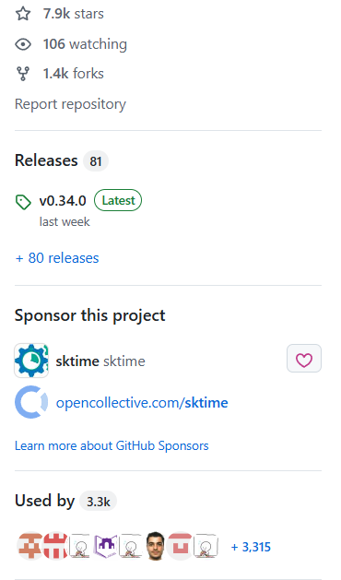
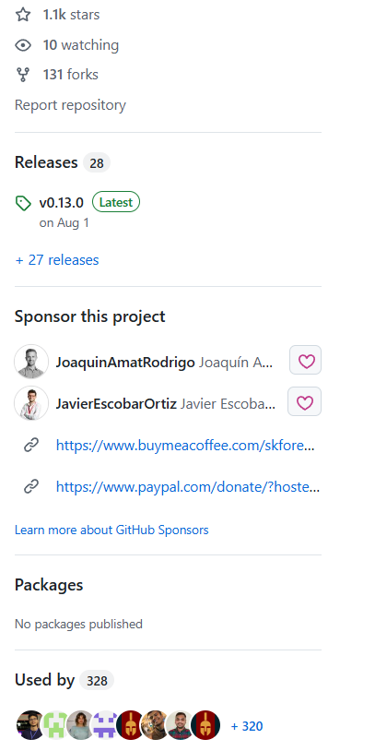
Growing Popularity of SKtime and Skforecast
GitHub Stars and Repository Activity
Community Engagement and Usage Trends

Slide 8
3- Critical Aspects for Forecasting Libraries
Data Understanding: How well does the library support Exploratory Data Analysis (EDA)?
Data Preparation: How robust and intuitive are the tool's preprocessing capabilities for handling quality issues, like missing values, NaNs, duplicate data, and exogenous variables?
Backtesting: How effective and scalable are the library’s modeling and evaluation capabilities for forecasting algorithms?

Slide 9
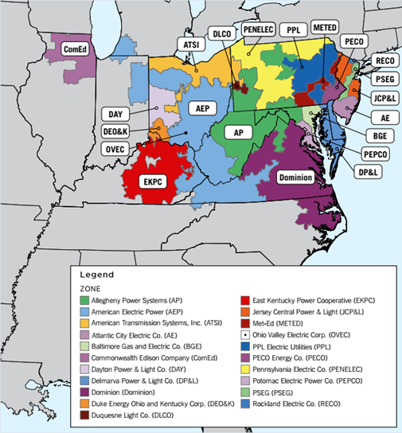
Dataset used for the experiments
PJM Hourly Energy Consumption Data
Independent nonprofit organization that manages the electric transmission system for a large region
Hourly power consumption data comes from PJM's website and are in megawatts (MW).
Data used : 125 days of hourly power consumption of Duquesne Light Company (DUQ)

Slide 10
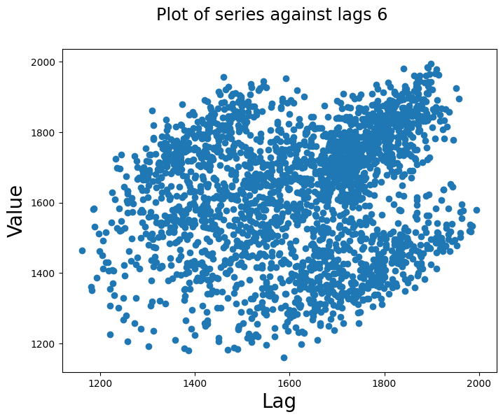
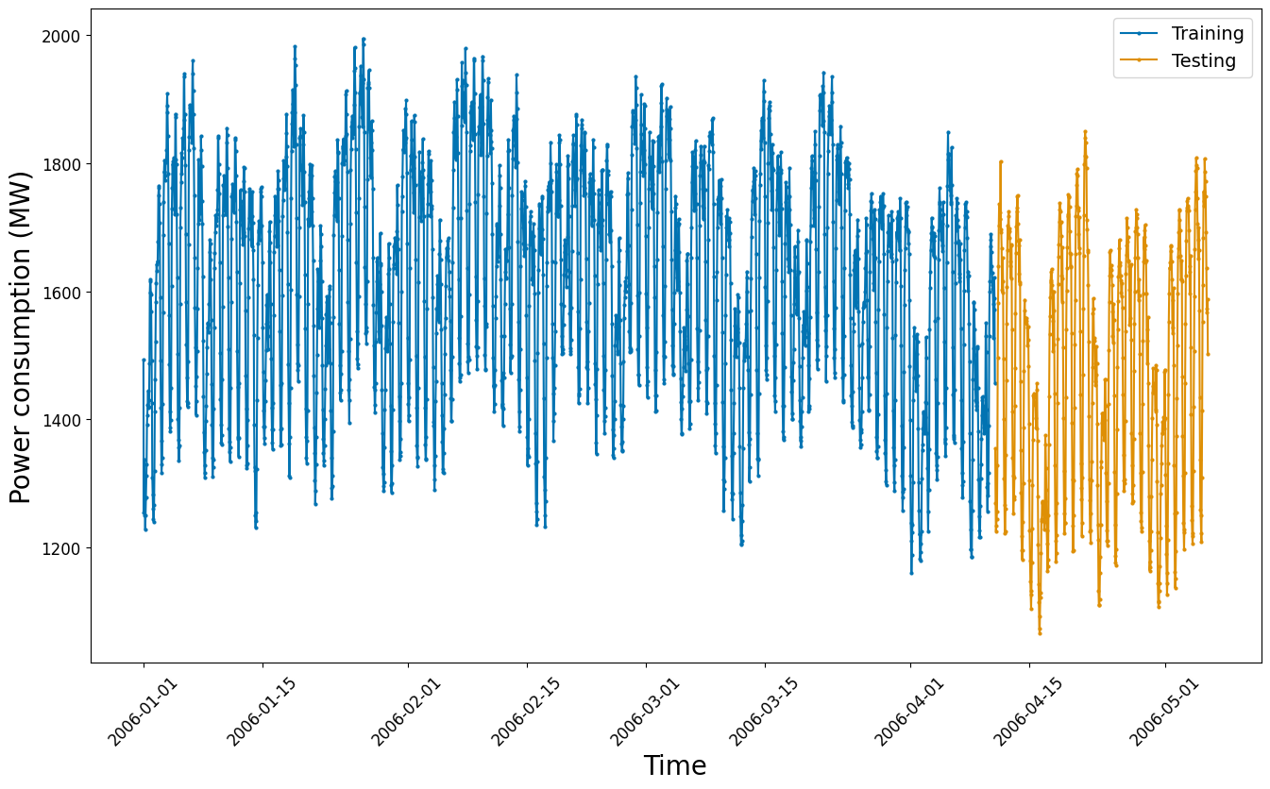
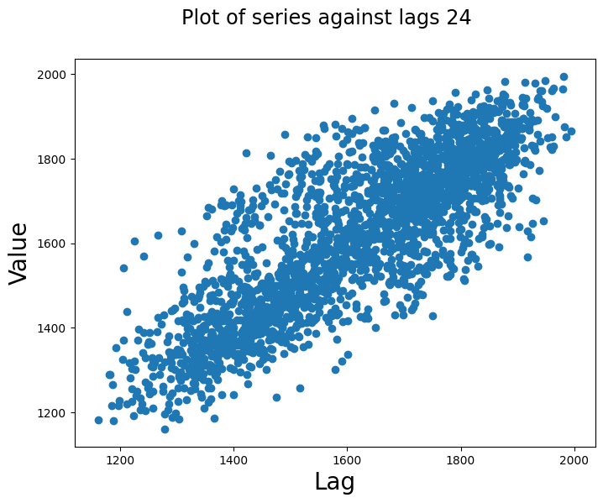
Data Understanding : Forecasting Libraries accelerate EDA
Viz. trends with train-test split
Plot one or more lagged versions of the time-series data
plot_series()
plot_lags()
plot_series(y_train, y_test, labels=["Training", "Testing"], markers=['.', '.'], ax=ax)
plot_lags(y_train, lags=6)
plot_lags(y_train, lags=24)

Slide 11
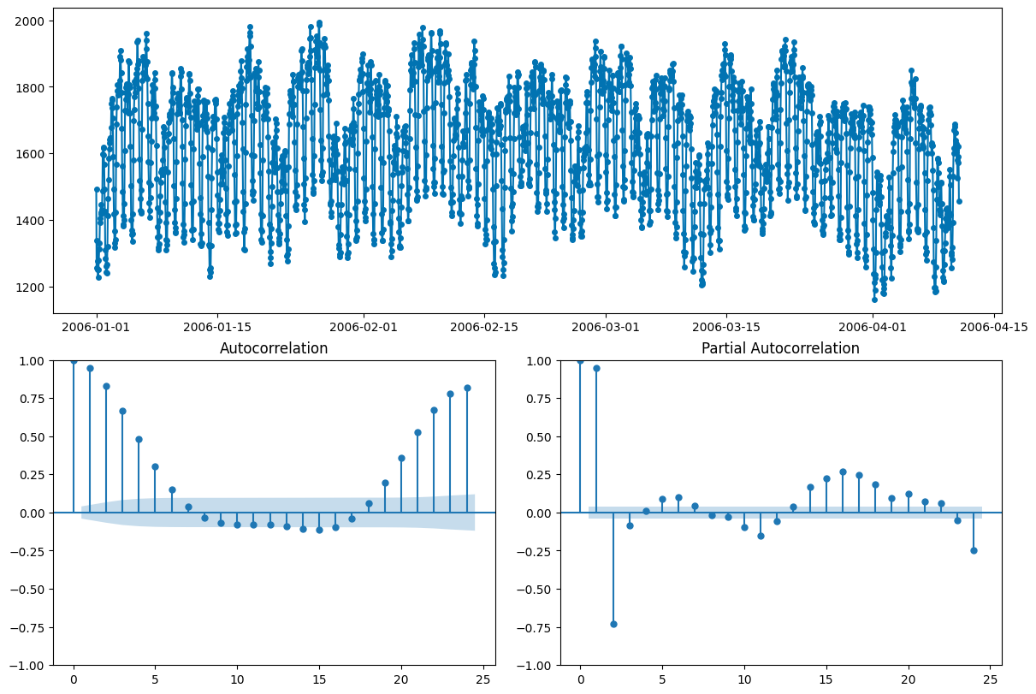
Data Understanding
Correlation (auto & partial)
plot_correlations()
plot_correlations(y_train)

Slide 12
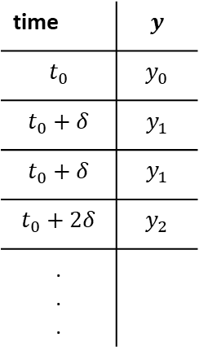
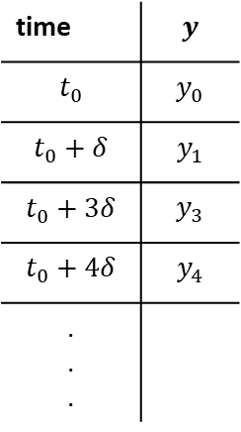
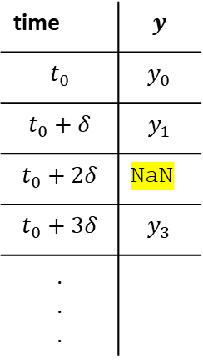
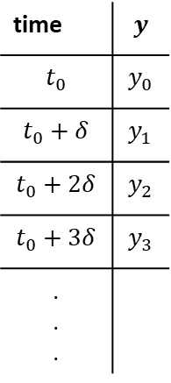
Data Preparation: Forecasting Libraries offer pre-processing features
time | $$y$$
$$t_{0}$$ | $$y_{0}$$
$$t_{0}+δ$$ | $$y_{1}$$
$$t_{0}+2δ$$ | $$y_{2}$$
$$t_{0}+3δ$$ | $$y_{3}$$
. . .
time | $$y$$
$$t_{0}$$ | $$y_{0}$$
$$t_{0}+δ$$ | $$y_{1}$$
$$t_{0}+2δ$$ | NaN
$$t_{0}+3δ$$ | $$y_{3}$$
. . .
time | $$y$$
$$t_{0}$$ | $$y_{0}$$
$$t_{0}+δ$$ | $$y_{1}$$
$$t_{0}+3δ$$ | $$y_{3}$$
$$t_{0}+4δ$$ | $$y_{4}$$
. . .
time | $$y$$
$$t_{0}$$ | $$y_{0}$$
$$t_{0}+δ$$ | $$y_{1}$$
$$t_{0}+δ$$ | $$y_{1}$$
$$t_{0}+2δ$$ | $$y_{2}$$
. . .
Data quality issues are expected in the training and testing datasets.
The forecasting library must help the data scientist analyze and mitigate the issues through:
Missing value imputation
Outlier detection and removal
Detrending and seasonality adjustment
Resampling irregular timestamps to fixed frequency
Time-based train-test splitting utilities
Nominal
Missing data
Irregular data
Duplicate data
Notes:
Mention stateless and stateful forecaster.

Slide 13
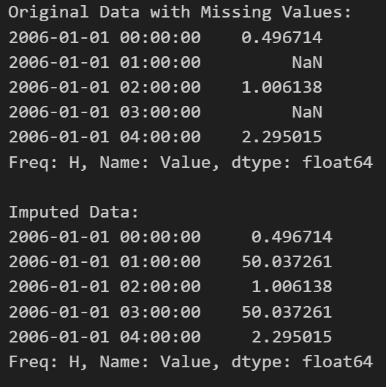
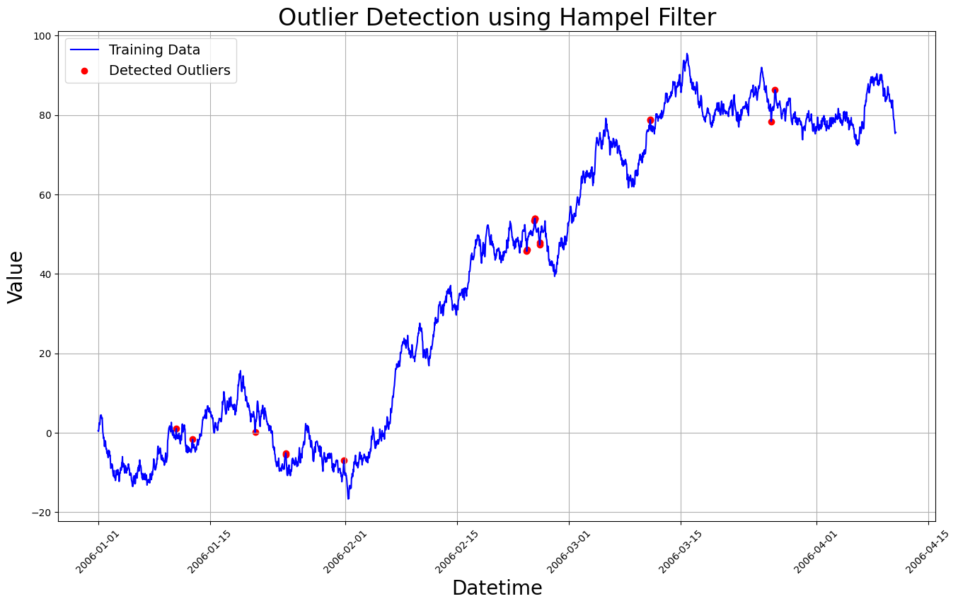
Data Preparation
Missing Value Imputation
Outlier Detection and Removal
from sktime.transformations.series.outlier_detection import HampelFilter
hampel_filter = HampelFilter(window_length=24, n_sigma=3)
outliers = hampel_filter.fit_transform(y_train)
from sktime.transformations.series.impute import Imputer
imputer = Imputer(method="mean")
data_imputed = imputer.fit_transform(y_train)

Slide 14
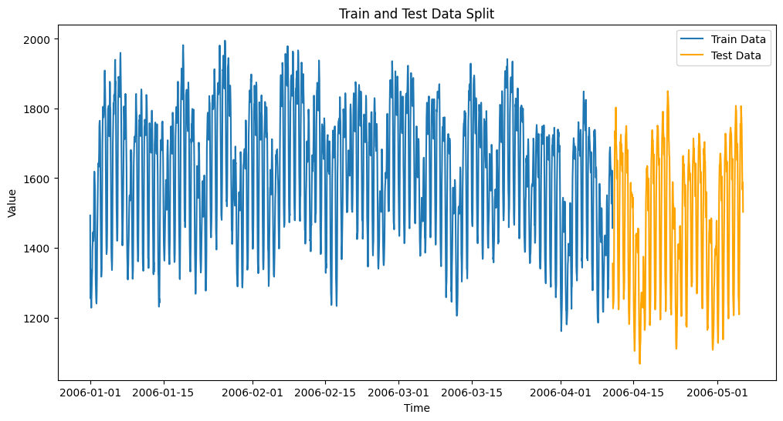
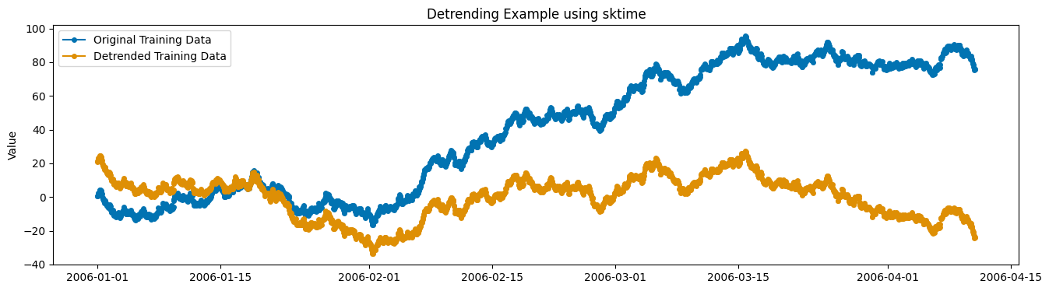
Data Preparation
Detrending and Seasonality Adjustment
Time-based train-test split
from sktime.transformations.series.detrend import Detrender
detrender = Detrender()
y_train_detrended = detrender.fit_transform(y_train)
from sktime.split import temporal_train_test_split
data = df['2006-01-01':'2006-12-31'][:(24*125)]
y_train, y_test =
temporal_train_test_split(data, test_size=0.2)

Slide 15
Data Preparation
Skforecast works with pandas for data preprocessing
Handle Outliers using Rolling Statistics
Resampling Irregular Timestamps
data_resampled = data.resample('H').mean()
roll_mean = data_clean.rolling(window=5, center=True).mean() roll_std = data_clean.rolling(window=5, center=True).std()
Detrending Using Differentiation
Handle missing values
ts_diff = ts_no_outliers.diff().dropna()
data_interpolated = data.interpolate(method='linear')

Slide 16





Backtesting: Forecasting libraries help scale experimentation
Forecast time
Window 1 (E1)
Window 2 (E2)
Fit the model on the initial training data
$$ℳ$$
Window 0 (E0)
Initial Training Data
Make prediction over the forecasting horizon
Compute performance $E_{i}$
(MAPE, MAE, etc)
Forecast horizon
Time
1
2
3
4
5
6
7
8
9
10
11
12
13
14
15
Ingest more training data: Move window
Forecasting libraries offer
wide variety of modeling choices by interfacing/ implementing popular algorithms (sci-kit, XGBoost, etc)
Standardized implementation of forecasting metrics
Windowing functions to replicate forecasting scenarios: sliding, expanding, etc
Model update/refit capabilities to replicate forecasting scenarios.
Process new data
Update the history used by the model, no refit.
Refit on bigger
train set
Do nothing
(retain model)
$$ℳ→ℳ$$
$$ℳ→ℳ$$
$$ℳ→ℳ^{refit}$$

Slide 17
Backtesting: Setting Up Your Experiment Parameters
Modeling Choices
regressor = RandomForestRegressor(n_estimators=250, max_depth=10, random_state=123)
forecaster = make_reduction(regressor, window_length=6, strategy='recursive')
regressor =
RandomForestRegressor(n_estimators=250, max_depth=10, random_state=123)
forecaster = ForecasterAutoreg(
regressor = regressor,
lags = 6)
Sliding/Expanding Window Features
cv = ExpandingWindowSplitter(initial_window=240,
step_length=24,
fh=np.arange(1, 25))
metric, predictions_backtest= backtesting_forecaster(
forecaster = forecaster,
y = y_train["DUQ_MW"],
initial_train_size = 240,
fixed_train_size = False,
steps = 24,
metric= mean_absolute_percentage_error,
refit = True,
verbose = True,
show_progress = True)
results = evaluate(forecaster=forecaster,
y=y_train,
cv=cv,
return_data=True,
strategy='refit',
scoring=mean_absolute_percentage_error)
Refit/Update Features
Performance Metrics

Slide 18
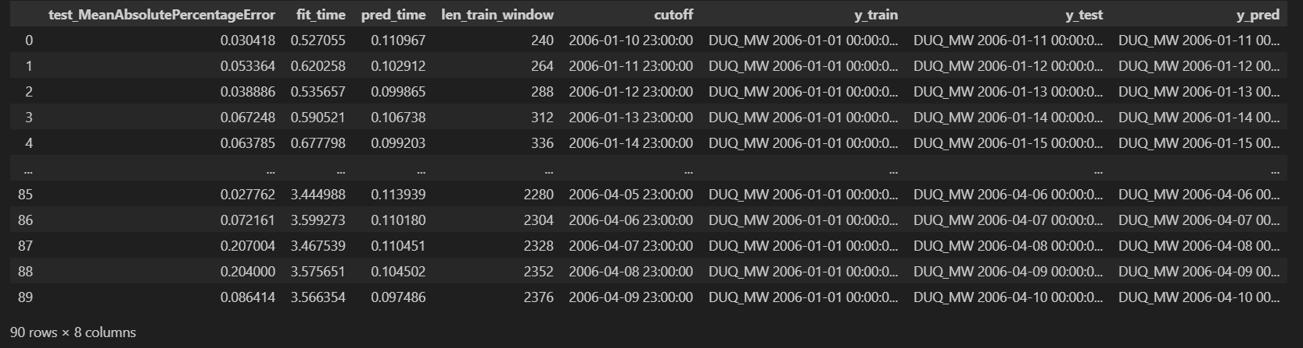
Backtesting Experiment
Training set, Testing set and Predictions for each window
End of each training window
Length of each window
Prediction time for each window
Training Time for each window
Error for each window

Slide 19
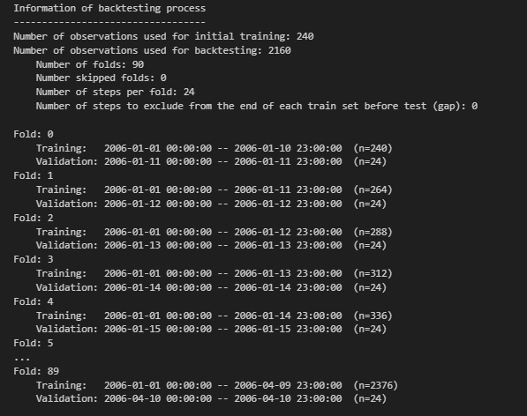
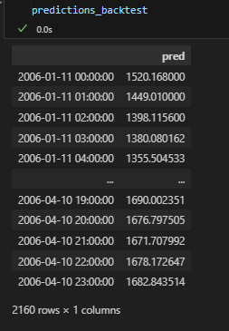
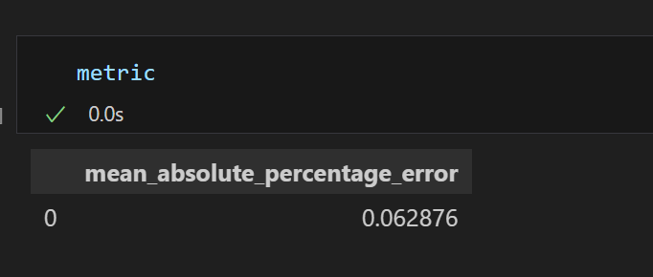
Backtesting Experiment
backtesting_forecaster() -> returns all the predicted values and the overall performance metric value
Training set, Testing set and the size for each fold can be seen when Verbosity is set to True

Slide 20
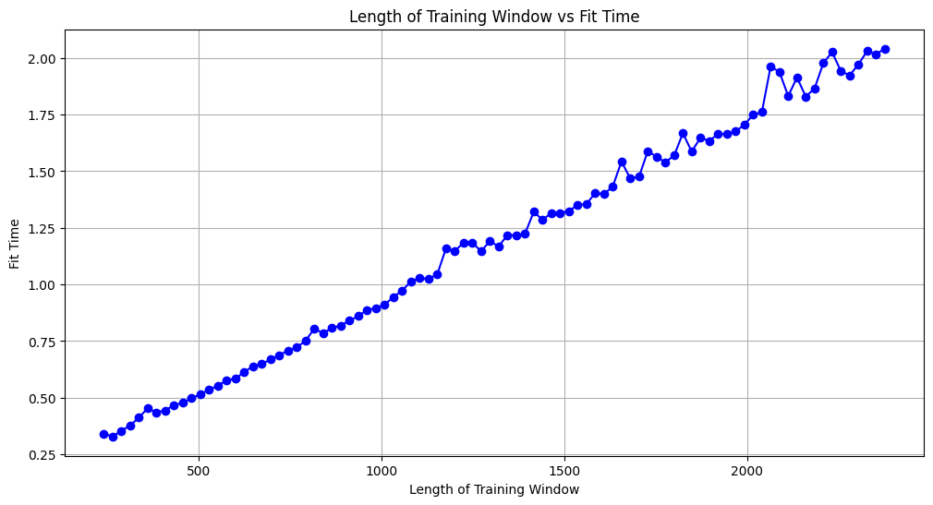
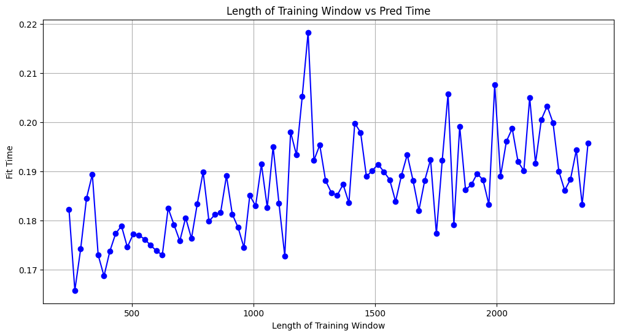
Backtesting Experiment
Experiment run time (ms) | 117357.61 | 33883.11
Experiment Metric (MAPE) | 0.088353 | 0.062876
Window length vs Training time |  | -
Window Length vs Prediction time |  | -
Backtesting Parameters:
window_movement = expanding
initial_data = 240
fh = 24
window_stride = 24
metric = MAPE
refit_update = refit
window_length = 24

Slide 21
Conclusion and Key Takeaways
Data Understanding
Data Preparation
Backtesting
Minimize boilerplate code accelerate development &
simplify maintenance
Lines of code (Dev)
Maintenance (Ops)
85 – 90%
45 – 50%
Code from scratch
Optimized forecasting library
Code from scratch
Optimized forecasting library
SKTime and SKForecast: two popular forecasting libraries. SKForecast focuses on a core set of features; SKTime is all encompassing.
Data Understanding: SKTime hooks into statsmodels to provide several visualization functions.
Data Preparation: SKTime provides several utilities, whereas SKForecast expects the data scientist to use Pandas preprocessing functions.
Backtesting: Despite limited functionality, SKForecast is quite fast. SKTime provides more options and fine-grained stats.

