Slide 1
CAPSTONE PROJECT
ProviBook: Streamlining Provision Distribution through Advanced Ticket Booking System
Presented By:
G R UDISTEN
B Tech Textile Technology, Alagappa College of Technology, Anna University, Chennai.

Slide 2
OUTLINE
Problem Statement
Proposed System/Solution
System Approach
Algorithm
Deployment
Result
Conclusion
Future Scope
References

Slide 3
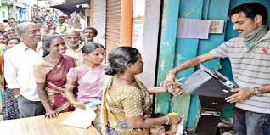
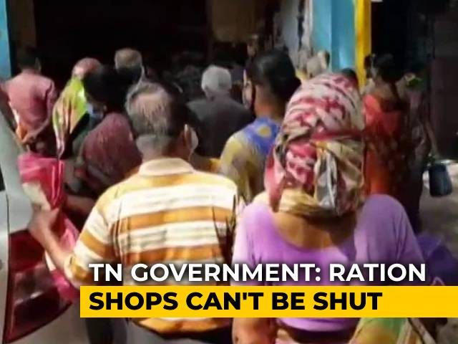
PROBLEM STATEMENT
In response to the challenges posed by overcrowding in Ration shops, especially affecting vulnerable populations such as the elderly and working individuals, and the increased risk of disease transmission during pandemics like COVID-19, there is a need to establish an efficient ticket booking system for government ration shops.
This system aims to alleviate the inconvenience of queuing, promote healthcare safety measures, and enhance provision distribution by identifying regular beneficiaries.

Slide 4
PROPOSED SOLUTION
The proposed ticket booking system streamlines government ration shop operations by efficiently managing user registrations, slot availability, and booking confirmations.
Utilizing advanced data structures and algorithms, the system dynamically updates slot availability, ensuring optimal resource allocation and mitigating overcrowding risks.
Robust authentication protocols and encryption mechanisms safeguard user privacy and prevent unauthorized access.
Scalable cloud infrastructure and real-time notifications enhance user experience, while comprehensive reporting capabilities provide insights for informed decision-making.
Overall, the system revolutionizes provision distribution, promoting efficiency, safety, and equitable access to essential provisions.

Slide 5
SYSTEM APPROACH
The system approach to the proposed ticket booking system for government ration shops entails a comprehensive strategy that integrates technology, process optimization, and user-centric design principles.
Central to this approach is the identification of key stakeholders, including users, administrators, and government officials, whose needs and requirements drive system development.
Through close collaboration and stakeholder engagement, the system's functional requirements are meticulously defined, encompassing user registration, slot management, authentication protocols, and reporting functionalities.
The system architecture is designed to be modular and scalable, leveraging cloud-based infrastructure to accommodate varying demand and ensure seamless performance.
Rigorous testing and validation procedures are employed to verify system functionality and security measures, guaranteeing reliability and trustworthiness.
Ultimately, the system approach emphasizes a holistic perspective, addressing not only immediate challenges but also laying the groundwork for future enhancements and innovation in provision distribution and ration shop management.

Slide 6
ALGORITHM
2. Define User class
2.1 Define __init__ method with parameters name, age, occupation, and contact
2.1.1 Set instance variables name, age, occupation, and contact
3. Define RationShop class
3.1 Define __init__ method with parameters location, slots, and capacity_per_slot
3.1.1 Set instance variables location, slots, and capacity_per_slot
1. Initialize BookingSystem
1.1 Initialize users list
1.2 Initialize ration_shop as None
1.3 Initialize bookings dictionary
1.4 Initialize token_counter as 1
6. Define display_available_slots method in BookingSystem
6.1 Print "Available Slots:"
6.2 Iterate through each slot and availability in ration_shop.slots
6.2.1 If availability is greater than 0
6.2.1.1 Print "Slot {slot}: {availability} available"
4. Define register_user method in BookingSystem
4.1 Takes parameters name, age, occupation, and contact
4.2 Create a new User instance with the provided information
4.3 Append the user to the users list
7. Define book_slot method in BookingSystem
7.1 Takes parameters user and slot
7.2 Check if slot is in ration_shop.slots and availability is greater than 0
7.2.1 If yes, decrement availability of the slot by 1
7.2.2 Check if user's name is in bookings
7.2.2.1 If yes, append (slot, token_counter) to the user's bookings
7.2.2.2 If no, create a new entry for the user in bookings with (slot, token_counter)
7.2.3 Print "Booking successful!"
7.2.4 Print booking details including user's information, slot, and token number
7.2.5 Increment token_counter by 1
7.3 If slot is not available, print "Slot not available."
5. Define initialize_ration_shop method in BookingSystem
5.1 Takes parameters location, slots, and capacity_per_slot
5.2 Create a new RationShop instance with the provided information
5.3 Set the ration_shop variable to the new instance

Slide 7
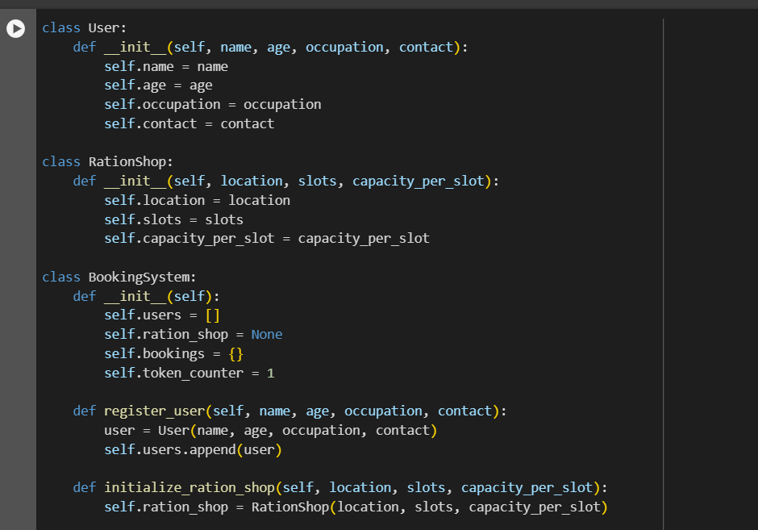
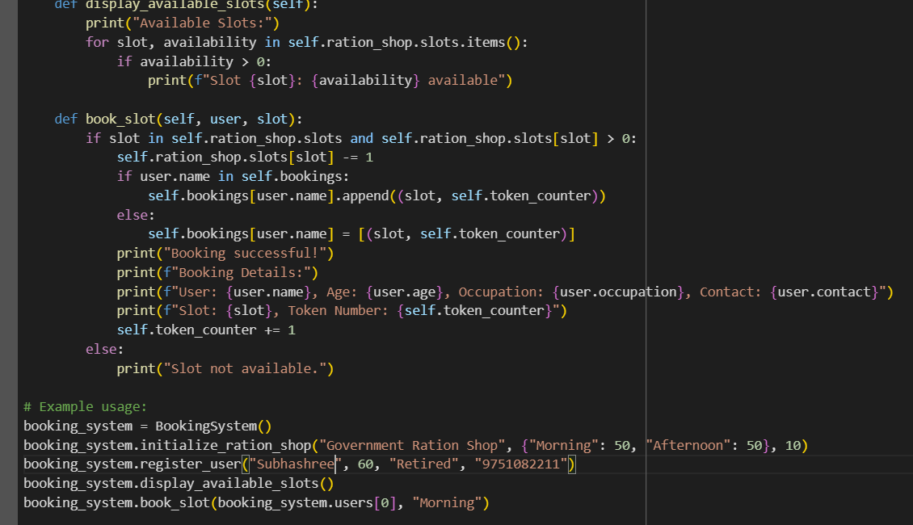
DEPLOYMENT

Slide 8
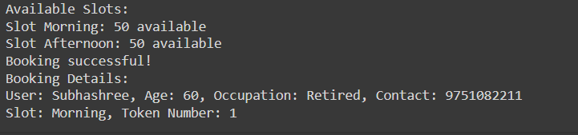
RESULT

Slide 9
CONCLUSION
In conclusion, the proposed ticket booking system for government ration shops presents a comprehensive solution to the challenges faced in provision distribution, particularly amidst scenarios of overcrowding and public health crises. By leveraging advanced data structures, authentication mechanisms, and cloud-based infrastructure, the system streamlines operations, optimizes resource allocation, and enhances user experience. Through rigorous testing and stakeholder engagement, the system ensures reliability, security, and scalability, laying the groundwork for transformative advancements in ration shop management. With its emphasis on efficiency, safety, and equitable access to essential provisions, the ticket booking system promises to revolutionize the way government ration shops serve communities, fostering resilience and well-being in times of need.

Slide 10
FUTURE SCOPE
The ticket booking system for government ration shops lays a solid foundation for future enhancements and innovations in provision distribution and ration shop management. One avenue for future development involves the integration of advanced analytics and machine learning algorithms to analyze booking trends, user behavior, and resource utilization patterns. By leveraging predictive analytics, the system can anticipate demand fluctuations, optimize slot allocation, and proactively address emerging challenges. Additionally, the implementation of mobile applications and IoT devices can further enhance user convenience and accessibility, allowing for seamless booking and real-time updates on provision availability. Furthermore, partnerships with local authorities and non-governmental organizations can extend the system's reach and impact, facilitating collaboration in emergency response efforts and community outreach initiatives. As technology continues to evolve, the ticket booking system remains poised to adapt and evolve, ensuring continued efficiency, transparency, and resilience in provision distribution for years to come.

Slide 11
REFERENCES
Sathya, S., V, K., G, M., Nigam, N., Asel, N., & Vijayan, V. (2023). Web Based Ration Provisioning System in Public Distribution Shop. E3S Web of Conferences. https://doi.org/10.1051/e3sconf/202339904054.
Yuvarajvikram, R., Sherwin, N., & Baig, R. (2016). A Universal Smart Quantity Analysis System. Automation and Autonomous System, 8, 213-217.
, B., & Priyaa.R, S. (2016). smart ration card application in android. International Journal of Advance Research and Innovative Ideas in Education, 2, 731-735.
Jha, R., Srivastav, Y., Sumbli, V., , T., Gandhi, V., & Jain, S. (2018). RFID based food rationing system. HardwareX. https://doi.org/10.1016/J.OHX.2018.E00043.
jacob, K. (2018). Efficient ration product distribution system using RFID. International Journal of Advance Research and Innovative Ideas in Education, 4, 652-654.
Golait, S., Kolhe, L., Rahangdale, S., Godghate, A., Sonkusare, P., & Sha, A. (2020). A Review on E-Ration Card System. , 51-53. https://doi.org/10.32628/cseit2062148.
Krishnan, U., DineshN., S., & Kumar, J. (2017). Digitalized e-ration System (Way to Smart City). Imperial journal of interdisciplinary research, 3.
(2020). Smart Automatic Ration Card using Webpage. International Journal of Recent Technology and Engineering. https://doi.org/10.35940/ijrte.f9438.059120.

Slide 12
THANK YOU

