Slide 1

IPv6 – IPv4 Network Address, Port & Protocol Translation
&
Multithreaded DNS Gateway
Navpreet Singh, Abhinav Singh, Udit Gupta, Vinay Bajpai, Toshu Malhotra
Computer Center
Indian Institute of Technology
Kanpur India
Computer Center | Network Group
IIT Kanpur India

Slide 2
Introduction
Transition from IPv4 to IPv6 is a slow process and the major drawback is that there is no compatibility between IPv4 and IPv6.
Using this translator, an IPv6 only host can communicate to any IPv4 only host as the translator converts IPv6 packets received from the IPv6 host into IPv4 packets and vice versa.
DNS Gateway is used to convert A address into AAAA address of requested name. Since this conversion consumes some time so multithreading is used to handle multiple requests simultaneously.
Computer Center | Network Group
IIT Kanpur India

Slide 3
IPv6 Test Bed
IIT Kanpur, under BITCOE (BSNL IIT Kanpur Telecom Centre of Excellence), is setting up an IPv6 test bed to test and validate IPv6 applications and functionalities.
As part of the Test Bed, there are several IPv6 Internet Application Servers, IPv6 enabled Layer 3/2 Switches and IPv6 enabled Router.
The IPv6 Test Bed is also connected to IIT Campus Network which is a fully IPv6 enabled Network.
Our Translator/gateway is a part of IPv6 test bed which connects IPv6 servers/clients to IPv4 network.
Computer Center | Network Group
IIT Kanpur India

Slide 4
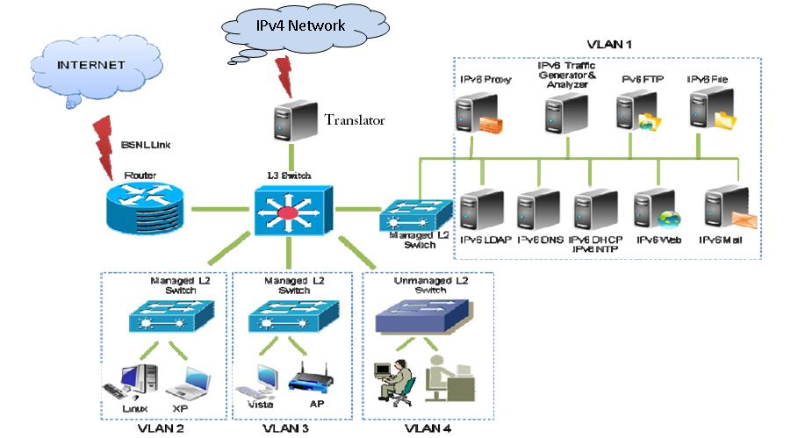
IPv6 Test Bed
IPv6 test bed diagram :-
Computer Center | Network Group
IIT Kanpur India

Slide 5
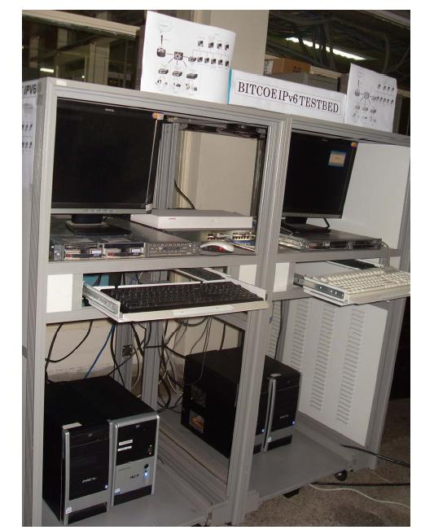
IPv6 Test Bed
Computer Center | Network Group
IIT Kanpur India

Slide 6
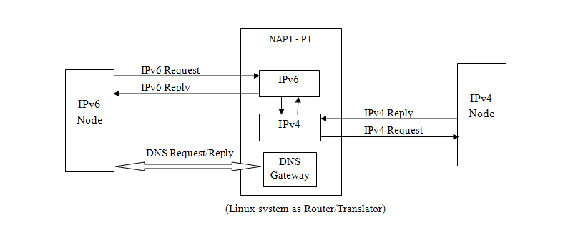
Methodology
We use the methodology as defined in RFC 2766. The basic architecture of translator is shown in Fig.
Computer Center | Network Group
IIT Kanpur India

Slide 7
Methodology….
Network Address Translation
IPv6 has 128 bit address space and IPv4 has 32 bit address network address translation is required to make communication between IPv4 and IPv6 networks.
IPv4 address is translated into IPv6 address a 96 bit prefix is added to 32 bit IPv4 address to make it 128 bit IPv6 address.
IPv6 address is translated into IPv4 address 96 bit prefix is removed from 128 bit IPv6 address to create 32 bit IPv4 address.
Computer Center | Network Group
IIT Kanpur India

Slide 8
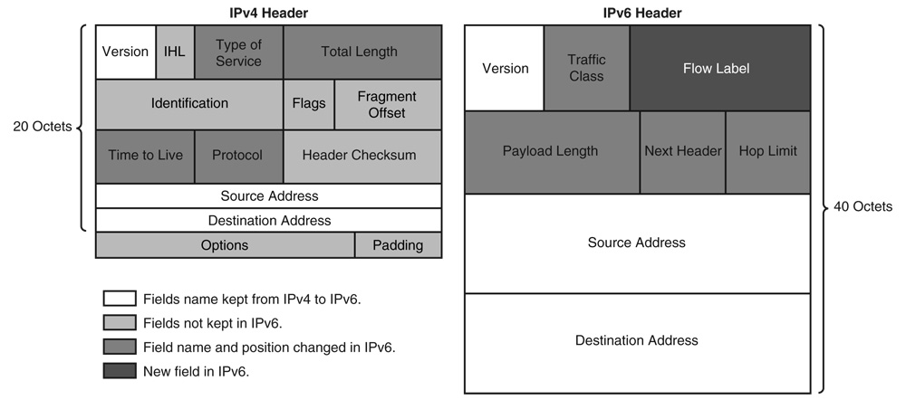
Packet Format
Computer Center | Network Group
IIT Kanpur India

Slide 9
IPv6 to IPv4 Header Translation
Version :- 6 to 4
Total length :- Payload length of IPv6 Header plus header length of IPv4 header.
Time To Live:- Hop Limit value from IPv6 header decreased by one
Protocol:- Next Header copied from IPv6 header.
Header Checksum:- Computed when the IPv4 header has been created
Source Address :- In 32 bit format.
Destination Address :- In 32 bit format.
Computer Center | Network Group
IIT Kanpur India

Slide 10
IPv4 to IPv6 Header Translation
Version :- 4 to 6
Payload length:- Total length of IPv4 header minus IPv4 header length.
Next Header:- Protocol field copied from IPv4 header.
Hop Limit:- Time To Live value from IPv4 header decreased by one
Source Address :- 128 bit format
Destination Address:- 128 bit format
Computer Center | Network Group
IIT Kanpur India

Slide 11
Packets by Tcpdump
IPv6 to IPv4
  02:26:38.201398 IP6 4001:4490::c0a8:105.42572 > 4001:4490::ac1f:1e3.squid: P 2233648499:2233649210(711) ack 1509661240 win 1002 <nop,nop,timestamp 1387212 240511488>
  02:26:38.201440 IP 172.29.0.1.42572 > 172.31.1.227.squid: P 2233648499:2233649210(711) ack 1509661240 win 1002 <nop,nop,timestamp 1387212 240511488>
IPv4 to IPv6
  02:26:38.201697 IP 172.31.1.227.squid > 172.29.0.1.42572: . ack 711 win 188 <nop,nop,timestamp 240520806 1387212>
  02:26:38.201738 IP6 4001:4490::ac1f:1e3.squid > 4001:4490::c0a8:105.42572: . ack 711 win 188 <nop,nop,timestamp 240520806 1387212>

Slide 12
Port Translation
Main purpose of translator is to make communication between IPv4 and IPv6 network without dual-stack system
In IPv6-IPv4 translation the purpose of port translation is same as in IPv4 port translation. Only one public IPv4 address is assigned to the group of IPv6 hosts and they will communicate with IPv4 network by this IP only.
Port from available pool is assigned to every connection from the IPv6 hosts which try to communicate through translator. An entry is made in table for further communication.
Computer Center | Network Group
IIT Kanpur India

Slide 13
Packets by Tcpdump
IPv6 to IPv4
  02:26:38.201398 IP6 4001:4490::c0a8:105.42572 > 4001:4490::ac1f:1e3.squid: P 2233648499:2233649210(711) ack 1509661240 win 1002 <nop,nop,timestamp 1387212 240511488>
  02:26:38.201440 IP 172.29.0.1.5000 > 172.31.1.227.squid: P 2233648499:2233649210(711) ack 1509661240 win 1002 <nop,nop,timestamp 1387212 240511488>
IPv4 to IPv6
  02:26:38.201697 IP 172.31.1.227.squid > 172.29.0.1.42572: . ack 711 win 188 <nop,nop,timestamp 240520806 1387212>
  02:26:38.201738 IP6 4001:4490::ac1f:1e3.squid > 4001:4490::c0a8:105.42572: . ack 711 win 188 <nop,nop,timestamp 240520806 1387212>

Slide 14
Protocol Translation
Protocol translation is for translation of UDP, TCP and ICMP. In TCP and UDP
Translate
  Port Number
  pseudo IP header
  update checksum
ICMP protocols are different in both networks. For IPv6 it is ICMPv6 and for IPv4 it is ICMPv4.
Computer Center | Network Group
IIT Kanpur India

Slide 15
Multithreaded DNS gateway
DNS Gateway synthesizes AAAA records from A records.
DNS gateway adds 96 bit prefix to A records to make it AAAA records.
When IPv6 machine tries to communicate with IPv4 host, if queries DNS for AAAA records. Since there is no entry for such records, the DNS gateway returns AAAA record to IPv6 client.
Computer Center | Network Group
IIT Kanpur India

Slide 16
Steps for Translation
An IPv6 only host wants to access IPv4 only host using its DNS name. IPv6 host sends query to DNS gateway to resolve the address of target host. IPv6 hosts sends type 'AAAA' query to DNS gateway.
DNS gateway changes the type 'AAAA' query into type 'A' query and requests IPv4 DNS (in the IPv4 network) to resolve the name to IPv4 address.
DNS gateway receives DNS reply and converts the type 'A' reply into type 'AAAA' reply and sends back to IPv6 host.
Computer Center | Network Group
IIT Kanpur India

Slide 17
Steps….
Now IPv6 host has an IPv6 address of target IPv4 host.
IPv6 host generates IPv6 packet and the packet is routed to the translator. The translator receives the packet and translate IPv6 packet into IPv4 packet by changing the header and forwards the packet to IPv4 target host.
Target IPv4 host generates the IPv4 reply and packet is routed to the translator. Now the translator translates back the IPv4 packet into IPv6 packet and forwards the packet to IPv6 host.
Computer Center | Network Group
IIT Kanpur India

Slide 18
Implementation
Linux machine will act as a IPv6/IPv4 translator gateway.
Kernel modules are created and installed in the system and translator machine is connected to the networks.
It works as a Translator cum Router which receives the packets, translates them and forwards to desired networks.
Computer Center | Network Group
IIT Kanpur India

Slide 19
Translation from IPv6 to IPv4
DNS resolves the IPv4 address of the destination host and adds a 96 bit prefix to the address of destination machine to make it 128 bit IPv6 address. This address is provided to the client host and it uses this address to send the packet.
Packet is received by translator and added 96 bit is removed by translator and an available IPv4 address and port number from pool is assigned for header translation.
  Translated packet is forwarded to IPv4 network.
Computer Center | Network Group
IIT Kanpur India

Slide 20
Translation from IPv4 to IPv6
IPv4 packet is received by translator and the table is searched for original destination of packet i.e. IPv6 address and port number.
  96 bit prefix is added to source IPv4 address.
  Translated packet is forwarded to IPv6 network.
Computer Center | Network Group
IIT Kanpur India

Slide 21
Multithreaded DNS Gateway
Socket is created and bound to DNS port i.e. port 53 to listen DNS request.
When there is some request on port 53, it alters the request and forwards the request to local DNS.
when response is received from DNS it alters the DNS response and adds required prefix and sends it back to the requesting client.
Computer Center | Network Group
IIT Kanpur India

Slide 22
Steps Involved
IPv6 client sends AAAA query to DNS gateway.
DNS gateway changes AAAA query into A query and sends it to DNS.
DNS gateway receives the response from DNS.
DNS gateway adds 96 bit address prefix in 32 bit IPv4 address response from the server and makes the response AAAA type.
Now sends the modified response back to IPv6 client.
Client receives the AAAA response and it will think it is communicating with IPv6 machine.
Computer Center | Network Group
IIT Kanpur India

Slide 23
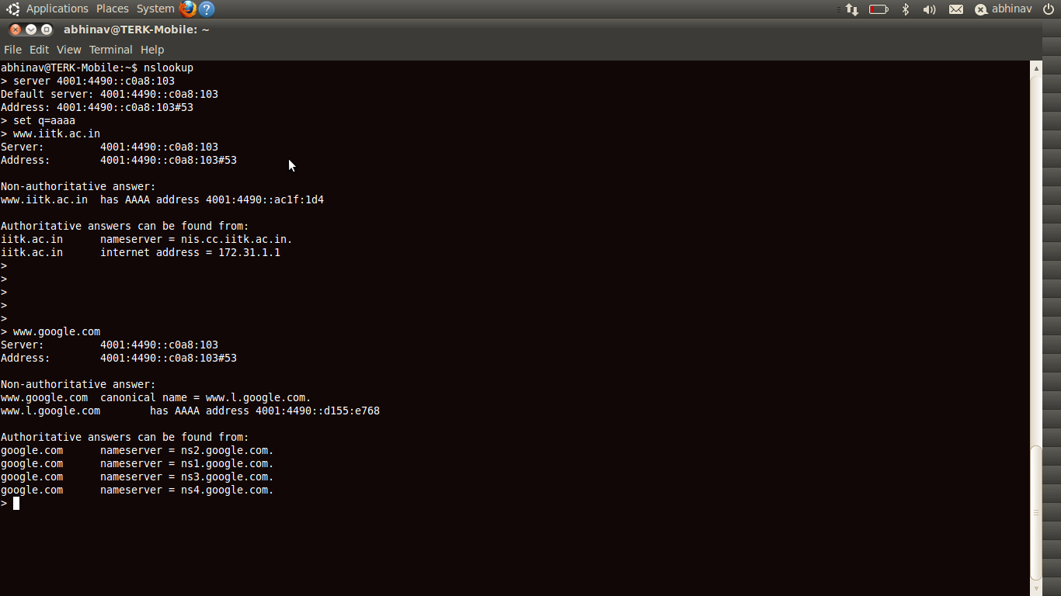

Slide 24
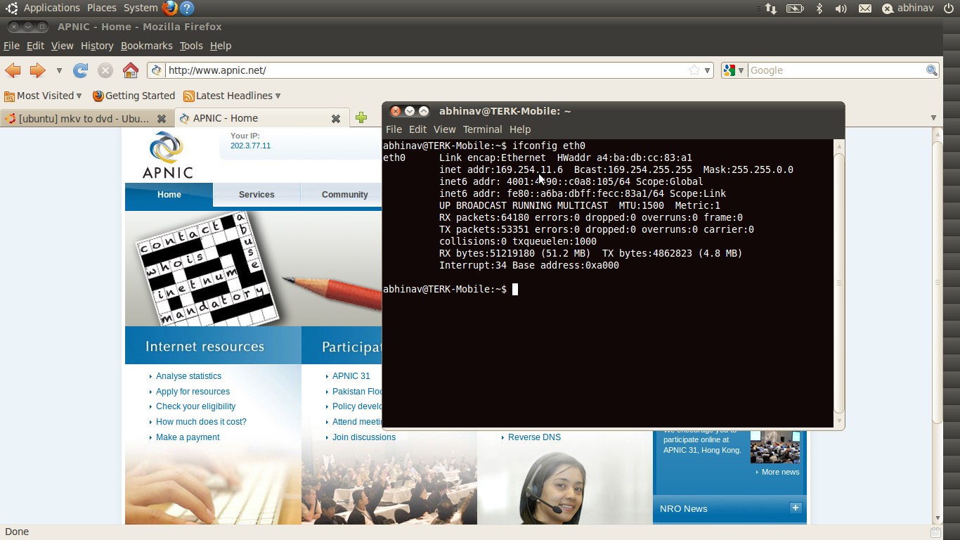
Screenshot

Slide 25

HTTP browsing by IP address

Slide 26

HTTP browsing by hostname

Slide 27
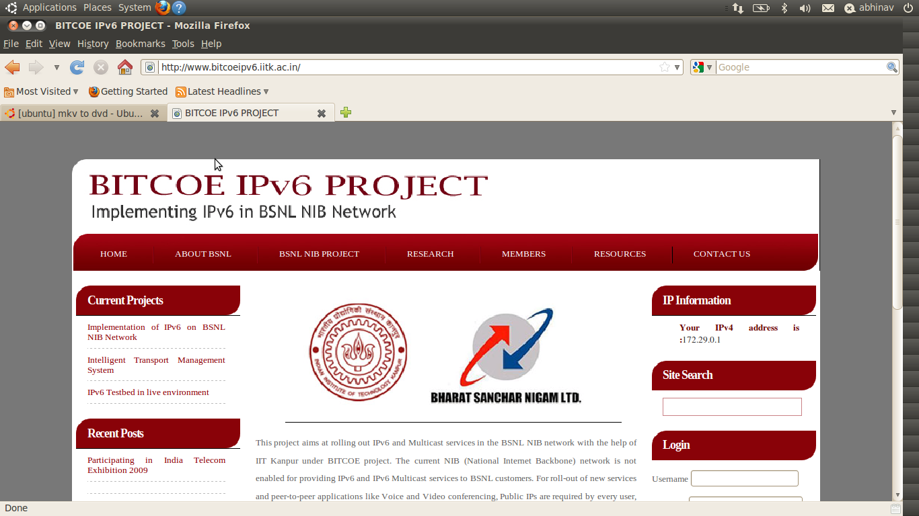
HTTP

Slide 28
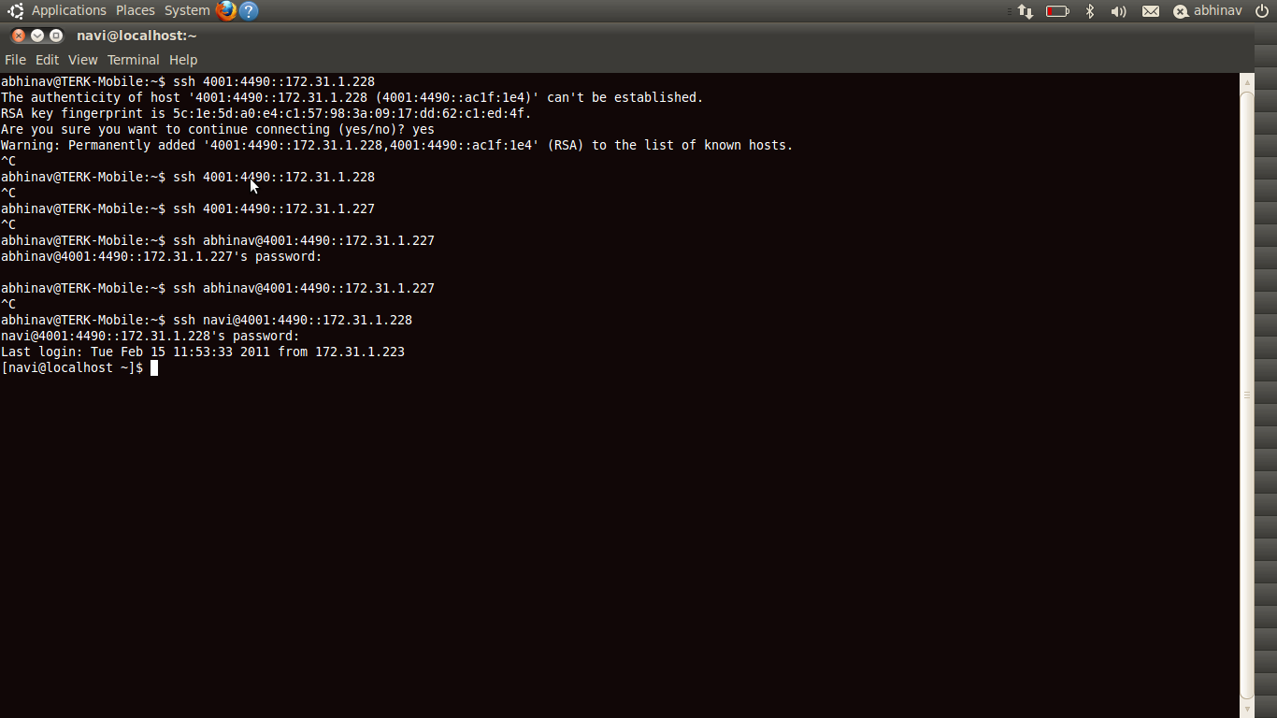
SSH

Slide 29
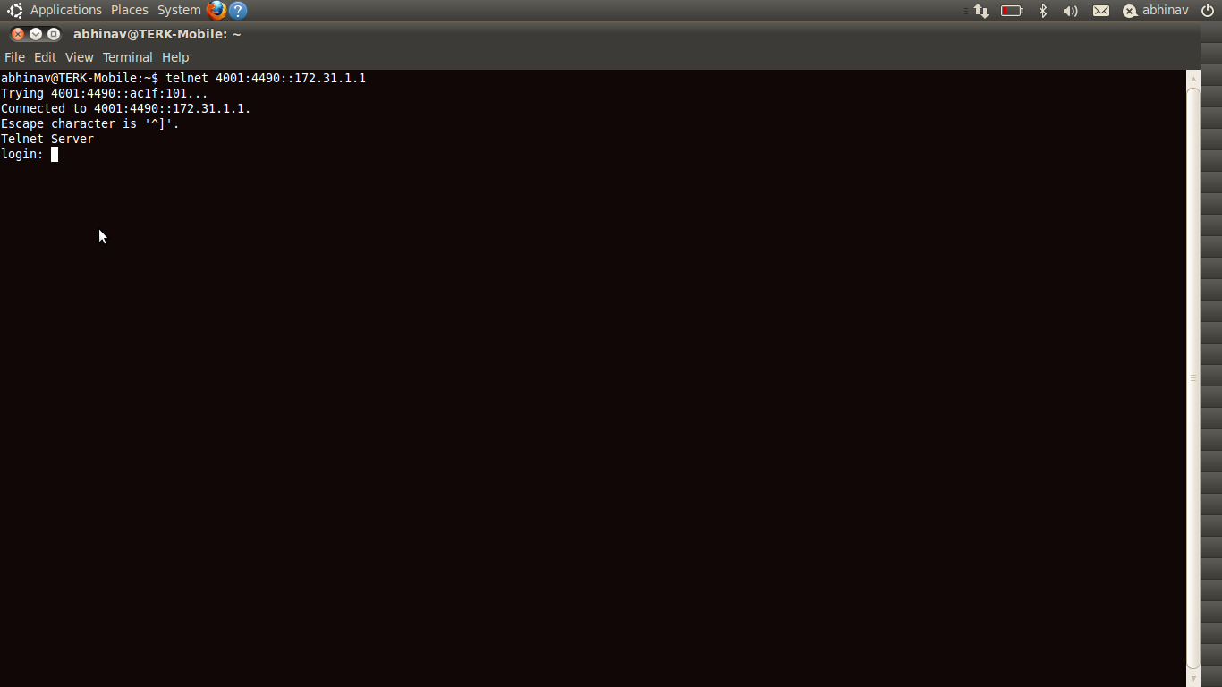
Telnet

Slide 30

If u have any queries….
?
Thank
U

