Slide 1
GENERIC_TEAM_NAME
Theme - Beautify and Gamify
IIITD
Aabhaas Batra: aabhaas19001@iiitd.ac.in
Rishi Singhal: rishi19194@iiitd.ac.in
Udit Narang: udit19120@iiitd.ac.in

Slide 2


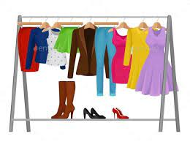
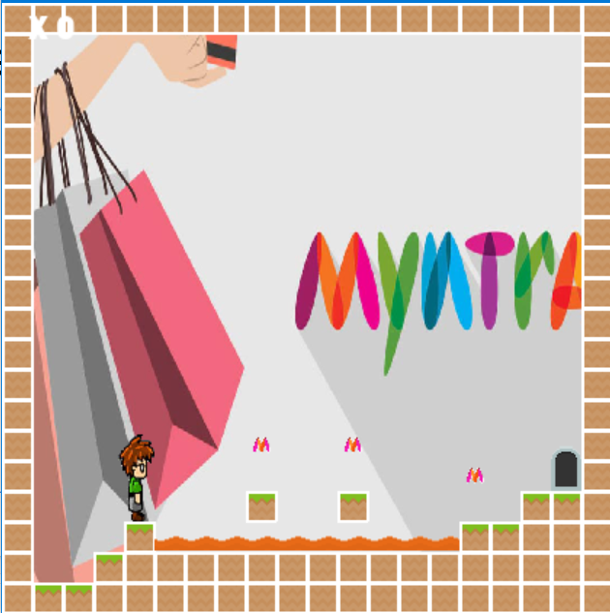
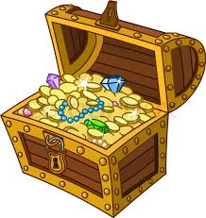
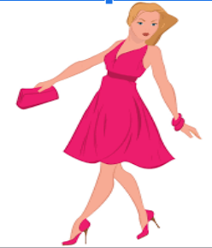
SOLUTION OVERVIEW
Select from a plethora of accessories, dresses & try them virtually!
Web - based App
using ReactJS
Upload the user’s body & hand images
Play the Myntra Game
Earn MynCash Coins

Slide 3
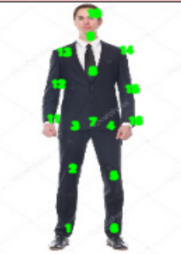
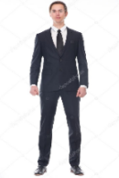
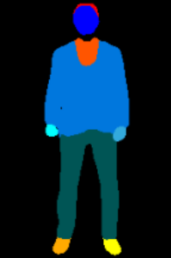
SOLUTION (Virtual Try On - Clothes)
JPPNet Model
(Position Estimate)
Contd to CPVTON+
(User Image)
(Parsed Image)

Slide 4
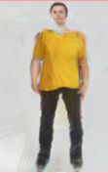
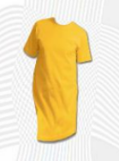
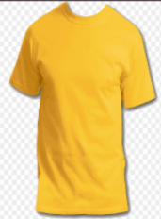
Virtual Try On - Clothes (Contd.)
TOM model
GMM model
(User Image)
(Result image)
(Original Cloth)
(Warped Cloth)

Slide 5
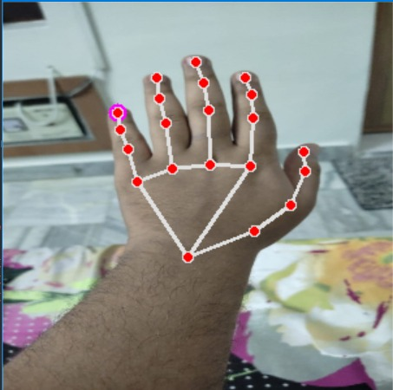
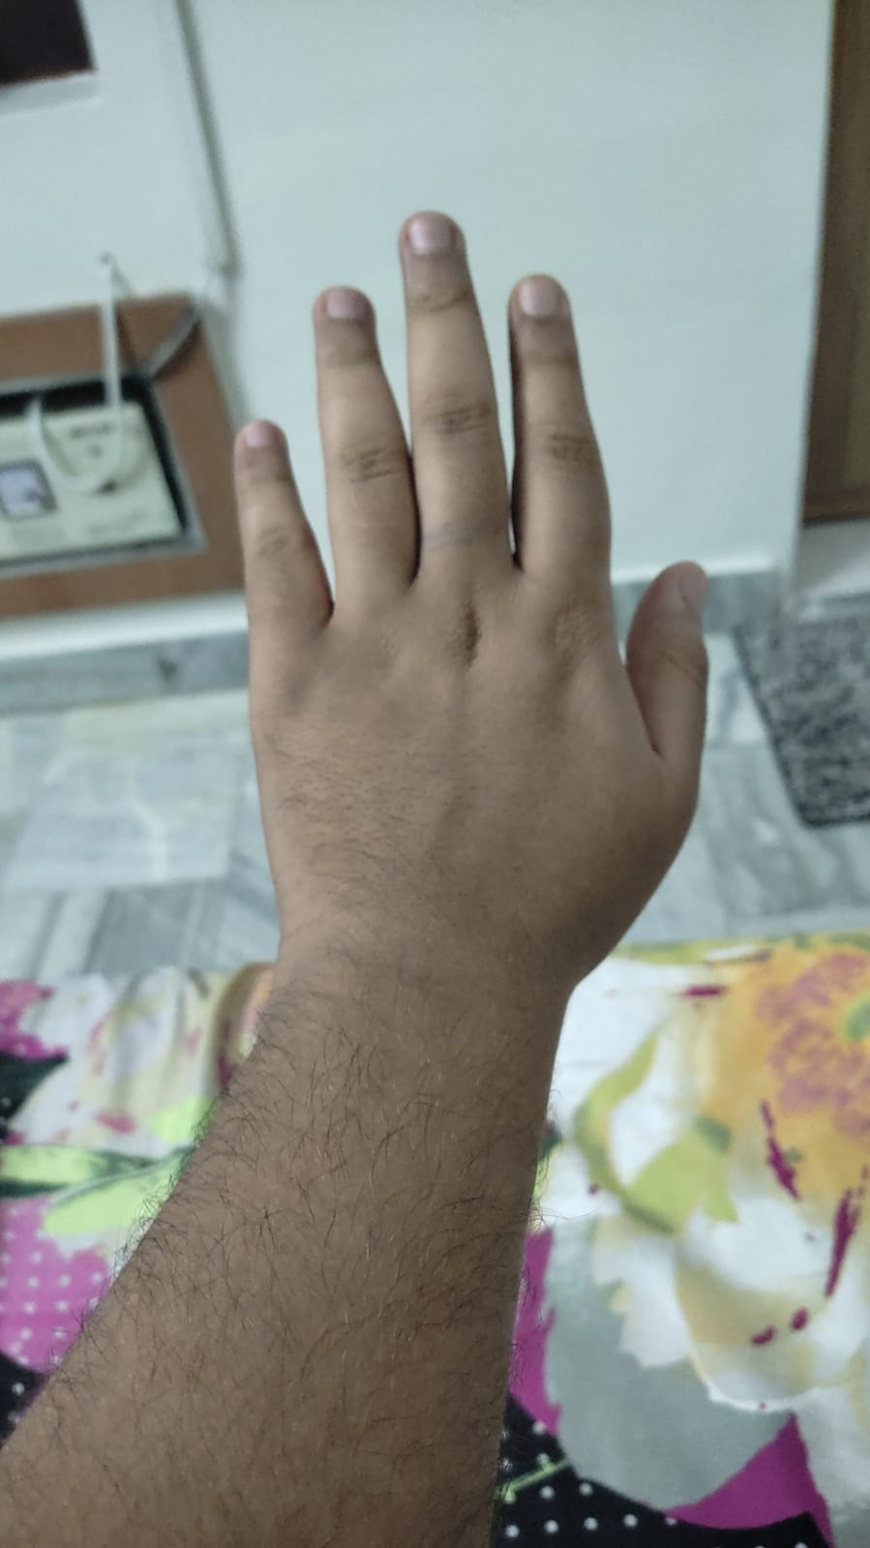
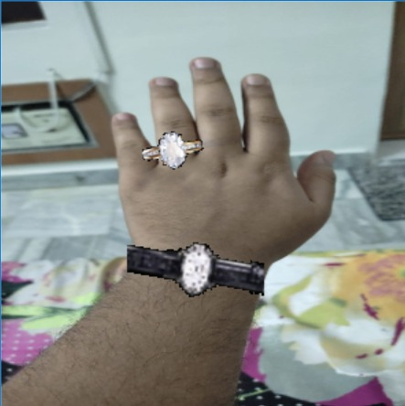
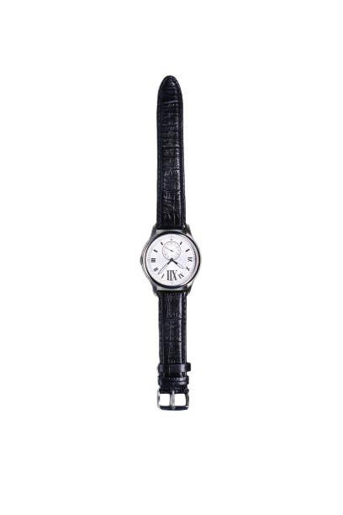
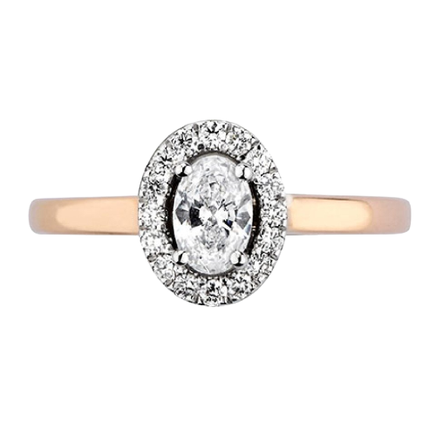
SOLUTION (Virtual Try On - Accessories)
Hand Tracking
(Hand Tracked Image)
(Original Image)
Resizing Accessories
Combining all the components to get the final image
(Accessories)
(Resultant Image)

Slide 6
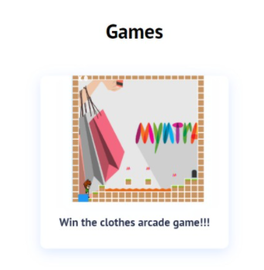
GAMIFY ELEMENT
Game made using pygame is embedded into the website.
Users could enjoy playing the challenging games on the platform and collect MynCash(shown as Myntra logo) while playing the game.

Slide 7
THANK YOU!!!
Link for the video of the project :-
https://drive.google.com/drive/folders/1QhBIACXDx95BJVNBTvkHpP0GejKReC2F?usp=sharing
Github Project Link :-
https://github.com/udit19120/Generic_Team_Name

