Slide 1


CA2 PartB AIML
By Song Han

Slide 2
Overview of the workflow
Data Preprocessing
Clustering
Student Cluster Characteristics
Final Cluster Model Analysis
Conclusion

Slide 3
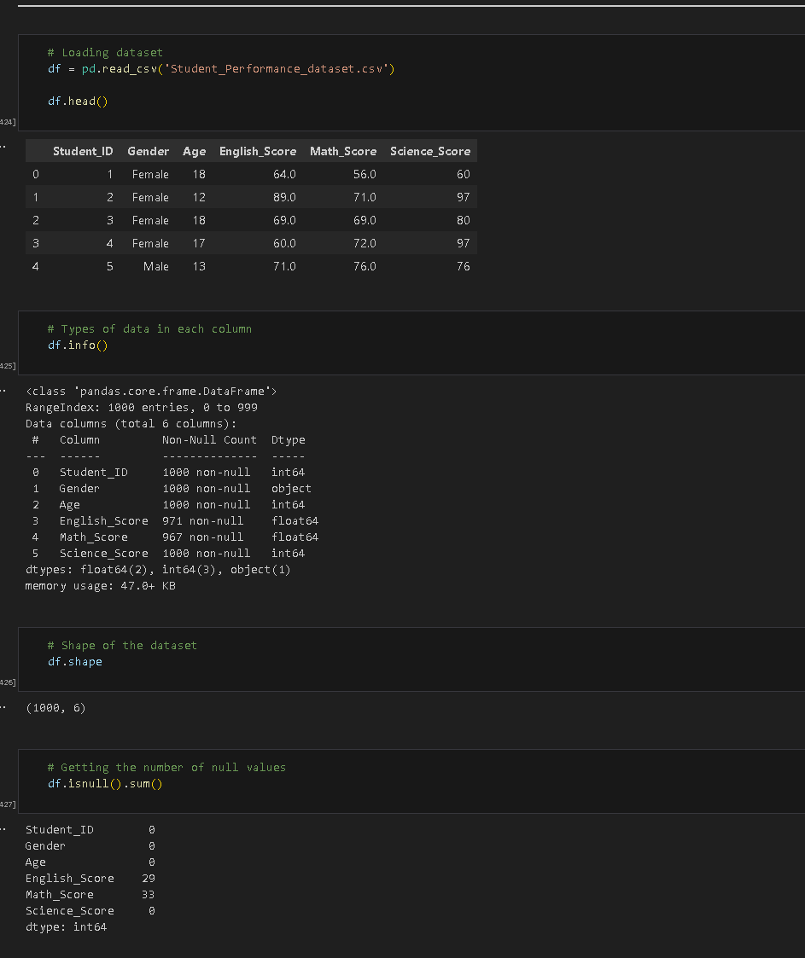
Importing dataset
Dataset has 1000 rows, 6 columns
Null values present in 2 columns

Slide 4
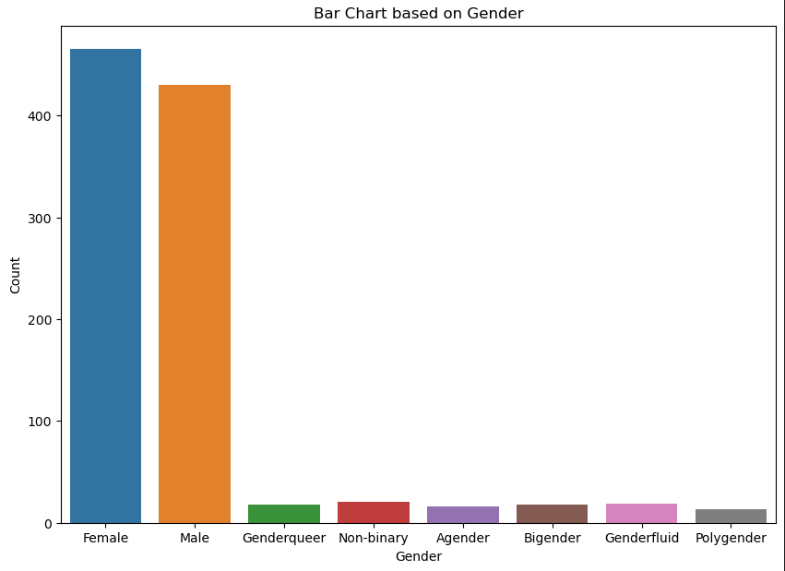
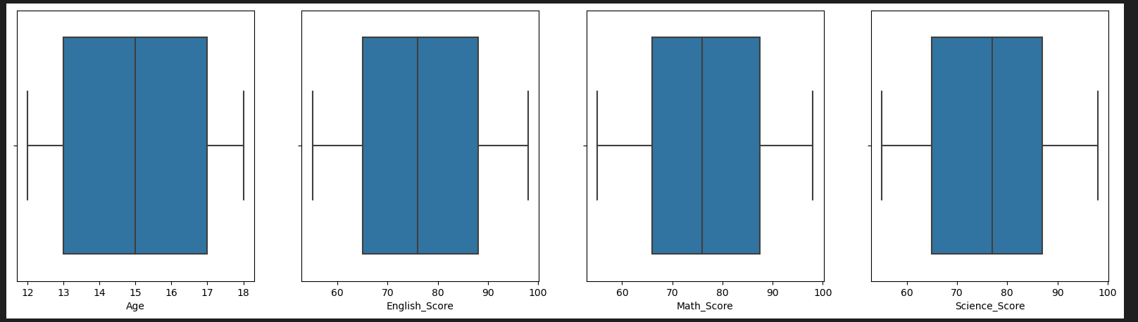
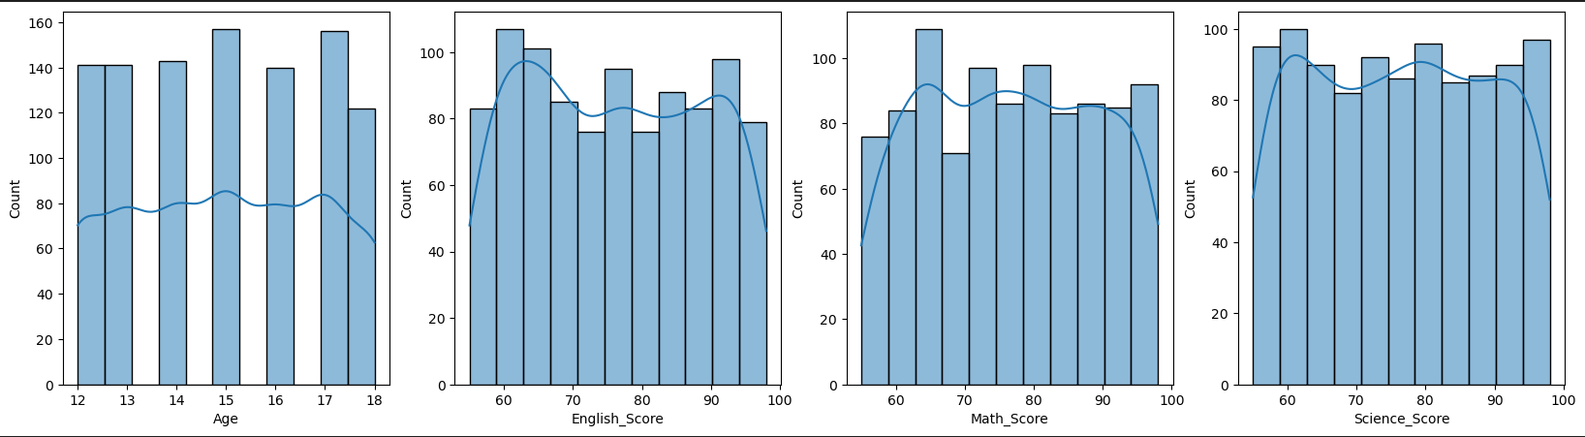
Univariate Analysis
Majority of the students are Male and Female
The distribution of the scores are evenly distributed

Slide 5
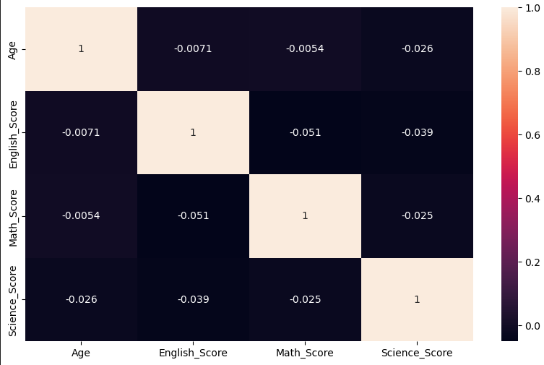
Bivariate Analysis

Slide 6

Data Preprocessing

Slide 7
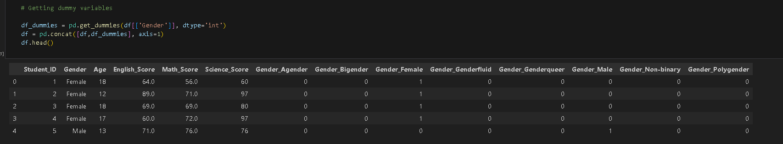
Categorical Encoding
Making dummy variables for the categorical data in the dataset

Slide 8
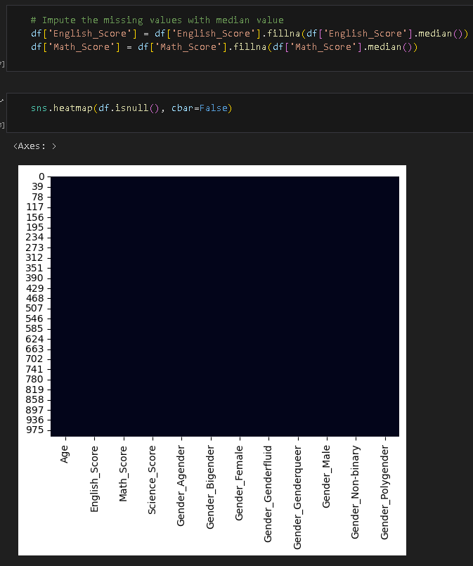
Handling Null Values
Since we have null values in our dataset, its important that we handle them.
I imputed the missing values as I did not want to lose any valuable information

Slide 9
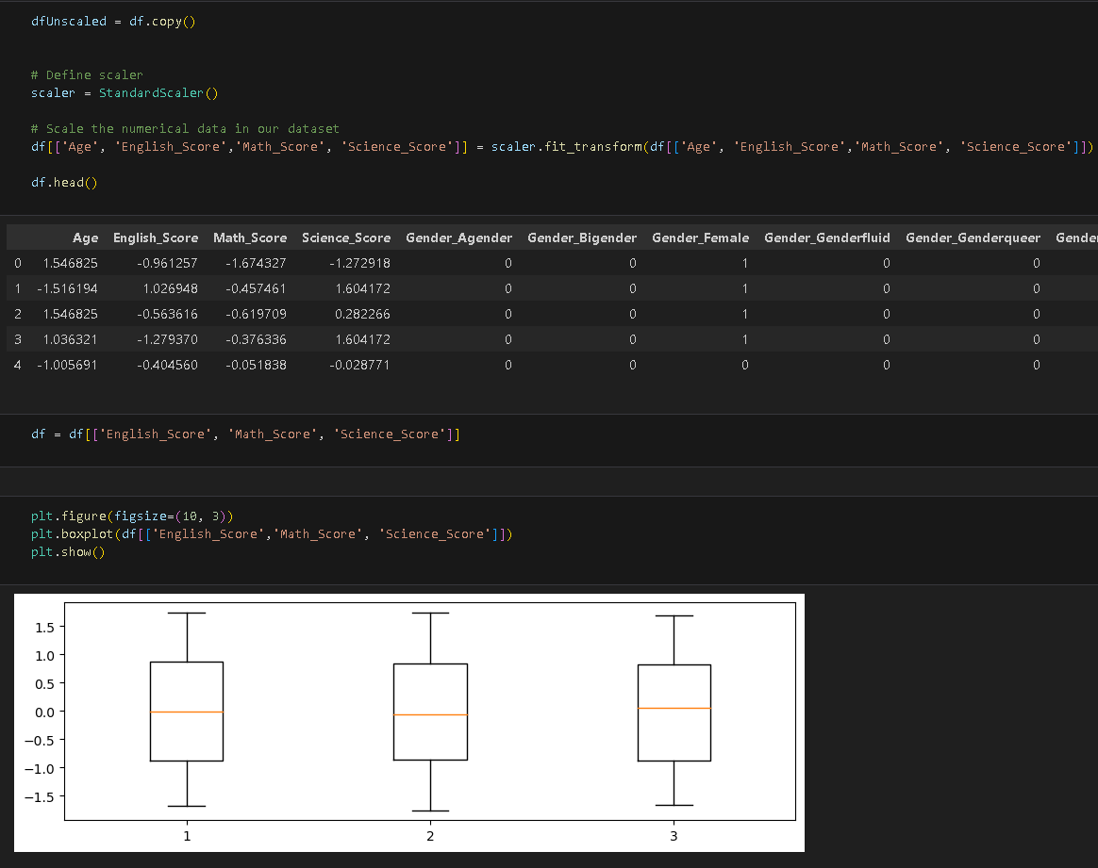
Standardized Scaling
Ensures that clustering algorithms are effective and produce meaningful results by removing biases introduced

Slide 10
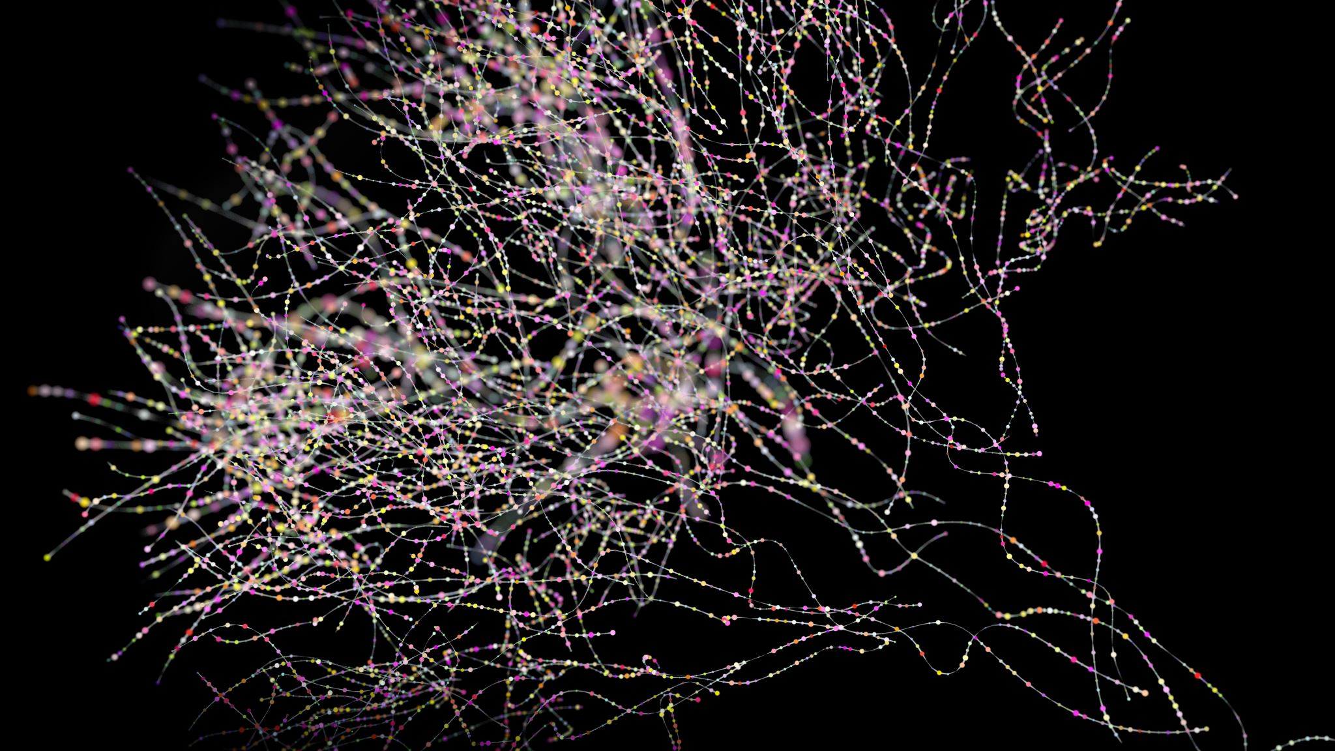
Clustering

Slide 11
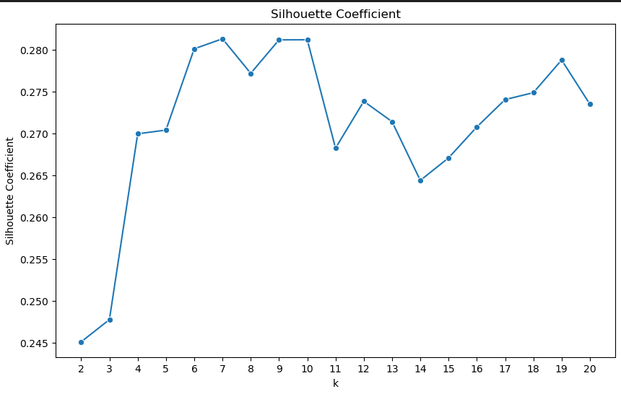
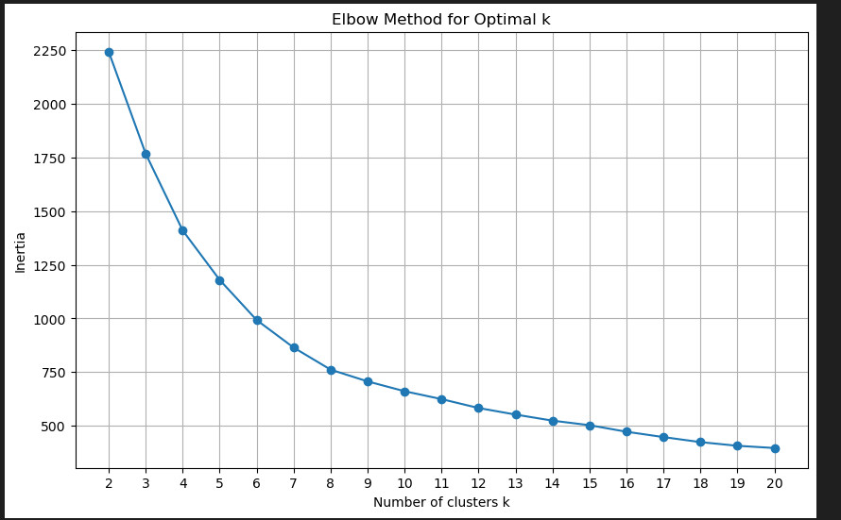
Choosing Optimal K
Using Silhouette & Elbow Method, we find the optimal k for clustering

Slide 12
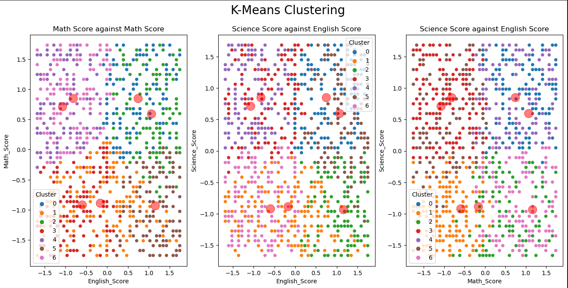
KMeans Clustering

Slide 13
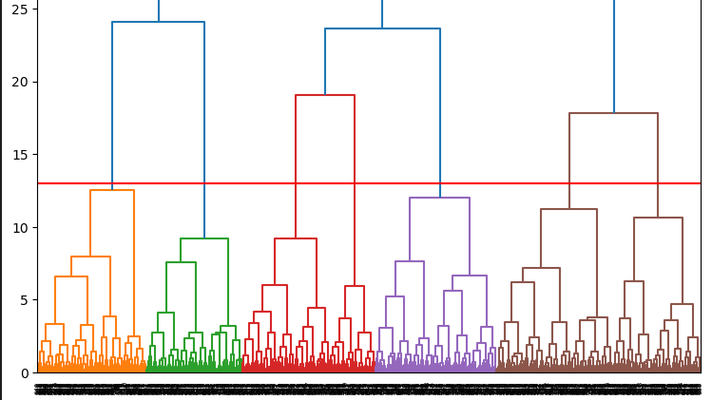
Hierarchical Clustering

Slide 14
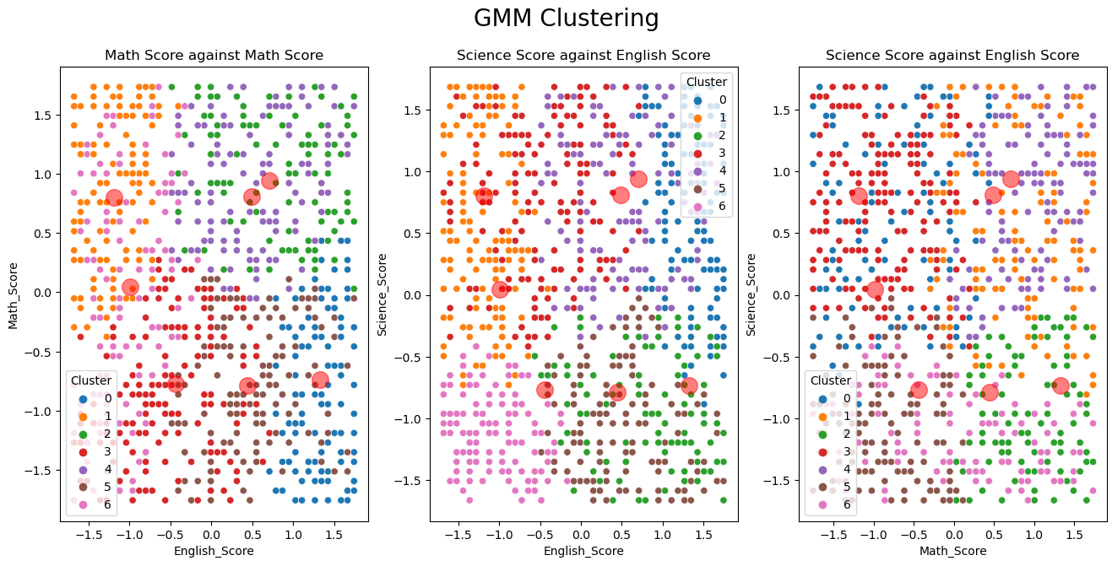
GMM Clustering

Slide 15
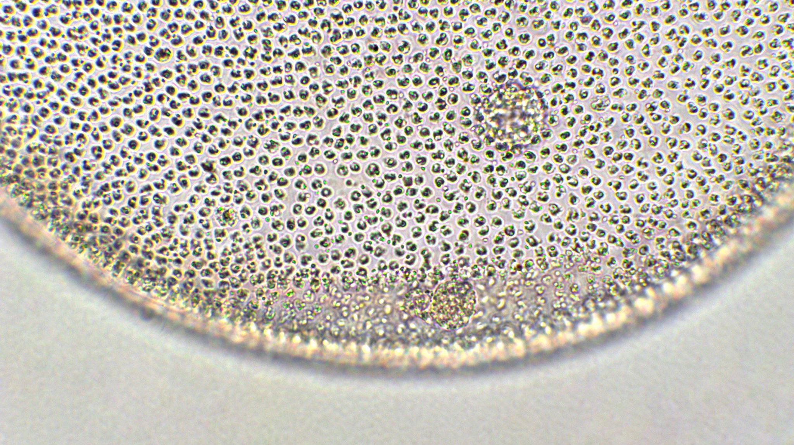
Cluster Characteristics

Slide 16
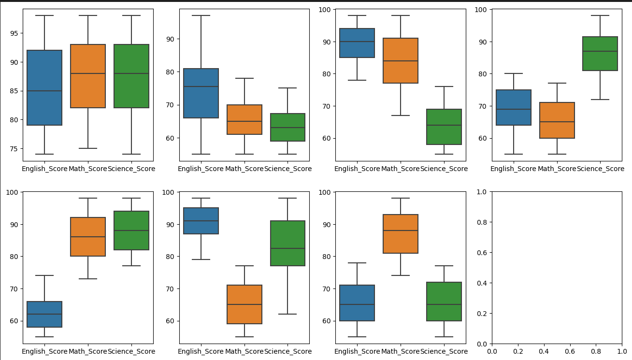
Kmeans Clustering
First Cluster: All High Scores
Second Cluster: English Score is moderate but Math & Science Score is low
Third Cluster: High English & Math Scores but low Science Score
Forth Cluster: Low English & Math Score but High Science Score
Fifth Cluster: High Math & Science Score but low English Score
Sixth Cluster: High English & Science Score but low Math Score
Seventh Cluster: High Math Score but low English & Science Score

Slide 17
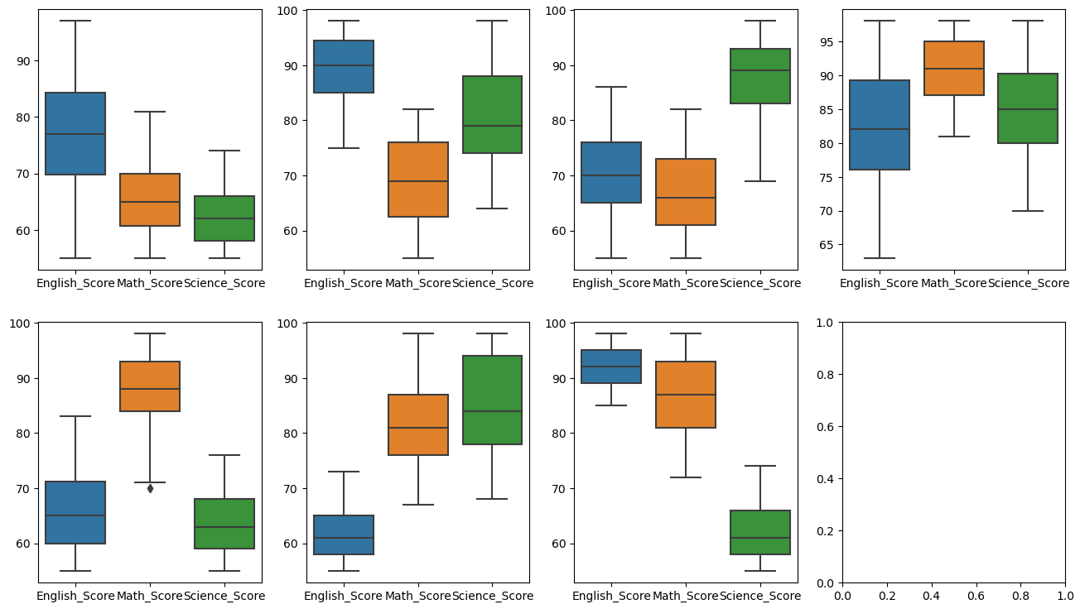
Hierarchical Clustering
First Cluster: Moderate English Score & Low Math & Science Score
Second Cluster: High English Score , Moderate Science Score & Math Score is low
Third Cluster: High Science Score but low Math & Science Score
Forth Cluster: All High Scores
Fifth Cluster: High Math Score but low English & Science Score
Sixth Cluster: High Math & Science Score but low English Score
Seventh Cluster: High English & Math Score but low Science Score

Slide 18
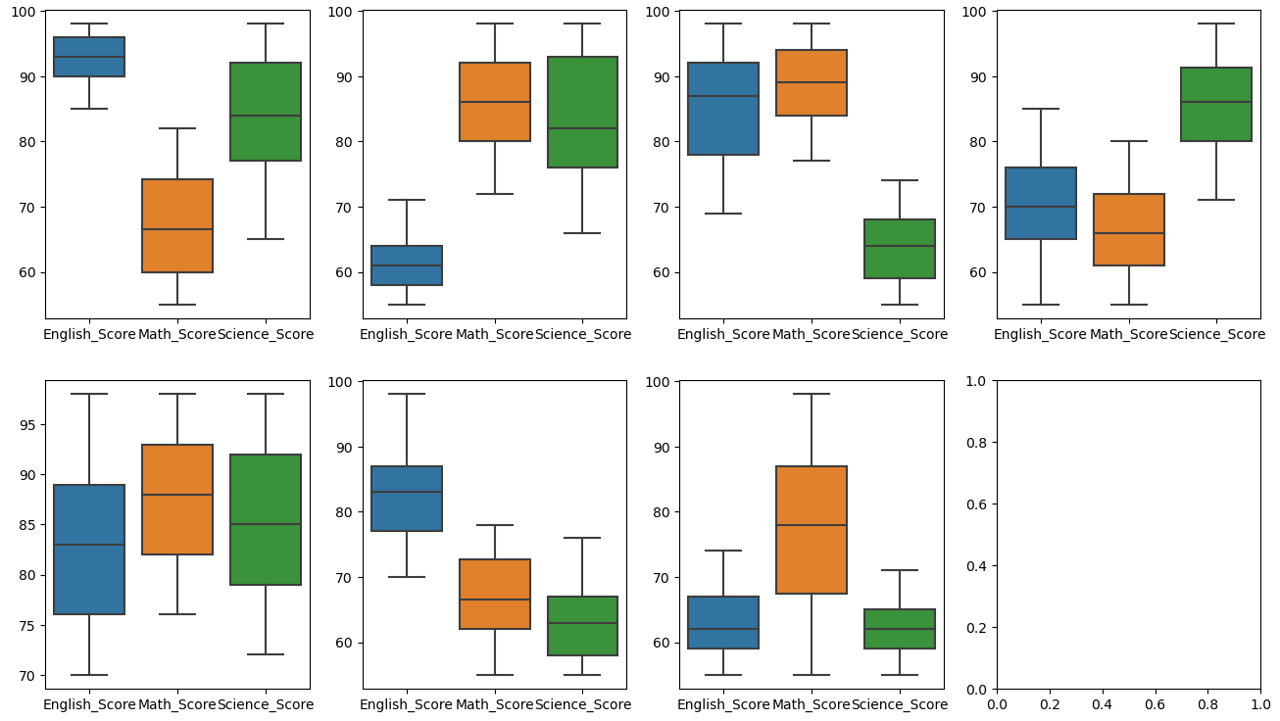
GMM Clustering
First Cluster: High English & Science Score but low Math Score
Second Cluster: High Math & Science Score but low English Score
Third Cluster: High English & Math Score but low Science Score
Forth Cluster: High Science Score but low English & Math Score
Fifth Cluster: All High Scores
Sixth Cluster: High English Score but low Math & Science Score
Seventh Cluster: Moderate Math Score but low English & Science Score

Slide 19

Final Model
K-Means(k=7)

Slide 20
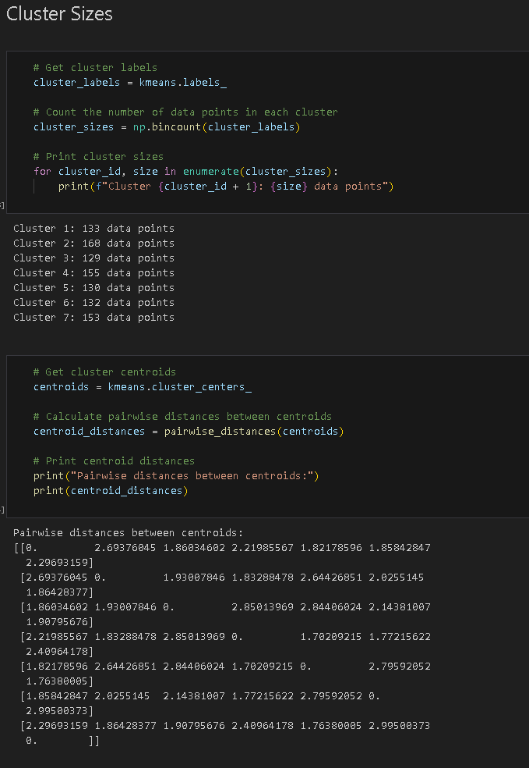
Cluster Analysis(Kmeans)
Found the cluster sizes & the centroid distances

Slide 21
Conclusion
We went through preprocessing techniques such as removing outliers, imputing null values , categorical encoding, and scaling the data
We found the optimal k and did clustering with 3 different clustering models
We Analysed the characteristics of each cluster of each model
Found our best model

