Slide 1
CSA431 COMPUTER VISION · M2 + M3
Patient-level evaluation of malaria parasite classification
M2: approximate reproduction of Rajaraman et al., 2018, PeerJ 6:e4568
M3: one evaluation change, predicted before it is coded
Dataset: NIH / NLM thin-smear cells, 27,558 images
Presenters: Udita (230082), then Aman Kumar (230064)
Rishihood University

Slide 2

ROADMAP
What this talk covers
M1
M2
M3
M4
Leakage is real; the mean-accuracy drop is small.
Patient-grouped ResNet-50 baseline on the official NLM release.
Hypothesis and decision rule saved 3 Oct 2026, before any grouped analysis.
Re-aggregate the saved predictions by Patient-ID.
Settled
Done
Done
Not started
Success here is a verified protocol and an honest comparison, not a higher score.
CSA431 · M2 baseline + M3 pre-registered prediction
2

Slide 3
MOTIVATION
The claim we are testing
Task: one segmented cell → Parasitized or Uninfected.
Same-source cells share stain, lighting, and focus.
A pooled cell average can be carried by a few large groups.
This is a reporting question on fixed predictions, not a new model.
OPEN QUESTION
Under leakage-free folds, does Patient-ID–macro sensitivity sit below pooled sensitivity?
CSA431 · M2 baseline + M3 pre-registered prediction
3

Slide 4
METHOD
What M2 reproduced
Frozen ResNet-50
→
2,048 features
→
FC 2048→512→1
→
Threshold 0.5
ImageNet weights
from the backbone
dropout 0.5
Parasitized = positive
Training setup
Logged approximations
Resize 224×224, ImageNet mean/std, no augmentation
Fresh classifier each fold
SGD, lr 0.01, momentum 0.9, L2 1e-4
20 epochs, seed 42
Paper fold IDs
Exact feature layer, classifier width
Original learning-rate search
Never tuned on the test fold
CSA431 · M2 baseline + M3 pre-registered prediction
4

Slide 5
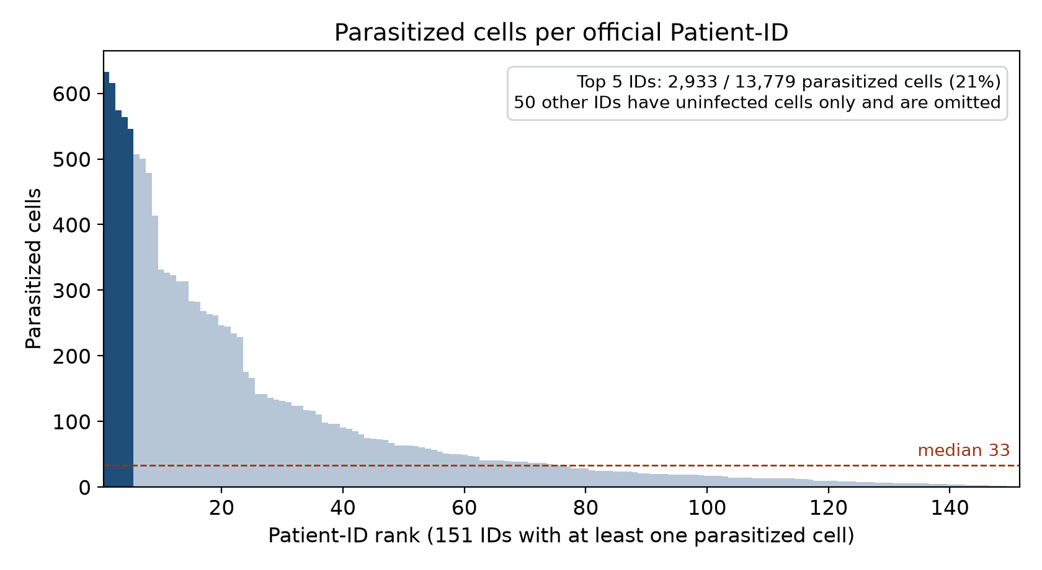
DATA
Dataset audit: PASS
27,558
201
151
50
PNGs (13,779 + 13,779)
unique Patient-IDs
IDs with parasitized cells
uninfected-only IDs
Exact cell_images.zip; zero corrupt, unmapped, or cross-label duplicate images.
Grouping key: official NLM Patient-ID, not parsed from filenames.
Parasitized cells per ID: 1 to 633, median 33. Five IDs hold 2,933 of 13,779 (~21%).
Uninfected counts stay tight: 63–77 per ID.
Paper’s 150 infected + 50 healthy is the source census; we split on the official 201 keys and do not treat them as the same list.
CSA431 · M2 baseline + M3 pre-registered prediction
5

Slide 6
PROTOCOL
Patient-grouped folds
Fold | Test cells | Test IDs | ID overlap
1 | 5,497 | 40 | 0
2 | 5,520 | 40 | 0
3 | 5,544 | 41 | 0
4 | 5,483 | 40 | 0
5 | 5,514 | 40 | 0
StratifiedGroupKFold, seed 42, five folds; class balance preserved, groups intact.
These are our deterministic folds, not claimed as Rajaraman Table 1.
Their cell-level split (Table 6) was not rerun.
CSA431 · M2 baseline + M3 pre-registered prediction
6

Slide 7
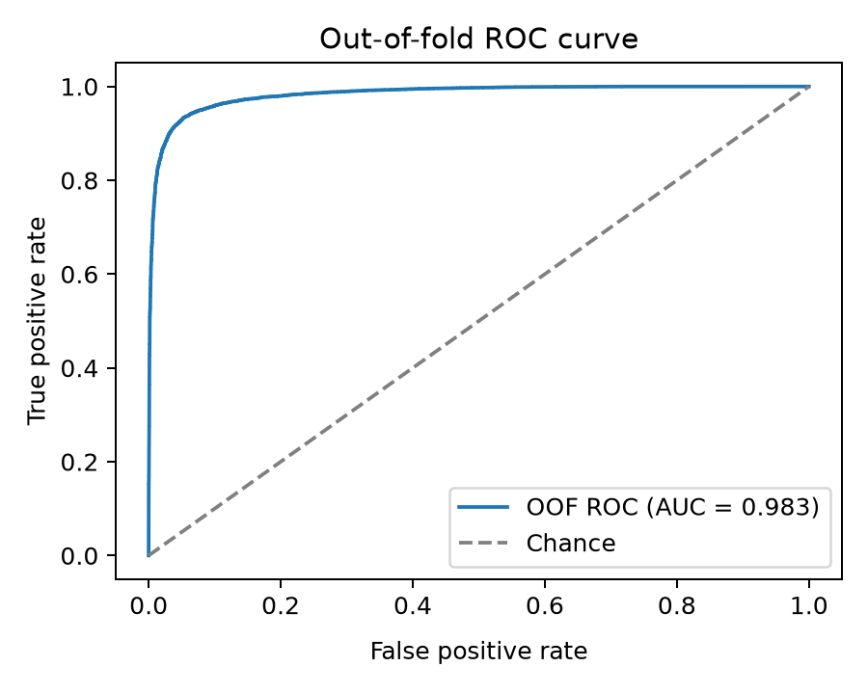
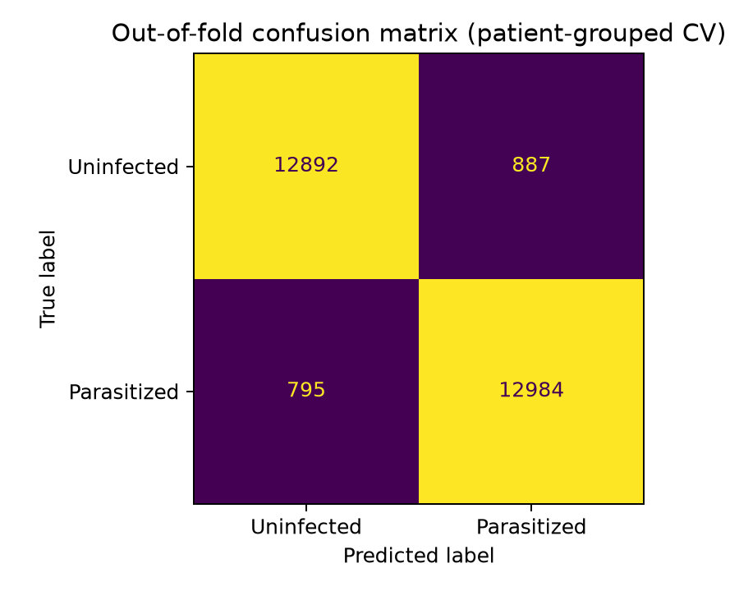
RESULTS
Measured baseline (mean of five folds)
Metric | M2 mean ± SD
Accuracy | 93.90% ± 1.95 pp
Sensitivity | 94.24% ± 3.36 pp
Specificity | 93.56% ± 1.30 pp
AUC | 0.9832 ± 0.0086
F1 | 93.90% ± 2.03 pp
Out-of-fold ROC, pooled AUC 0.983
Out-of-fold confusion matrix, threshold 0.5
Table AUC is the mean of five fold AUCs; the pooled curve uses all 27,558 out-of-fold scores. Means are unweighted across folds. Measured on these Patient-ID folds; not a clinical-performance claim.
CSA431 · M2 baseline + M3 pre-registered prediction
7

Slide 8
RESULTS
The mean hides one fold
Fold | Cells | Acc | Sens | Spec | AUC | FN
1 | 5,497 | 93.69% | 95.31% | 92.06% | 0.984 | 129
2 | 5,520 | 90.63% | 88.28% | 93.01% | 0.968 | 325
3 | 5,544 | 94.93% | 96.38% | 93.52% | 0.988 | 99
4 | 5,483 | 95.57% | 95.52% | 95.62% | 0.990 | 123
5 | 5,514 | 94.67% | 95.71% | 93.61% | 0.986 | 119
Four folds sit near 95–96% sensitivity; fold 2 is 88.28% with 325 false negatives. Sensitivity SD 3.36 pp vs accuracy SD 1.95 pp: this motivates the M3 question, it does not answer it.
CSA431 · M2 baseline + M3 pre-registered prediction
8

Slide 9
RESULTS
Comparison with the paper
Metric | Paper Table 6 (patient level) | M2 measured | Difference
Accuracy | 95.90% | 93.90% | −2.00 pp
Sensitivity | 94.70% | 94.24% | −0.46 pp
Specificity | 97.20% | 93.56% | −3.64 pp
AUC | 0.991 | 0.9832 | −0.0078
Approximate reproduction: closest on sensitivity, lower on specificity.
Defensible causes: unpublished folds, feature layer, normalization, classifier width, hyperparameter search.
No test-fold tuning was used to close the gap.
CSA431 · M2 baseline + M3 pre-registered prediction
9

Slide 10
PRE-REGISTRATION
Hypothesis (saved before M4)
IF
the fixed out-of-fold rows are scored per official Patient-ID
THEN
macro sensitivity will be lower than pooled sensitivity
BECAUSE
large groups dominate a cell-weighted mean, so a hard small group can disappear inside it
Prediction: macro − pooled sensitivity ≈ −1 to −3 pp, bounded by the measured 3.36 pp sensitivity SD. No weight, threshold, or label changes; pooled M2 numbers must stay the same.
CSA431 · M2 baseline + M3 pre-registered prediction
10

Slide 11
DECISION RULE
How the result will be called
Primary number: mean of five paired differences (Patient-ID–macro sensitivity − pooled sensitivity).
Supported
Unsupported
Inconclusive
≥ 4 of 5 differences negative, and mean ≤ −1.68 pp
≥ 4 of 5 positive, and mean ≥ +1.68 pp
Anything else, including a smaller negative mean
Macro uses only IDs with at least one parasitized cell; IDs with none are counted, not dropped quietly.
Accuracy and specificity differences are secondary. AUC is not predicted to move.
CSA431 · M2 baseline + M3 pre-registered prediction
11

Slide 12
NEXT STEP
M4, and what we will not do
Will do
Will not do
Limits
Reuse the saved manifest, folds, probabilities, 0.5 threshold
Add Patient-ID macro metrics and false-negative-rate spread
Report supported, unsupported, or inconclusive
Retraining
Augmentation
New backbone or loss
Threshold search
One public P. falciparum thin-smear set
Segmented cells only
Approximate paper match
No external hospital set
No diagnostic claim
CSA431 · M2 baseline + M3 pre-registered prediction
12

