Slide 1

Online store Myhsop.com
FullStack-II Presentation
GLA University
Department of CEA
Presented By:
Madan Mohan (181500354)
Udit Aggarwal(181500765)
Submitted To: Mr. Pankaj kapoor

Slide 2
Introduction
It is MERN based application that provide the interface to user for Making shop online and sale products.
It gives a dashboard to Shop Owner to manage their shop.
This is Single page application which increases its speed as compares to other web.
Express is used at backend to call the api’s from front end.

Slide 3
Problem Statement
The online store web application sets up a dashboard for shop owner so that he makes their shop like offline method Also, customers can easily track their location. This system also provides a review system in which user can rate the purchased items.
The proposed is beneficial for those people who make their shop online and grow business in short of time. The payment method is cash on delivery which makes sense for customer who hesitate by sharing their bank details to anyone.

Slide 4
Objective
The primary objective of online store is to provide the platform to everyone who wants to sale their product online from offline shop.
It gives the solution to people how to grow their online shop from offline.
Customer also purchased product easily from online store without share their credentials like other platform.

Slide 5
System Requirements
1. Hardware Requirements:
PC with 4GB RAM, 500 GB HDD
I3 Processor
2. Software Requirements:
Compass
VS code editor 1.46.1.0
GitHub Repository

Slide 6
Languages Used
HTML5
CSS
React Js
Express Js
MongoDB database
React-Bootstrap

Slide 7
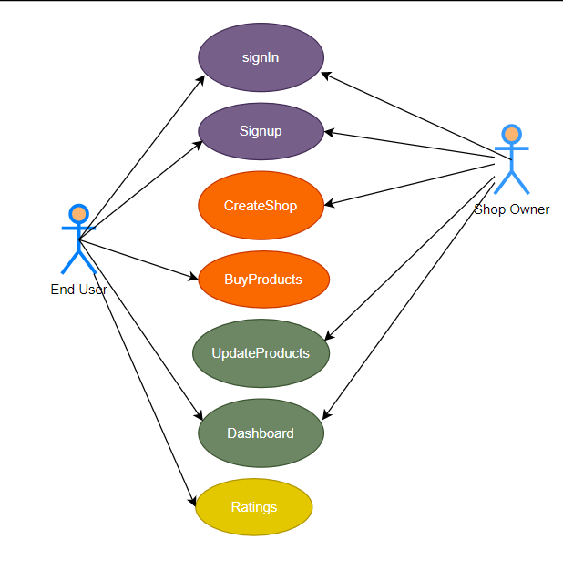
Software Design
Use Case Diagram:

Slide 8
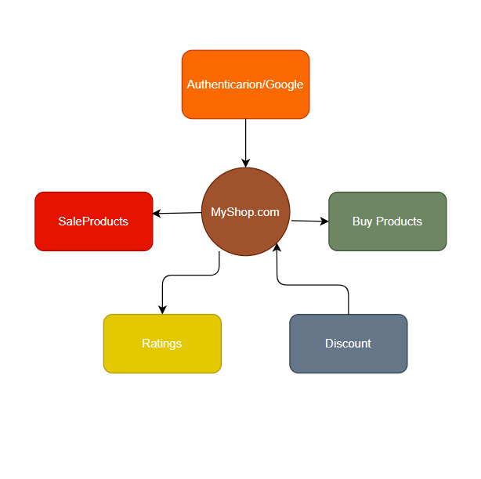
Software Design
DFD 0:

Slide 9
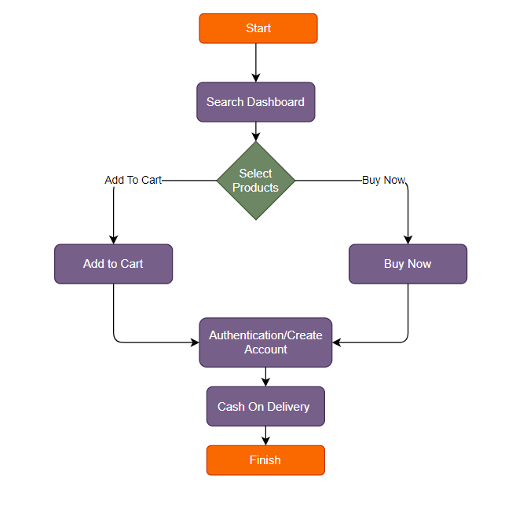
Software Design
Flow chart for buying:

Slide 10
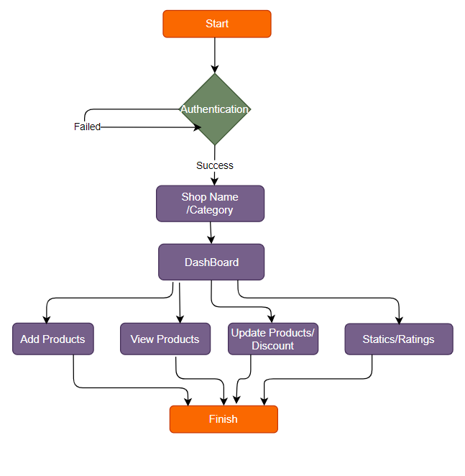
Software Design
Flow chart for shop:

Slide 11
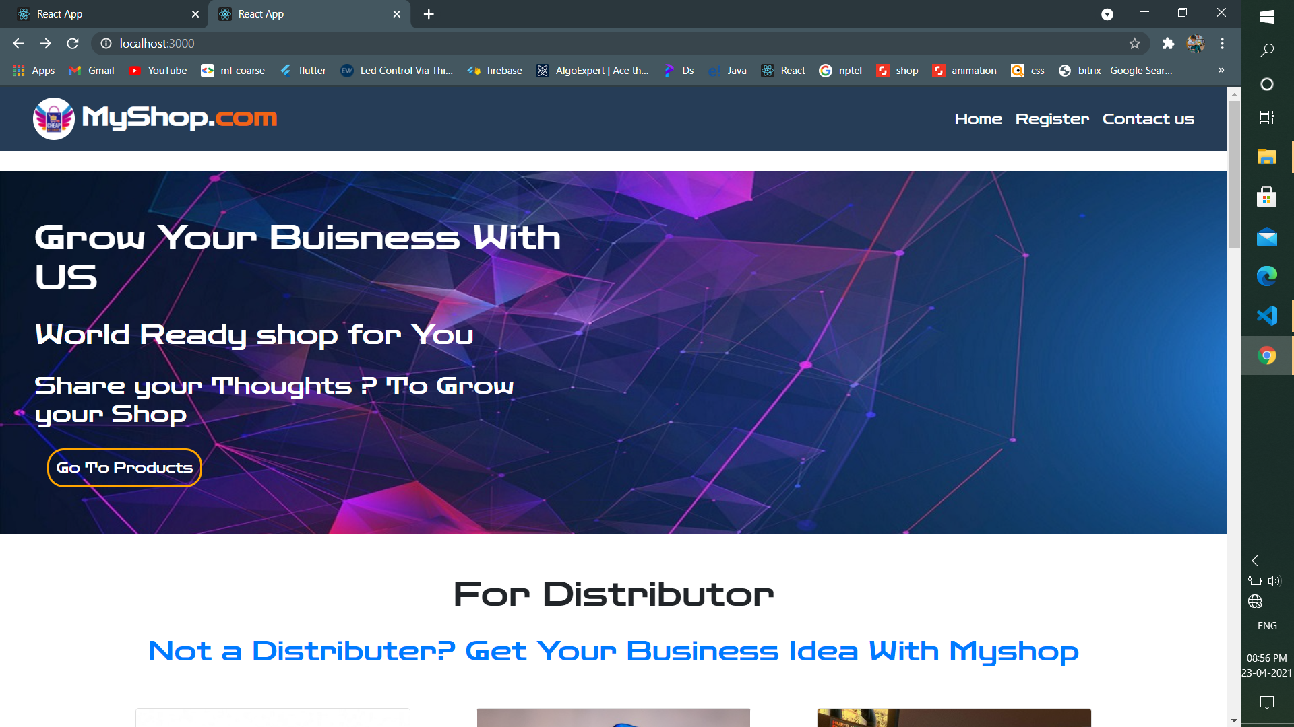
Implementation
1. Home Page:

Slide 12
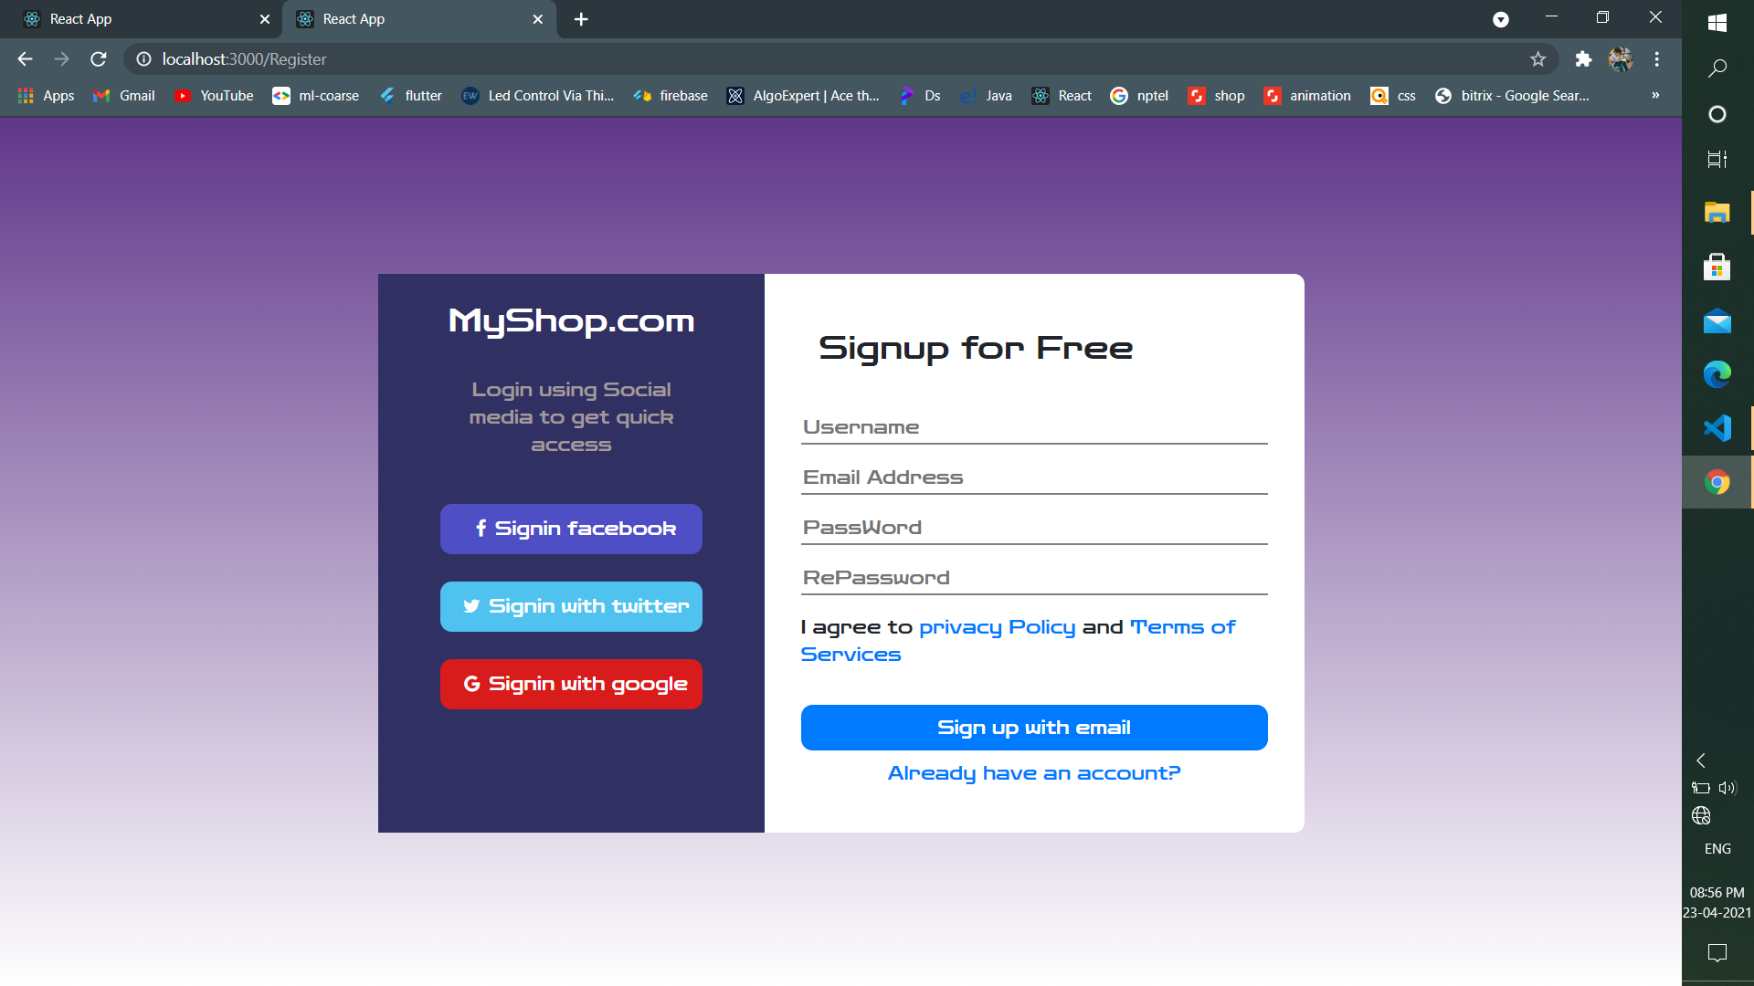
Implementation
2. Login Pages:

Slide 13
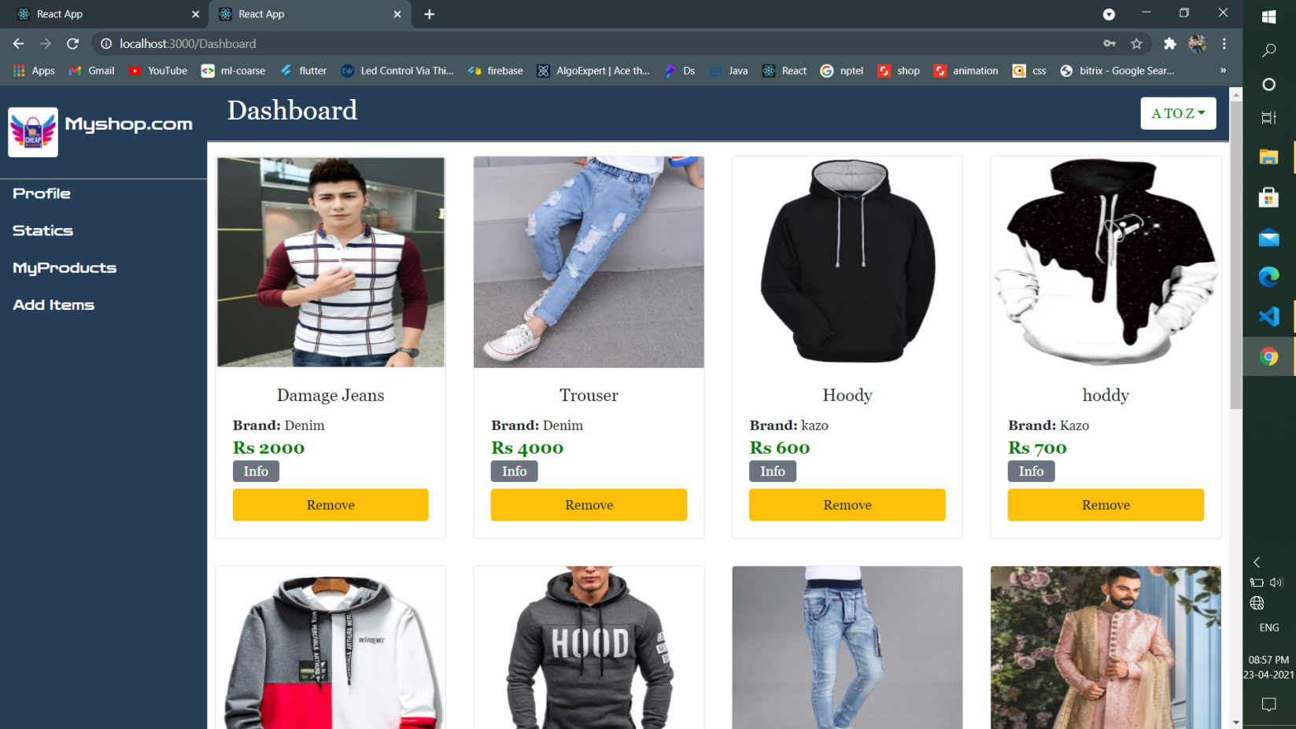
Implementation
3. Shop Dashboard:

Slide 14
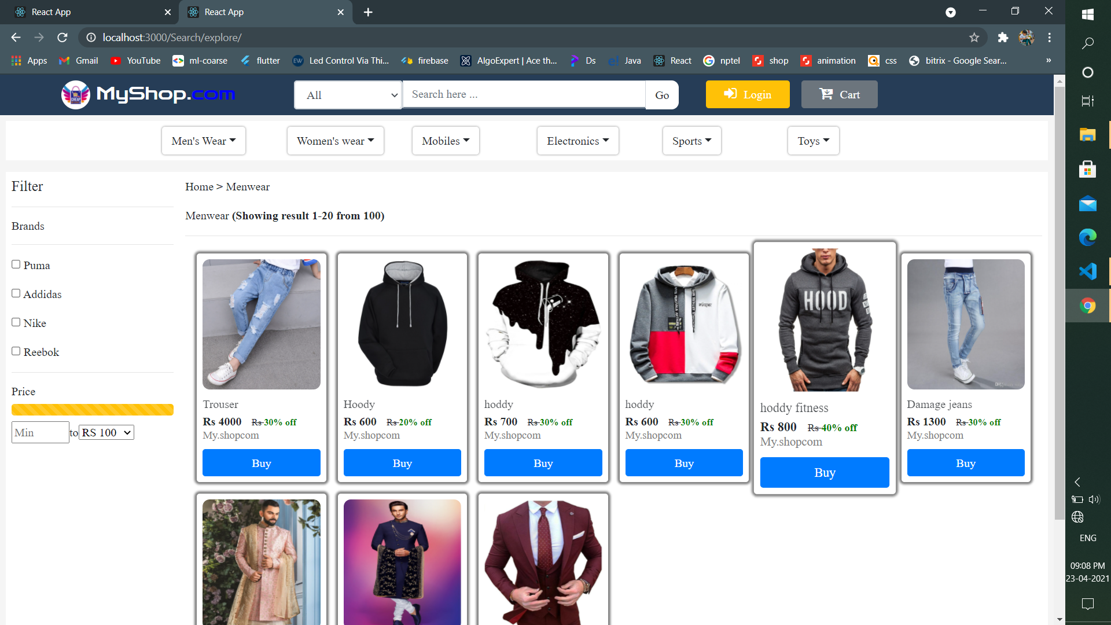
Implementation
4. Searching:

Slide 15
Conclusion
We learned a lot through this project. This project has sharpened our concept of React Js, Express Js, MongoDB etc.
After the completion of project, users can share shop link and grow their business.
We provides some new feature to this system in future for better accessibility like payment Method.

Slide 16
THANK YOU

