Slide 1

UDIT SINGHAL (D-75 1710989) ASHEESH NELLUTLA (D-20 1710909) MAYANK TYAGI (D-09 1710912) SAMRUDDHA MOHIRE (D-10 1710065)
BANSILAL RAMNATH AGARWAL CHARITABLE TRUST`S
VISHWAKARMA INSTITUTE OF TECHNOLOGY
Recommendation of crop and yield prediction

Slide 2
INDEX
Introduction
Motivation
Problem Statement
Objectives
Literature Survey
Limitations in existing model
Proposed System
Project Scope
Project Requirements
Design
Result
Conclusion
References

Slide 3
INTRODUCTION
Achieving maximum crop yield at minimum cost is one of the goals of agricultural production.
Early detection and management of problems associated with crop yield indicators can help increase yield and subsequent profit.
Predictions could be used by crop managers to minimize losses when unfavorable conditions may occur.

Slide 4
MOTIVATION
Climate and other environmental changes in the world and Indian sub-continent has become a major threat to the agricultural economy.
Being able to predict future yield of specific crop would help farmers, decide the better option among many to maximize the yield.
Yield production can reduce the financial risk of farmers.

Slide 5
PROBLEM STATEMENT
To develop a system which recommends crop and yield prediction and to suggest the crops suitable for farming.

Slide 6
LITERATURE SURVEY
Author | Title | Methodology | Conclusion
Miss.Snehal S.Dahikar Dr.Sandeep V.Rode | Agricultural Crop Yield Prediction Using Artificial Neural Network Approach | Supervised Learning(Back Propagation, Feed Forward) | feed forward back propagation methods used for developing ANN model.
S.Veenadhari Dr. Bharat Misra Dr. CD Singh | Machine learning approach for forecasting crop yield based on climatic parameters | Decision Tree | The decision rules developed based on the model for soybean crop in Dewas district

Slide 7
Author | Title | Methodology | Conclusion
Anup K. Prasad , Lim Chai , Ramesh P. Singh, Menas Kafatos | Crop yield estimation model for Iowa using remote sensing and surface parameters | Linear regression | The model discussed in the present paper reasonably minimizes inconsistency and errors in yield prediction giving high R 2 -values with maximum accounting of variability in model
Askar Choudhury James Jones | Crop yield prediction using time series models | Simple Exponential Smoothing, Double Exponential Smoothing, Damped-Trend Linear Exponential Smoothing, and ARMA(autoregressive moving average) | Among all different time series models estimated, ARMA models performed best with higher coefficient of determinations for all five districts considered in this paper.

Slide 8
Author | Title | Methodology | Conclusion
X.E. Pantazi , D. Moshou , T. Alexandridis , R.L. Whetton , A.M. Mouazen | Wheat yield prediction using machine learning and advanced sensing techniques | Counter-propagation Artificial Neural Network (CPANN), Supervised Kohonen Network (SKN) and XY-fusion network (XYF) | The average overall accuracy of cross-validation for SKN was 81.65%, for CP-ANN 78.3% and for XY-F 80.92%, showing that the SKN model had the best overall per- formance.
Alberto Gonzalez-Sanchez , Juan Frausto-Solis Waldo Ojeda-Bustamante | Predictive ability of machine learning methods for massive crop yield prediction | Multiple linear regression, Regression trees, Artificial neural networks, Support vector regression, k-Nearest neighbor | Average RMSE shows that kNN has the lowest mean error, followed closely by SVR and M5-Prime.

Slide 9
LIMITATIONS IN EXISTING MODEL
The existing work in this field is done using various models like Artificial Neural Networks, Regression like polynomial regression, multiple linear regression, decision trees, fuzzy algorithm and genetic algorithms.
These existing systems consider only some of the parameters, multiple parameters are generally not considered.
The accuracy and precision has scope of improvement.
Farming is dependent on various factors therefore it is very important to train our model on the basis of multiple parameters for accurate results.

Slide 10
PROPOSED SYSTEM
Our project aims at predicting yield and crop based on historical data and suggesting most suitable crop for farming.
We will give the approximate prediction of yield
Suggest the crop according to parameters like area, temperature and soil.

Slide 11
PROJECT SCOPE
This system is planned to be used by farmers in order to have the knowledge about their crop.
The system will work to give an idea about crop to the farmer (called “user” here after)
The user will enter his location and some details in system, the system will recognize the area and after processing details the system will display the crop which farmer should prefer for sowing
After training the machine on historical dataset it will predict the yield of crop (approximate yield)

Slide 12
PROJECT REQUIREMENTS
FUNCTIONAL REQUIREMENTS
Input the area in Maharashtra by the farmer where farming is to be done
Check area and recommend the crop according to user specified area
Predict yield
Suggest the crop for farming

Slide 13
SYSTEM REQUIREMENTS
1. SOFTWARE REQUIREMENTS
-Operating System: Windows/Ubuntu
-Datasets Used:
Crop-wise_State-wise_Land holdings_Area_Number.xlsx
crop_production.csv
district wise rainfall normal.csv

Slide 14
DESIGN
Architecture Diagram
(High level view)
Usecase Diagram

Slide 15
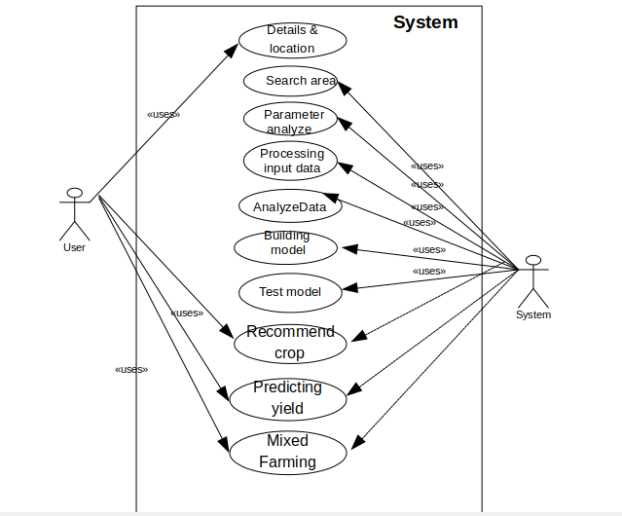
USECASE DIAGRAM

Slide 16
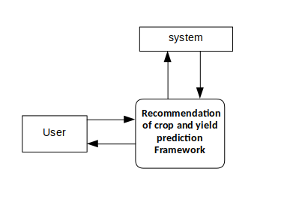
DATA FLOW DIAGRAM:
Level 0

Slide 17
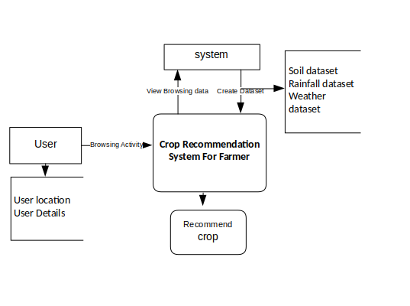
DATA FLOW DIAGRAM :
LEVEL1:

Slide 18
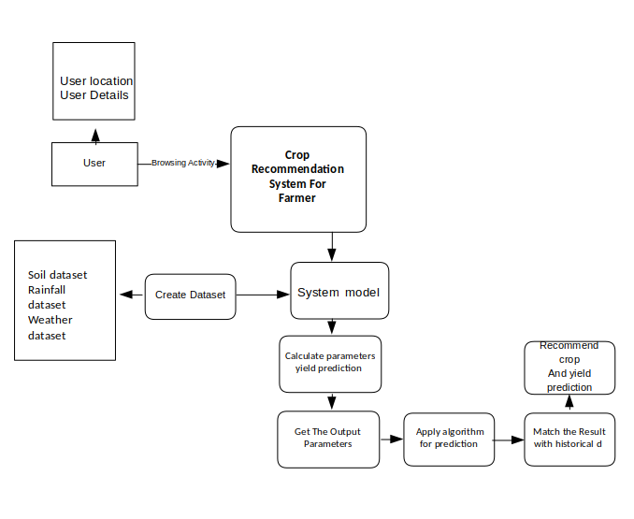
DATA FLOW DIAGRAM :
LEVEL2:

Slide 19
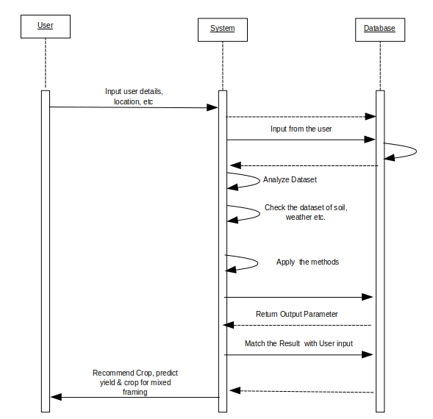
SEQUENCE DIAGRAM:

Slide 20
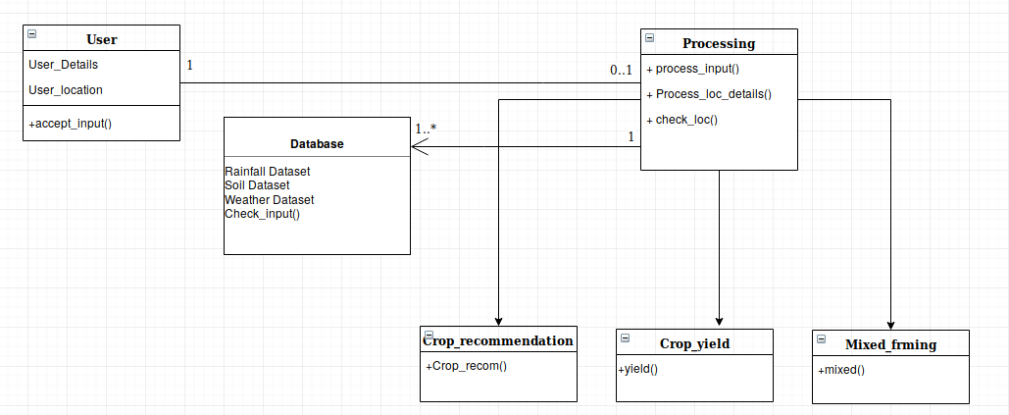
CLASS DIAGRAM

Slide 21
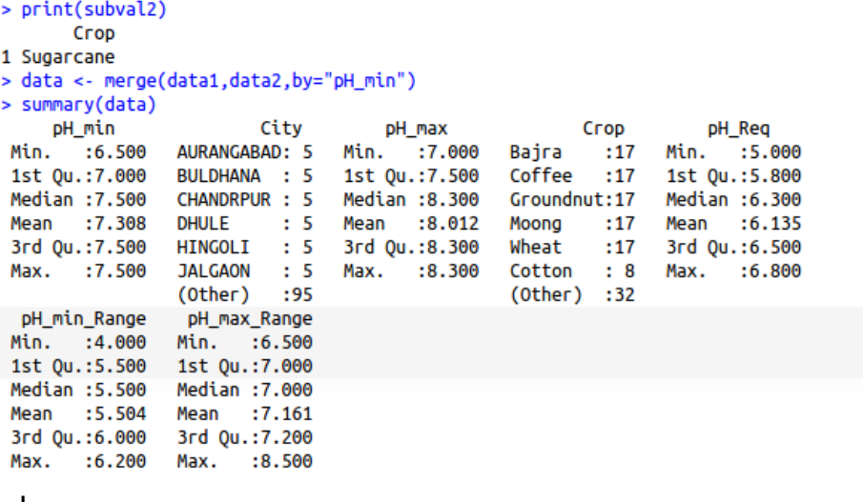
RESULT
In this system work, we have recommended crops to the farmers according to the area of production, temperature, and rainfall and pH value of the soil. We predict the yield of the crop and recommend farmers crop suitable for farming which will give them best results

Slide 22
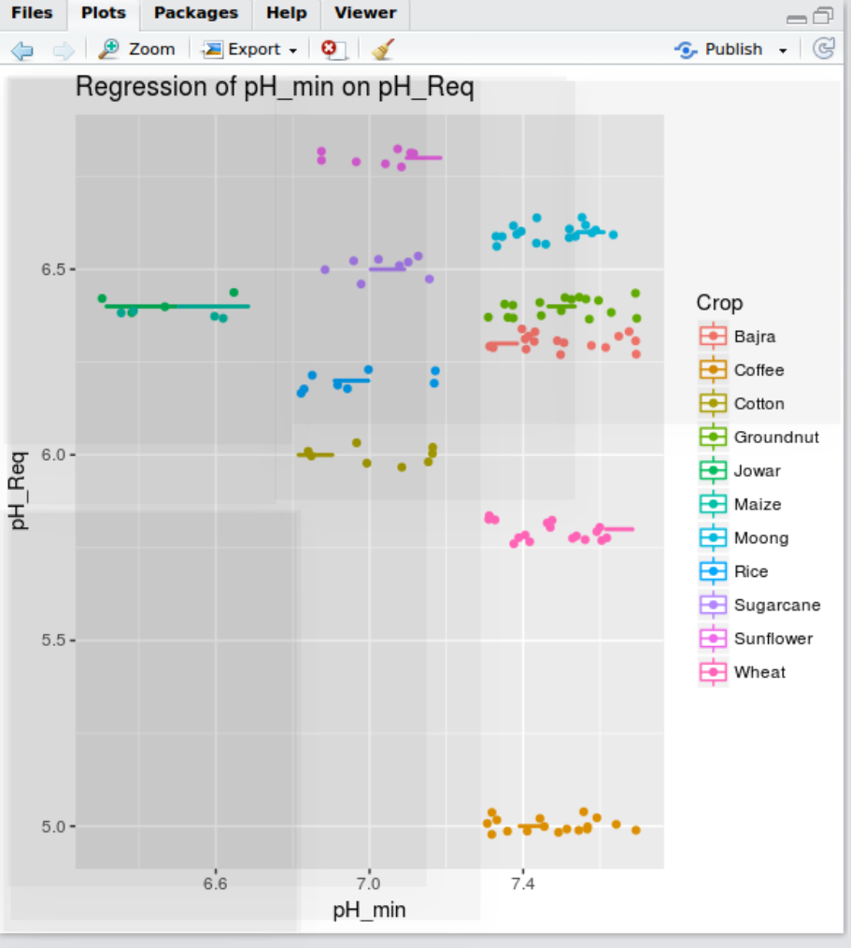
RESULT

Slide 23
RESULT
The analysis of rainfall and temperature areawise helps us determine the most suitable range
required for different crops.
Analyzing pH values of land with the above analysis of rainfall and temperature, a regression model is created to help predict which crop is most suitable in which area.
Area vs Production helps to reinforce the correctness of this model.

Slide 24
CONCLUSION
After sufficient research in our domain, we have understood how
recommendation of crop and predicting yield using different methods works. Research on this problem has been done along with the different crops from different region. The system architecture and data flow has also been designed for the system. After analyzing the limitations, advantages and scope of this system we have successfully completed the Software Requirement Specification of this project.

Slide 25
REFERENCES
Jharna Majumdar, Sneha Naraseeyappa and Shilpa Ankalaki, Analysis of agriculture data using data mining techniques: application of big data , 2017
Miss.Snehal, S.Dahikar, Dr.Sandeep, V.Rode , Agricultural Crop Yield Prediction Using Artificial Neural Network Approach, Journal Vol. 2, 1, January 2014January 1, 2014
S.Veenadhari, Dr. Bharat Misra, Dr. CD Singh, Machine learning approach for forecasting crop yield based on climatic parameters, Conference, January 2014
Anup K. Prasad , Lim Chai , Ramesh P. Singh, Menas Kafatos, Crop yield estimation model for Iowa using remote sensing and surface parameters,International Journal of Applied Earth Observation and Geoinformation 8 (2006) 2633, June 2005
Askar Choudhury, James Jones, Crop Yield Prediction Using Time Series Models , Journal of Economic and Economic Education Research, Volume 15, Number 3, 2014

Slide 26
6. X.E. Pantazi , D. Moshou , T. Alexandridis , R.L. Whetton ,A.M. Mouazen, Wheat
yield prediction using machine learning and advanced sensing techniques,
Journal, 2015
7. Alberto Gonzalez-Sanchez , Juan Frausto-Solis Waldo Ojeda-Bustamante
Predictive ability of machine learning methods for massive crop yield prediction,
Spanish journal of Agricultural research, June 2014
8. Tirtha Ranjeet,Leisa Armstrong ,An Artificial Neural Network for Predicting Crops
Yield in Nepal, 2014
9. Snehal S. Dahikar, Prof. Dr. Sandeep V. Rode,Prof. Pramod Deshmukh, An
Artificial Neural Network Approach for Agricultural Crop Yield Prediction Based
on Various Parameters, Volume 4, Issue 1, January 2015
10.https://data.world/thatzprem/agriculture-india (Dataset) (visited: 16 Octobe
2018)
11. https://knoema.com/atlas/India/topics/Agriculture (Dataset)
(vis-ited : 16 October 2018)

