Slide 1
Age and gender detection using python
Mentor- Amlan Jyoti Baruah
Presented by :- Group 09
Sirajul (group leader)
Sudipa
Shougaigm
Subhrodev
Udit
Ujjal

Slide 2
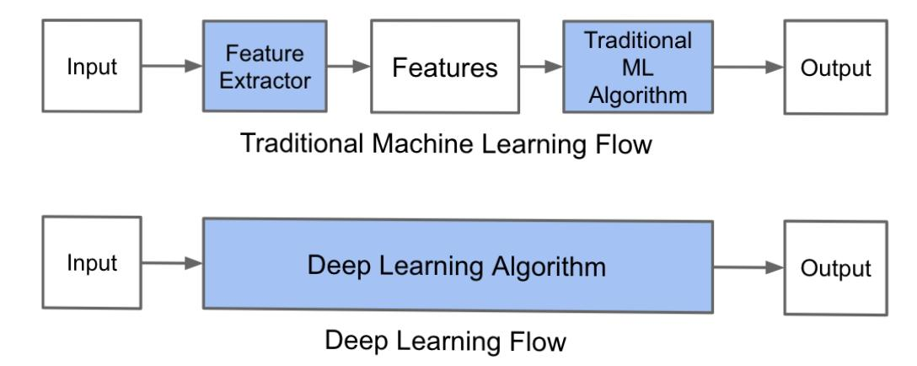
Terminology
Before going through the project first ,we have to understand these terms.
Computer Vision
Computer Vision is the field of study that enables computers to see and identify digital images and videos as a human would. The challenges it faces largely follow from the limited understanding of biological vision. Computer Vision involves acquiring, processing, analyzing, and understanding digital images to extract high-dimensional data from the real world in order to generate symbolic or numerical information which can then be used to make decisions.
OpenCV
OpenCV is short for Open Source Computer Vision. Intuitively by the name, it is an open-source Computer Vision and Machine Learning library. This library is capable of processing real-time image and video while also boasting analytical capabilities. It supports the Deep Learning frameworks Tensorflow, Caffe, and PyTorch.
CNN
A Convolutional Neural Network is a deep neural network (DNN) widely used for the purposes of image recognition and processing and NLP. Also known as a ConvNet, a CNN has input and output layers, and multiple hidden layers, many of which are convolutional. In a way, CNNs are regularized multilayer perceptrons.

Slide 3
Deep Learning framework
Deep Learning frameworks can either be an interface or a library/tool that helps Data Scientists and ML Developers to build Deep Learning models much more conveniently. The best part about Deep Learning frameworks is that you need not get into the intricacies of the underlying ML/DL algorithms – that is taken care of by the Deep Learning frameworks.
To go about the python project, we’ll
Detect faces
Classify into Male/Female
Classify into one of the 8 age ranges
Put the results on the image and display it.
Prerequisites
We install OpenCV to be able to run this project.
To run the caffe model we use the command cv.dnn
Atlast the output is shown.

Slide 4
Conclusion
Many previous methods have tackled the problem of age and gender classification of images .We have tried to do it in a very simplest way.
We have used CNN which provide improved age and gender classification results, even considering the much smaller sizeof contemporary unconstrained image sets labeled for age and gender.The simplicity of the model implies that more elaboratesystems using more training data may well be capable of substantially improving results beyond these results.
If￼there had been more time, we would have dedicated more effort towards fine-tuning the parameters and the modified architectures we experimented with.

Slide 5
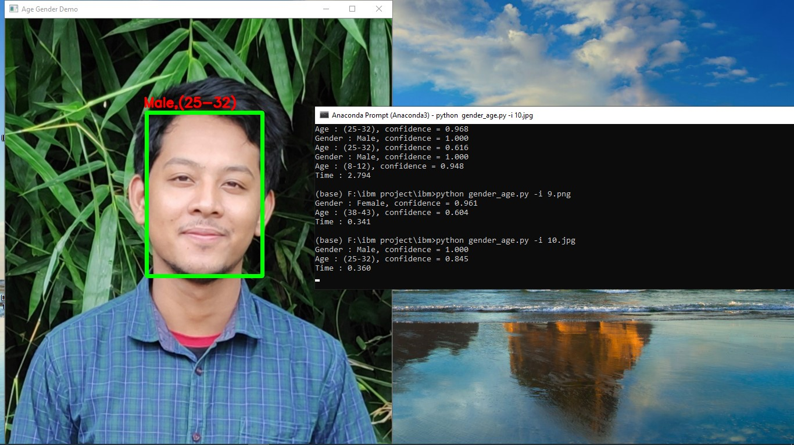
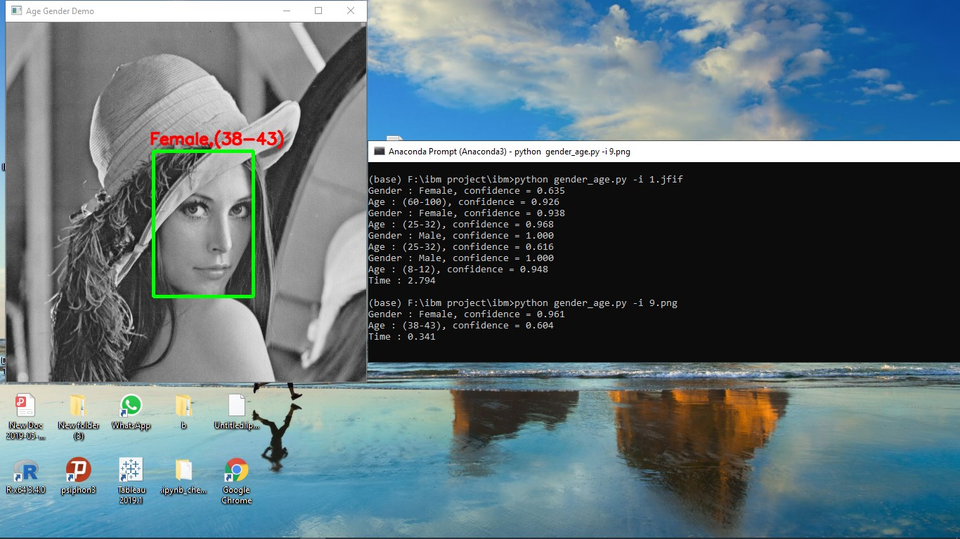
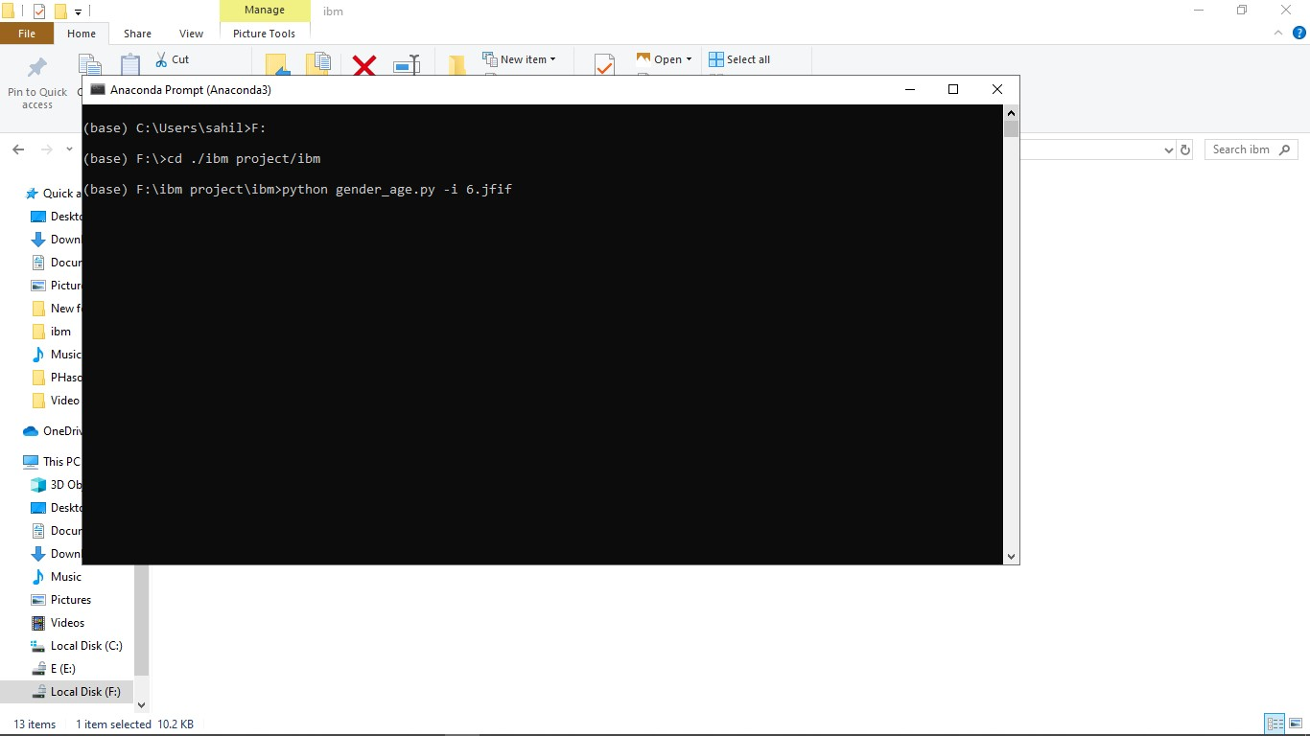
Screenshots of some outputs

Slide 6
THANKYOU

