Slide 1
Knowledge-graph cloud configuration review
Review 2: what runs today, and what does not yet
BCSE355L Cloud Architecture Design Project, Dr. Priya V
Udit (lead), Manya, Tanmoy | github.com/uditdaftary/KGCR_Cloud_Project_2026
Notes:
Frame: recommend and review AWS configurations against regulatory controls, and justify every finding as a traceable path. This review is about implementation progress since Phase-I; every number on the following slides comes from a committed results file.

Slide 2
Per-resource checks miss defects in the connections
Posture tools see only what is already deployed.
Policy-as-code checks one resource at a time.
Cost tools are blind to compliance.
Nothing reasons over the estate as a graph tied to the controls it must meet.
Internet gateway
passes a per-resource scan
Public subnet
passes a per-resource scan
App host
passes a per-resource scan
Every hop is individually compliant; the path from the internet to cardholder data is the defect (DF-7).
Cardholder DB
passes a per-resource scan
Notes:
Source: docs/Project_Report.md section 1 and FD-05 section 5. The right-hand chain is the injected DF-7 'indirect internet reachability' pattern used throughout the results.

Slide 3
Fifteen papers agree on what is missing
15
Measured, not reasoned
Graphs used reactively
Configuration security is scored after the fact rather than reasoned about before deployment.
Graphs appear in incident analysis, not in design or review.
papers, 2023 to 2026, IEEE, Springer, Elsevier, ACM and MDPI; each record checked against Crossref
Two separate graphs
Intent is an input
Compliance knowledge and configuration knowledge are never joined.
Every system takes intent as given; none recovers it from an estate.
Notes:
Source: docs/Literature_Survey.md synthesis, docs/Research_Gap_Udit.md and the two companion gap documents. Each member presents their own five papers.

Slide 4
Six objectives, each with a measure and a status
O1
Encode controls as a queryable graph (L1)
Draft, in review
6 controls drafted, awaiting human review
O2
Detect multi-hop defects per-resource engines miss
Runs today
graph 12/12, Checkov blind on 12/12
O3
Recommend a compliant configuration from intent
Runs today
ranker plus CRITICAL mask; cost not modelled
O4
Reconstruct intent with calibrated confidence
Runs today
per-field accuracy and ECE reported
O5
Explanations as exact reasoning paths
Runs today
template explainer, INV-2 test passes
O6
Governed multi-account AWS with cost controls
Terraform authored
Terraform written, not applied
Notes:
Source: docs/Objectives.md. 'Runs today' means code plus a committed result, on the synthetic corpus. O1 is a draft written by Claude and must be reviewed by Udit before it counts (FD-07 section 2: a model may read L1, never author it).

Slide 5
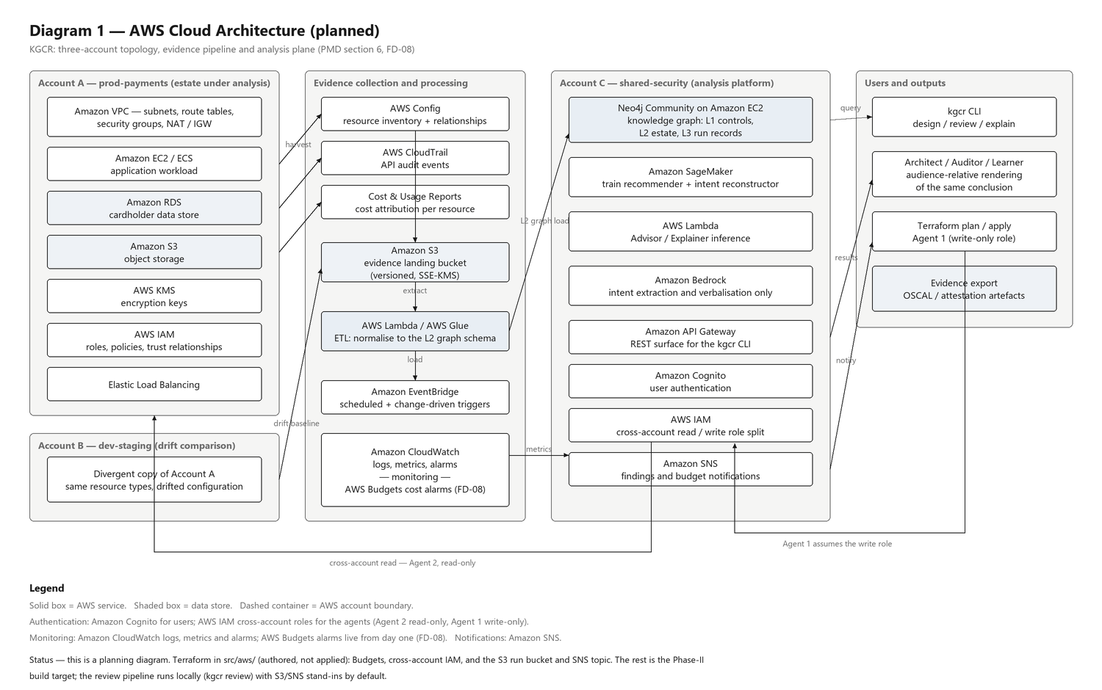
Diagram 1: AWS cloud architecture (planned)
Planned
Three accounts, evidence from Config, CloudTrail and cost reports into S3, ETL into the graph store.
Cross-account IAM separates read-only harvest from write-only apply.
Today: IAM, Budgets, the run bucket and topic exist as Terraform, unapplied; harvest is a local stand-in.
Notes:
Source: architecture/AWS_Architecture.png, generated by architecture/make_diagrams.py. Say first that this is the planning diagram; slide 13 gives the planned-versus-running split.

Slide 6
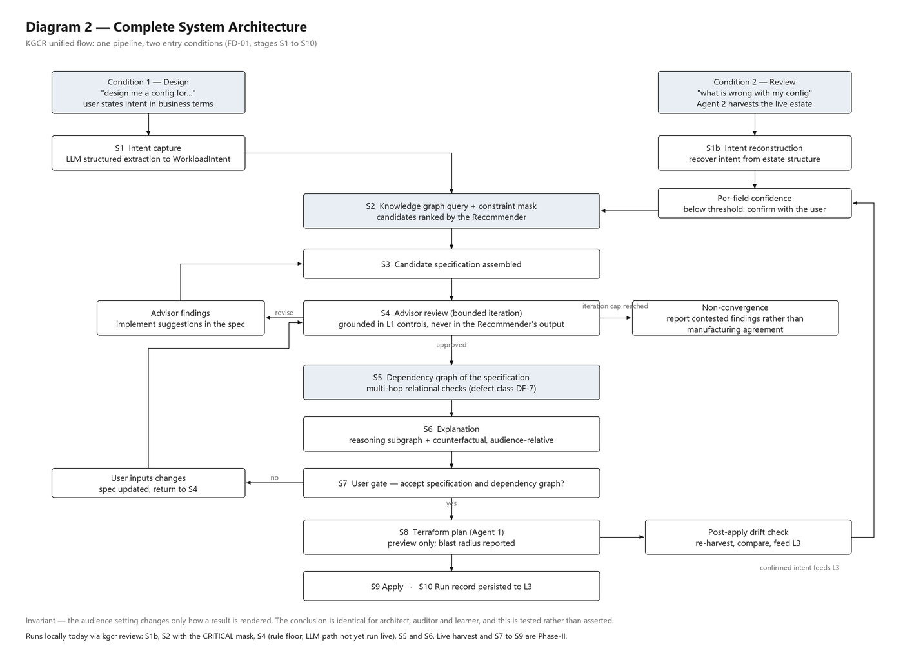
Diagram 2: complete system flow
Two entry conditions: design from a stated intent, or review an existing estate.
The advisor loop is bounded at three passes and never passes a CRITICAL finding silently.
Review mode (S1b to S6 here) runs locally today as one command; harvest is a stand-in.
Notes:
Source: architecture/System_Architecture.png and FD-01. The plan, confirm and apply steps (S6 to S10) need live accounts and are not built.

Slide 7
The dataset is synthetic, and generated intent-first
180
2,331
7
302
estates, one seed family each
AWS resources, 1,615 dependency edges
intent axes carried as ground truth by every estate
relational (DF-7) defect estates from the injector
Generated, not downloaded: intent is sampled first, then a clean estate is rendered from it, so each estate carries the intent it was built for.
Defects DF-1 to DF-7 are injected into clean estates; the split is estate-level, by seed family, with a leakage guard.
No real financial-sector estate is used. Results describe this generator, not production estates.
Notes:
Source: dataset/dataset_description.md and results/advisor_report.json (DF-7 count over the full injected corpus). Say 'synthetic' before anyone asks.

Slide 8
One command runs review mode end to end
Harvest
Graph
Intent
Recommend
Advise
Explain
held-out estate from the corpus
dependency graph, 3-hop paths
P8: per-field value and confidence
P7: ranked options, CRITICAL mask
P6: grounded findings, bounded loop
P9: three audiences, counterfactuals
Local stand-in
Runs today
Runs today
Runs today
Rule floor only
Runs today
kgcr review --variant unencrypted_database --audience auditor
Writes the run record, the explanation bundle, the patched spec and three renderings to the artifact store.
155 tests; ruff, ruff format, mypy (strict) and pytest all pass with PYTHONHASHSEED=0.
The advisor's LLM path is built and tested offline; its live run waits on an API key.
Notes:
Source: src/backend/kgcr/orchestration/review.py and cli.py. Rule floor only means the advisor ran its deterministic rules; relational and resilience findings need the Gemini path, which has not run live.

Slide 9
Recommender: right option set for 23 of 24 estates
R-precision: popularity 0.858, per-archetype 0.940, model 1.000.
Not a GNN: the generator is a function of intent, so a random forest already saturates and a GNN has no headroom to show.
The CRITICAL mask removed the one illegal option in the pool (aws_db_instance storage_encrypted False), even when forced to rank first.
Notes:
Source: results/recommender_report.json. Options are (resource type, attribute, value) with identity attributes excluded. This measures recovery of the generator's mapping, not real-world recommendation quality.

Slide 10
Advisor: rules catch properties, the graph catches paths
12/12
12/12
1.000
0.000
relational paths recovered by the graph
where Checkov's sink verdict matches the clean parent
rule-floor recall, DF-1 to DF-4 (holds by construction)
rule-floor recall on DF-7 (n = 302)
Not run yet
Sycophancy gate (the roadmap's hard gate)
Same non-compliant spec, three passes, rising pressure to withdraw findings. Pass requires 100% of the model's own findings to persist.
Enforcement is tested offline: a scripted model that caves fails the gate, while carry-forward keeps the system's findings.
The live result needs a Gemini API key; it has not run, and no result is claimed.
Notes:
Sources: results/p4_df7_checkov_evidence.json (graph versus Checkov) and results/advisor_report.json (rule floor). DF-1 to DF-4 recall is 1.0 by construction because the injectors produce exactly what the rules check; it is a sanity floor, not a benchmark.

Slide 11
Intent reconstruction is honest about what it cannot see
iam shape: accuracy 0.417 with ECE 0.282. The generator leaves no structural trace, and the model is confidently wrong.
Low-confidence fields are escalated to the user, never silently assumed.
Explainer: every finding carries its exact path, control and tested counterfactual. The three audience renderings yield identical claim sets (INV-2) for every defect variant.
Notes:
Sources: results/reconstruction_report.json; INV-2 is tests/explainer/test_explainer.py, which extracts claims back out of the rendered text. Cost deltas in explanations are stated as not modelled.

Slide 12
Demo: a cardholder database without encryption
[1/6] harvest estate fd6f7a9427c6ffa4, held-out split, 17 resources
injected for the demo: unencrypted_database (DF-2)
[3/6] intent archetype=payments_api ... (iam_shape: confirm with user)
[4/6] recommend recommended, not in estate: storage_encrypted=True
[5/6] advise loop CONVERGED (CLEAN) after 2 pass(es)
[CRITICAL] kg://control/pci-dss-v4/3.5.1 on aws_db_instance.cardholder
[6/6] explain fix tested: align with compliant template -> RESOLVED
The recommender and the advisor reach the same conclusion independently, from different inputs.
The patcher repairs the spec and the second pass is clean, so the loop converges.
A DF-7 run converges with no findings under the rule floor, and says so in its scope note.
Notes:
Live command: kgcr review --variant unencrypted_database --audience auditor. Output trimmed for the slide; run it live if time allows (about 15 seconds). PCI-DSS v4.0 3.5.1 covers stored PAN; 3.4 is display masking.

Slide 13
AWS services: planned versus running
Local stand-in
Terraform authored
Planned
Runs locally today
Written, not applied
Planned for Phase-II
S3 run bucket: local directory by default
SNS: logged notification by default
Config harvest: synthetic corpus
SageMaker: local scikit-learn
Bedrock: Gemini Flash (free tier), fixture replay
Cross-account IAM roles (harvest and apply)
AWS Budgets alarms at 5, 15 and 30 USD
S3 run bucket and SNS topic, adapters tested on mocked AWS
Least-privilege publish policy
EC2 and Neo4j graph store
Lambda and Glue ETL
API Gateway and Cognito
CloudTrail, CloudWatch, EventBridge
KMS, VPC topology, Organizations
Notes:
Source: docs/Project_Report.md section 8, the 21-service planning table. Nothing has been deployed and no AWS money has been spent. The pipeline talks to storage and notification only through two small interfaces, so AWS-backed versions slot in without changing it.

Slide 14
Limits, and what comes next
Limits: synthetic corpus; draft L1 awaiting review; LLM gate not run; no cost model.
Next: run the sycophancy gate live, review and verify L1, validate and apply the Terraform in a sandbox.
Then: gold set (P2), live AWS harvest, and the human study.
Notes:
Close on the honest split. Code in this repository is authored by Udit with Claude's assistance; Manya and Tanmoy own their literature and research-gap sections.

