Slide 1
TERMWORK (19ECE457)
WAVELETS AND APPLICATION
Wavelet in channel coding
CB.EN.U4CCE21019 | - | Phani Varma
CB.EN.U4CCE21061 | - | Sana Udith Kumar
CB.EN.U4CCE21075 | - | Tejdeep

Slide 2
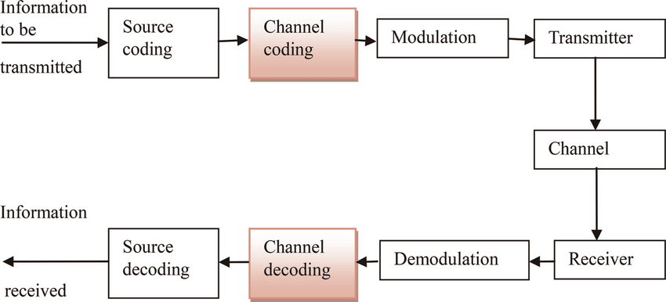
CHANNEL CODING

Slide 3
Libraries:
PyWavelets
Numpy
Matplotlib
For performing wavelet decomposition and reconstruction
Used for signal generation,noise addition and error correction
Used for visualizing the original, reconstructed, and noisy signals.

Slide 4

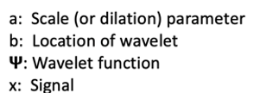
Wavelets and Their Role in Signal Processing
Wavelets are mathematical functions used for signal analysis and decomposition, capable of representing signals at multiple scales or resolutions. Unlike traditional Fourier transforms, which represent signals in terms of sinusoidal components, wavelets can represent both high and low-frequency components of a signal simultaneously.
Wavelets can be adjusted to better overlap with an input signal using parameters such as scaling and shifting

Slide 5
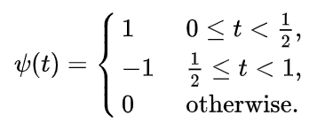



Haar Wavelet
ψ(t) is used for capturing the high-frequency details (edges, sharp transitions)
ϕ(t)is used for capturing the low-frequency smooth components of the signal.
The LPF captures the approximation (smooth, low-frequency) components of the signal. It averages pairs of adjacent values in the signal, providing a coarse representation.
The HPF captures the detail (high-frequency) components of the signal. It detects the differences between adjacent signal values, highlighting sharp transitions or edges.

Slide 6
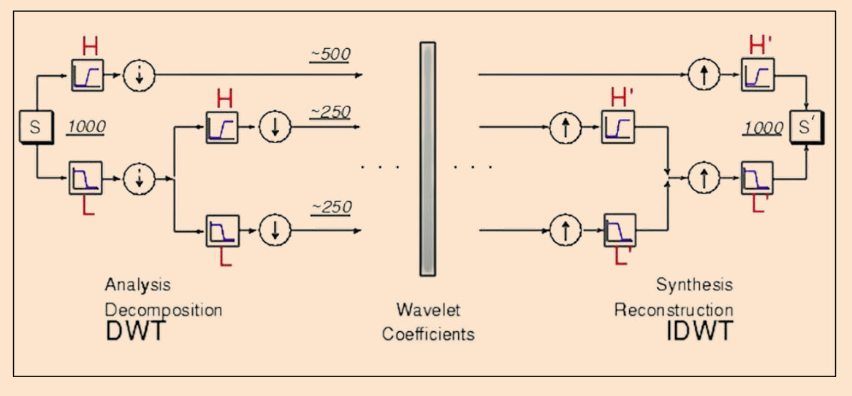

Decomposition and Reconstruction Using Haar Wavelets
Let’s take the simple 8-point signal
Apply Haar Wavelet Decomposition

Slide 7
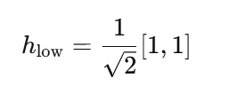

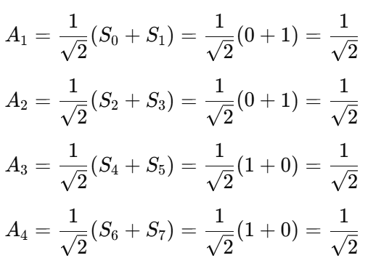
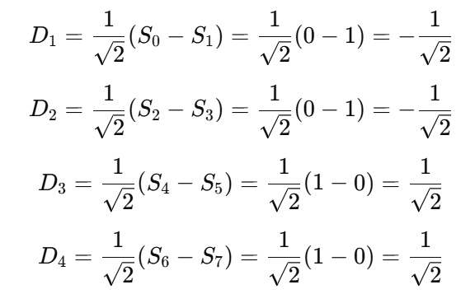

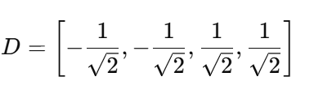
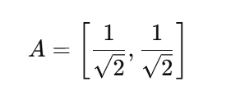
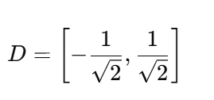
Apply Filters
The Low-Pass Filter (LPF) coefficients smooth the signal by averaging adjacent values, capturing the low-frequency components (approximation).
The High-Pass Filter (HPF) coefficients highlight the differences between adjacent values, capturing the high-frequency components (details).

Slide 8
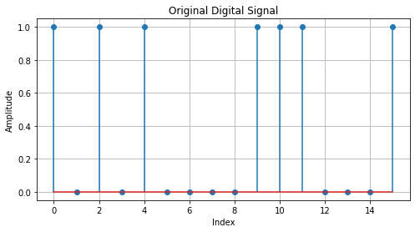
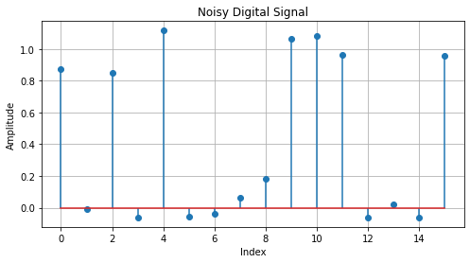
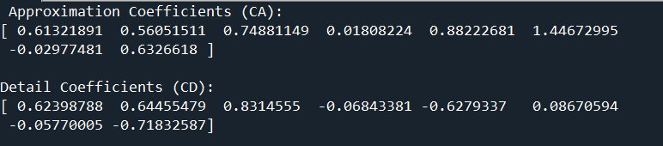
Code
Generate a digital signal
import numpy as np
import matplotlib.pyplot as plt
# Generate a binary digital signal (0s and 1s)
signal_length = 16 # Length of the signal
digital_signal = np.random.choice([0, 1], size=signal_length)
Adding Gaussian noise
# Adding Gaussian noise to the digital signal
noise = np.random.normal(0, 0.1, digital_signal.shape)
noisy_signal = digital_signal + noise
Wavelet decomposition
import pywt
# Perform single-level wavelet decomposition using Haar wavelet
coeffs = pywt.dwt(noisy_signal, 'haar’)
# Coefficients: (CA, CD)
CA, CD = coeffs

Slide 9
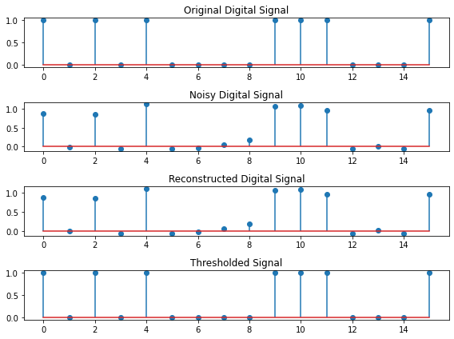
Code
Reconstruction
# Reconstruct the signal from CA and CD using inverse DWT
reconstructed_signal = pywt.idwt(CA, CD, 'haar')
Threesholding
thresholded_signal = np.where(reconstructed_signal >= 0.5, 1, 0)

Slide 10
Thank you

