Slide 1


Bank of Baroda Hackathon - 2022
Technology Partner
Your Team Name : SynKIt
Your team bio : We are a team of enthusiastic developers hoping to bring a unique change with our development .
Date : 18/9/22

Slide 2
Problem Statement?
Call Centres receive numerous calls from people that require immediate attention to their problems. It is necessary to keep track of all the activities between the customer and the agent, analyze them so as to enhance the contact center services.
The call quality and hygiene is of utmost importance for a call center to function well. So, having a sentimental analysis of every call will help in analyzing the customer satisfaction and gain feedback on every agent and the service thus provided.
So, the problem we will be dealing with encircles around call quality and hygiene using different AI techniques and ideas.

Slide 3
User Segment & Pain Points
Bank wants to automate the process of customer feedback, enquiry and finding the solution of the problem of a customer with the help of AI based techniques.
Banks want to do this because they want to monitor and measure the KPIs like call data quality, call hygiene, customer sentiment,customer satisfaction etc.
We can check for the waiting duration of the call and analyse it because the longer waiting duration before attending the call ultimately leads to increase in customer annoyance.
As the project is based on the bank customer analysis we would like Bank of Baroda to be the early adopter of our product!.

Slide 4
Competitive Products
Geomant is special customer service experience integrator, which is one of the competitive products for the problem.
They have made a geomant wallboard which provide a detailed call analysis to every person.
It helps them to analyse and improve the performance of each employee, who needs training and changing trends and needs.

Slide 5
Azure tools or resources
Azure tools or resources which are likely to be used by us to make our prototype:
Azure Cognitive Services
Azure Search
Azure Machine Learning
Azure Blob Storage
Azure Functions
Azure App Service
Azure SQL DB
Loome

Slide 6
Any Supporting Functional Documents
There are several KPIs (Key Performance Indicators) that we are going to consider for our project. Some of them are as follows:
Sales Per Agent
Active Waiting Calls
Longest Call Hold
Peak hour Traffic
Call Abandonment
Average Handle Time
Revenue per successful call
On-Hold Time
Call Arrival Rate
Call setup success rate
Downtime (Time lost due to technological issues)
Callback Messaging
Repeat Calls
Call completion rate
Agent Utilization
Customer Satisfaction Score.
Total Calls answered.
Calls answered per hour.

Slide 7
Key Differentiators & Adoption Plan
Our proposed solution is different than other analytics as most analytics tools and platforms focus on agent based segmentation and analysis. In our project, we not only focus on agent utilization and its characteristics, but also customer segmentation. Customers are grouped based on different parameters like age group, location, number of time called, etc. This segmentation helps in finding better analytics regarding customer-agent interaction. Also, sentimental analysis of agent-customer interaction gives a better view of call quality.
Adoption Plan:
We will be using azure resources and Power BI to create our own call centre dashboard with visual analytics features that gives an aesthetic look with apt functionalities.
Thus we will be focussing on two key functionalities:
Call sentiment Analysis of different languages.
KPI Dashboard - Agent Segmentation and Customer Segmentation.

Slide 8
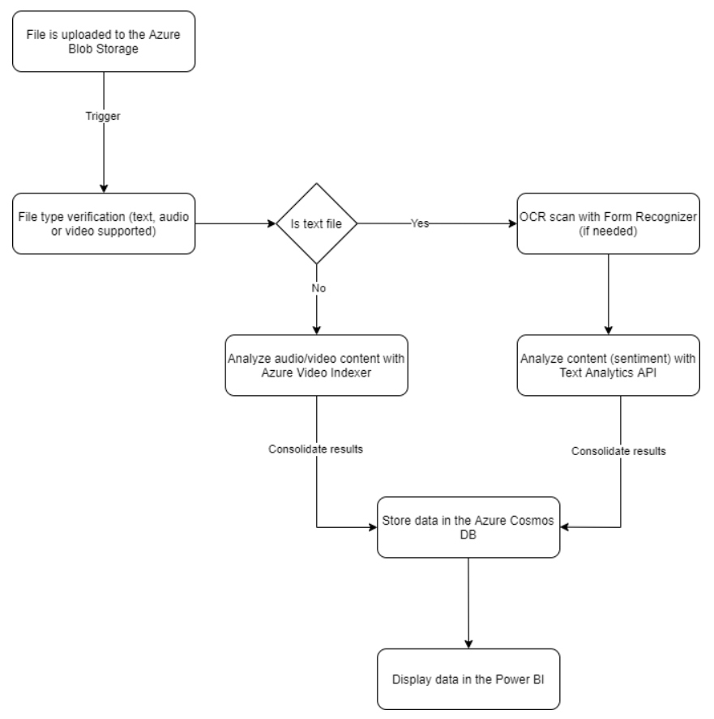
Flow Diagram

Slide 9
Thank You
Team member names
Lavish R Jain
Uditi Gupta

