Slide 1
Sentiment-Aware Stock Price Prediction using LSTM
Final Project Presentation
AI & ML
UDIT SARKAR(23b1009)
JAINENDRAJEET(23b1008)

Slide 2
Problem Statement
Input:
- A dataset of tweets related to various companies.
- Historical stock price data.
Output:
- Sentiment scores for each tweet.
- A prediction of stock price movement using LSTM based on sentiment and historical prices.
Example:
Input: "Apple stock is booming after the new iPhone launch!", and the history of the prices(closing) of the stock.
Output: Next day Price.

Slide 3
Brief Explanation of the Problem
This project aims to analyze social media sentiment—especially from tweets—and predict stock trends using an LSTM-based model. The sentiment of the tweets is first processed and then combined with historical stock data for forecasting.

Slide 4
Motivation
- Real-time market decisions rely increasingly on public sentiment.
- Tweets often precede actual stock price movements.
Challenges: Sarcastic tweets, Pandemic condition :( .
- This project bridges NLP(sentiment) and time-series forecasting(LSTM) to improve financial decision-making.

Slide 5
Literature Review
- Bollen et al. (2011): Showed public mood on Twitter could predict stock market trends.
- StockNet Dataset: Used in sentiment + price prediction tasks.
- Techniques like LSTM networks were common in prior work.

Slide 6
Dataset
Example Data Instance:
Tweet: “Tesla is the future of clean energy.”
Processed Sentiment: Positive
Associated stock movement: Increase
Statistics:
- ~75,000 tweets
- Classes: Positive, Negative, Neutral
- Features: Text, Time, Sentiment, Price
- Balanced Dataset (mostly)
Source:
- StockNet Dataset

Slide 7
Method/Technique
Tweet Processing: Cleaning, tokenization, lemmatization, language filtering
Sentiment Analysis: TextBlob + Manual labeling
Prediction Model:
- LSTM (3 layers)
- Dense + Dropout
- Trained on past n days + sentiment vectors
Libraries: Tweepy, NLTK, Scikit-learn, Keras, TensorFlow, Matplotlib

Slide 8
Model Architecture
Input: Stock prices + Sentiment vector
Layers:
- LSTM(50) → Dropout(0.2)
LSTM(50) → Dropout(0.2)
- LSTM(50) → Dropout(0.2)
OUTPUT LAYER : dense(1)
Loss Function: MSE
Optimizer: Adam
Callbacks: EarlyStopping, ModelCheckpoint

Slide 9
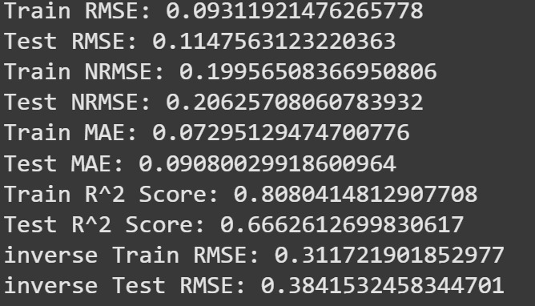
Results
Performance Metrics:
Benchmark Comparison:
Model R-squared Inverse RMSE
LSTM Only 0.2 - 0.5 >0.5
LSTM + Sentiment 0.666 0.384

Slide 10
DEMO
Let’s See through the code
JAINENDRAJEET
UDIT SARKAR

Slide 11
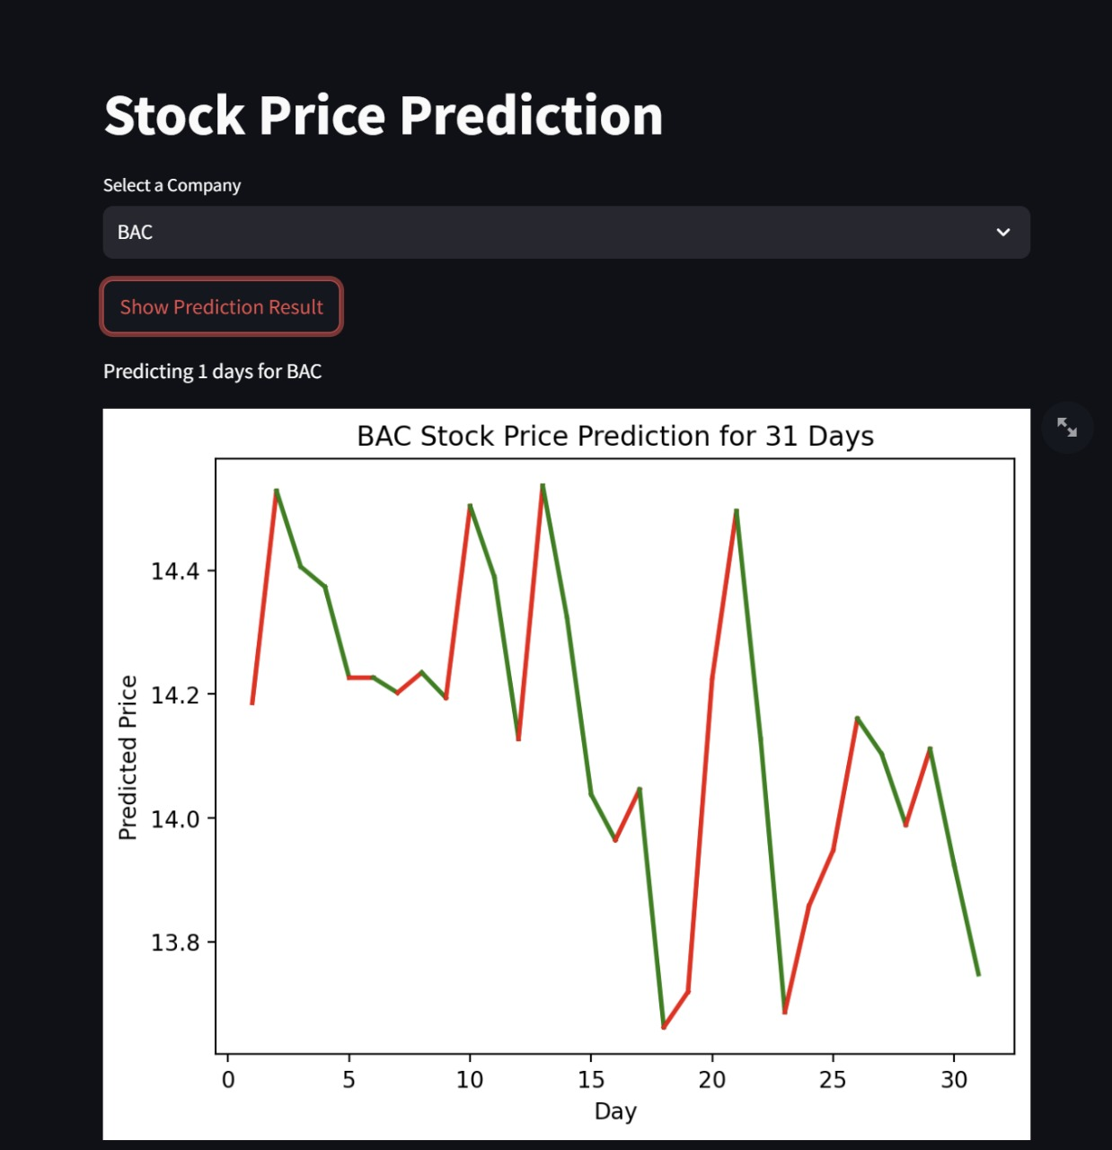
Analysis
Sentiment features correlated with sudden market moves (e.g., Tesla tweets showing strong predictive power).
Positive sentiment days generally aligned with minor upward trends

Slide 12
Error Analysis
False positives occurred during sarcasm or ambiguous phrasing (e.g., 'Great! Tesla crashes again 😒').
Stock dips not associated with sentiment shift—likely due to external economic factors.
LSTM failed to generalize during extremely volatile days.

Slide 13
Improvement Over the Paper (We have not used the Paper method )
Hybrid sentiment approach: TextBlob + manual label boosting increased labeling precision.
We also predicted the price (while in the paper predicts only movement( UPWARD / DOWNWARD)).

Slide 14
Learning
Learned how to integrate NLP pipelines with time-series forecasting models (LSTM).
Realized the importance of robust preprocessing when dealing with social data.
Enhanced collaboration skills through team-based division of preprocessing, modeling, and evaluation tasks.

Slide 15
Summary and Conclusion
We predicted stock movements using tweet sentiment + historical prices.
Sentiment improves prediction accuracy by over LSTM-only models.
Future Work: Use attention-based models (e.g., BERT) and real-time Twitter ingestion pipelines.

