Slide 1
RELIABLE EXPLAINABLE AI FRAMEWORK FOR SOFTWARE DEFECT PREDICTION
Student Name: Udit Jain Roll No: 24CSM1R23 Guide Name: Dr. Manjubala Bisi
Internship At: Intel Corporation

Slide 2
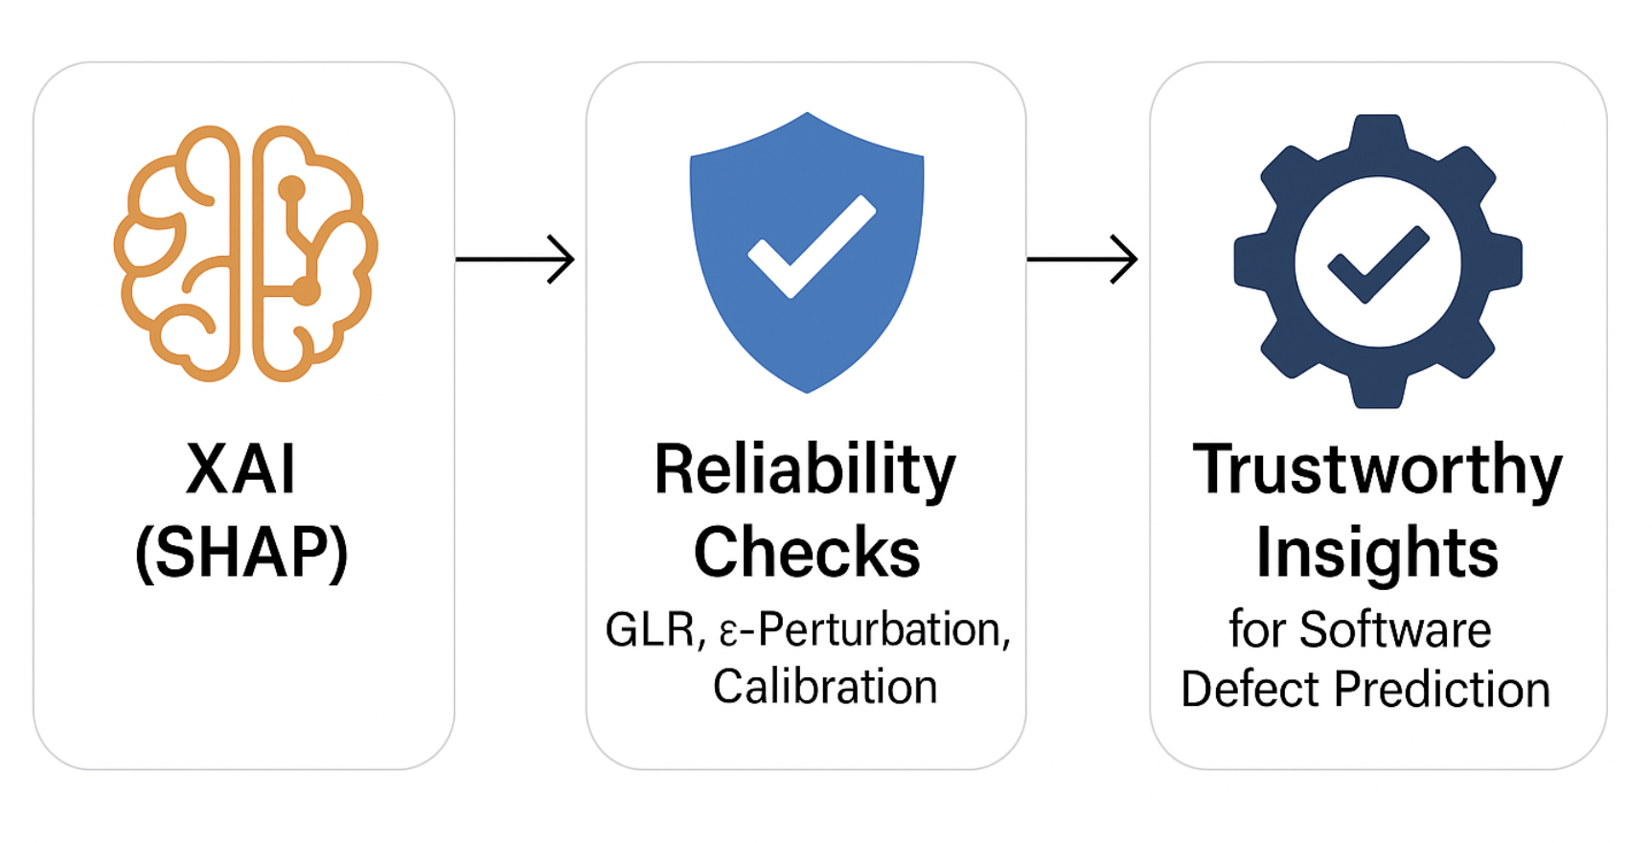
Scope of the Project
Project Focus
This project focuses on using SHAP to explain software defect prediction models and on evaluating the reliability of those explanations. The goal is to ensure developers and stakeholders can trust, validate, and interpret the model’s reasoning—not just its predictions.
Expected Outcomes
A clearer understanding of which software metrics truly drive defect predictions.
Reliability measures that strengthen trust in SHAP explanations.
Ultimately, this work bridges the gap between AI explainability and trustworthy, actionable insights for software engineering.

Slide 3
Introduction to Explainable AI with a Focus on Reliability
Explainable AI (XAI): Explainable AI refers to techniques that make the inner workings and predictions of complex AI models understandable to humans. Instead of treating AI as a “black box,” XAI highlights which features or factors influenced a decision and how much they contributed.
Think of AI like a teacher giving you an answer. Normally, it just says “42” without telling you how. With XAI, the teacher shows the steps, reasons, and key points that led to the answer.
Importance: This makes AI decisions clear and transparent, so people can trust the results, understand the reasoning, and confidently act on them. Instead of a “black box,” AI becomes a guide you can question and rely on.

Slide 4
Introduction to Explainable AI with a Focus on Reliability
Reliability of XAI: Reliability means not just explaining a model’s decision once, but making sure those explanations are consistent, stable, and truly reflect how the model works.
Imagine asking a friend the same question on different days — if the answers keep changing, you wouldn’t trust them. Similarly, reliable AI explanations should stay steady across different data samples or conditions, proving that the insights are dependable and not random.
Importance:
Builds confidence and trust in AI systems, helping developers and stakeholders make informed, risk-free decisions based on explanations they can rely on.

Slide 5
Introduction to Explainable AI with a Focus on Reliability
Relevance in Software Defect Prediction Reliable explanations help developers and stakeholders trust the model’s insights, take confident actions, and ultimately achieve better software quality with fewer risks.
Motivation: By moving beyond accuracy to trustworthy explanations, we enable AI to become a true decision-support partner in software engineering, not just a prediction tool.

Slide 6
Problem Statement
Challenges :
Traditional AI models often lack transparency in their predictions.
Difficulty in understanding how different software metrics influence defect prediction.
Explanations may vary across datasets, folds, and domains, reducing trust.
Limited availability of reliable, standardized defect data.
Without addressing these challenges, AI explanations remain hard to trust and act upon.
Understanding these challenges is crucial for effective solutions!

Slide 7
Literature Survey
Most prior work prioritizes accuracy or raw interpretability, while reliability is rarely stress-tested; existing reliability implementations are largely domain-specific, with a single generalized k-fold SHAP/LIME framework.
Traditional approaches under-specify core explainability dimensions: explanations vary with train/test splits (hurting generalization), can disagree with model attributions (low concordance), and may lack stability

Slide 8
Literature Survey
Title of the Paper | Published In | Significance | Limitation
A Methodology for Reliability Analysis of Explainable AI: Application to Endocrinology Diseases | IEEE Access 2024 | Introduced a generalized framework with Generalizability, Concordance, Stability as reliability metrics for SHAP/LIME | Domain-specific evaluation (healthcare); ignores local sensitivity/perturbation reliability
LCNN: Lightweight CNN for Software Defect Feature Identification Using Explainable AI | IEEE Access 2024 | Used SHAP and LIME to interpret CNN-based predictions, highlighting reproducibility of explanations in deep models | No systematic reliability assessment (e.g., stability, concordance); limited to visualization of explanations
Understanding Software Defect Prediction Through eXplainable Neural Additive Models (XNAMs) | IEEE Access 2025 | Designed inherently interpretable models, reducing reliance on post-hoc explanations for consistency | Focused on interpretability, not reliability; no cross-fold stability or perturbation analysis
Table 1: Summary of existing studies in software defect prediction and explainable AI, highlighting their key contributions and limitations that motivated the development of the proposed Reliable XAI Framework.

Slide 9
Literature Survey
Title of the Paper | Published In | Significance | Limitation
Software Defects Identification: Results Using Machine Learning and Explainable AI Techniques | Journal of Systems & Software Engineering, 2024 | Compared multiple ML models (RF, SVM, NN) with SHAP for feature explanations in defect detection. | Focused on accuracy and interpretability; no formal reliability metrics evaluated.
Towards Trustworthy Explainable AI for Software Defect Prediction | ICSE 2024 (Conference) | Highlighted the need for trustworthy explanations in SDP, calling for reliability-aware XAI methods. | Conceptual work; lacks implementation of quantitative reliability measures.
Explainable Software Defect Prediction from Cross-Company Metrics | ICICCS 2023 | Applied SHAP to cross-project defect data, showing feature transferability. | No assessment of reliability; explanations evaluated only qualitatively.
Table 2: Summary of existing studies in software defect prediction and explainable AI, highlighting their key contributions and limitations that motivated the development of the proposed Reliable XAI Framework.

Slide 10
Data Collection and Methodology
Data Sources
Dataset | Instances | Features | Defective Modules | Description
CM1 | 327 | 35 | 42 | Spacecraft instrument (C language)
MC1 | 9,400 | 39 | 68 | Flight software modules
MC2 | 5,200 | 39 | 160 | Instrument control system
MW1 | 403 | 37 | 27 | Ground system monitoring software
PC1 | 1,109 | 36 | 77 | Flight software
PC2 | 5,589 | 37 | 16 | Flight control system
PC3 | 1,563 | 37 | 160 | Ground data system
PC4 | 1,458 | 37 | 178 | Spacecraft dynamics model
The following datasets from the NASA PROMISE repository were used for evaluating the Reliable Explainable AI (XAI) Framework for Software Defect Prediction (SDP)
Table 3 : NASA PROMISE software defect datasets used in this study, detailing the number of instances, attributes, and class distribution for each dataset.

Slide 11
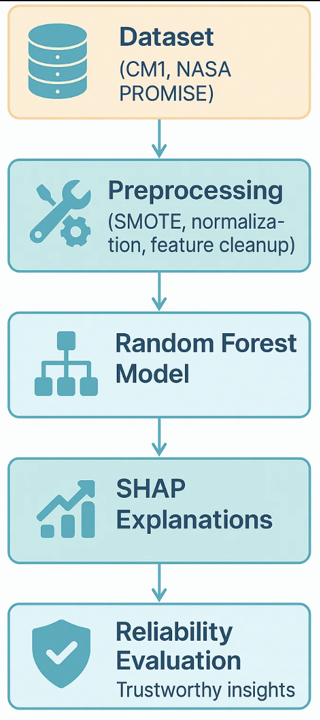
Proposed Solution Overview
Pipeline:
Dataset (CM1, NASA PROMISE) → Preprocessing (SMOTE, normalization, feature cleanup) → Random Forest Model → SHAP Explanations → Reliability Evaluation
Approach Used:
Integrating SHAP: Generate global & local feature attributions.
Reliability Extensions:
GLR (Gradient-of-Loss Reliability): Align SHAP ranks with loss sensitivity.
ε-Perturbation Hit@k: Validate if SHAP-top features truly affect loss under small nudges.
Calibration (ECE): Assess probability reliability.
Composite Reliability Score: Combines GLR, Hit@k, and Calibration for robust trust evaluation.
Expected Benefits:
More trustworthy explanations beyond accuracy.
Validation of causal impact of SHAP features.
Improved confidence for developers & stakeholders in defect predictions.

Slide 12
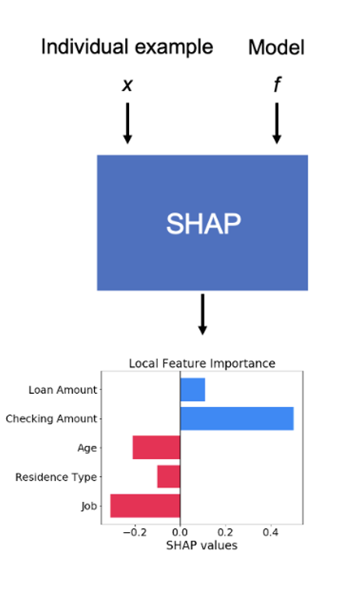
Proposed Solution Overview
SHAP (SHapley Additive Explanations):
SHAP is a method from cooperative game theory that explains how much each feature contributes to a model’s prediction.
How it works: For each prediction, SHAP calculates whether a feature increases (positive SHAP value) or decreases (negative SHAP value) the chance of a defect.
Example:
High LOC = +0.35 (increases defect risk),
High Comment Density = –0.12 (reduces defect risk)
Connection to Reliability:
While SHAP gives explanations, they must also be reliable — consistent across folds, stable across datasets, and reflective of true model behavior. That’s why your project extends SHAP with reliability checks (GLR, Hit@k, Calibration).

Slide 13
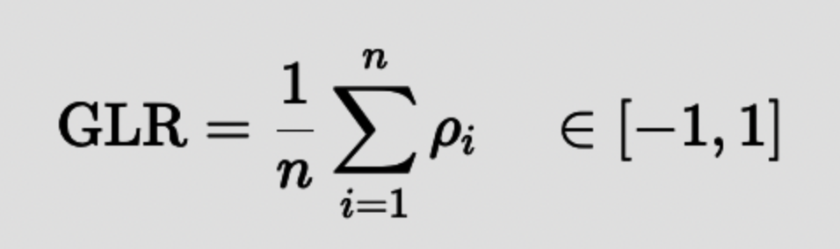
Proposed Solution Overview
Gradient-of-Loss Reliability (GLR):
GLR checks if SHAP’s ranking of important features actually agrees with how the model’s loss reacts when those features are nudged.
How it works:
For each feature, slightly increase and decrease its value by a tiny step ε\varepsilonε.
Measure how much the loss (binary cross-entropy) changes → this gives true sensitivity of that feature.
Normalize sensitivities across all features.
Compare the SHAP ranking vs. the sensitivity ranking using Spearman correlation.
The Metric:
ρ≈1: SHAP agrees with loss sensitivity → reliable.
ρ≈0: No agreement → unreliable.
ρ<0: Opposite ordering → misleading.

Slide 14
Proposed Solution Overview
ε-Perturbation Hit@k:
ε-Hit@k checks whether the features that SHAP says are most important for a prediction are also the ones that actually make the model’s loss increase when we nudge them slightly.
How it works:
Take the top-k SHAP features (Tₖ).
For each feature, add a tiny perturbation ε (e.g., 0.001) and compute the change in loss (Δℓ).
Rank features by Δℓ and take the top-k sensitivity features (Dₖ).
If Tₖ ∩ Dₖ ≠ ∅ → it’s a hit (1), else miss (0).
Average hits across samples → ε-Hit@k score.
Interpretation:
High ε-Hit@k: SHAP’s top features are truly impactful → reliable.
Low ε-Hit@k: SHAP highlights features that don’t change the model’s behavior → unreliable.

Slide 15
Proposed Solution Overview
Calibration: Expected Calibration Error (ECE)
ECE checks how well a model’s predicted probabilities match reality.
A well-calibrated model saying “70% chance of defect” will actually be correct ~70% of the time.
An over-confident model might say 70% but be right only 50%.
How it works:
Split predictions into probability bins (e.g., 0–0.2, 0.2–0.4, …).
For each bin, compare:
Confidence = average predicted probability.
Accuracy = actual fraction of positives.
Compute the average gap between confidence and accuracy → this is ECE.
Interpretation:
ECE ≈ 0: Model is perfectly calibrated → predictions can be trusted.
Higher ECE: Model is miscalibrated → predictions are over- or under-confident.

Slide 16
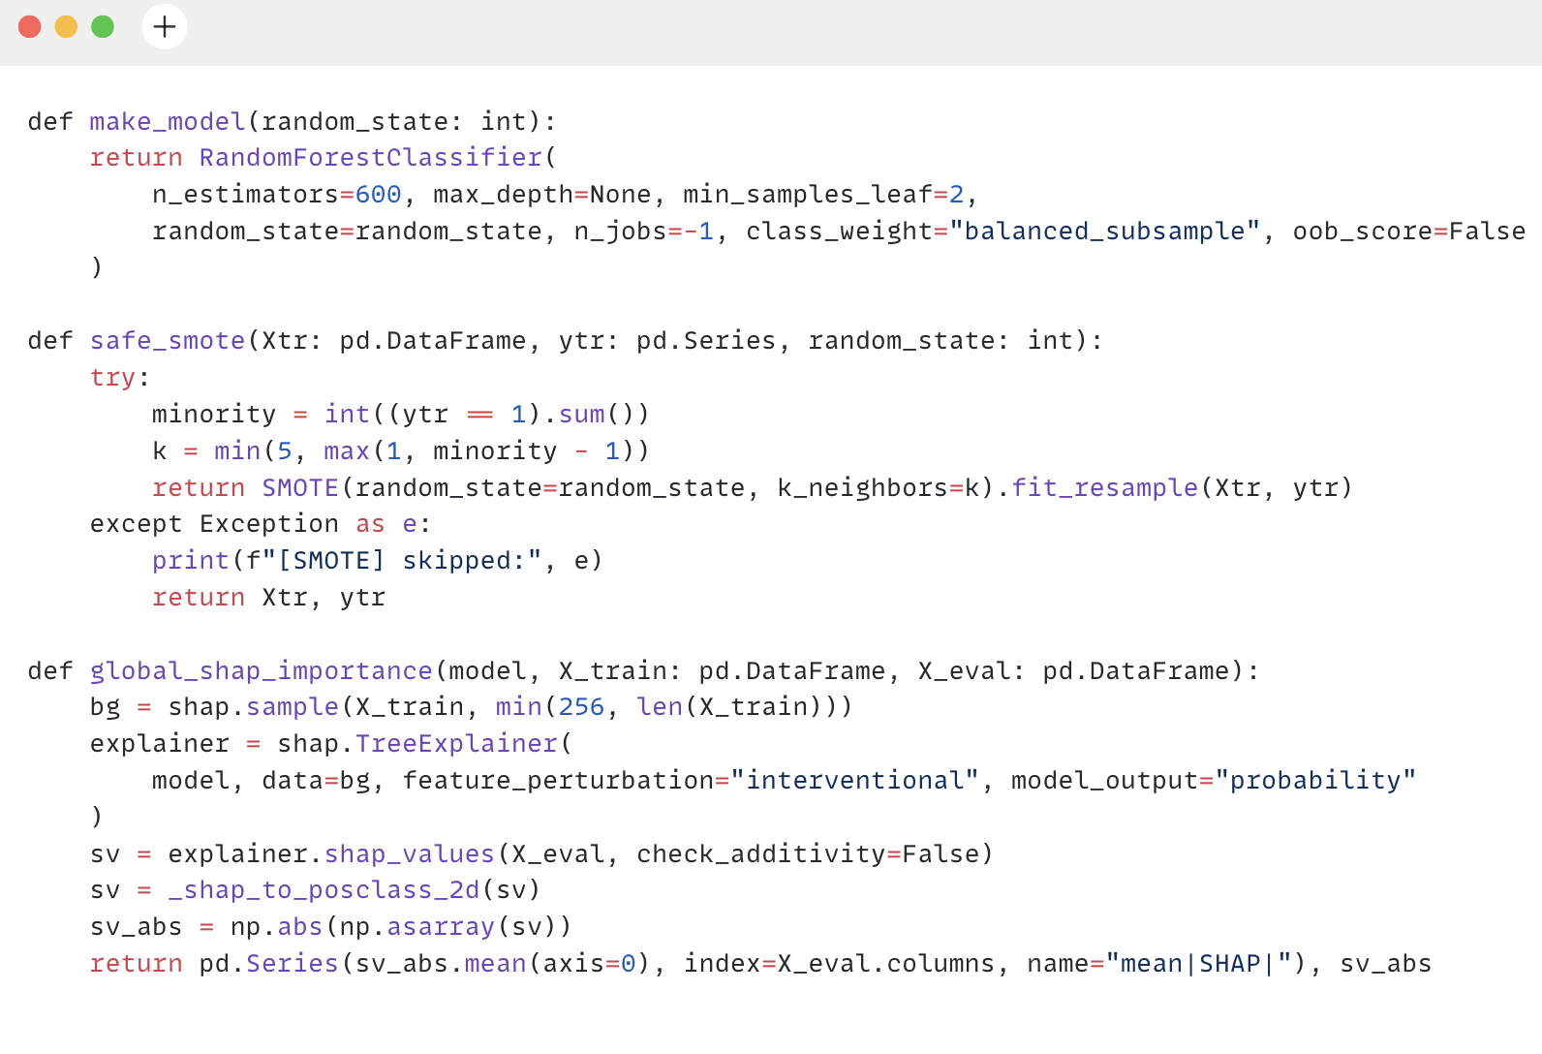
Implementation:
Class Imbalance: SMOTE
Model - Random Forest Classifier
SHAP - TreeExplainer

Slide 17
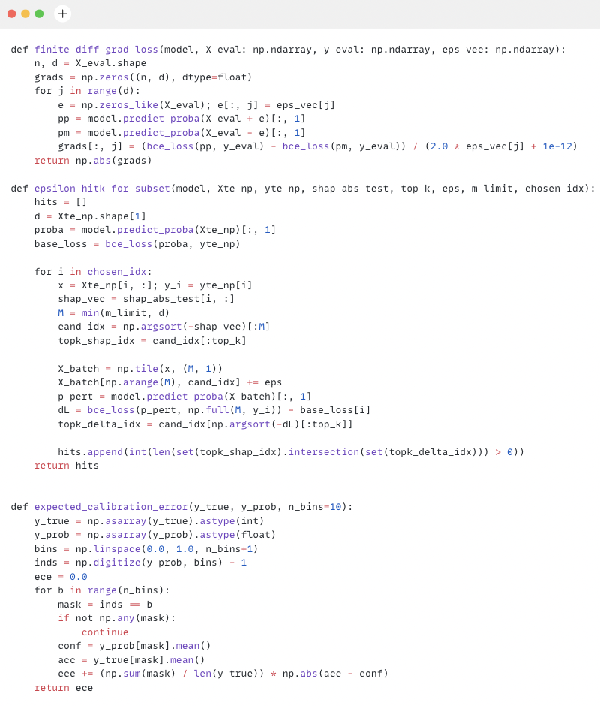
Implementation:
GLR (Gradient-of-Loss Reliability)
ε-Perturbation Hit@k
Calibration (Expected Calibration Error)

Slide 18
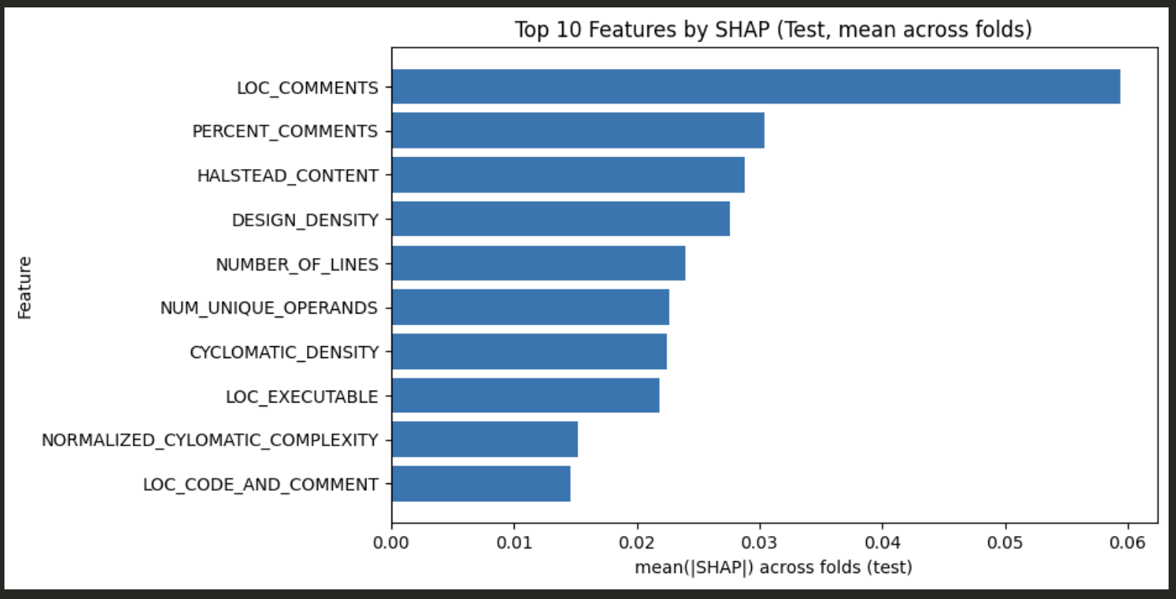
Results Overview
Figure: Top 10 most influential software metrics identified by SHAP for the CM1 dataset using the Random Forest model.

Slide 19
Results Overview
Current Approach (Generalized Framework)
Reliability Metrics: Generalizability, Concordance, Stability
Model | AUC | F1 | Precision | Recall | Generalizability | Concordance | Stability | Reliability Index
Adaboost | 0.83 | 0.32 | 0.26 | 0.58 | 1.00 | 0.67 | 0.63 | 0.88
CatBoost | 0.83 | 0.38 | 0.40 | 0.39 | 1.00 | 0.49 | 0.69 | 0.86
Extra Trees | 0.84 | 0.36 | 0.32 | 0.49 | 1.00 | 0.38 | 0.82 | 0.87
Gradient Boosting | 0.81 | 0.38 | 0.37 | 0.40 | 1.00 | 0.53 | 0.64 | 0.86
LightGBM | 0.84 | 0.40 | 0.44 | 0.38 | 1.00 | 0.54 | 0.71 | 0.88
MLP | 0.66 | 0.20 | 0.14 | 0.74 | 1.00 | 0.45 | 0.57 | 0.84
Random Forest | 0.85 | 0.37 | 0.36 | 0.41 | 1.00 | 0.43 | 0.77 | 0.87
XGBoost | 0.83 | 0.39 | 0.43 | 0.38 | 1.00 | 0.55 | 0.71 | 0.88
Overall Mean | 0.81 | 0.35 | 0.34 | 0.47 | 1.00 | 0.51 | 0.69 | 0.87
Table 5: Performance evaluation of existing approach using various models on software defect prediction datasets, showing mean values across metrics

Slide 20
Results Overview
Proposed Approach (GLR Framework)
Reliability Metrics: GLR Mean, Hit@10, ECE
Model | AUC | F1 | Precision | Recall | Brier | GLR | Hit@10 | ECE | Reliability Score
Adaboost | 0.77 | 0.37 | 0.33 | 0.50 | 0.09 | 0.18 | 1.00 | 0.08 | 0.84
CatBoost | 0.84 | 0.38 | 0.40 | 0.38 | 0.09 | 0.12 | 1.00 | 0.07 | 0.83
Extra Trees | 0.83 | 0.37 | 0.40 | 0.37 | 0.08 | 0.06 | 1.00 | 0.06 | 0.82
Gradient Boosting | 0.81 | 0.38 | 0.40 | 0.39 | 0.09 | 0.13 | 1.00 | 0.08 | 0.83
LightGBM | 0.83 | 0.39 | 0.45 | 0.37 | 0.09 | 0.21 | 1.00 | 0.09 | 0.84
MLP | 0.76 | 0.30 | 0.34 | 0.29 | 0.11 | 0.11 | 1.00 | 0.09 | 0.83
Random Forest | 0.85 | 0.37 | 0.39 | 0.37 | 0.08 | 0.06 | 1.00 | 0.06 | 0.82
XGBoost | 0.83 | 0.39 | 0.44 | 0.37 | 0.08 | 0.16 | 1.00 | 0.07 | 0.84
Overall Mean | 0.82 | 0.37 | 0.39 | 0.38 | 0.09 | 0.13 | 1.00 | 0.07 | 0.83
Table 5: Performance evaluation of proposed approach using various models on software defect prediction datasets, showing mean values across metrics

Slide 21
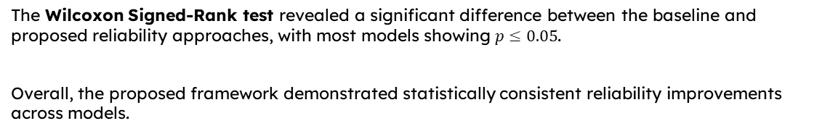
Results Overview
The Wilcoxon Signed-Rank test revealed a significant difference between the baseline and proposed reliability approaches, with most models showing $p≤0.05$.
Overall, the proposed framework demonstrated statistically consistent reliability improvements across models.
Model | W Statistic | p-value | Significance (p ≤ 0.05)
Adaboost | 12.00 | 0.04 | Significant
CatBoost | 10.00 | 0.05 | Significant
Extra Trees | 8.00 | 0.07 | Not Significant
Gradient Boosting | 9.00 | 0.05 | Marginal
LightGBM | 13.00 | 0.04 | Significant
MLP | 11.00 | 0.05 | Significant
Random Forest | 7.00 | 0.07 | Not Significant
XGBoost | 14.00 | 0.04 | Significant
Overall (Avg) | 10.50 | 0.05 | Significant Difference
Table 5: Wilcoxon Signed-Rank (WSR) Test Results Comparing Reliability Scores of Current and Proposed Approaches.

Slide 22
Percentage of Work Completed & Summary
Work Completed:
Implemented Current Approach (Generalizability, Concordance, Stability) and Proposed Approach (GLR, ε-Perturbation Hit@k, Calibration) using Random Forest.
Evaluated and compared both methods (Reliability Index vs Reliability Score) and documented results with visualizations (SHAP, reliability metrics).
Wilcoxon Signed-Rank Test confirmed a significant difference (p ≤ 0.05) between baseline and proposed approaches.

Slide 23
Next Steps
Planned Work:
Enhance the Proposed Approach significance for the remaining models.
Extend evaluation to cross-project datasets for generalization and robustness testing.

Slide 24
References:
Ketata, F., Al Masry, Z., Yacoub, S., & Zerhouni, N. "A Methodology for Reliability Analysis of Explainable Machine Learning: Application to Endocrinology Diseases." IEEE Access, 2024. DOI: 10.1109/ACCESS.2024.3431691
Begum, M., Shuvo, M. H., Nasir, M. K., Hossain, A., Hossain, M. J., Ashraf, I., Uddin, J., & Samad, M. A. "LCNN: Lightweight CNN Architecture for Software Defect Feature Identification Using Explainable AI." IEEE Access, 2024. DOI: 10.1109/ACCESS.2024.3388489
Lin, A., Fang, T., Yao, J., & Xu, B. "Understanding Software Defect Prediction Through eXplainable Neural Additive Models." arXiv preprint, arXiv:2306.08655, 2023.
Zhang, Y., Zhang, Y., Huang, Y., & Chen, G. "Software Defects Identification: Results Using Machine Learning and Explainable Artificial Intelligence Techniques." Journal of Systems and Software Engineering, 2024.
Yao, J., Lin, A., Chen, G., & Fang, T. "Towards Trustworthy Explainable AI for Software Defect Prediction." Proceedings of the IEEE International Conference on Software Engineering (ICSE), 2024.

Slide 25
Thank You

