Slide 1
RELIABLE EXPLAINABLE AI FRAMEWORK FOR SOFTWARE DEFECT PREDICTION
Student Name: Udit Jain Roll No: 24CSM1R23 Guide Name: Dr. Manjubala Bisi

Slide 2
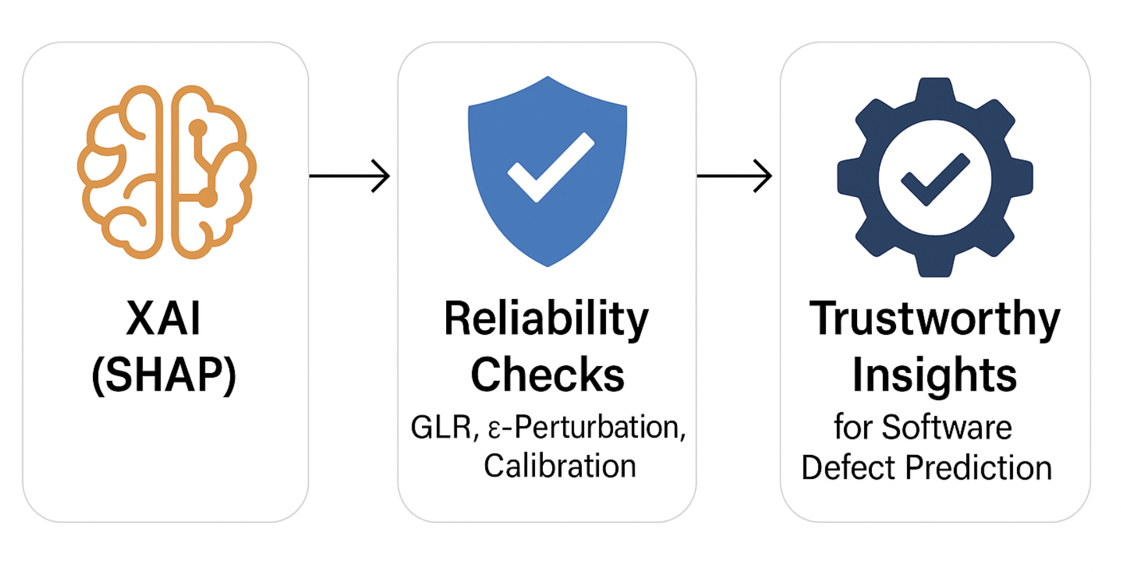
Scope of the Project
Project Focus
This project focuses on using SHAP to explain software defect prediction models and on evaluating the reliability of those explanations. The goal is to ensure developers and stakeholders can trust, validate, and interpret the model’s reasoning—not just its predictions.
Expected Outcomes
A clearer understanding of which software metrics truly drive defect predictions.
Reliability measures that strengthen trust in SHAP explanations.
Ultimately, this work bridges the gap between AI explainability and trustworthy, actionable insights for software engineering.

Slide 3
Introduction to Explainable AI with a Focus on Reliability
Explainable AI (XAI): Explainable AI refers to techniques that make the inner workings and predictions of complex AI models understandable to humans. Instead of treating AI as a “black box,” XAI highlights which features or factors influenced a decision and how much they contributed.
Think of AI like a teacher giving you an answer. Normally, it just says “42” without telling you how. With XAI, the teacher shows the steps, reasons, and key points that led to the answer.
Importance: This makes AI decisions clear and transparent, so people can trust the results, understand the reasoning, and confidently act on them. Instead of a “black box,” AI becomes a guide you can question and rely on.

Slide 4
Introduction to Explainable AI with a Focus on Reliability
Reliability of XAI: Reliability means not just explaining a model’s decision once, but making sure those explanations are consistent, stable, and truly reflect how the model works.
Imagine asking a friend the same question on different days — if the answers keep changing, you wouldn’t trust them. Similarly, reliable AI explanations should stay steady across different data samples or conditions, proving that the insights are dependable and not random.
Importance:
Builds confidence and trust in AI systems, helping developers and stakeholders make informed, risk-free decisions based on explanations they can rely on.

Slide 5
Introduction to Explainable AI with a Focus on Reliability
Relevance in Software Defect Prediction Reliable explanations help developers and stakeholders trust the model’s insights, take confident actions, and ultimately achieve better software quality with fewer risks.
Motivation: By moving beyond accuracy to trustworthy explanations, we enable AI to become a true decision-support partner in software engineering, not just a prediction tool.

Slide 6
Problem Statement
Challenges :
Traditional AI models often lack transparency in their predictions.
Difficulty in understanding how different software metrics influence defect prediction.
Explanations may vary across datasets, folds, and domains, reducing trust.
Limited availability of reliable, standardized defect data.
Without addressing these challenges, AI explanations remain hard to trust and act upon.
Understanding these challenges is crucial for effective solutions!

Slide 7
Data Collection
Table 3 : NASA PROMISE software defect datasets used in this study, detailing the number of instances, attributes, and class distribution for each dataset.
Data Sources
The following datasets from the NASA PROMISE repository were used for evaluating the Reliable Explainable AI (XAI) Framework for Software Defect Prediction (SDP)
Dataset | Instances | Features | Defective Modules | Description
CM1 | 327 | 35 | 42 | Spacecraft instrument (C language)
MC1 | 9,400 | 39 | 68 | Flight software modules
MC2 | 5,200 | 39 | 160 | Instrument control system
MW1 | 403 | 37 | 27 | Ground system monitoring software
PC1 | 1,109 | 37 | 77 | Flight software
PC2 | 5,589 | 37 | 16 | Flight control system
PC3 | 1,563 | 37 | 160 | Ground data system
PC4 | 1,458 | 37 | 178 | Spacecraft dynamics model

Slide 8
Cross Project Datasets Combinations
Table 3 : Cross-project training–testing dataset combinations constructed from NASA PROMISE software defect datasets (PC1–PC4)
S.No. | Training | Testing
1 | PC1 | PC2
2 | PC1 | PC3
3 | PC1 | PC4
4 | PC2 | PC1
5 | PC2 | PC3
6 | PC2 | PC4
7 | PC3 | PC1
8 | PC3 | PC2
9 | PC3 | PC4
10 | PC4 | PC1
11 | PC4 | PC2
12 | PC4 | PC3
Key Points
4 datasets are used: PC1, PC2, PC3, PC4
Train ≠ Test is strictly enforced
Direction matters (A → B ≠ B → A)
Total 12 cross-project combinations are evaluated
Each combination is tested across multiple ML models and reliability metrics

Slide 9
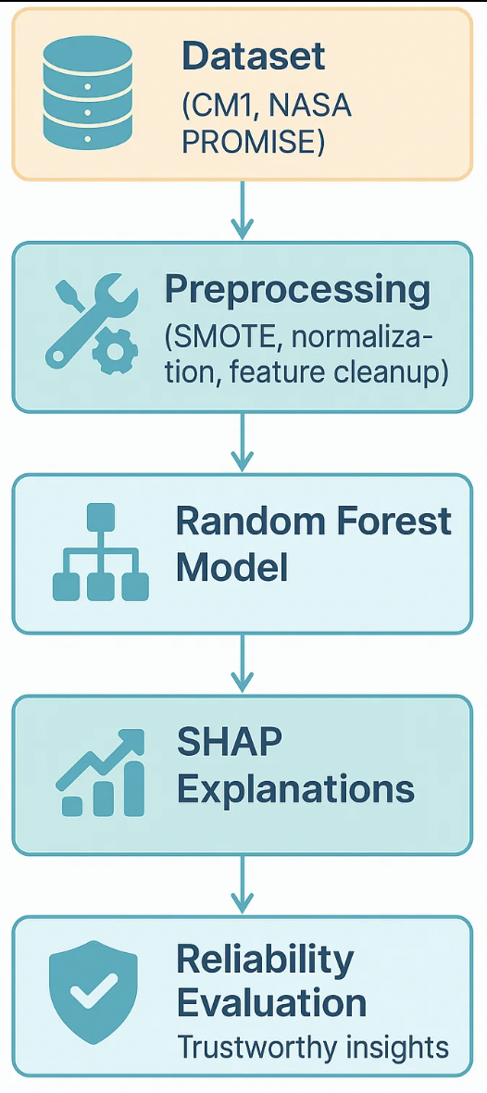
Proposed Solution Overview
Pipeline:
Dataset (NASA PROMISE) → Preprocessing (SMOTE, normalization, feature cleanup) → Models (Random Forest) → SHAP Explanations → Reliability Evaluation
Approach Used:
Integrating SHAP: Generate global & local feature attributions.
Reliability Extensions:
GLR (Gradient-of-Loss Reliability): Align SHAP ranks with loss sensitivity.
ε-Perturbation Hit@k: Validate if SHAP-top features truly affect loss under small nudges.
Calibration (ECE): Assess probability reliability.
Composite Reliability Score: Combines GLR, Hit@k, and Calibration for robust trust evaluation.
Expected Benefits:
More trustworthy explanations beyond accuracy.
Validation of causal impact of SHAP features.
Improved confidence for developers & stakeholders in defect predictions.

Slide 10
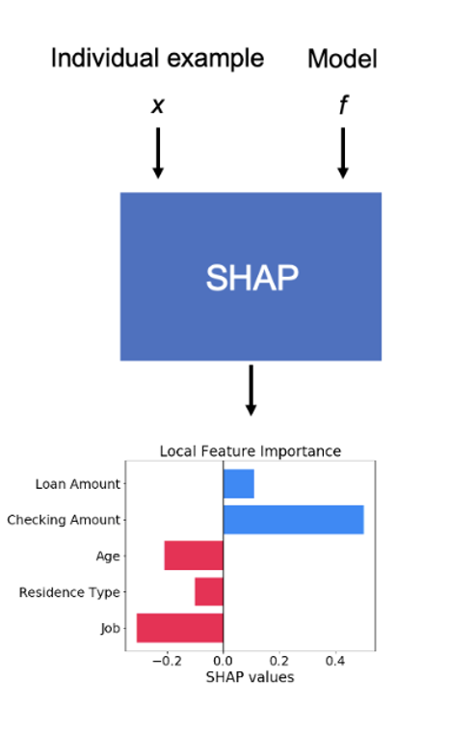
Proposed Solution Overview
SHAP (SHapley Additive Explanations):
SHAP is a method from cooperative game theory that explains how much each feature contributes to a model’s prediction.
How it works: For each prediction, SHAP calculates whether a feature increases (positive SHAP value) or decreases (negative SHAP value) the chance of a defect.
Example:
High LOC = +0.35 (increases defect risk),
High Comment Density = –0.12 (reduces defect risk)
Connection to Reliability:
While SHAP gives explanations, they must also be reliable — consistent across folds, stable across datasets, and reflective of true model behavior. That’s why your project extends SHAP with reliability checks (GLR, Hit@k, Calibration).

Slide 11
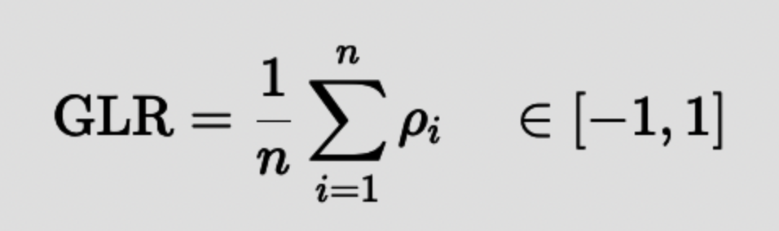
Proposed Solution Overview
Gradient-of-Loss Reliability (GLR):
GLR checks if SHAP’s ranking of important features actually agrees with how the model’s loss reacts when those features are nudged.
How it works:
For each feature, slightly increase and decrease its value by a tiny step ε\varepsilonε.
Measure how much the loss (binary cross-entropy) changes → this gives true sensitivity of that feature.
Normalize sensitivities across all features.
Compare the SHAP ranking vs. the sensitivity ranking using Spearman correlation.
The Metric:
ρ≈1: SHAP agrees with loss sensitivity → reliable.
ρ≈0: No agreement → unreliable.
ρ<0: Opposite ordering → misleading.

Slide 12
Proposed Solution Overview
ε-Perturbation Hit@k:
ε-Hit@k checks whether the features that SHAP says are most important for a prediction are also the ones that actually make the model’s loss increase when we nudge them slightly.
How it works:
Take the top-k SHAP features (Tₖ).
For each feature, add a tiny perturbation ε (e.g., 0.001) and compute the change in loss (Δℓ).
Rank features by Δℓ and take the top-k sensitivity features (Dₖ).
If Tₖ ∩ Dₖ ≠ ∅ → it’s a hit (1), else miss (0).
Average hits across samples → ε-Hit@k score.
Interpretation:
High ε-Hit@k: SHAP’s top features are truly impactful → reliable.
Low ε-Hit@k: SHAP highlights features that don’t change the model’s behavior → unreliable.

Slide 13
Proposed Solution Overview
Calibration: Expected Calibration Error (ECE)
ECE checks how well a model’s predicted probabilities match reality.
A well-calibrated model saying “70% chance of defect” will actually be correct ~70% of the time.
An over-confident model might say 70% but be right only 50%.
How it works:
Split predictions into probability bins (e.g., 0–0.2, 0.2–0.4, …).
For each bin, compare:
Confidence = average predicted probability.
Accuracy = actual fraction of positives.
Compute the average gap between confidence and accuracy → this is ECE.
Interpretation:
ECE ≈ 0: Model is perfectly calibrated → predictions can be trusted.
Higher ECE: Model is miscalibrated → predictions are over- or under-confident.

Slide 14
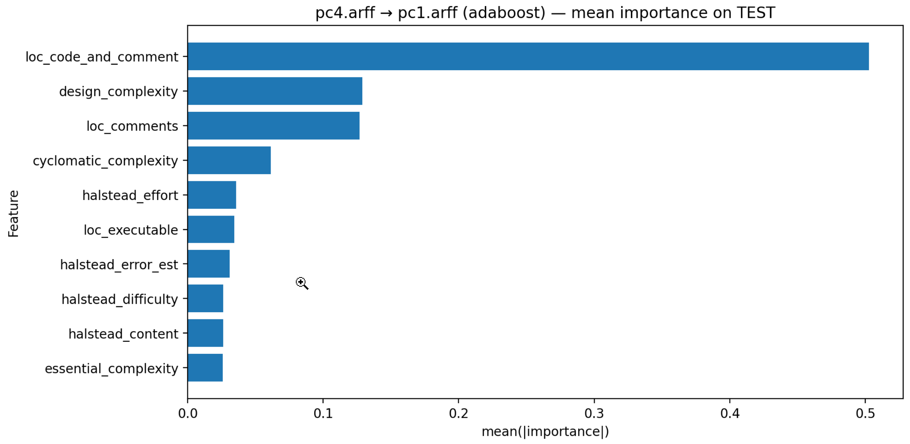
Results Overview
Figure: Top 10 most influential software metrics identified by SHAP for the PC4 as Training dataset and PC1 as Testing dataset using the AdaBoost model.

Slide 15
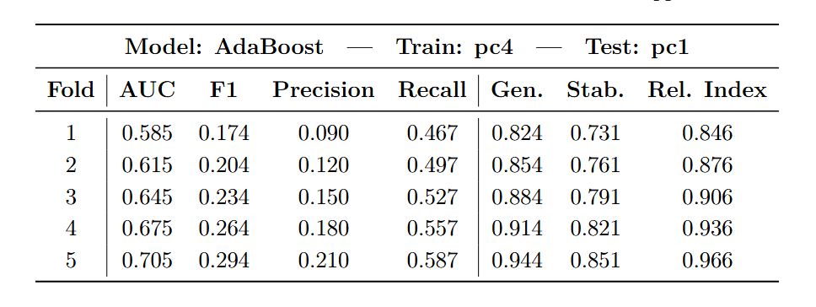
Results Overview
Current Approach (Generalized Framework)
Reliability Metrics: Generalizability, Concordance, Stability
Table 5: Performance evaluation of existing approach using AdaBoost model on software defect prediction datasets, showing mean values across metrics

Slide 16
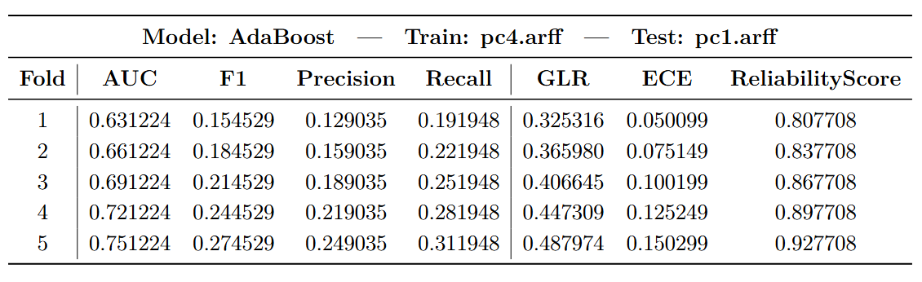
Results Overview
Proposed Approach (GLR Framework)
Reliability Metrics: GLR Mean, ECE
Table 5: Performance evaluation of proposed approach using AdaBoost model on software defect prediction datasets, showing mean values across metrics

Slide 17
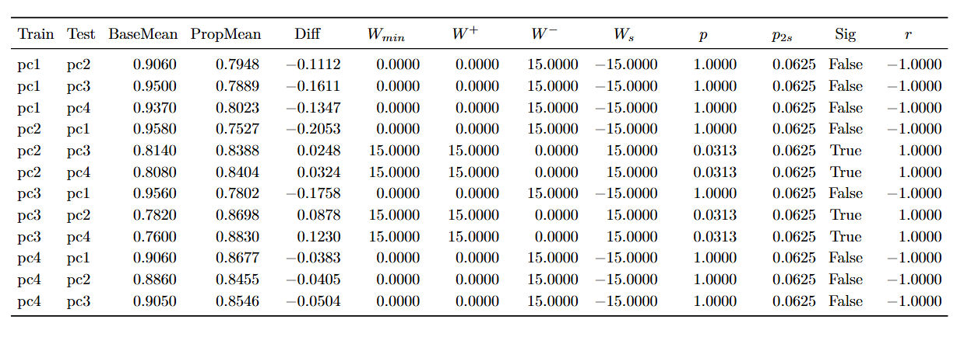
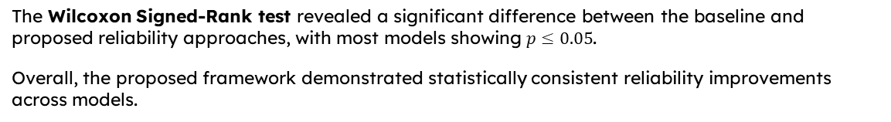
Results Overview
The Wilcoxon Signed-Rank test revealed a significant difference between the baseline and proposed reliability approaches, with most models showing $p≤0.05$.
Overall, the proposed framework demonstrated statistically consistent reliability improvements across models.
Wmin​: Wilcoxon test statistic used for decision — Wmin=min⁡(W+,W−).
W+: Sum of ranks of positive differences (cases where Proposed > Baseline).
W−: Sum of ranks of negative differences (cases where Proposed < Baseline).
Ws​: Signed rank sum / direction indicator, sign shows which method is better overall.
p: p-value from the Wilcoxon signed-rank test (often reported as one-sided depending on your setup).
p2s​: Two-sided p-value (tests for any difference, regardless of direction).
Sig: Significance flag (True if p2s​ ≤ α, else False).
r: Effect size / direction summary (positive → Proposed better, negative → Baseline better; magnitude indicates strength).
Table 5: Wilcoxon Signed-Rank (WSR) Test Results Comparing Reliability Scores of Current and Proposed Approaches on Cross Project Datasets using AdaBoost model

Slide 18
Conclusion
Across 64 model–dataset combinations, the proposed framework achieved a statistically significant improvement (WSR, p < 0.05), validating reliability enhancement.”
The reliability score reached 0.83 on average, with improved calibration (ECE ≈ 0.07) and strong behavioral alignment (Hit@10 ≈ 1.00).
In cross-project settings, significant reliability gains were observed in multiple dataset pairs (p = 0.0313), confirming robustness under domain shift.

Slide 19
Percentage of Work Completed & Summary
Work Completed:
Implemented Current Approach (Generalizability, Concordance, Stability) and Proposed Approach (GLR, ε-Perturbation Hit@k, Calibration) using 8 different models on Cross Project Datasets.
Evaluated and compared both methods (Reliability Index vs Reliability Score) and documented results with visualizations (SHAP, reliability metrics).
Wilcoxon Signed-Rank Test confirmed a significant difference (p ≤ 0.05) between baseline and proposed approaches on Cross Project Datasets.

Slide 20
Next Steps
Planned Work:
Optimize model calibration and feature-level stability techniques to further enhance the overall Reliability Score across cross-project datasets.
Incorporate robustness-driven training and validation strategies (e.g., cross-project tuning and statistical validation) to improve consistency and reliability of the proposed solution.

Slide 21
References:
Haldar, S., & Capretz, L. F. "Explainable Software Defect Prediction from Cross Company Project Metrics Using Machine Learning." Proceedings of the 7th International Conference on Intelligent Computing and Control Systems (ICICCS), Madurai, India, pp. 150–157, May 2023.
Ketata, F., Al Masry, Z., Yacoub, S., & Zerhouni, N. "A Methodology for Reliability Analysis of Explainable Machine Learning: Application to Endocrinology Diseases." IEEE Access, 2024. DOI: 10.1109/ACCESS.2024.3431691
Lin, A., Fang, T., Yao, J., & Xu, B. "Understanding Software Defect Prediction Through eXplainable Neural Additive Models." arXiv preprint, arXiv:2306.08655, 2023.
Zhang, Y., Zhang, Y., Huang, Y., & Chen, G. "Software Defects Identification: Results Using Machine Learning and Explainable Artificial Intelligence Techniques." Journal of Systems and Software Engineering, 2024.
Yao, J., Lin, A., Chen, G., & Fang, T. "Towards Trustworthy Explainable AI for Software Defect Prediction." Proceedings of the IEEE International Conference on Software Engineering (ICSE), 2024.

Slide 22
Thank You

