Slide 1
From Explainability to Reliability
Enhancing AI for Software Defect Prediction
Student Name: Udit Jain
Roll No: 24CSM1R23
Guide Name: Dr. Manjubala Bisi

Slide 2
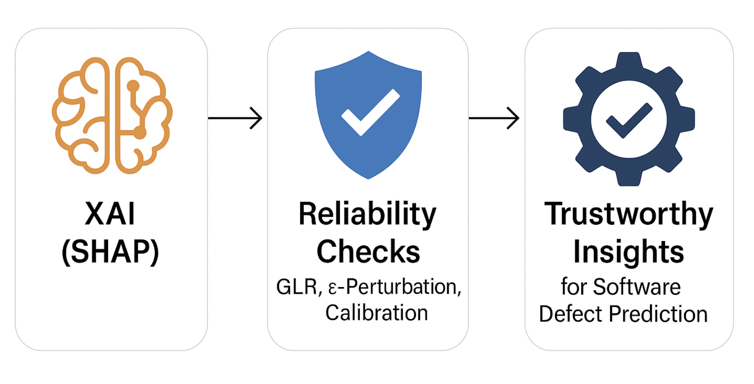
Scope of the Project
Project Focus
This project focuses on using SHAP to explain software defect prediction models and on evaluating the reliability of those explanations.
The goal is to ensure developers and stakeholders can trust, validate, and interpret the model’s reasoning—not just its predictions.
Expected Outcomes
A clearer understanding of which software metrics truly drive defect predictions.
Reliability measures that strengthen trust in SHAP explanations.
Ultimately, this work bridges the gap between AI explainability and trustworthy, actionable insights for software engineering.

Slide 3
Introduction to Explainable AI with a Focus on Reliability
Explainable AI (XAI): Makes AI decisions understandable to humans, building clarity.
Importance: Enhances trust and transparency in model outputs.
Reliability: Goes beyond explanation, ensuring insights are consistent, stable, and truly reflective of model behavior.
Relevance in Software Defect Prediction: Reliable explanations empower developers and stakeholders to act with confidence, leading to better software quality and reduced risks.

Slide 4
Problem Statement
Challenges :
Traditional AI models often lack transparency in their predictions.
Difficulty in understanding how different software metrics influence defect prediction.
Explanations may vary across datasets, folds, and domains, reducing trust.
Limited availability of reliable, standardized defect data.
Without addressing these challenges, AI explanations remain hard to trust and act upon.
Understanding these challenges is crucial for effective solutions!

Slide 5
Literature Survey
Most prior work prioritizes accuracy or raw interpretability, while reliability is rarely stress-tested; existing reliability implementations are largely domain-specific, with a single generalized k-fold SHAP/LIME framework.
Traditional approaches under-specify core explainability dimensions: explanations vary with train/test splits (hurting generalization), can disagree with model attributions (low concordance), and may lack stability
Title of the Paper | Published In | Significance | Limitation
LCNN: Lightweight CNN for Software Defect Feature Identification Using Explainable AI | IEEE Access 2024 | Used SHAP and LIME to interpret CNN-based predictions, highlighting reproducibility of explanations in deep models | No systematic reliability assessment (e.g., stability, concordance); limited to visualization of explanations
A Methodology for Reliability Analysis of Explainable AI: Application to Endocrinology Diseases | IEEE Access 2024 | Introduced a generalized framework with Generalizability, Concordance, Stability as reliability metrics for SHAP/LIME | Domain-specific evaluation (healthcare); ignores local sensitivity/perturbation reliability
Understanding Software Defect Prediction Through eXplainable Neural Additive Models (XNAMs) | IEEE Access 2025 | Designed inherently interpretable models, reducing reliance on post-hoc explanations for consistency | Focused on interpretability, not reliability; no cross-fold stability or perturbation analysis

Slide 6
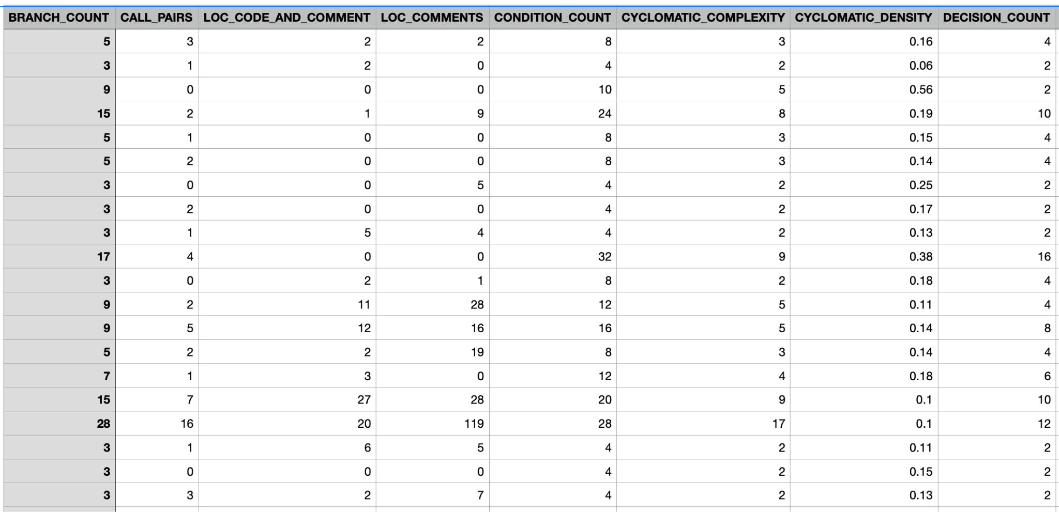
Data Collection and Methodology
Data Sources
Methodology
CM1 (NASA PROMISE Repository) — widely used in Software Defect Prediction.
Attributes: software metrics (e.g., LOC, McCabe complexity, Halstead metrics, OO measures).
Target: Defective (1) / Non-Defective (0) modules.
Highly imbalanced dataset → addressed using SMOTE for synthetic oversampling.
We preprocess the CM1 dataset with SMOTE, train a Random Forest, explain predictions using SHAP, and evaluate reliability through Generalizability, Concordance, Stability, and our proposed GLR, ε-Perturbation, and Calibration metrics
Dataset

Slide 7
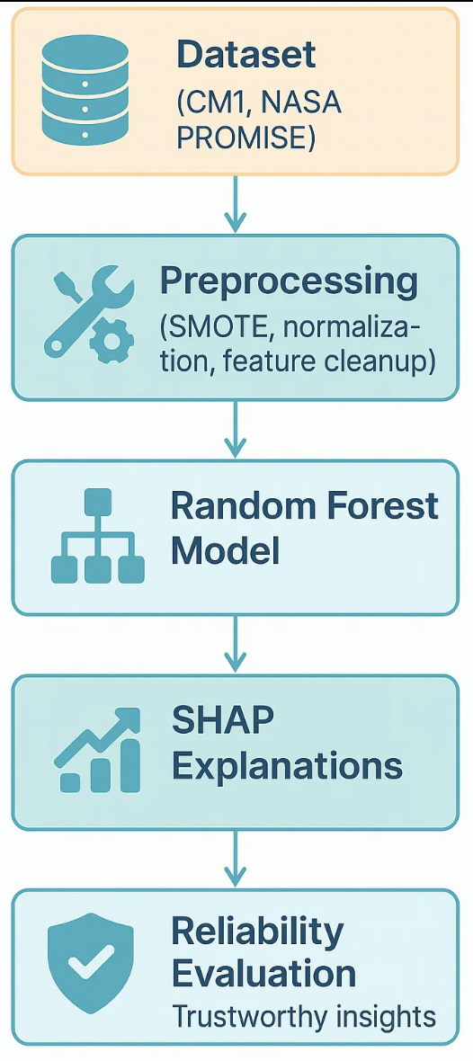
Proposed Solution Overview
Pipeline:
Dataset (CM1, NASA PROMISE) → Preprocessing (SMOTE, normalization, feature cleanup) → Random Forest Model → SHAP Explanations → Reliability Evaluation
Approach Used:
Integrating SHAP: Generate global & local feature attributions.
Reliability Extensions:
  GLR (Gradient-of-Loss Reliability): Align SHAP ranks with loss sensitivity.
  ε-Perturbation Hit@k: Validate if SHAP-top features truly affect loss under small nudges.
  Calibration (ECE & Brier Score): Assess probability reliability.
Composite Reliability Score: Combines GLR, Hit@k, and Calibration for robust trust evaluation.
Expected Benefits:
More trustworthy explanations beyond accuracy.
Validation of causal impact of SHAP features.
Improved confidence for developers & stakeholders in defect predictions.

Slide 8
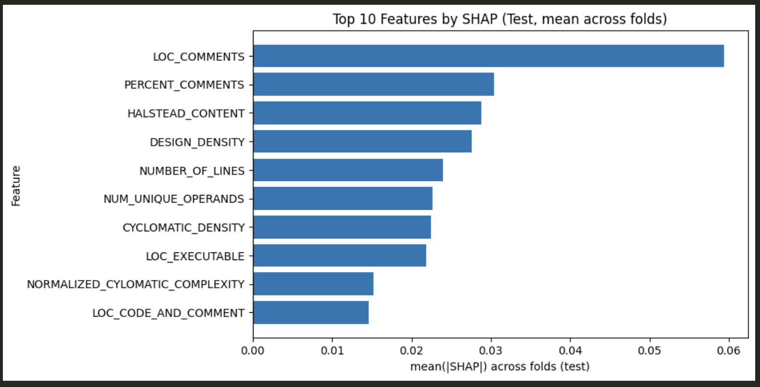
Results Overview
Current Approach (Generalized Framework)
Reliability Metrics:
  Generalizability: 0.9866
  Concordance: 0.9154
  Stability: 0.7788
  Reliability Score: 0.9468
Key Takeaway: Explanations are highly generalizable and concordant, with moderate stability across folds.
Proposed Approach (GLR Framework)
Reliability Metrics:
  GLR_mean: 0.0864
  Hit@10: 1.0 (SHAP-top features always validated by perturbation test)
  ECE: 0.1098 (lower error, better calibration)
  Reliability Score: 0.8111
Key Takeaway: Explanations are not only reproducible but also causally validated (Hit@k = 1.0) and probability-calibrated, providing stronger trust in model outputs.

Slide 9
Thank You

