Slide 1


TICKBOOK-
MOVIE TICKET BOOKING SYSTEM
Presented by :-
UDIT NARAYAN CHOUDHURY
SANDEEP KUMAR SINGH
NITISH SAMAL

Slide 2
Table of contents
Introduction
Methodology
Tech Stack
Use Case Scenario
References
Conclusion

Slide 3
INTRODUCTION
Online movie ticket booking is becoming a trend.
TickBook aims to make booking easy and user-friendly.
Built as a static model for demonstration.

Slide 4
Methodology
Planning and design of layout
Creating web pages using HTML and CSS
Linking pages for navigation
Preparing for future interactivity using JavaScript

Slide 5
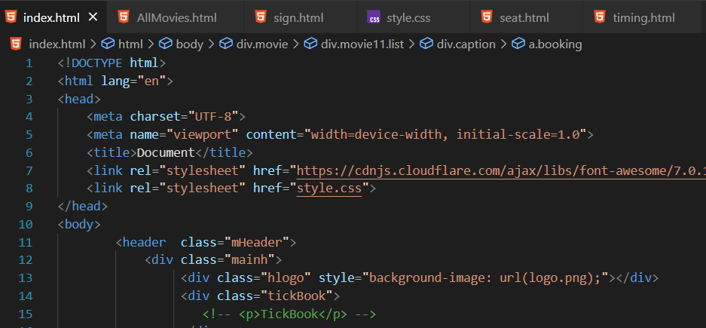
Tech stack
Planning and design of layout
Creating web pages using HTML and CSS
Linking pages for navigation
Preparing for future interactivity using JavaScript

Slide 6
Use case scenario
User visits homepage
Browses available movies
Selects movie → chooses timing → selects seats
Proceeds to login or signup page
Booking confirmed (in future with JS backend)

Slide 7
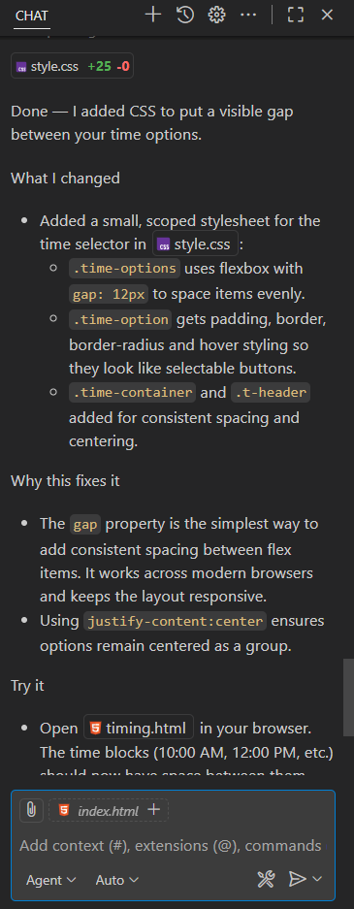
reference
YouTube tutorials
GitHub Copilot AI
Friends and classmates for ideas and support

Slide 8
conclusion
Basic structure and design completed
Ready for next phase with JavaScript
Scope to expand into a dynamic system

Slide 9
THANK YOU…

