Slide 1
Fitness Buddy – Ai companion
AICTE IBM CLOUD PROJECT
Presented By: UDIT NARAYAN BAIRI
Student name : UDIT NARAYAN BAIRI
College Name: MCKV INSTITUTE OF ENGINEERING
Department: COMPUTER SCIENCE AND ENGINEERING (DATA SCIENCE)

Slide 2
OUTLINE
Problem Statement
Technology used
Wow factor
End users
Result
Conclusion
Git-hub Link
Future scope
IBM Certifications

Slide 3
Problem Statement
In today’s fast-paced and digitally driven world, individuals often struggle to maintain a healthy lifestyle due to a lack of personalized fitness guidance, limited time, inconsistent motivation, and the high costs associated with traditional fitness programs or consultations. Existing solutions are often rigid, expensive, or fail to adapt to an individual's unique preferences, goals, and daily routines.
There is a pressing need for an intelligent, accessible, and user-friendly virtual assistant that can provide on-demand fitness advice, motivational support, and basic nutritional guidance—personalized for each user and available anytime, anywhere.
Fitness Buddy aims to address this challenge by developing an AI-powered conversational health and fitness assistant that:
Recommends personalized home workouts.
Provides motivational tips and daily inspiration.
Suggests simple, healthy meal ideas.
Encourages habit-building and consistent fitness practices.
This solution will leverage IBM Cloud Lite services or IBM Granity to ensure scalability, AI integration, and ease of deployment.

Slide 4
Technology used
IBM cloud lite services
Natural Language Processing (NLP)
Retrieval Augmented Generation (RAG)
Prompt-based AI technology for conversational flows
IBM Granite model

Slide 5
IBM cloud services used
IBM Cloud Watsonx AI Studio
IBM Cloud Watsonx AI runtime
IBM Cloud Agent Lab
IBM Granite foundation model

Slide 6
Wow factors
Fully implemented on the IBM Cloud Lite free tier with no upgrades required
Simple to build and deploy without complex data storage
Provides friendly, accurate fitness, meal planning, and motivation advice
Customizable prompt-based conversational flow
Easily integrated as a web chat widget for immediate user access

Slide 7
End users
Fitness enthusiasts and beginners
Students and working professionals looking for quick fitness guidance
Health coaches seeking a supplementary assistant
Anyone wanting motivational support for a healthy lifestyle

Slide 8
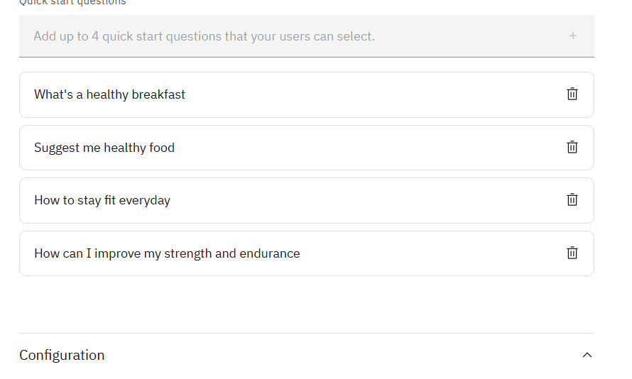
Results

Slide 9
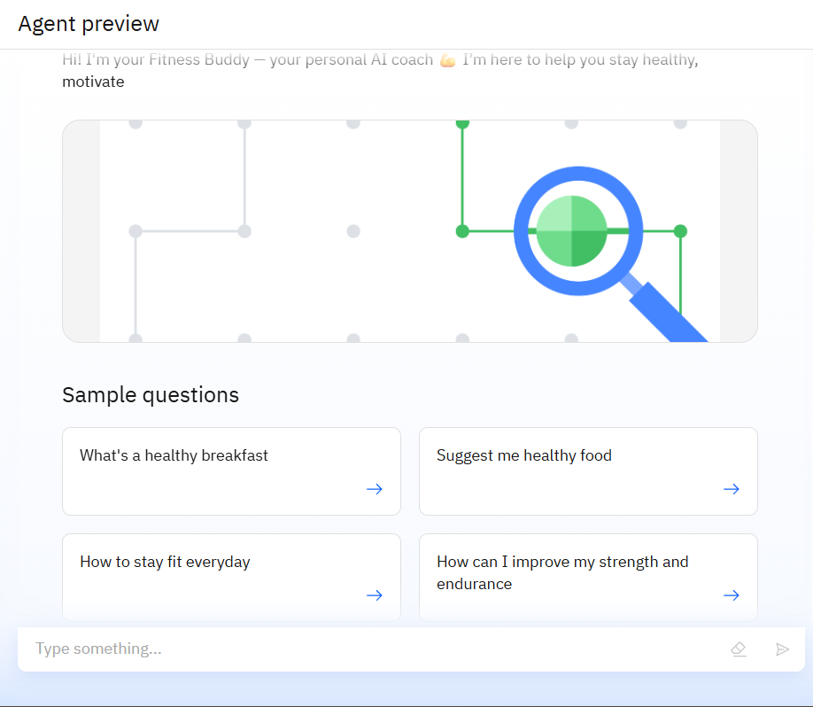
Results

Slide 10
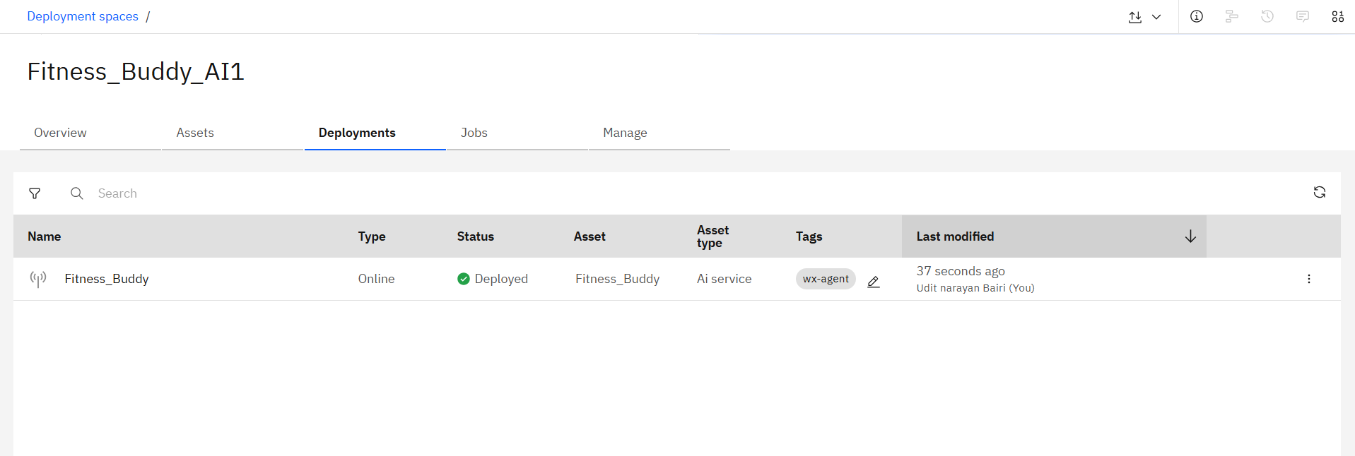
Results

Slide 11
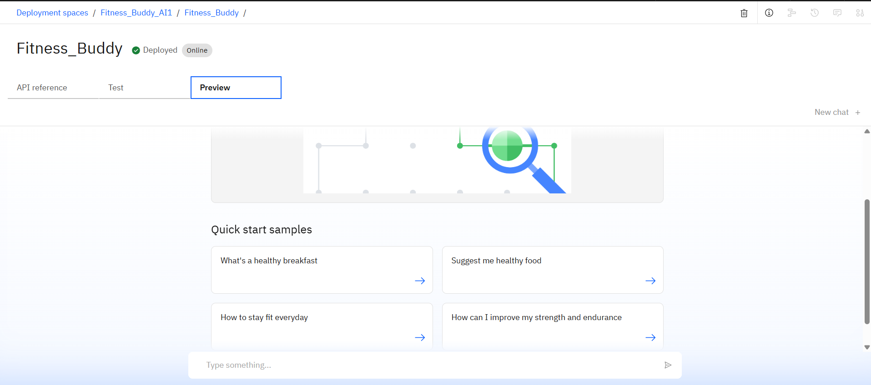
Results

Slide 12
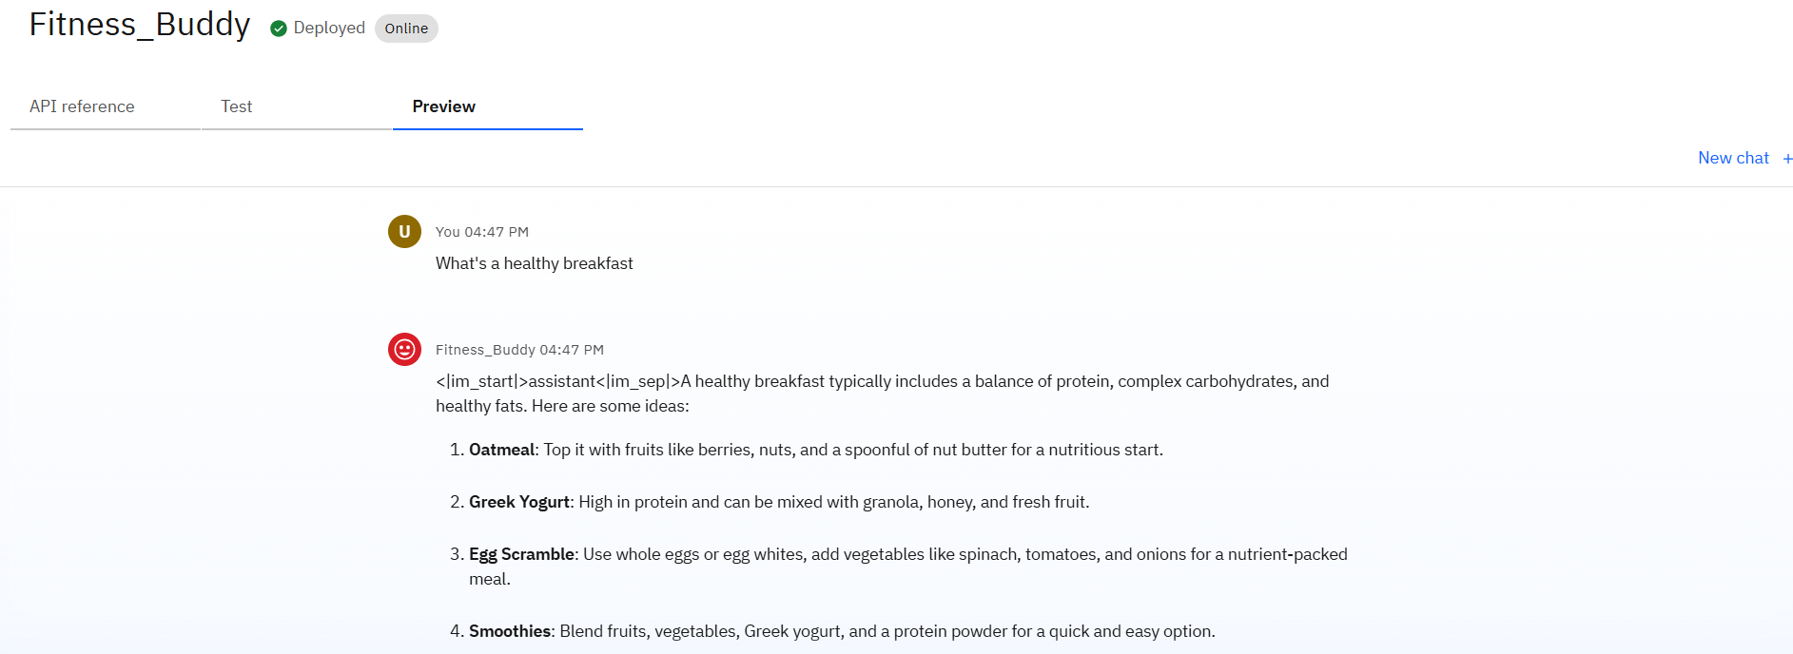
Results

Slide 13
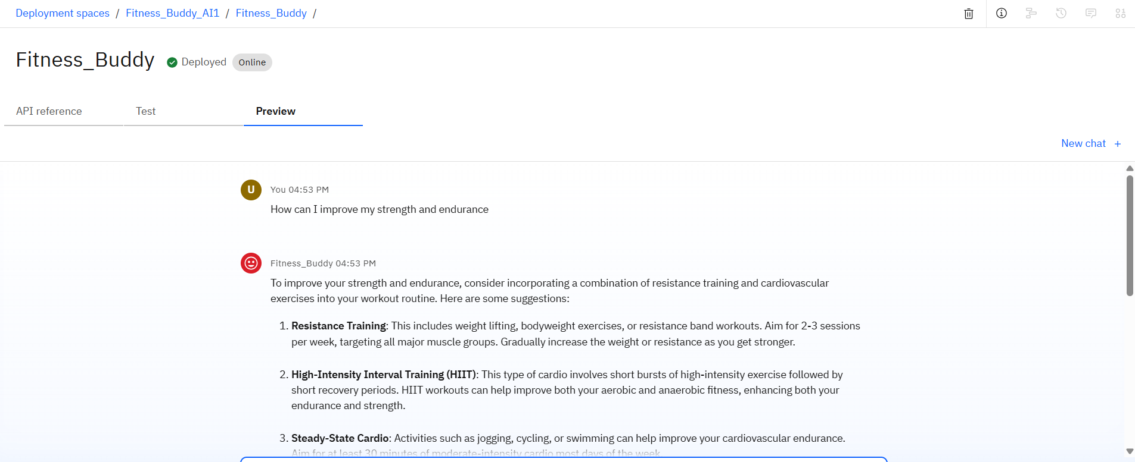
Results

Slide 14
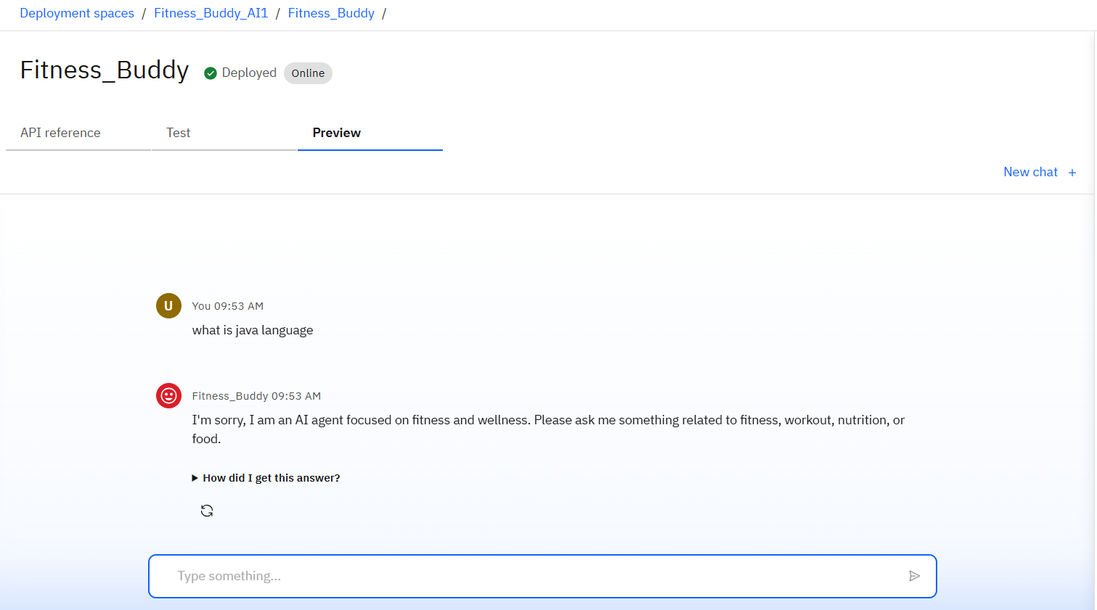
Results

Slide 15
Conclusion
Fitness Buddy offers a smart, accessible, and cost-effective solution to modern fitness challenges by leveraging AI and IBM Cloud technologies. It empowers users to stay healthy with personalized workout recommendations, motivational support, and simple meal ideas—anytime, anywhere. By combining conversational AI (Watson Assistant), cloud functions, and data storage, Fitness Buddy ensures a seamless, interactive, and scalable experience that promotes long-term wellness and habit-building without the need for expensive subscriptions or rigid schedules.

Slide 16
GitHub Link
https://github.com/uditnarayan1234/Fitness-Buddy-IBM-cloud-

Slide 17
Future scope
Extend with user profile tracking for personalized plans
Add voice interaction through IBM Watson Speech-to-Text and Text-to-Speech
Integrate with wearable fitness devices for real-time feedback
Expand to multi-language support for diverse users
Enhance with RAG-based knowledge retrieval for richer contextual advice

Slide 18
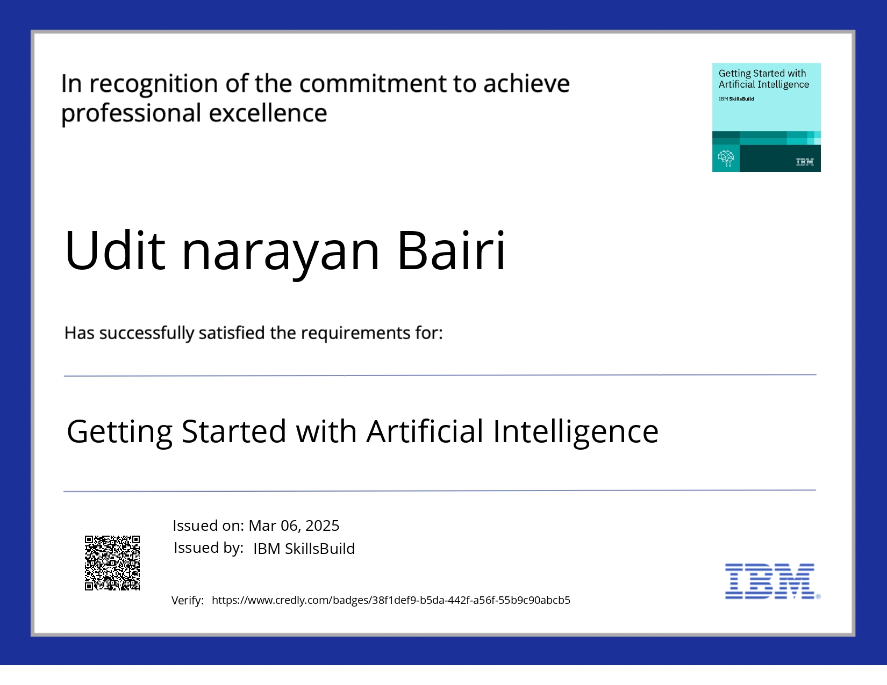
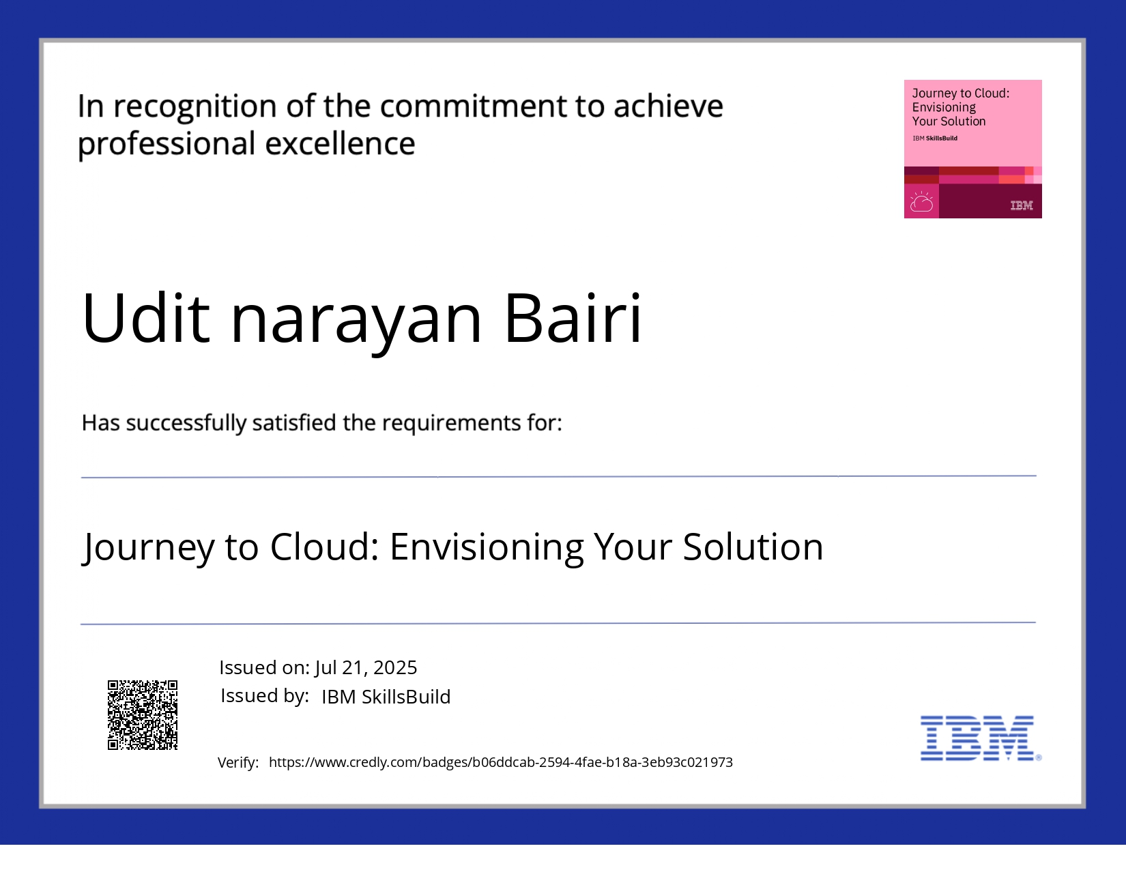
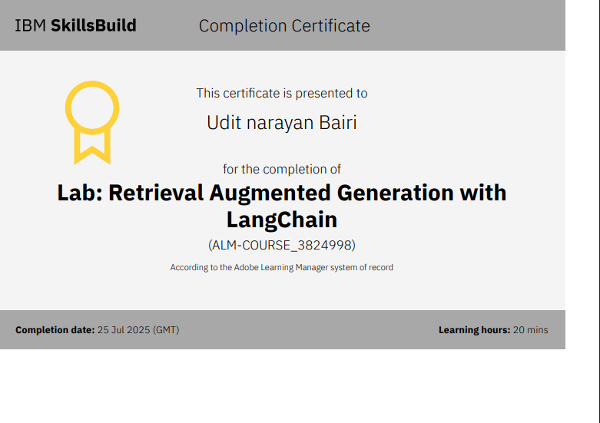
IBM Certifications

Slide 19
THANK YOU

