Slide 1


Slide 2
WHY METADATA LINEAGE MATTERS
Enterprise data lakes can store large volumes of data, but the context around those datasets is scattered.
Fragmented metadata
Relationship complexity
Lineage blindspot
Schemas, storage paths, topics, and pipeline context are hard to inspect in one place.
Traditional tables are awkward for dynamic relationships between datasets, processes, runs, and columns.
Without run-level evidence, it is difficult to prove when a schema changed and which run caused it.
1

Slide 3
THE TESTBED TURNS PIPELINE ACTIVITY INTO A QUERYABLE GRAPH
Project objective
Automatically extract dataset schemas from lakehouse files, model them as RDF knowledge graph entities, and use OpenLineage/Marquez to trace runs and schema changes.
Metadata extraction
Knowledge graph
Lineage evidence
Read Parquet files from MinIO and extract columns, data types, row counts, and null counts.
Map datasets, columns, storage systems, and metadata collections into RDF and load them into GraphDB.
Capture OpenLineage events in Marquez and export compact SchemaChange nodes into GraphDB.
2

Slide 4
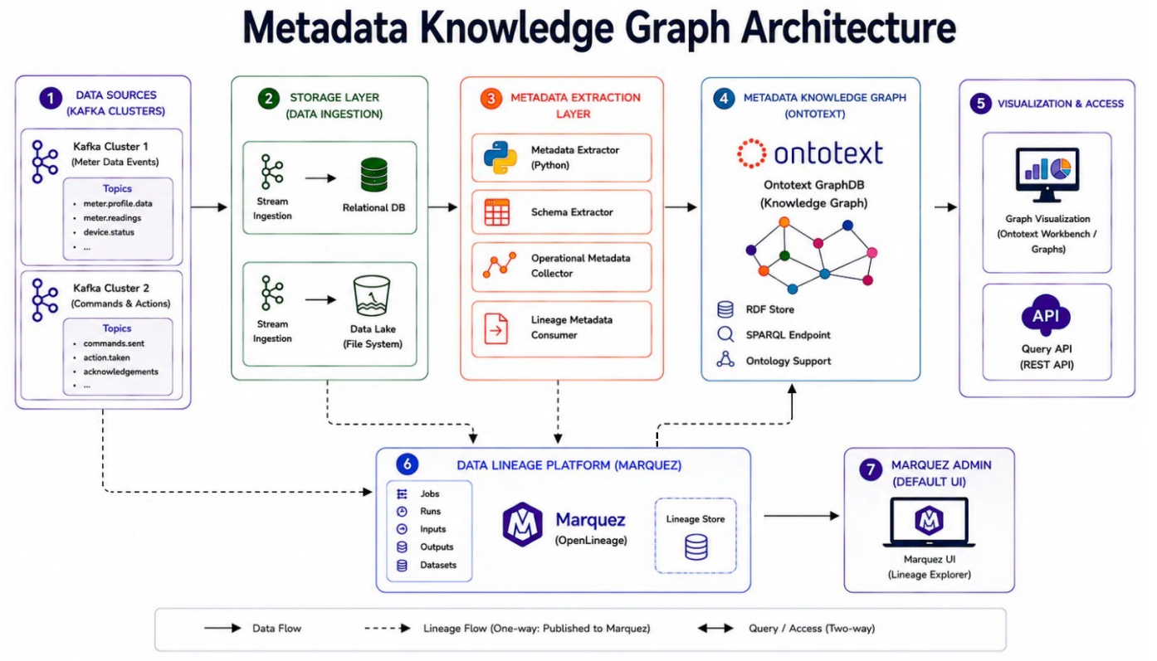
END-TO-END ARCHITECTURE
3

Slide 5
METADATA PROCESSING CREATES THE DATASET VIEW
1. Discover datasets
2. Extract schema
3. Generate RDF
List Parquet objects in MinIO for meter-data and command-response.
Read columns, data types, row counts, null counts, and storage paths.
Create RDF triples using the ontology and serialize dataset TTL files.
4. Load GraphDB
5. Query columns
Clear stale triples and reload the current metadata and lineage graph.
Use SPARQL to inspect datasets, columns, data types, and lineage changes.
4

Slide 6

LINEAGE TRACKING RECORDS THE RUN THAT CHANGED A SCHEMA
The consumer writes Parquet through the lakehouse writer. That writer emits an OpenLineage event with the output schema. Marquez stores the run history, and the lineage pipeline exports compact schema-change evidence to GraphDB.
GraphDB lineage nodes
DataCollectionRun
SchemaVersion
SchemaChange
addsColumn / removesColumn / changesColumn
5

Slide 7
DEMO PROVES SCHEMA-CHANGE LINEAGE WITH REAL CONSUMER OUTPUT
Baseline
Changed run
Evidence
Run the real Kafka consumers.
They write the original meter-data and command-response schemas.
Run demo.run_changed_schema.
It preserves the latest real rows and adds campus context columns.
Run main.py and query GraphDB.
The graph returns the run ID that added each column.
Added demo columns: run_location, department, building, demo_run_label, operator_group
6

Slide 8
GRAPHDB IDENTIFIES WHICH RUN ADDED EACH COLUMN
Process
Run
Added column
meter-data-pipeline
OpenLineage run ID
run_location
meter-data-pipeline
OpenLineage run ID
department
meter-data-pipeline
OpenLineage run ID
building
command-response-pipeline
OpenLineage run ID
operator_group
SPARQL pattern: SchemaChange -> observedInRun -> DataCollectionRun -> runId
7

Slide 9
NOW LET US MOVE ONTO THE DEMONSTRATION
We will run the real consumers, add controlled schema changes, reload GraphDB, and query the run that introduced each new column.
8

Slide 10
WHAT THE TESTBED DEMONSTRATES
The system turns raw pipeline activity into queryable metadata knowledge.
Datasets
Columns
Processes
Runs
What datasets exist and where they are stored.
What columns they contain and their data types.
Which jobs consume and create datasets.
Which run introduced a schema change.
Thank you
9

