Slide 1
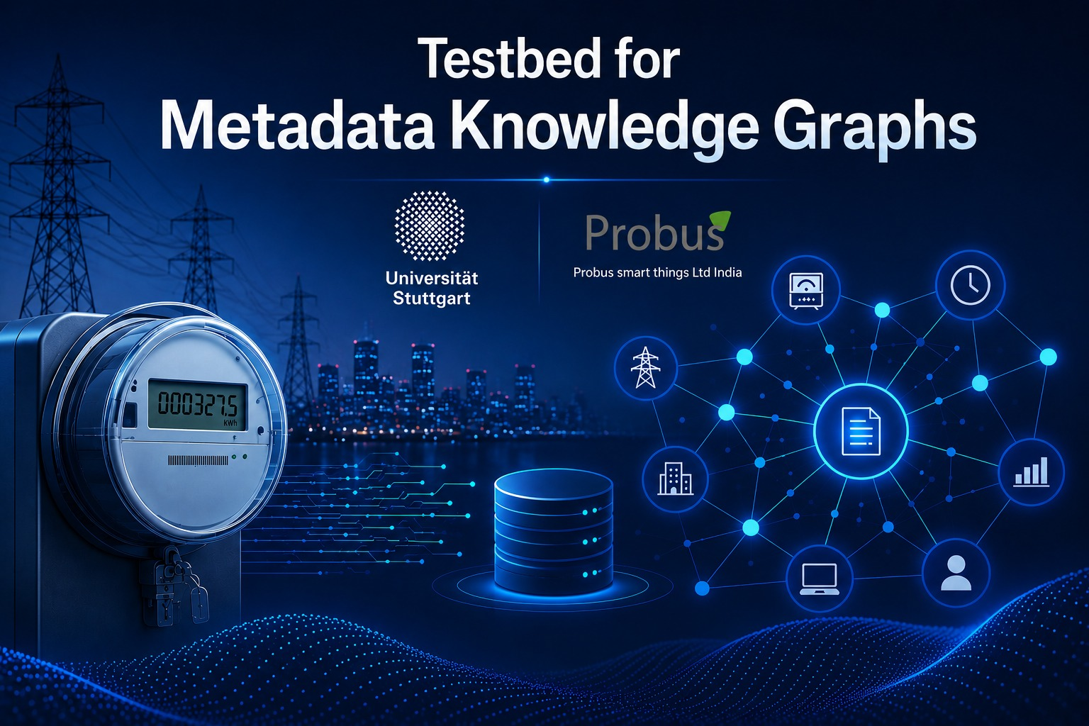
Testbed for Metadata
Knowledge Graphs
Udit Pande Pratyush Jha

Slide 2
Problem Statement
Lack of Centralization: Modern enterprise data lakes lack a unified central repository to handle large volumes of metadata.
Relational Scaling Bottlenecks: Traditional RDBMS struggle to scale and efficiently query complex, dynamic entity relationships.
The Data Lineage Blindspot: Without verifiable data history, manually tracking data across pipelines is impossible.
1

Slide 3
Project objective
Automatically extract structural metadata, build an interconnected Knowledge Graph, and track end-to-end lineage.
Main Goals
Automated Metadata Extraction: Auto-harvest processing layer metadata and schemas.
Knowledge Graph Architecture: Semantically map device, data product, and system relationships.
End-to-End Lineage Tracking: Track end-to-end data flow and transformations across all pipelines.
2

Slide 4
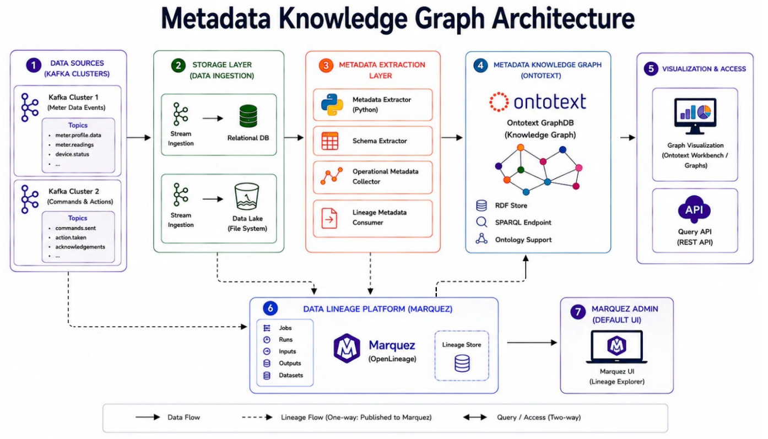
4

Slide 5
Metadata processing
Dataset Discovery in MinIO
Automated File Detection
Pipeline Registration Trigger
2. Schema & Metadata Extraction
Zero-Overhead Parsing
Target Attributes Scoped
Profile Consolidation
RFD generation via ontology
Semantic compiling
Ontological consolidation
GraphDB storage and integration
Repository ingestion
Semantic mapping execution
3

Slide 6

Lineage tracking
OpenLineage Event Capture Framework
Automated runtime auditing
Logical plan parsing
Run-level analytics
2. Tracked Structural Stages
Data Lakehouse ingestion
Metadata pipeline processing
Semantic knowledge loading
3. End-to-End Lineage & Split Routing
Lineage Hub
The visual workspace
The semantic workspace
3

Slide 7
Now let us move onto the demonstration
3

Slide 8
Thank You

