Slide 1
Assumptions:-
Entity → Attributes
Agent → Attributes: (Agent_Name, Agent_Contact Number, Primary Key : Agent_Id );
Property → Attributes: (Property_Name, Property_Type, Price, Status, Year, No_Bedroom, Address, Primary Key : Property_Id );
Buyer → Attributes: (Buyer_Name, Buyer_Contact_Number, Buyer_Address, Buyer_Email, Primary Key : Buyer_Id);
Owner → Attributes: (Owner_Id, Owner_Name, Owner_Email, Owner_Contact_Number, Owner_Address);
Relationship Cardinalities:-
Many to many from Agent to Property entity.
Many to one from Property to Buyer entity.
Many to one from Property to Owner entity.
E R Diagram

Slide 2
Agent_ Name
Agent_ Contact _Number
Property_Id
Property _Name
Property_Type
Agent _Id
Property_ Agent
No_Bedroom
Agent
Property
Address
Price
Buyer_Address
Property _Buyer
Property _Owner
Status
Year
Buyer_ Email
Buyer
Owner
Owner_Id
Buyer_ Name
Owner_ Address
Owner_ Name
Owner_
Contact _Number
Buyer_Contact _Number
Buyer_Id
Owner_ Email

Slide 3
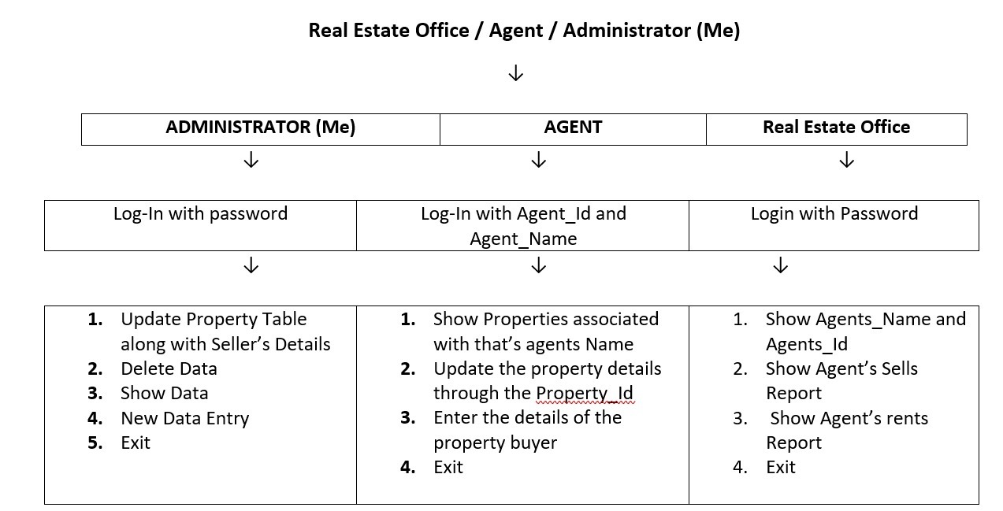
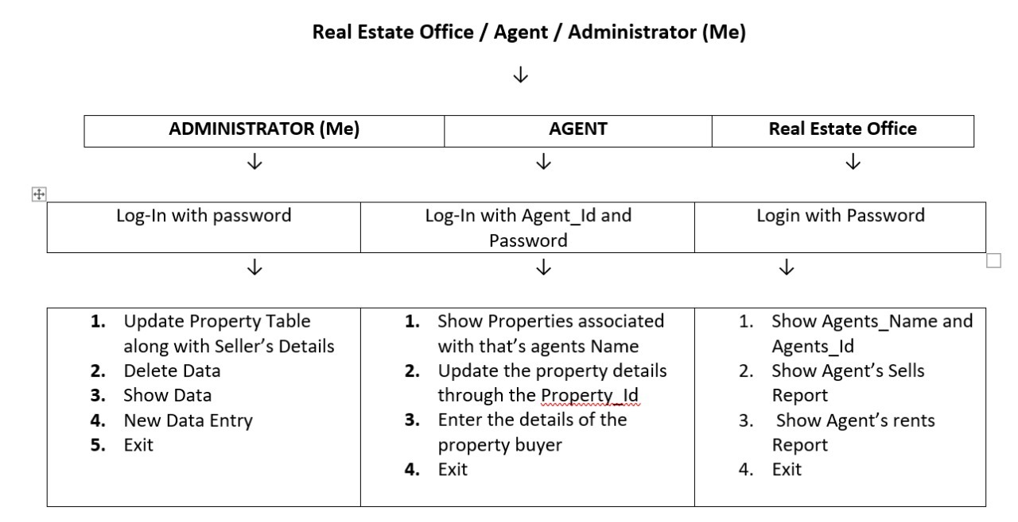
User Interfaces

Slide 4
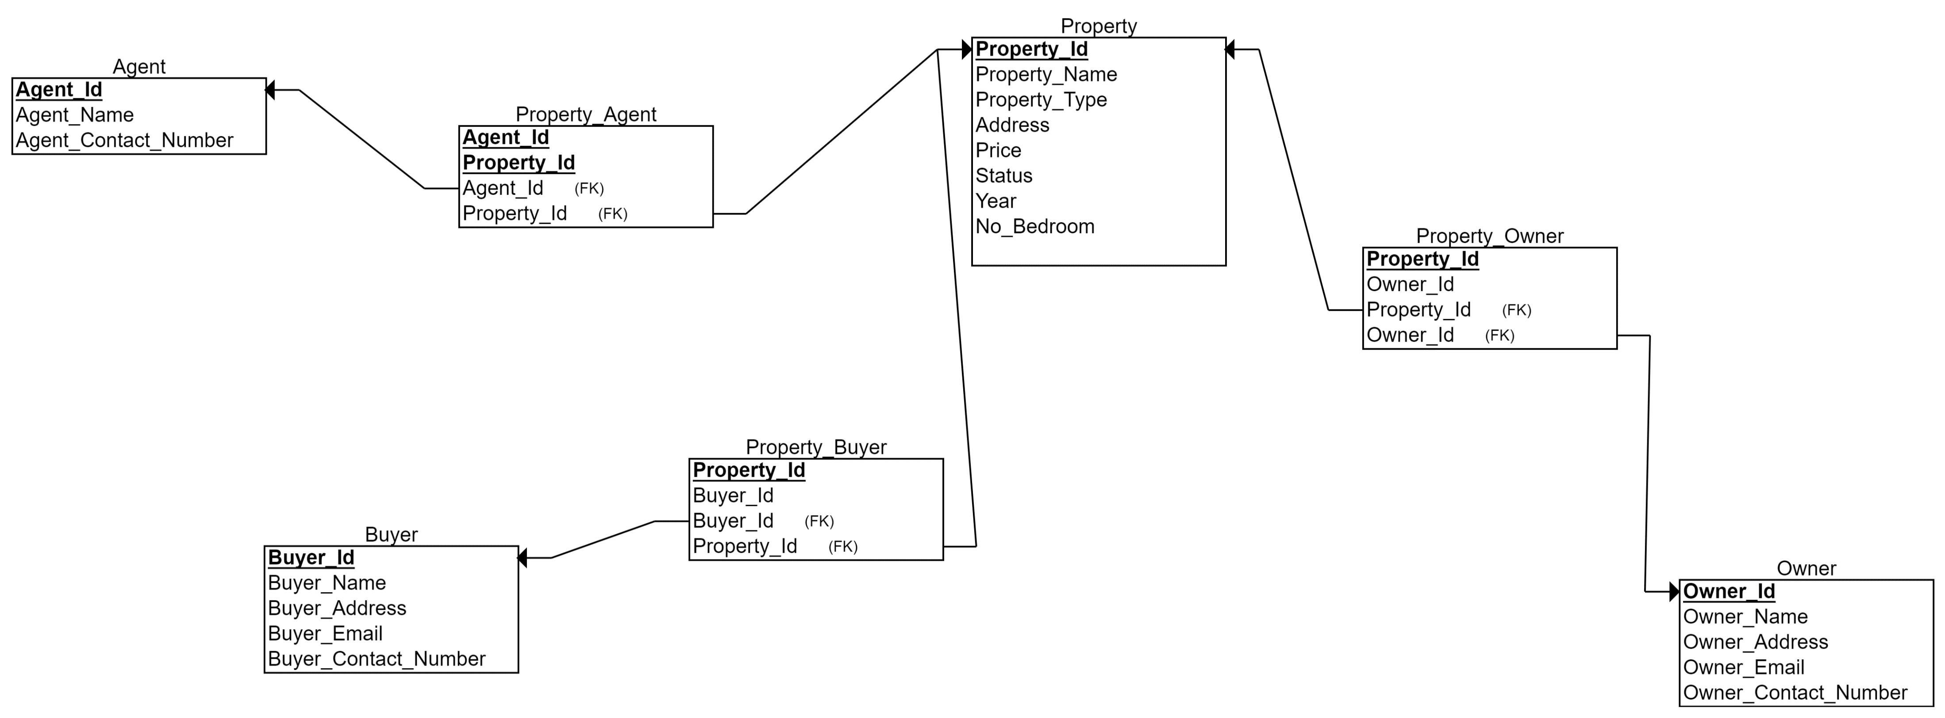
Relational Model of the Real Estate Agency

