Slide 1
Towards Data Sovereignty
MME TIME
Q-Hack 2026

Slide 2
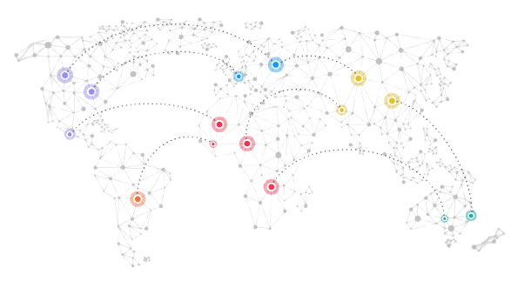
Is your data really yours?
Data sovereignty is increasing becoming an important aspect for European businesses & consumers, due to rapid AI growth and geopolitical changes

Slide 3

Meet DoxShield
A real-time data sovereignty monitor for European consumers and businesses*
*Beta version available locally
MME TIME
Q-Hack 2026

Slide 4
How it works
Computes sovereignty risk score by tracking
Processed by On-Device Mistral 7B
Providing a Comprehensive Data Sovereignty Report
Apps installed on device
Cookies stored on browser
Data flowing to foreign jurisdictions
Analyses EULA & Privacy Policy of Apps installed
Tracks transmission destination of cookies
Matches your foreign stored data with their data laws
Emails alerts when high risk exposures happen
Provides actionable insights like secure/EU based alternatives
Detailed organization wide report covering all your employees

Slide 5
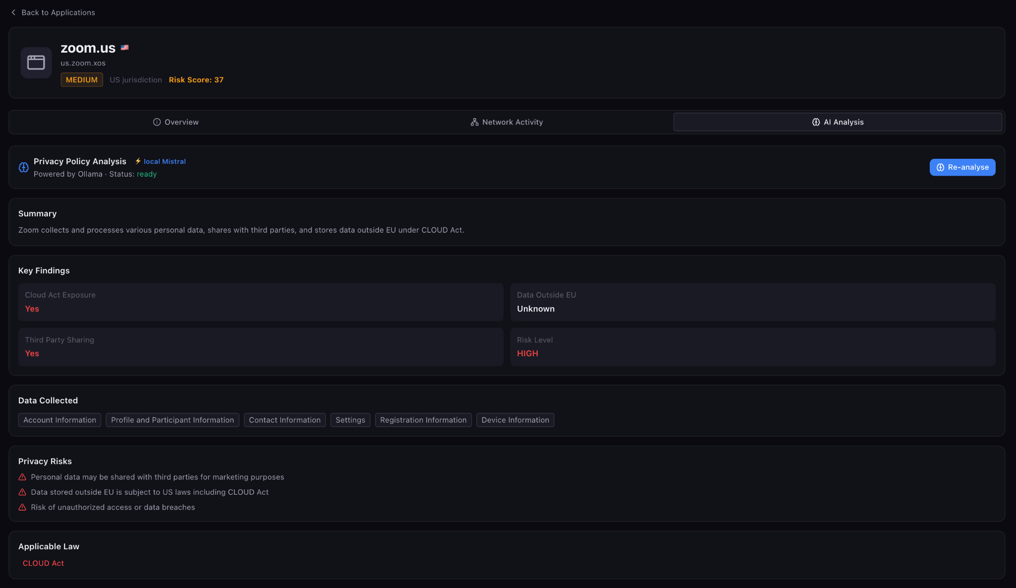
Why do you need DoxShield?
DoxShield is a locally run, secure way to track and address your your personal data sovereignty
Break down complex policies
Privacy policy & TnC breakdown powered by Mistral 7B
Locally installed your devices
Real time peace of mind
Real time exposure alerts
Data never leaves your device
Month Year

Slide 6
Why does your org need DoxShield?
DoxShield is a locally run, secure way to track and address your company’s data sovereignty
EU friendly tech stack
Seamless connects with your employees
Comprehensive org risk profile
Analysis by Mistral 7B
Locally installed on devices
Tracks and protects sensitive info
Data never leaves the device
Tracks key sovereignty metrics
Generates comprehensive reports

Slide 7
Monetization
Here’s how we plan to monetize the product
Consumer
One time 39€ purchase
Business
Free 14 day trial
19€ per seat (minimum 5)

Slide 8
Thank you
MME TIME

