Slide 1
Bayesian Optimization for Q-error Boundaries
Using BO as an online sampler to find where the optimizer mis-predicts — not to predict runtime
Objective: maximise q(P₁,P₂) = max(rt₁,rt₂)/min(rt₁,rt₂) over predicate values, fixed template + DB
3 representations · 5 kernels · 5 acquisitions (+3 baselines) = 78 methods · 10% budget · run on gt_results_sf1_10x10_s1q0 (5 queries × 3 sampling methods = 15 grids)
scripts/bo_interpolation.py + evaluate_bo_interpolation.py + bo_interpolation_summary.py

Slide 2
PROBLEM FRAMING
The goal is a sampler, not a runtime model
▸ We do not build a general runtime predictor.
▸ We use BO as an online intelligent sampler to efficiently discover high-q-error (boundary) regions.
▸ Quantity of interest is q-error, not runtime itself.
▸ Condition on everything except the predicate values:
· query template, DB instance, indexes, PG config, hardware — all fixed.
▸ So the black box reduces to q = f(predicate values) = f(grid point).
▸ Another DB / template = a new optimization problem (no cross-DB transfer).
online BO — never build the full grid first
initial random samples
│
▼ measure q → fit GP surrogate
▼ acquisition picks next point
▼ measure q → update GP
└────────── repeat (online) ─────────┘
the conditioned black box
q = f( predicate_values | template, DB,
indexes, pg_config, hardware )
Analogous to BO for hyper-parameter tuning: dataset & model fixed, only the knobs (here, predicate values) vary.
Bayesian Optimization · q-error boundary discovery · scripts/bo_interpolation.py
2

Slide 3
FOUNDATIONS · LABEL & INSTANCES
Instance = axis-neighbour pair; label = its q-error
symmetric ratio (bo_interpolation.symmetric_ratio)
▸ q ≈ 1 = neighbours run alike (smooth).
▸ q large = a runtime cliff between neighbours (e.g. a plan flip) — the boundary we want to find.
▸ The neighbour is deterministic once the grid is built — this enables representation B.
▸ Most of the 220 pairs are ≈1; only a handful are large. On this grid q ranges 1 → ~1500.
▸ Budget = 10% of P ⇒ measure only ~22 of 220 pairs.
q(a,b) = max(rtₐ, rt_b) / min(rtₐ, rt_b) ≥ 1
model in log-space: z = log q → q̂ = eᶻ ≥ 1
grid → directed axis-neighbour pairs (10×10 resolution)
points = N × N = 11 × 11 = 121
pairs / axis = (N−1) × N = 10 × 11 = 110
TOTAL pairs P = 2·(N−1)·N = 220
neighbour of (i,j): (i+1,j) [axis0] , (i,j+1) [axis1]
Bayesian Optimization · q-error boundary discovery · scripts/bo_interpolation.py
3

Slide 4
DESIGN · INPUT REPRESENTATION
Two representations of a BO input (A is the default)
 | input | feature X (2-D grid) | fdim | pros / cons
A · pair | (P₁, P₂) | [P₁ , P₂] | 4 | general, no neighbour assumption · higher-dim, redundant
B · point | P (+ det. neighbour) | [P₁] | 2 | lower-dim · H+V pairs share X=P (collision)
B-split · point/axis | P (one BO per axis) | [P₁] ×2 models | 2 | recovers axis info, NO extra feature · no collision
same target, different X
▸ Professor's hint: if the neighbour is deterministic, a function of P₁ alone (rep B) may suffice.
▸ All horizontal & vertical pairs are still evaluated — B only shrinks the feature, not the pair set.
▸ Test both; if similar, prefer the lower-dimensional rep B (easier GP fit).
both: label = q(P₁, P₂) (same 220 pairs)
differ only in the feature X the GP sees
Feature X is exactly the specified input — no axis one-hot. Rep B lets a point's H & V pairs share X = P; B-split fixes that with one BO per axis (still input = P).
Bayesian Optimization · q-error boundary discovery · scripts/bo_interpolation.py
4

Slide 5
SURROGATE
Gaussian-Process surrogate over log q
sklearn GaussianProcessRegressor (make_gp)
▸ The GP returns both a best guess μ and an uncertainty σ at every un-sampled pair.
▸ σ is exactly what lets an acquisition choose the next pair to measure.
▸ Everything is done in log-q space (ratios are multiplicative), then exp() back — so q̂ ≥ 1 always.
▸ kernel = C·k(r) + WhiteKernel — a signal scale, the shape below, and a learned noise floor.
fit on sampled (X, log q):
μ(X) = k*ᵀ (K + σ²I)⁻¹ y posterior mean
σ²(X) = k(X,X) − k*ᵀ(K+σ²I)⁻¹k* posterior var
k* = kernel from X to every sampled pair
hyper-params by MLE (sklearn L-BFGS), normalize_y
Bayesian Optimization · q-error boundary discovery · scripts/bo_interpolation.py
5

Slide 6
SURROGATE · KERNELS
Every kernel we sweep (k(r), r = ‖X − X'‖ z-scored)
kernel | k(r) | smoothness / behaviour
rbf (SE) | exp(−r²/2ℓ²) | ∞-differentiable — very smooth (can over-smooth cliffs)
matern12 (ν=½) | exp(−r/ℓ) | non-differentiable — rough, reacts fast to local jumps
matern32 (ν=3/2) | (1 + √3·r/ℓ)·exp(−√3·r/ℓ) | 1× differentiable
matern52 (ν=5/2) | (1 + √5·r/ℓ + 5r²/3ℓ²)·exp(−√5·r/ℓ) | 2× differentiable — curvature but finite at a cliff (best here)
rquad (RQ) | (1 + r²/2αℓ²)^(−α) | scale-mixture of RBFs (many length-scales at once)
Each kernel is wrapped as ConstantKernel(σ_f²)·k(r) + WhiteKernel(noise) and its (σ_f, ℓ, noise) fit by marginal-likelihood at every BO step.
Bayesian Optimization · q-error boundary discovery · scripts/bo_interpolation.py
6

Slide 7
SAMPLER · ACQUISITIONS
Every acquisition — the one line that changes
acquisition | score a(X) — pick argmax | intent
sigma | σ(X) | pure explore / reconstruct
ucb | μ + κ·σ (κ = 2) | balance — hunt the peak
ei | (μ−f⁺)·Φ(z) + σ·φ(z), z=(μ−f⁺)/σ | expected gain over best f⁺
pi | Φ(z), z=(μ−f⁺)/σ | probability of beating f⁺
ts (Thompson) | draw g ~ GP posterior; a = g(X) | randomised explore/exploit
Φ = normal CDF φ = normal PDF f⁺ = best log-q seen so far μ,σ = GP posterior (log-q)
▸ sigma / ts spread out → good for reconstruction (accurate surface everywhere).
▸ ucb / ei / pi chase high μ → good for boundary discovery (find & cover the cliffs).
Bayesian Optimization · q-error boundary discovery · scripts/bo_interpolation.py
7

Slide 8
SAMPLER · THE ONLINE LOOP
One loop, swap the acquisition; 10% budget
run_bo() — refit after every observation (online)
▸ Same 6-pair seed for every (rep × kernel × acq) → fair comparison.
▸ Baselines: random & uniform-stride sample once, then linear-interpolate.
▸ ground_truth measures all 220 — the reference.
seed ← 6 random distinct pairs (shared across all runs)
while |sampled| < BUDGET: # BUDGET = ⌈0.10·P⌉ = 22
fit GP(kernel) on sampled (X, log q)
μ, σ ← GP.predict(all 220 pairs)
score ← ACQUISITION(μ, σ) ◄ the ONE differing line
next ← argmax score (un-sampled)
measure q(next) ; add to sampled # 'measure' = read ground_truth
budget
MIN = max(5, 2·dim+2)=6 BUDGET = min(P, max(MIN, ⌈0.10·P⌉))
Grid: 78 methods = 3 baselines + 3 reps × 5 kernels × 5 acquisitions (75 BO), run on each of 15 grids.
Bayesian Optimization · q-error boundary discovery · scripts/bo_interpolation.py
8

Slide 9
SCORING
Two families of metric: accuracy vs discovery
A. interpolation accuracy (uses ŷ vs y on unseen)
▸ Accuracy = how good is the interpolated q-surface where we didn't sample.
▸ Discovery = did the sampler go to the right places?
– max_found = did we hit the single tallest cliff?
– coverage = did we catch many of the cliffs?
▸ These are independent: a method can hit the peak yet miss most of the boundary, or vice-versa.
▸ That independence is the whole story of the results →
pred q-error: Q = max( y/ŷ , ŷ/y ) ≥ 1
QERR_MEDIAN_UNSEEN = median Q over UN-sampled pairs
WITHIN_kX = % of pairs with Q ≤ k
B. boundary discovery (uses y_true of sampled only)
max_qerr_found = max( y_true over SAMPLED pairs )
max_found_pct = 100 · max_found / max_true
coverage_5x = 100 · #(sampled, y>5) / #(all, y>5)
(breadth: fraction of q>5 pairs actually sampled)
Bayesian Optimization · q-error boundary discovery · scripts/bo_interpolation.py
9

Slide 10
RESULTS · RANKING
Top methods on gt_results_sf1_10x10_s1q0 (mean over 15 grids)
method | rep | kernel | acq | med-unseen q ↓ | max found % ↑ | cover>5x % ↑
random | - | - | - | 1.172 | 48.17 | 12.86
uniform_stride | - | - | - | 1.274 | 39.09 | 13.56
bo_point_split_matern52_sigma | point_split | matern52 | sigma | 1.326 | 75.86 | 24.08
bo_point_split_matern12_sigma | point_split | matern12 | sigma | 1.334 | 83.71 | 25.86
bo_point_split_matern32_ts | point_split | matern32 | ts | 1.387 | 48.10 | 19.80
bo_point_split_matern12_pi | point_split | matern12 | pi | 1.448 | 68.64 | 44.22
bo_point_split_matern12_ei | point_split | matern12 | ei | 1.449 | 62.29 | 43.23
bo_point_split_matern12_ts | point_split | matern12 | ts | 1.475 | 52.67 | 20.92
bo_point_split_matern32_sigma | point_split | matern32 | sigma | 1.478 | 75.86 | 24.19
Baselines (grey) still win pure accuracy — BO with the sigma acquisition (matern32/52) is the first to tie them. Ranking by median-unseen q-error rewards reconstruction, not boundary-hunting.
Bayesian Optimization · q-error boundary discovery · scripts/bo_interpolation.py
10

Slide 11
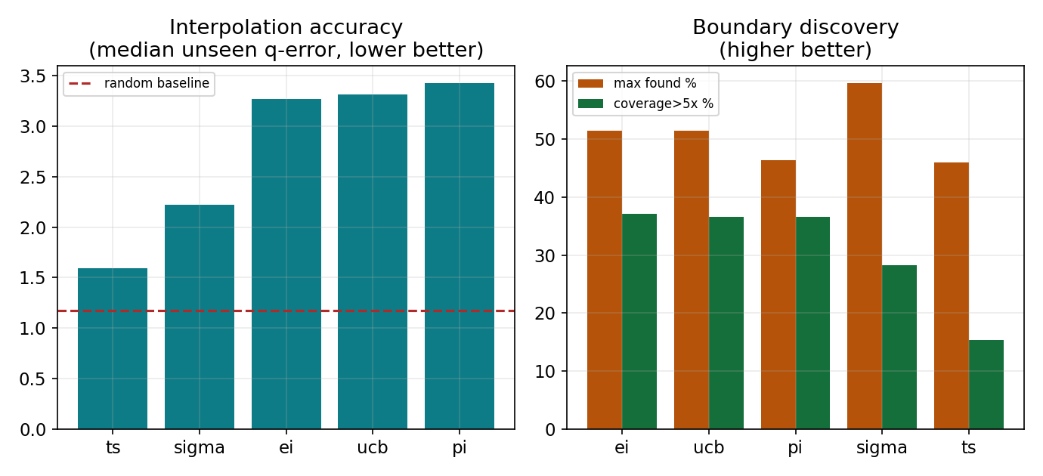
RESULTS · ACQUISITION
Acquisition drives the explore/exploit split
acq | med-q ↓ | found% ↑ | cov5% ↑
ts | 1.596 | 46.02 | 15.38
sigma | 2.219 | 59.64 | 28.25
ei | 3.270 | 51.45 | 37.17
ucb | 3.318 | 51.41 | 36.57
pi | 3.427 | 46.35 | 36.53
▸ sigma wins accuracy, low coverage.
▸ ucb/pi/ei ~2× the coverage of the boundary.
▸ Acquisition matters more than kernel or representation.
Bayesian Optimization · q-error boundary discovery · scripts/bo_interpolation.py
11

Slide 12
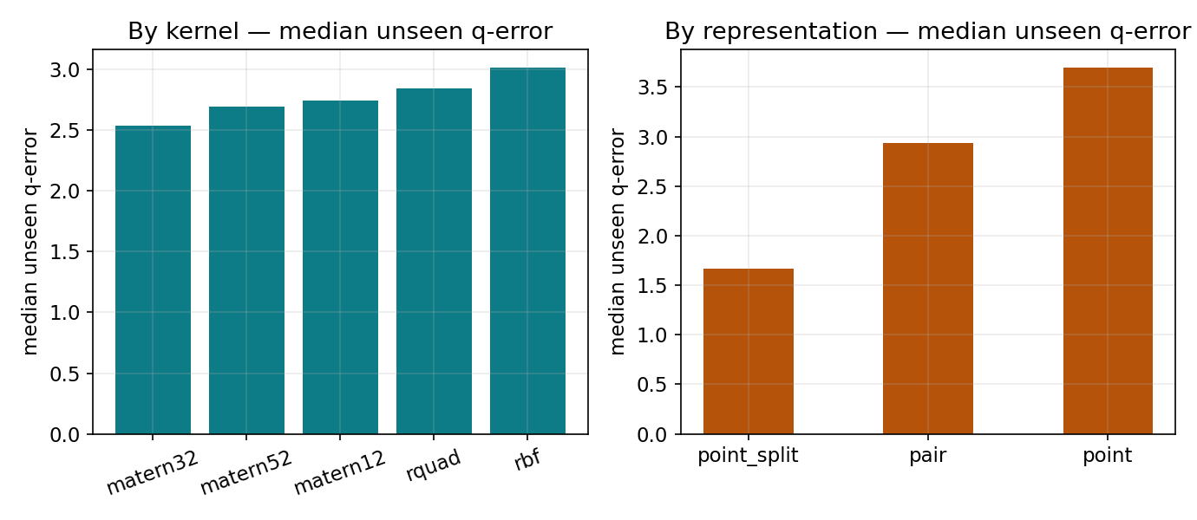
RESULTS · KERNEL & REPRESENTATION
Axis-split wins; kernel matters less
kernel | med-q ↓ | found% ↑
matern32 | 2.535 | 50.78
matern52 | 2.696 | 50.17
matern12 | 2.743 | 48.89
rquad | 2.843 | 56.14
rbf | 3.012 | 48.89
rep | med-q ↓ | found% ↑ | cov5% ↑
point_split | 1.671 | 70.54 | 34.89
pair | 2.934 | 42.28 | 28.84
point | 3.693 | 40.10 | 28.61
point_split (one BO per axis) beats both pair and point on accuracy AND discovery — same input P, no collision.
Bayesian Optimization · q-error boundary discovery · scripts/bo_interpolation.py
12

Slide 13
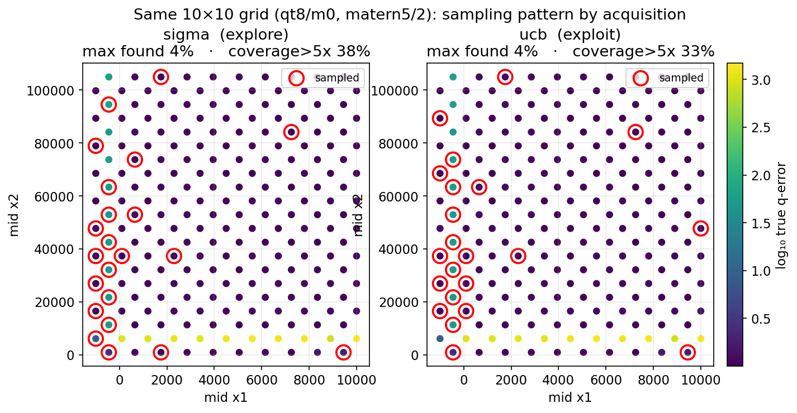
RESULTS · VISUALIZATION
Where the budget lands: explore vs exploit
▸ Same grid (qt8/m0), same kernel (matern5/2), same seed.
▸ sigma spreads samples to reduce uncertainty everywhere.
▸ ucb clusters on the bright high-q ridge.
▸ Both hit the peak; ucb covers far more of the boundary.
Bayesian Optimization · q-error boundary discovery · scripts/bo_interpolation.py
13

Slide 14
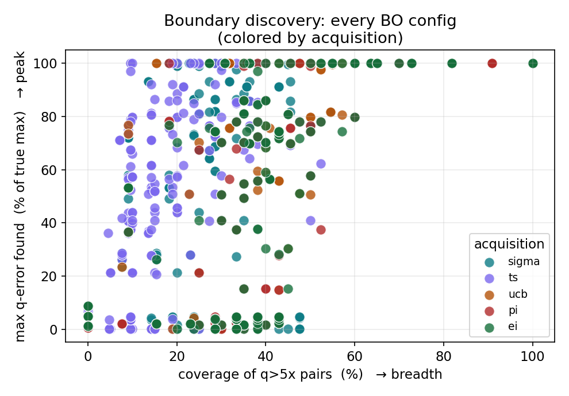
RESULTS · THE TRADE-OFF
Peak-hitting vs breadth — one point per BO config
▸ Y = max found % (did you reach the tallest cliff).
▸ X = coverage of q>5x (how many cliffs you caught).
▸ ucb / ei / pi occupy the high-coverage right side.
▸ sigma hits high peaks but sits at low coverage (explores broadly, not tail-focused).
▸ ts is the randomised middle ground.
Bayesian Optimization · q-error boundary discovery · scripts/bo_interpolation.py
14

Slide 15
CONCLUSION
Axis-split BO wins — then pick the acquisition
▸ Axis-split (one BO per axis) is the clear winner: point_split leads every representation mean — med-unseen q 1.67, max-found 71%, coverage>5x 35% (vs pair 2.93 / point 3.69).
▸ Best boundary discovery: bo_point_split_matern32_ucb — 86% of the true max q-error, 44% coverage>5x at 10% budget.
▸ Best accuracy: bo_point_split_matern52_sigma (med-unseen q 1.326) — sigma ties the linear baselines AND still finds boundaries.
Hunt boundaries → point_split + ucb
Accurate + finds cliffs → point_split + sigma
Why axis-split? the input stays exactly P, but running one BO per axis removes the horizontal/vertical X-collision — recovering the axis signal with NO extra feature. point_split is the recommended representation: sigma for an accurate surface, ucb for maximum boundary coverage — at a 10% budget a blind grid never targets.
Bayesian Optimization · q-error boundary discovery · scripts/bo_interpolation.py
15

