Slide 1
Anchoring the Grid
Choosing each axis's minimum so the joint cardinality is never 0 at the boundary
build_gt.py :: find_min_positive_point_nd()
diagonal doubling · binary search · coordinate descent · 10×10 resolution (11×11 points)

Slide 2
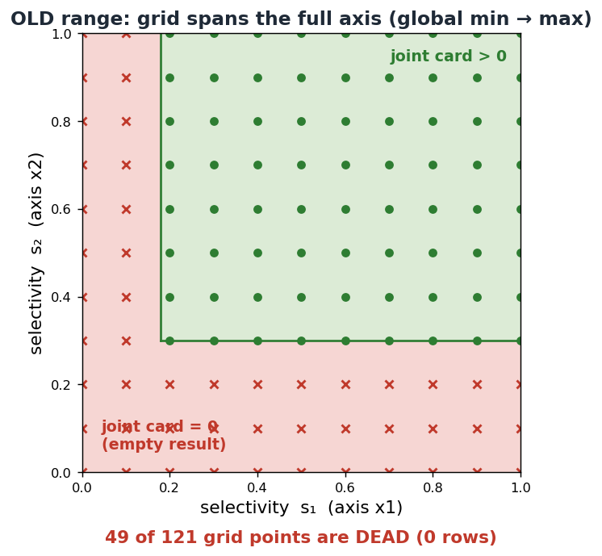
THE PROBLEM
Starting at the global min → an empty lower corner
▸ The grid is built over each axis's value range. The naive choice is [global min, max].
▸ At low selectivity on all axes, the joint predicate survives 0 rows.
▸ That whole lower-left strip is wasted:
– empty COUNT(*) → trivial/degenerate plan & runtime,
– meaningless q-errors, budget spent on dead points.
▸ Goal: guarantee joint card > 0 at the lower boundary.
Grid boundary anchoring · build_gt.py :: find_min_positive_point_nd
2

Slide 3
THE FIX
Search selectivity space for the per-axis minimum with rows
map selectivities → values → joint COUNT(*)
monotone assumption: more selectivity ⇒ ≥ rows
card_fn(s1..sd):
vᵢ = sorted_valsᵢ[ ⌊ sᵢ·(nᵢ−1) ⌋ ] # sel → value
return COUNT(*) of joint predicate(v1..vd)
build_gt.py output | meaning
boundary_sels | per-axis min selectivities
boundary_count | joint rows at that anchor (>0)
axis_lower_bounds | → the value each grid starts at
▸ Find the smallest selectivities (s1..sd) with card_fn > 0, in 3 phases:
– diagonal expansion — leap onto the positive region,
– binary search — pin the diagonal crossing,
– coordinate descent — minimise each axis on its own.
axis_lower_bounds is passed to sampler.sample(lower_bound=…), so each axis grid spans [anchor, max] instead of [global min, max].
Grid boundary anchoring · build_gt.py :: find_min_positive_point_nd
3

Slide 4
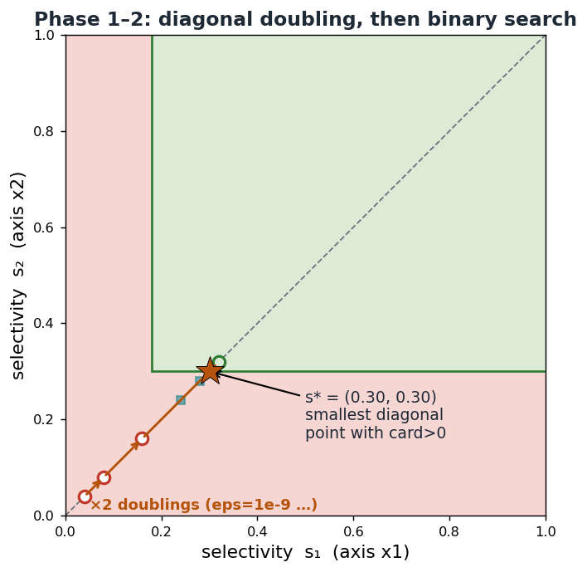
PHASES 1–2 · THE DIAGONAL
Leap onto the region, then pin the crossing
diagonal: same selectivity on every axis (s,s,…,s)
lo,hi = 0, eps # eps = 1e-9
while card([hi]*d)==0: # PHASE 1
lo, hi = hi, hi*2 # ×2 leap
while hi-lo > tol: # PHASE 2
m=(lo+hi)/2
hi=m if card([m]*d)>0 else …; lo=…
▸ Phase 1 doubles s from ~0 until the diagonal point enters the positive region (cheap, geometric).
▸ Phase 2 binary-searches that last interval → s* = smallest equal-selectivity point with rows.
▸ Gives a safe but conservative square box (s*, s*).
Grid boundary anchoring · build_gt.py :: find_min_positive_point_nd
4

Slide 5
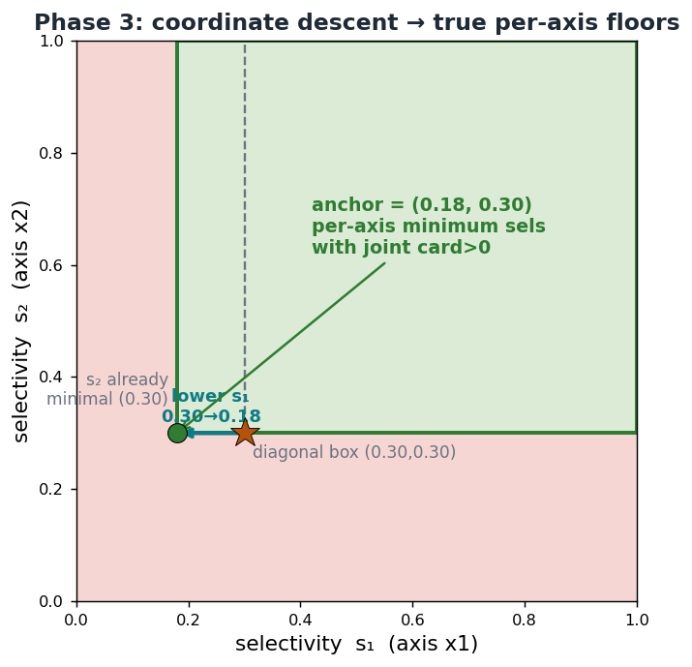
PHASE 3 · COORDINATE DESCENT
Free each axis down to its own true minimum
per-axis binary search, others held fixed
improved = True
while improved:
for axis in range(d):
lo,hi = 0, s[axis] # binary search
... hi=m if card(trial)>0 else lo=m
if hi < s[axis]: s[axis]=hi; improved=True
▸ The diagonal forced both axes equal (0.30). Coordinate descent frees each axis to its real floor.
▸ Here s₁ drops 0.30 → 0.18; s₂ is already minimal (0.30).
▸ Result: the anchor corner (0.18, 0.30) — the tight lower-left of the positive region.
Grid boundary anchoring · build_gt.py :: find_min_positive_point_nd
5

Slide 6
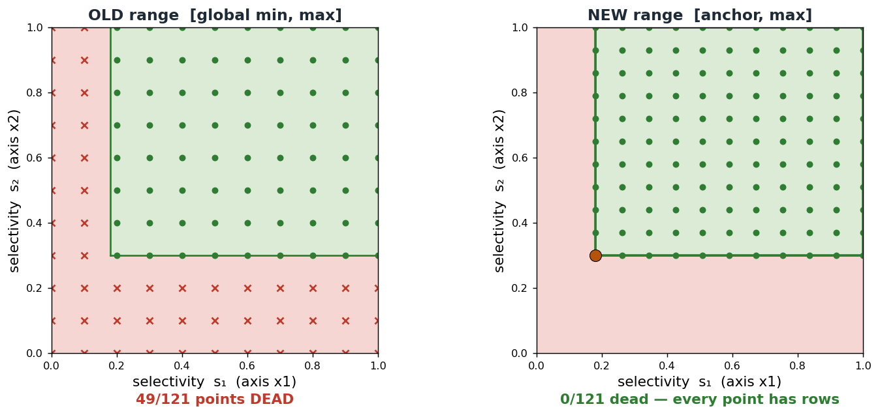
OLD VS NEW RANGE
10×10 resolution (11×11 points): every point now has rows
Same 121 points, same evenly-spaced selectivities — only the per-axis start moves from the global min to the anchor. Dead points: 49 → 0.
Grid boundary anchoring · build_gt.py :: find_min_positive_point_nd
6

Slide 7
SELECTIVITY & VALUE COMPARISON
What the anchor changes, per axis
axis | OLD lower selectivity | OLD lower value | NEW lower selectivity | NEW lower value
x1 | ≈ 0.00 (global min) | vals[0] | 0.18 | vals[⌊0.18·(n−1)⌋]
x2 | ≈ 0.00 (global min) | vals[0] | 0.30 | vals[⌊0.30·(n−1)⌋]
at the lower-left corner | OLD range | NEW range
joint selectivities | (≈0, ≈0) | (0.18, 0.30)
joint cardinality (rows) | 0 (empty) | boundary_count > 0
dead grid points (of 121) | 49 | 0
value at a selectivity: vals[ ⌊ sel · (n−1) ⌋ ] over that axis's sorted distinct values (n of them).
The selectivity grid is unchanged in spacing — it is just shifted so its origin sits on the anchor, not on the empty global min.
Grid boundary anchoring · build_gt.py :: find_min_positive_point_nd
7

Slide 8
SELECTIVITY-SPACE SAMPLING (M1)
m1 worked example — old vs new grid (real qt5 columns)
axis x1 anchor sel = 0.18
axis x2 anchor sel = 0.30
i | old sel | old val | new sel | new val
0 | 0.00 | -986 | 0.180 | 1,004
1 | 0.10 | 108 | 0.262 | 1,894
2 | 0.20 | 1,228 | 0.344 | 2,782
3 | 0.30 | 2,303 | 0.426 | 3,676
4 | 0.40 | 3,392 | 0.508 | 4,574
5 | 0.50 | 4,485 | 0.590 | 5,488
6 | 0.60 | 5,599 | 0.672 | 6,396
7 | 0.70 | 6,705 | 0.754 | 7,298
8 | 0.80 | 7,802 | 0.836 | 8,196
9 | 0.90 | 8,895 | 0.918 | 9,094
10 | 1.00 | 10,000 | 1.000 | 10,000
i | old sel | old val | new sel | new val
0 | 0.00 | -964 | 0.300 | 2,353
1 | 0.10 | 142 | 0.370 | 3,118
2 | 0.20 | 1,246 | 0.440 | 3,891
3 | 0.30 | 2,353 | 0.510 | 4,664
4 | 0.40 | 3,446 | 0.580 | 5,404
5 | 0.50 | 4,558 | 0.650 | 6,172
6 | 0.60 | 5,616 | 0.720 | 6,944
7 | 0.70 | 6,728 | 0.790 | 7,699
8 | 0.80 | 7,807 | 0.860 | 8,461
9 | 0.90 | 8,898 | 0.930 | 9,228
10 | 1.00 | 10,000 | 1.000 | 10,000
m1 places points at evenly-spaced selectivities. OLD spans [0,1] → its first points sit at the global min (x1 = −986, x2 = −964). NEW spans [anchor,1] → compressed above the anchor, so the lowest value sampled is the anchor's (x1 ≈ 1004 @ .18, x2 ≈ 2353 @ .30).
Same column distribution — only the sampled percentiles shift. Real qt5 m1 columns; new values interpolated from the measured 11-pt curve; anchor (0.18, 0.30) is the running example (qt5's own corner already survives, so its true anchor ≈ 0).
Grid boundary anchoring · build_gt.py :: find_min_positive_point_nd
8

Slide 9
DATA-SPACE SAMPLING (M0)
m0 worked example — old vs new grid (real qt5 columns)
axis x1 anchor sel = 0.18
axis x2 anchor sel = 0.3
i | old sel | old val | new sel | new val
0 | 0.001 | -986 | 0.180 | 991
1 | 0.102 | 113 | 0.263 | 1,892
2 | 0.200 | 1,212 | 0.346 | 2,793
3 | 0.302 | 2,310 | 0.428 | 3,694
4 | 0.402 | 3,409 | 0.510 | 4,595
5 | 0.503 | 4,507 | 0.591 | 5,496
6 | 0.601 | 5,606 | 0.672 | 6,397
7 | 0.700 | 6,704 | 0.754 | 7,297
8 | 0.800 | 7,803 | 0.836 | 8,198
9 | 0.901 | 8,901 | 0.918 | 9,099
10 | 1.000 | 10,000 | 1.000 | 10,000
i | old sel | old val | new sel | new val
0 | 0.003 | -964 | 0.300 | 2,326
1 | 0.101 | 132 | 0.369 | 3,093
2 | 0.201 | 1,228 | 0.439 | 3,861
3 | 0.300 | 2,325 | 0.508 | 4,628
4 | 0.399 | 3,421 | 0.580 | 5,395
5 | 0.498 | 4,518 | 0.650 | 6,163
6 | 0.601 | 5,614 | 0.720 | 6,930
7 | 0.699 | 6,711 | 0.790 | 7,698
8 | 0.800 | 7,807 | 0.861 | 8,465
9 | 0.901 | 8,903 | 0.931 | 9,232
10 | 1.000 | 10,000 | 1.000 | 10,000
m0 places points evenly in VALUE. OLD spans [global min, max] → first points at the global min (x1 = −986, x2 = −964). NEW spans [anchor value, max] → the same even spacing, shifted up to start at the anchor (x1 ≈ 992 @ .18, x2 ≈ 2326 @ .30).
Real qt5 m0 columns; new selectivities read off the value↔selectivity curve; anchor (0.18, 0.30) is the running example.
Grid boundary anchoring · build_gt.py :: find_min_positive_point_nd
9

Slide 10
SELECTIVITY-SPACE SAMPLING (M2 · PICASSO)
m2 worked example — old vs new grid (real qt5 columns)
axis x1 anchor sel = 0.18
axis x2 anchor sel = 0.3
i | old sel | old val | new sel | new val
0 | 0.0000 | -986 | 0.1800 | 991
1 | 0.0004 | -981 | 0.1803 | 995
2 | 0.0013 | -971 | 0.1811 | 1,003
3 | 0.0033 | -949 | 0.1827 | 1,022
4 | 0.0077 | -902 | 0.1863 | 1,062
5 | 0.0176 | -795 | 0.1945 | 1,154
6 | 0.0398 | -549 | 0.2126 | 1,352
7 | 0.0893 | -7 | 0.2532 | 1,789
8 | 0.2000 | 1,228 | 0.3440 | 2,773
9 | 0.4473 | 3,910 | 0.5468 | 5,001
10 | 1.0000 | 10,000 | 1.0000 | 10,000
i | old sel | old val | new sel | new val
0 | 0.0000 | -964 | 0.3000 | 2,326
1 | 0.0004 | -958 | 0.3003 | 2,329
2 | 0.0013 | -945 | 0.3009 | 2,336
3 | 0.0033 | -925 | 0.3023 | 2,351
4 | 0.0077 | -879 | 0.3054 | 2,386
5 | 0.0176 | -785 | 0.3123 | 2,462
6 | 0.0398 | -542 | 0.3279 | 2,634
7 | 0.0893 | 21 | 0.3625 | 3,016
8 | 0.2000 | 1,246 | 0.4400 | 3,875
9 | 0.4473 | 3,955 | 0.6131 | 5,749
10 | 1.0000 | 10,000 | 1.0000 | 10,000
m2 clusters points geometrically at low selectivity. OLD wastes ~8 of 11 points in the near-min region (x1 sels ≤ 0.09 → vals −985…−7). NEW restricts the percentiles to [anchor, max], so the same geometric cluster sits just above the anchor — the method that gains most from anchoring.
Actual global selectivities shown; m2's Picasso target fractions are unchanged, only now measured within [anchor, max]; new values interpolated.
Grid boundary anchoring · build_gt.py :: find_min_positive_point_nd
10

Slide 11
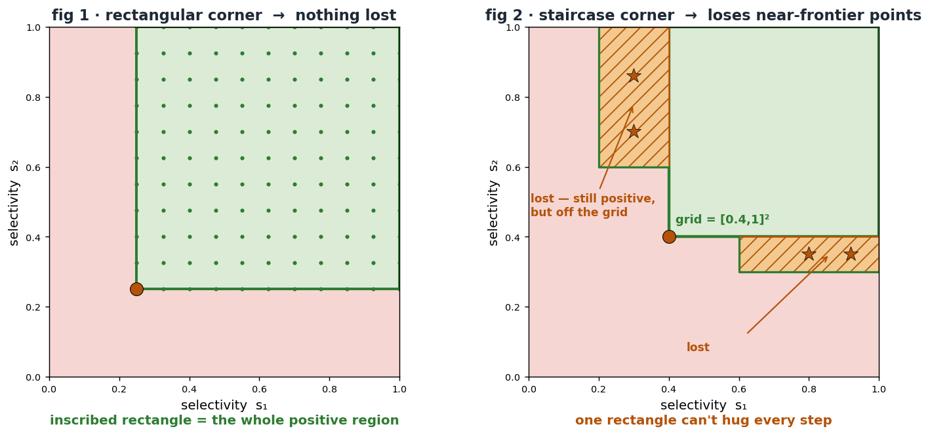
LIMITATION
The one limitation — a staircase frontier
▸ The grid is a Cartesian product → an axis-aligned rectangle in selectivity space.
▸ Phase 3 finds one corner and inscribes one rectangle [anchor,1]ᵈ.
▸ fig 1 — a single rectangular corner: the rectangle = the whole positive region. Exact.
▸ fig 2 — a staircase frontier (≥2 corners; happens when the predicates are correlated / the joint isn't axis-separable).
▸ One rectangle can't hug every step → positive points in the other steps (low-s₁/high-s₂ and high-s₁/low-s₂) fall off the grid and are never sampled.
▸ Those near-frontier points are exactly where joint cardinality just switches on → plan flips & q-error cliffs — the interesting ones.
no dead points are added — the rectangle stays inside the positive region — but some interesting near-frontier points are lost.
Mitigation: detect a multi-corner frontier and union per-step rectangles (a staircase-aware lower envelope) instead of one anchor.
Grid boundary anchoring · build_gt.py :: find_min_positive_point_nd
11

Slide 12
SUMMARY
One anchor, computed once per query, fixes the boundary
▸ Problem: a grid over [global min, max] wastes its low-selectivity corner on 0-row joints.
▸ Fix: find_min_positive_point_nd finds the per-axis minimum selectivities whose joint cardinality is > 0.
– diagonal doubling → jump onto the positive region (geometric, cheap),
– binary search → pin the diagonal crossing s*,
– coordinate descent → shrink the square to the tight per-axis anchor.
▸ Effect: the grid is re-based to [anchor, max] — every one of the 11×11 points returns rows; no dead boundary, no wasted profiling.
▸ Cost: a handful of COUNT(*) probes per query, run once before sampling.
Grid boundary anchoring · build_gt.py :: find_min_positive_point_nd
12

